Slide 1
Authoring System
OST TEAM
28 Oktober 2019

Slide 2
Index
1. Explanation
2. Feature
3. How To login
4. Homepage For Supervisor And Area Manager.
5. Todo (supervisor)
5.1 Todo (2)
Schedule for Supervisor
6.1 Schedule for Area Manager
Audit Report Flow
7.1 AR List In Schedule Detail (Supervisor).
7.2 Audit Report Which Need to Fixed By SPV(Supervisor).
7.3 Add an attachment and Comment List (Supervisor).
7.4 Rejected Audit Report (Supervisor).
7.5 AR in Audit Report Page (Supervisor).
Area Manager (Todo).
Approved and Close Audit Report (Area Manger).
9.1 Approved Audit Report By Area Manager (Area Manager).
Actual AR List.
SIC Recapitulation For Supervisor.
11.1 SIC Recapitulation For Area Manager.
12. Frequently Answer And Question (FAQ)

Slide 3
1. Authoring
What is Authoring ?
Authoring is an application which simplify auditing process by center to each Erha Clinic.

Slide 4
2. Feature
Homepage : View all of Audit Report which have by a Clinic
Schedule : View SIC and All of Each Clinic Audit Report.
SIC : View grade which given by auditing team for Clinic.
Audit Report :.View findings from auditing team, approve root cause, re-upload result of progress or fixing Audit Report.

Slide 5
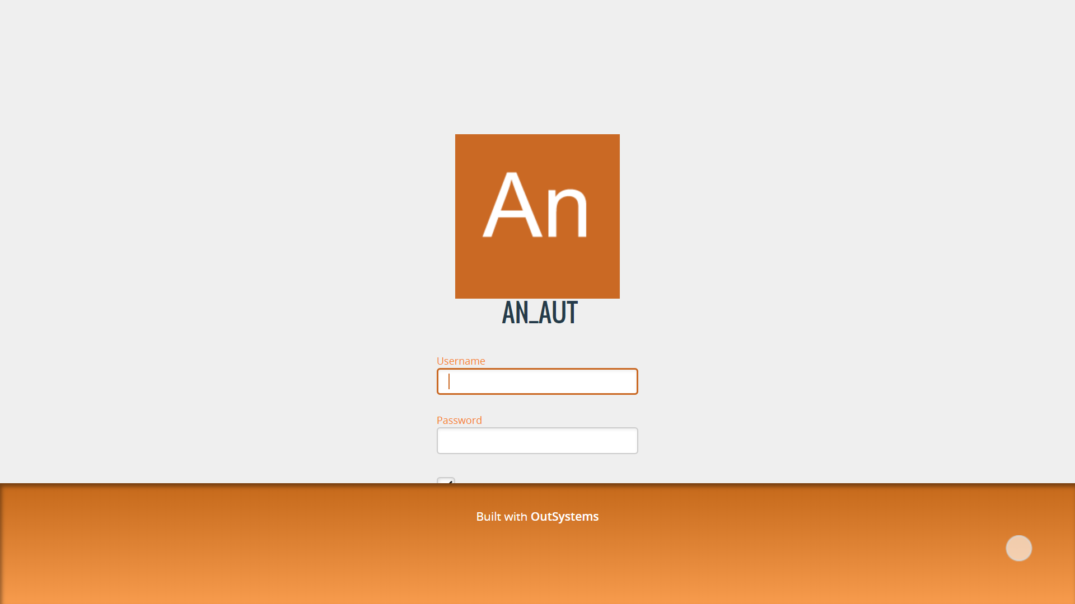
3. Login
1. Access AN_Authoring with your browser through the link: https://aryanoble-tst.outsystemsenterprise.com/AN_AUT/ 2. The login page will appear as shown in the image on the left 3. Input your username and password to login. 4. Clicking on the “Remember” checklist below the password to make login easier when you close your browser.
Note : Use username and password from your Arya Noble account. If the password that you submitted is not correct, you can try using “Arya2019” as the password (make sure you type the first a using the upper case letter “A”. If you still fail in logging into AN_AUT, try to contact AN_AUT Team for help.

Slide 6
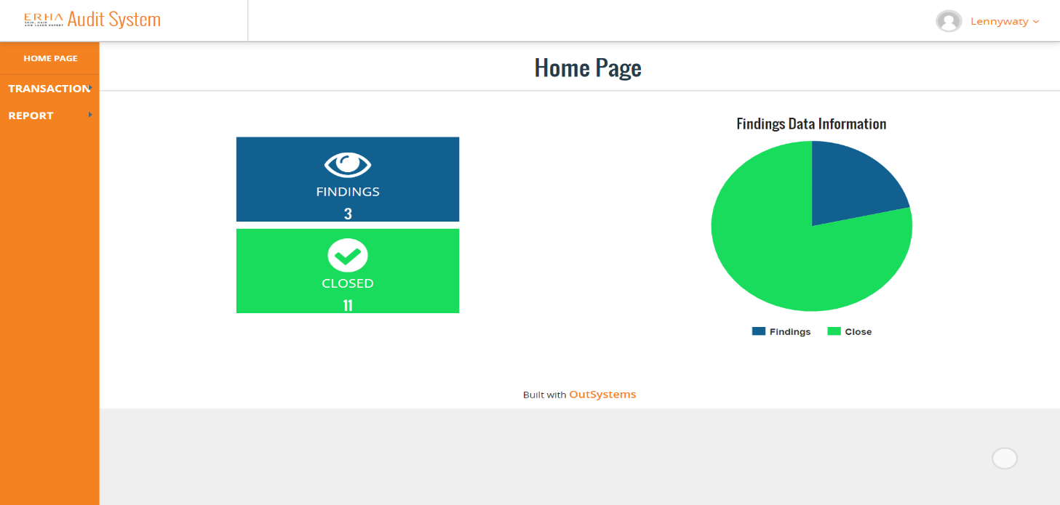
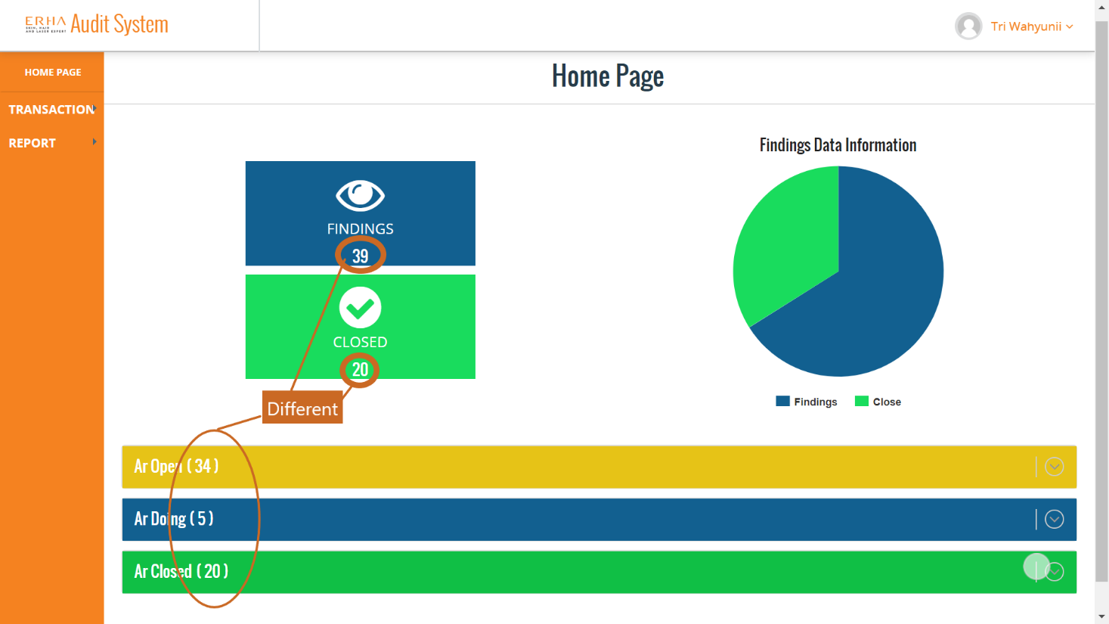
4. Homepage for Area Manager and Supervisor
On role Area Manager, homepage will shown Findings and Close, Chart, Transaction Bar and Report Bar. Findings and Close based by data from clinic groups who held by Area Manager and AR which assigned to Area Manager
Area Manager have Transaction and Report bar (this bar we will discuss in menu bar section
Homepage for Area Manager
On role Supervisor, homepage will shown Findings and Close, Chart, AR Open (AR which already assigned to supervisor and need to fixing their findings), AR Doing( current status for AR after submitted by supervisor), AR Close (Approved AR from each supervisor clinic), Transaction Bar and Report Bar.
Findings and Close based by data from their clinic. Supervisor have Transaction and Report bar (this bar we will discuss in menu bar section
Homepage for Supervisor

Slide 7
5. Todo(Supervisor).
Supervisor :
1. Filling root cause for audit report already made by auditing team
2. Approve for root cause when audit report already made by auditing team.
3.Finishing findings by uploading file, when audit report notified from Area Manager (this status appear when all Audit Report approved by supervisor). Supervisor need to press submit button to sending fixing Audit Report to auditing team, if fixing have finalized, and sure to sending fixing to Auditing Team. If fixing not sure to send for auditing team, you need to press save data button (this data will not send to auditing team).

Slide 8
5.1 Todo(2).
4. Waiting for review from auditing team, if audit report get rejected by them, supervisor will get email notification that inform to fixing rejected Audit Report. In Authoring Application on Rejected Audit Report, will appear status and comment of finding why get rejected by auditing team. For fixing an Audit Report, you need to re-upload new data (data already fixing based by revision of auditing team) like explained on point 3.
5. Fixing Audit Report when status rejected until Audit Report Approved by auditing team.

Slide 9
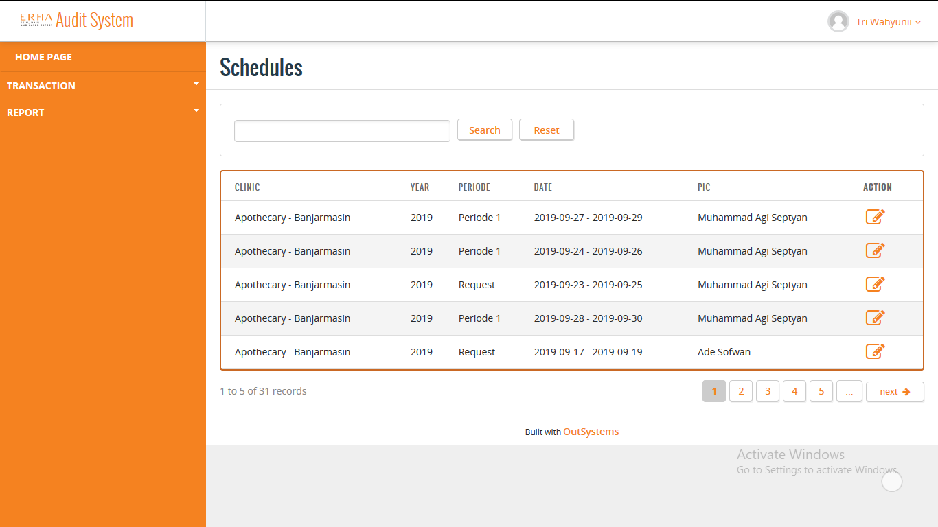
6. Schedule for Supervisor
On Role Supervisor, Schedule will shown the list that only from the clinic they supervised
Schedule for Supervisor
Explanation :
Schedule, Supervisor can see the list that only from the clinic they supervised.
Schedule list only appear in Supervisor Schedule menu when AR in Draft Final state by Auditor.
Supervisor can see the detail of Schedule that contain SIC and AR.
Supervisor can search based on the PIC name.

Slide 10

6.1 Schedule for Area Manager
On Role Area Manager, Schedule will shown the list from all the clinic they manage
Schedule for Area Manager
Explanation :
Schedule, Area Manager can see the list from all the clinic they manage.
Schedule list only appear in Area Manager menu when SIC have been approve by Audit Lead and all AR have been close.
Area Manager can see the detail of Schedule that contain SIC and AR.
Area Manager can search based on the PIC name.

Slide 11
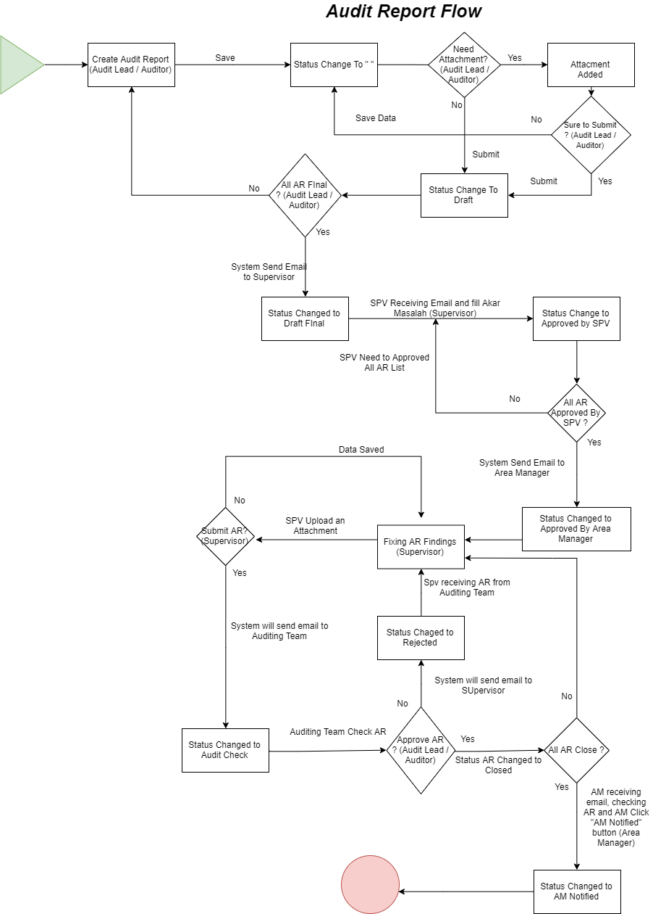
7. Audit Report Flow
All AR have made by Auditor
This is flow when you want to how to make Audit Report, what happen in each process and etc.

Slide 12
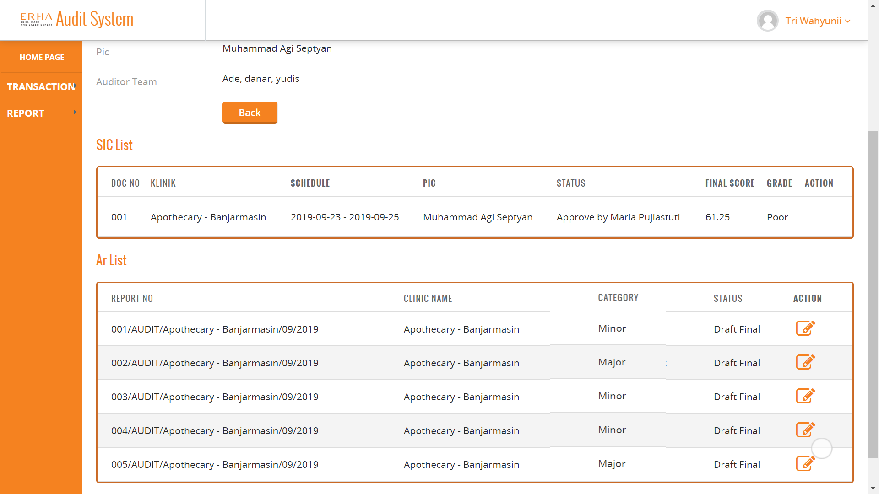
7.1 AR List in Schedule Detail (Supervisor)
This is AR List when auditor finalize AR”, systems will auto generating email and send to Clinic Supervisor as notification for new AR has assigned to them. In this state only assigned Supervisor can edited their AR Clinic which is need approved by them.

Slide 13
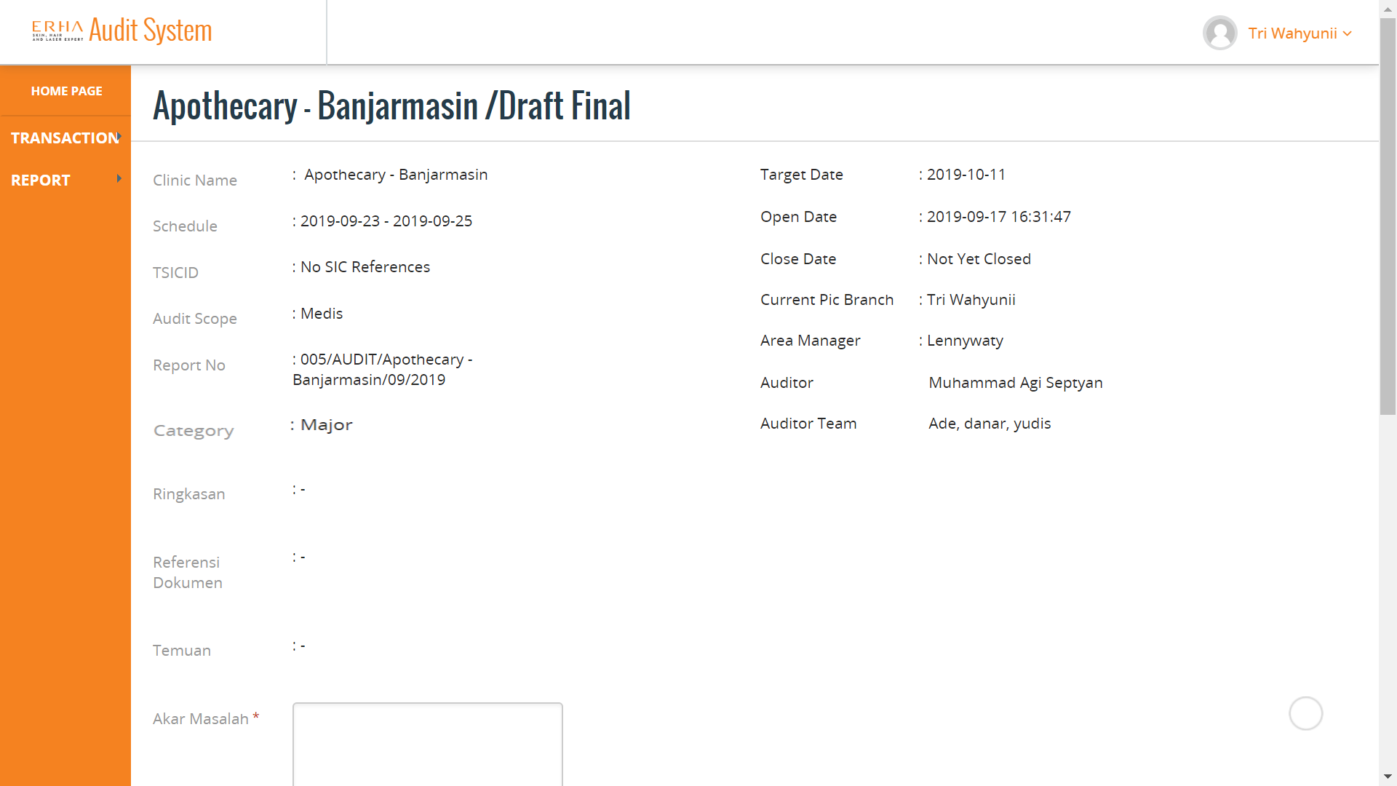
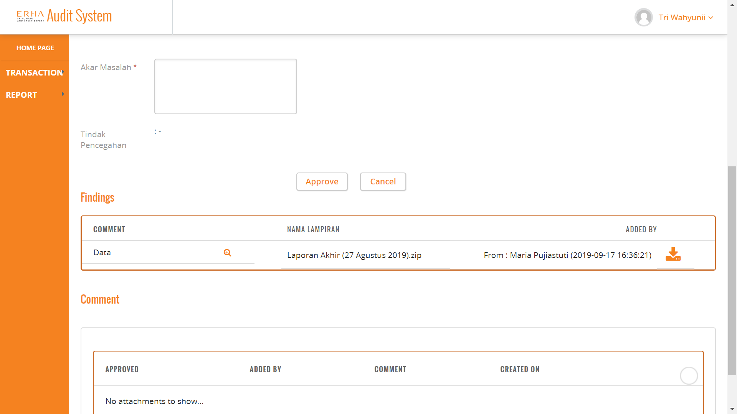
7.2 Audit Report Which Need to Fixed by SPV (Supervisor)
Audit Report Which Need Approve by SPV (Supervisor)
This is Audit Report Detail on Supervisor Role, in fact the view of all role is same but, on this state (Draft Final) only Supervisor from each clinic can approved Audit Report their clinic. In this state too, Supervisor need to fill Akar Masalah to completely their Audit Report.
Current AR Status
Audit Report Detail Page
Supervisor can see their finding who made by auditing team. You can use download button to download findings. Audit Report can change status to Approved By Supervisor after clicking button “Approve”. After all of your AR has Approve by you (Supervisor), system will send email to Area Manager and your status will change automatically to “Approved By Area Manager”.
Audit Report Detail Page When Scroll Down

Slide 14
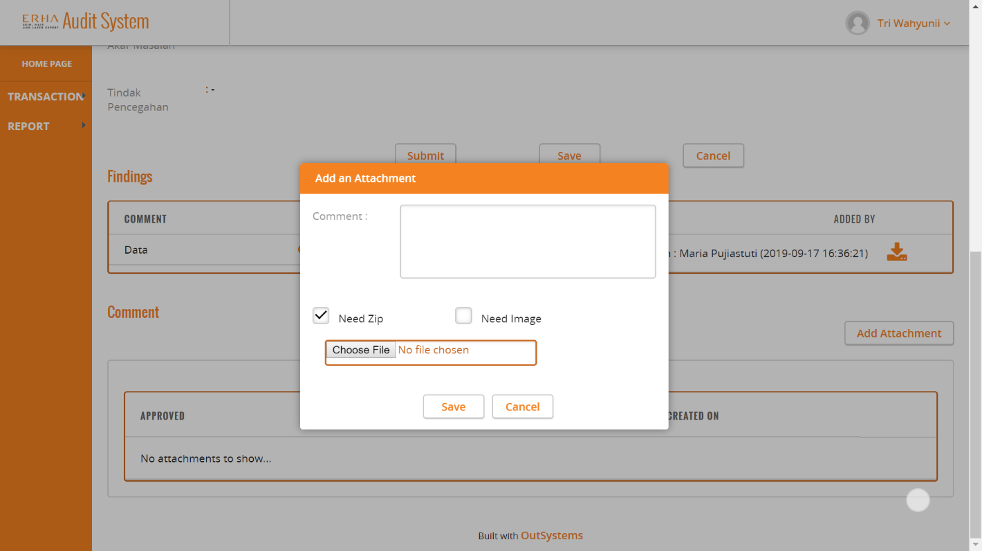
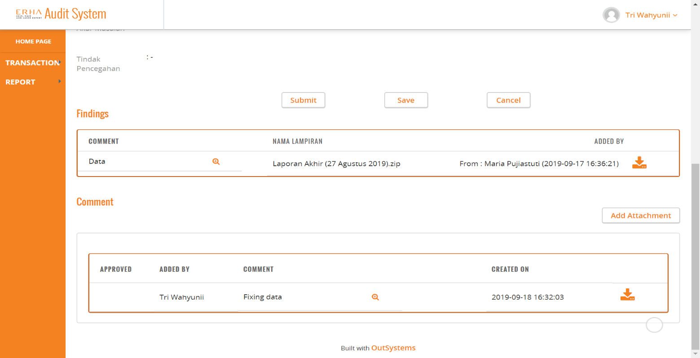
7.3 Add an Attachment and Comment List(Supervisor)
This is when we clicking “Add Attachment” button to add document to fixing your findings. You can add comment and choose type of document you want to upload, if you want document as zip, you can tick at “Need Zip” checklist and if you want to upload an image, you can tick at “Need Image” Checklist. Then click “Save” button to save your data. Remember “Speed upload based by document size, the largest the document can make upload process take a little bit longer”.
Add an Attachment Pop Up
On comment list you can see document which already you have made or comment by auditor or audit lead for fixing data you send before. You can see comment by auditor or audit lead for fixing after submitted your Audit Report as feedback from auditor or audit lead. Approved in comment list that mean your document have approved or rejected by audit lead or auditor.
Comment List (After Add an Attachment)

Slide 15
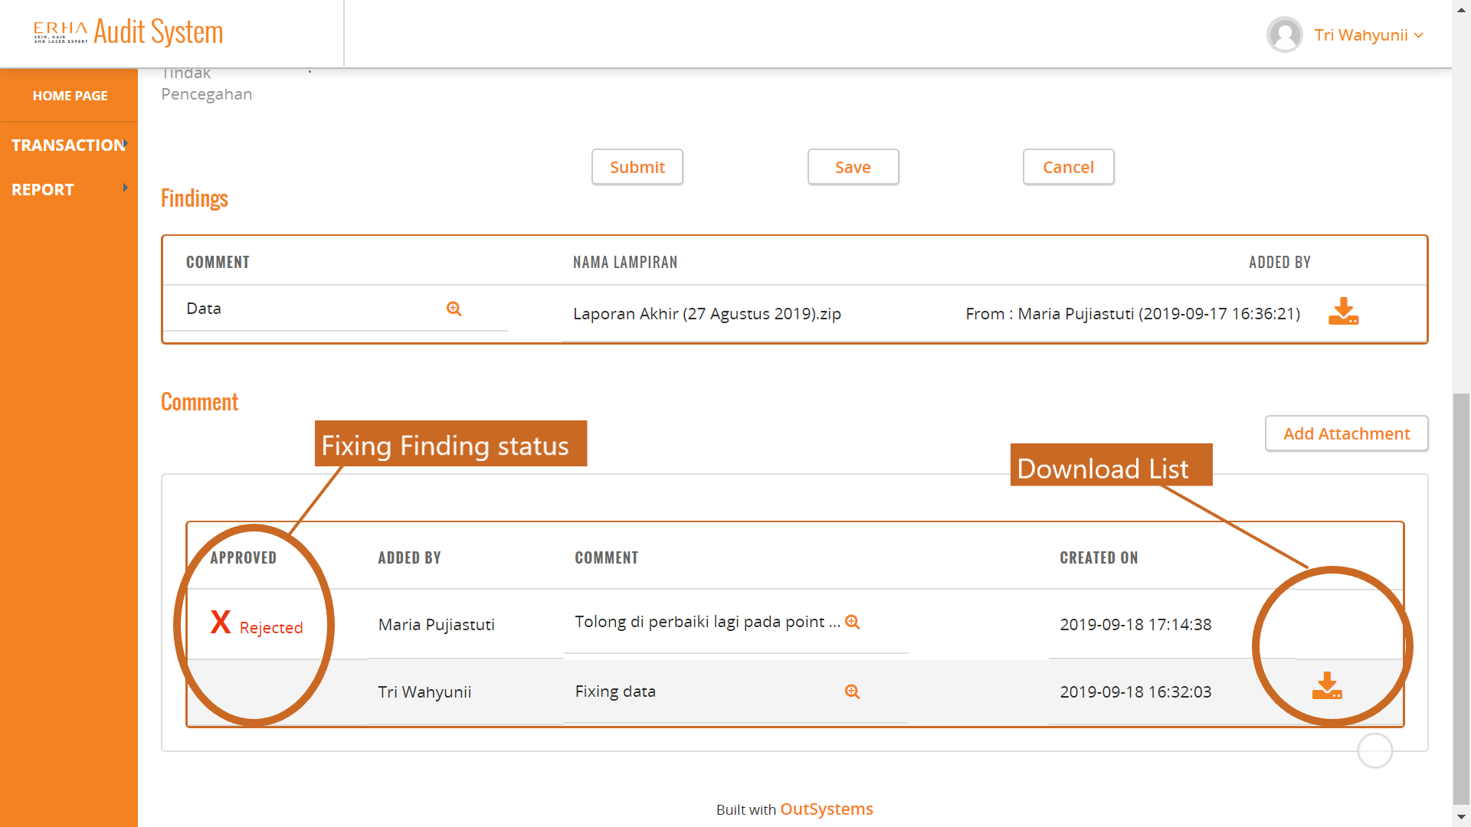
7.4 Rejected Audit Report (Supervisor)
This is comment list, as you can see the page show Fixing Findings Status, this list appear when you submitted your AR as we discuss before and after Audit or Audit Lead give they feedback for your AR. Feedback can be Approved or Rejected if status approved, AR will be change status to Close, if rejected that AR need to revision and you can submit revision. In download list you can download data from Auditor or Audit Lead if they send you Status with Document inside.
This process can continously after your AR Approved by them. Fixing Finding Status will change to “Approved” if current AR has Approved and “Rejected” if current AR need to revision. After all of your AR Closed, Systems will automatically send email to Area Manager to check and Approve all of your AR.

Slide 16
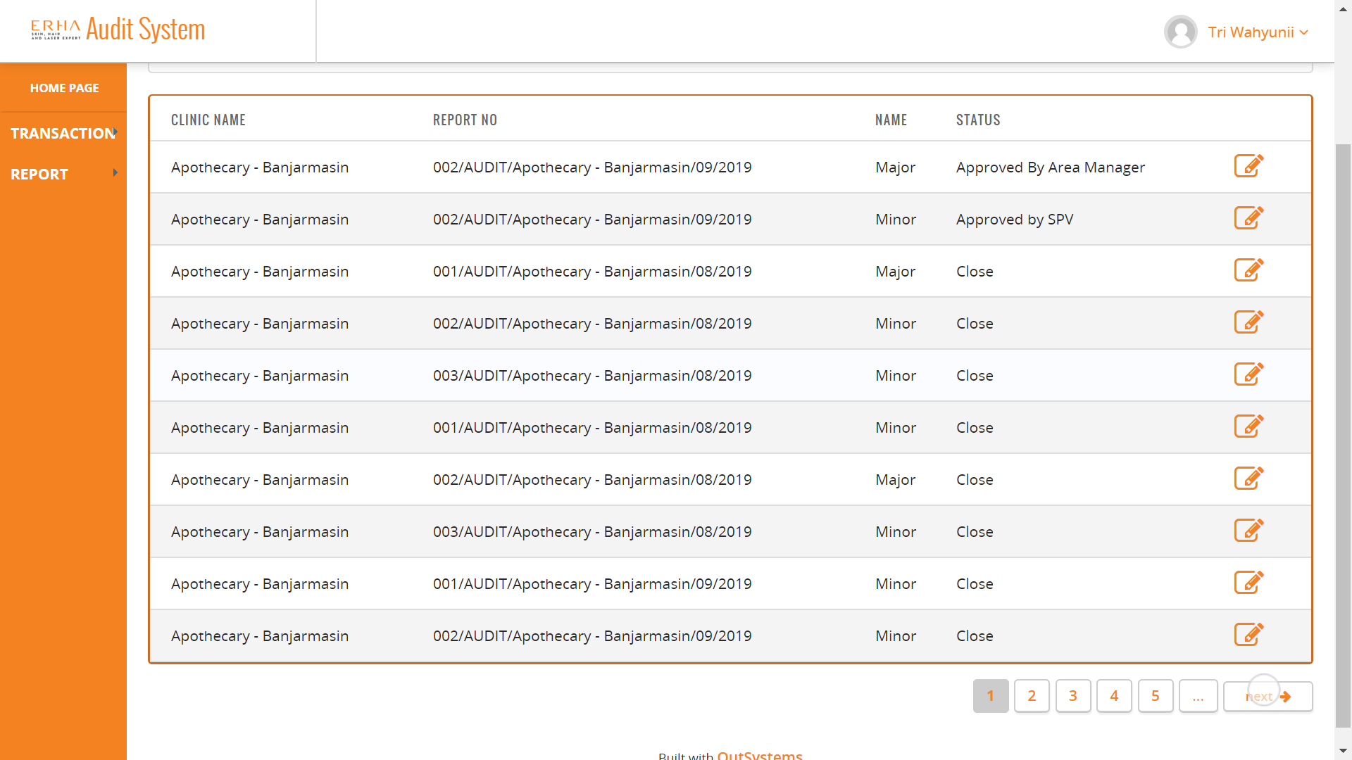
7.5 AR in Audit Report Page (Supervisor)
You can check all of your AR too by accessing Audit Report From “Transaction Bar -> Audit Report”. In there you can check AR which assigned to you and you can see all of your AR, this page can only accessed by Supervisor

Slide 17
8. Area Manager (Todo).
Approve and Close Audit Report in their Area, when clinic AR in their area, already Approved by Auditing Team.

Slide 18
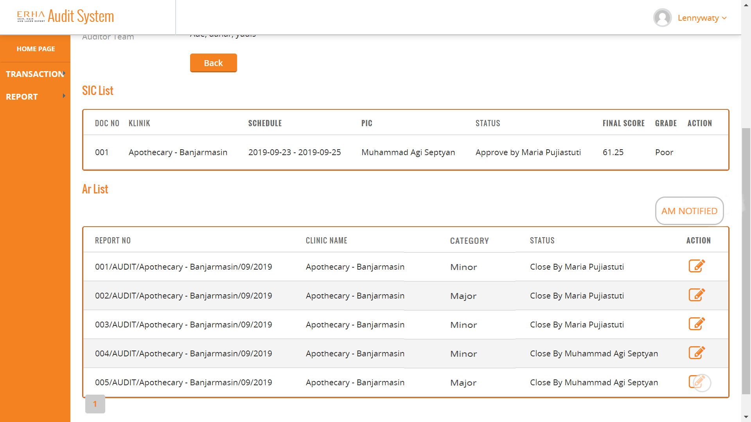
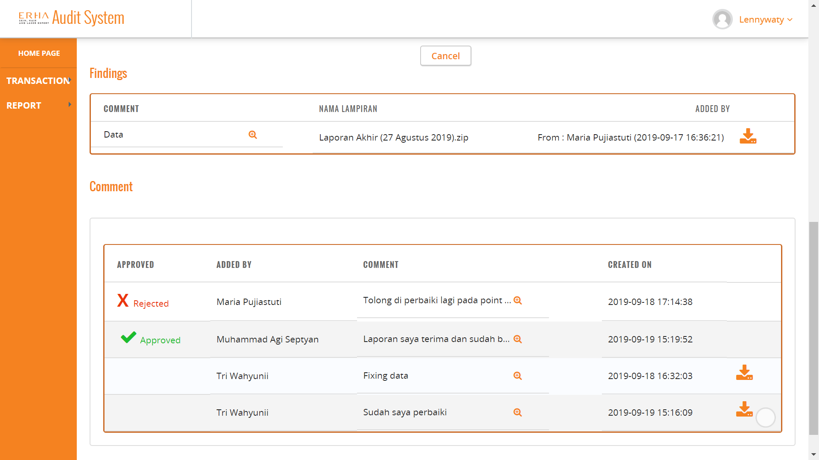
9. Approved and Closed Audit Report (Area Manager)
This is view of AR if all AR has approved by auditing team, in this view all role can accessed if they already assigned in which clinic. They can only see their clinic (Supervisor) and all of clinic in their area (Area Manager).
This is final step of Audit Report, Area Manager can only accessing “AM Notified” button to approve all AR in the clinic in their area and “AM Notified” button will appear after all AR in the clinic already closed. All role can accessed closed AR detail by clicking detail button .
AM Notified View
As you can see in picture on right, if you go do detail, you can only see your AR history and you cannot change your AR. If your AR has Approved, list approved will show “Approve” icon with Approved by who, date and time approved same like when you get rejected.
Audit Report Detail When Closed (Approved)

Slide 19
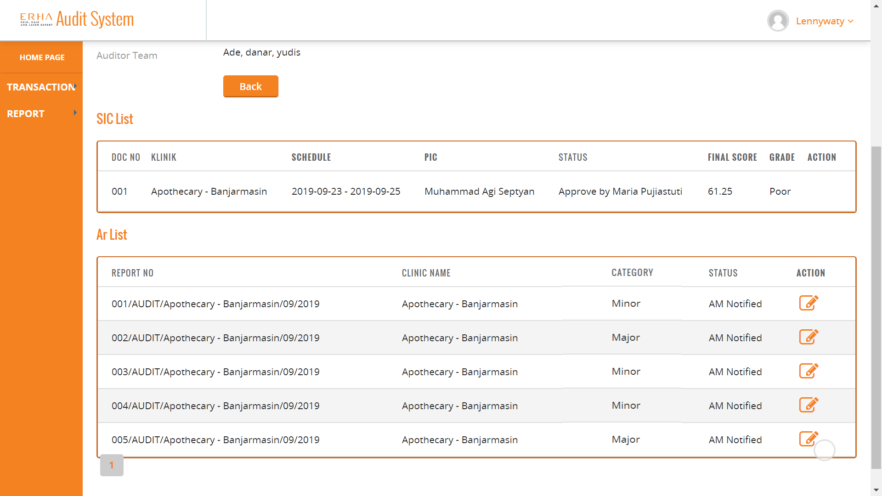
9.1 Approved Audit Report by Area Manager (Area Manager)
This is View when you click “AM NOTIFIED” button. Status will change from “Closed By “ to AM Notified. In this state all of your Audit Report has finished.

Slide 20
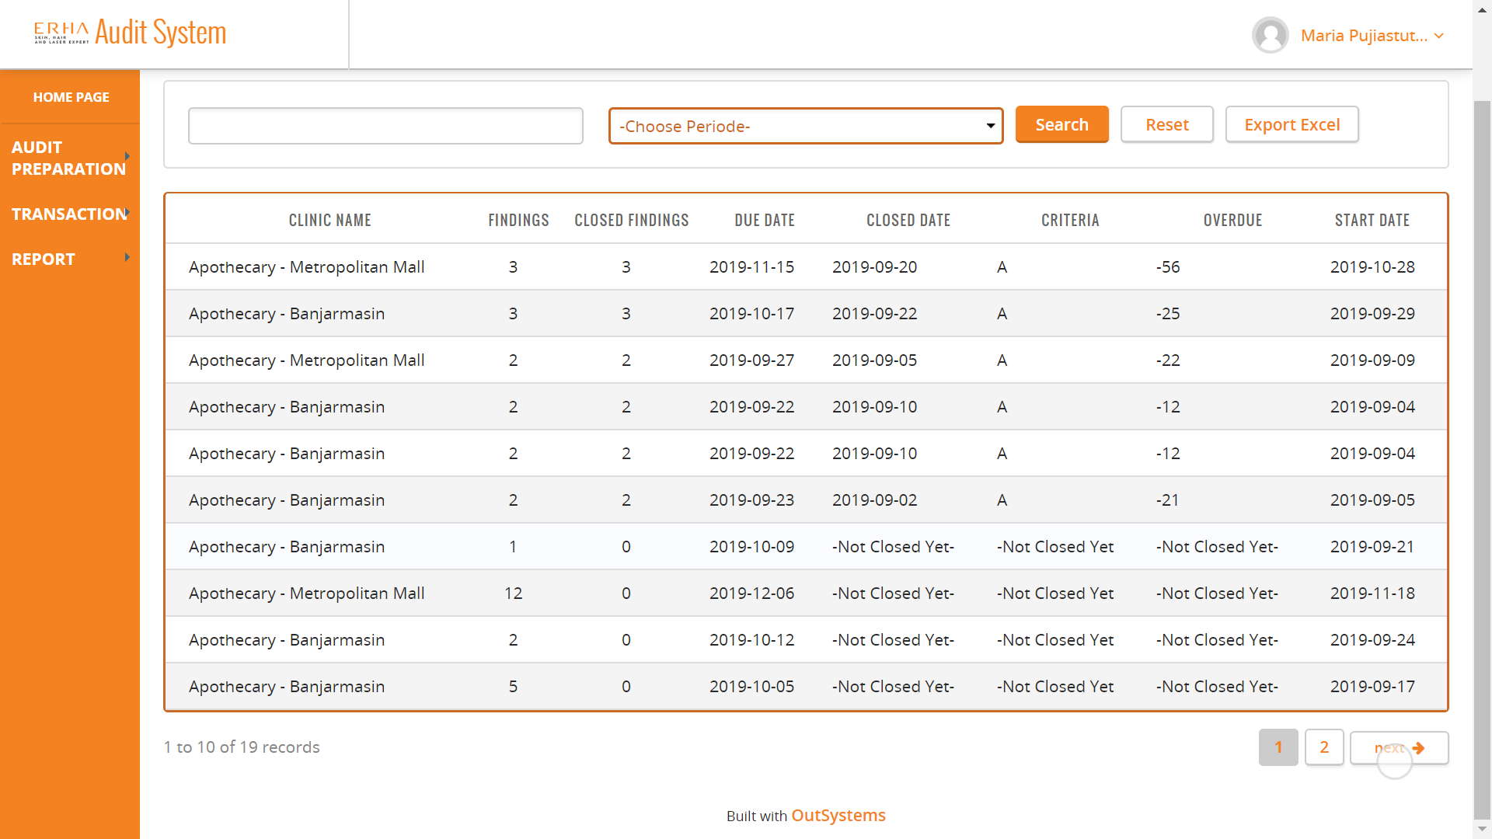
10. Actual AR List
This is view of Actual AR List , Actual AR list show after SIC Approved by Auditing Team. In this screen all role can access that by clicking “Report” then select “Actual AR”, but only Auditing team can see all clinic actual AR. Supervisor and Area Manager can see actual AR according to their assigned clinic.

Slide 21
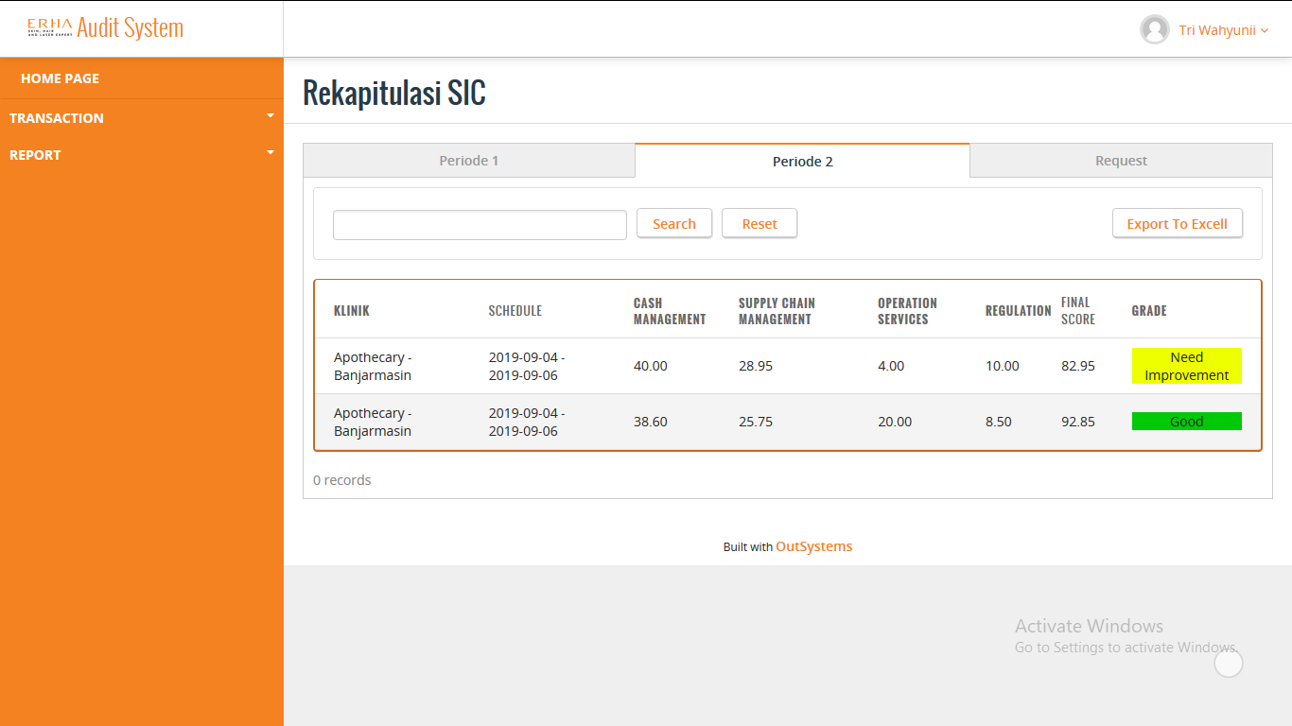
11 SIC Recapitulation for Supervisor
On Role Supervisor, SIC Recapitulation will shown three tab of SIC List based on the periode and only PCT Type of SIC
SIC Recapitulation for Supervisor
Explanation :
SIC Recapitulation, Supervisor can see SIC only from the clinic they supervised, divide by three tab of periode and only PCT Type of SIC.
Supervisor can also Export the SIC Recapitulation from the clinic they supervised into Excell.
Supervisor can search based on schedule date and Clinic name.

Slide 22

11.1 SIC Recapitulation for Area Manager
On Role Area Manager, SIC Recapitulation will shown three tab of SIC List based on the periode and only PCT Type of SIC
SIC Recapitulation for Area Manager
Explanation :
SIC Recapitulation, Area Manager can see SIC from all the clinic in the area they manage, divide by three tab of periode and only PCT Type of SIC.
Area Manager can also Export the SIC Recapitulation from the clinic in the area they manage into Excell.
Area Manager can search based on schedule date and Clinic name.

Slide 23
12. Frequently Asked Question (FAQ)
1. Q: What is the address page to open AN_AUT web application?
A: You can access AN_AUT website through https://aryanoble.outsystemsenterprise.com/AN_AUT/
2. Q: How do you sign in to AN_AUT web pages?
A: Username and Password to login same as another Aryanoble outsystems application that is user name: “initials” dan password “Arya2019”
3. Q: Who can login to AN_AUT web apps?
A: Only people register and assigned role for AN_AUT such as , Supervisor, Area Manager, Auditor and Audit Lead
4. Q: What do I do if I forget my username and password?
A: You can ask AN_AUT Team through the created Whatsapp group (it will be shared after the application has launched).
5. Q: I inputted the wrong username / password too many times and I cannot log in. How do I solve this?
A: You should ask the AN_AUT Team to unblock your account or to change your password if you forgot your password.
6. Q: What I can do if add an attachment but taking a long time when loading ?
A: You need to wait until loading has finished, and make sure to check your attachment size. The bigger file size, the longer it will be.

Slide 24
Frequently Answe And Question
7. Q: What if I failed upload an attachment because long upload time?
A: You need to check your internet connection and your file size, The bigger file size, the longer it will be.
8. Q: What if I want to uploaded many file when uploaded an attachment ?
A: You need to zipped your file, by make a new folder, then copy your file on new folder then zip it.

