Slide 1
Named Router Outlets

Slide 2
Agenda
Definition
  What is a named router outlet?
  Why named router outlets are used?
Implementation
Demo Code

Slide 3
Definition

Slide 4
What is a named router outlet?
A simple router outlet with a unique name.
The name allows to distingush between multiple router outlets.
It determines where subpages should be rendered.

Slide 5
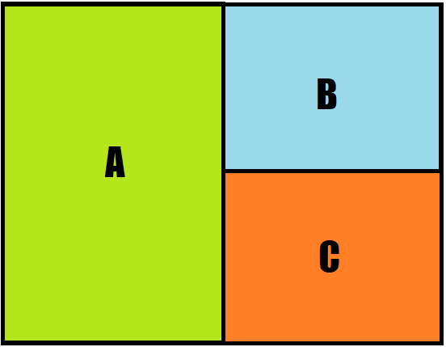
What named outlets are used for?
Render multiple independet routes on the same page by targeting different router outlets
Create dynamic and flexible view.

Slide 6
Implementation

Slide 7
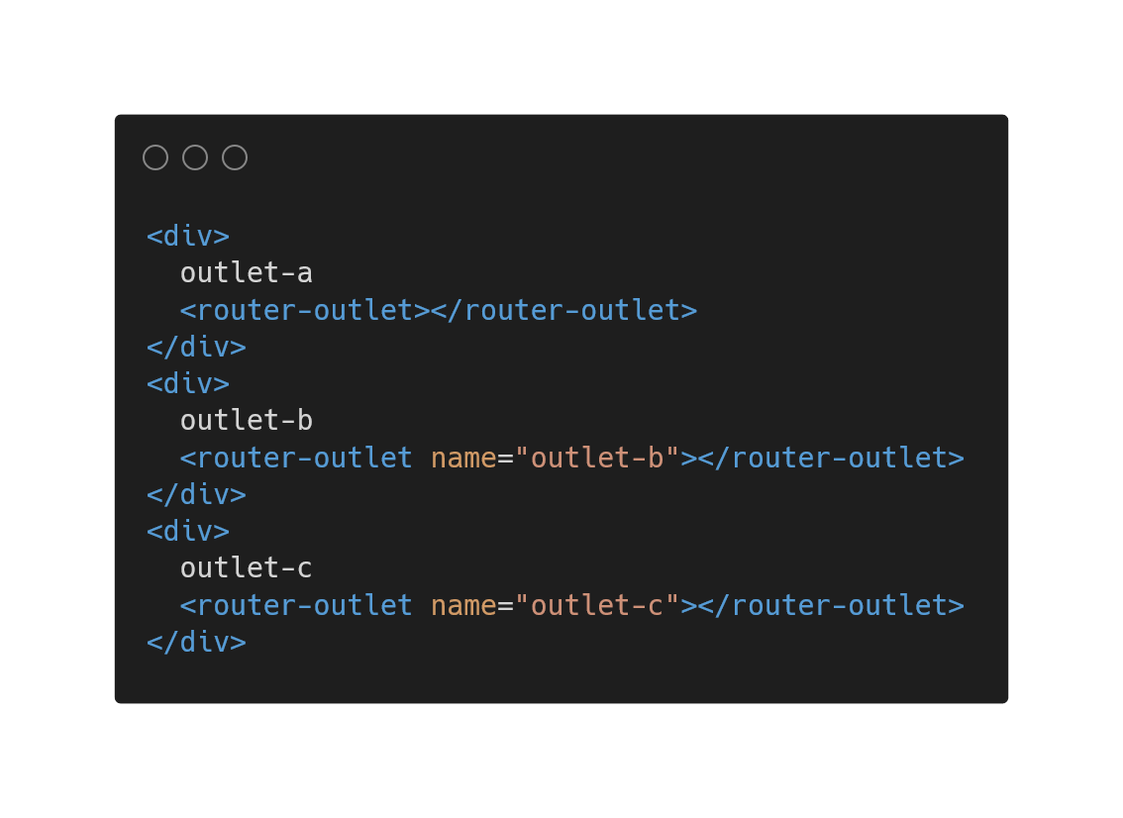
Add a name to the router outlet
Use the „name“ Attribute to name an outlet
An router outlet without a name property is called a primary outlet.

Slide 8
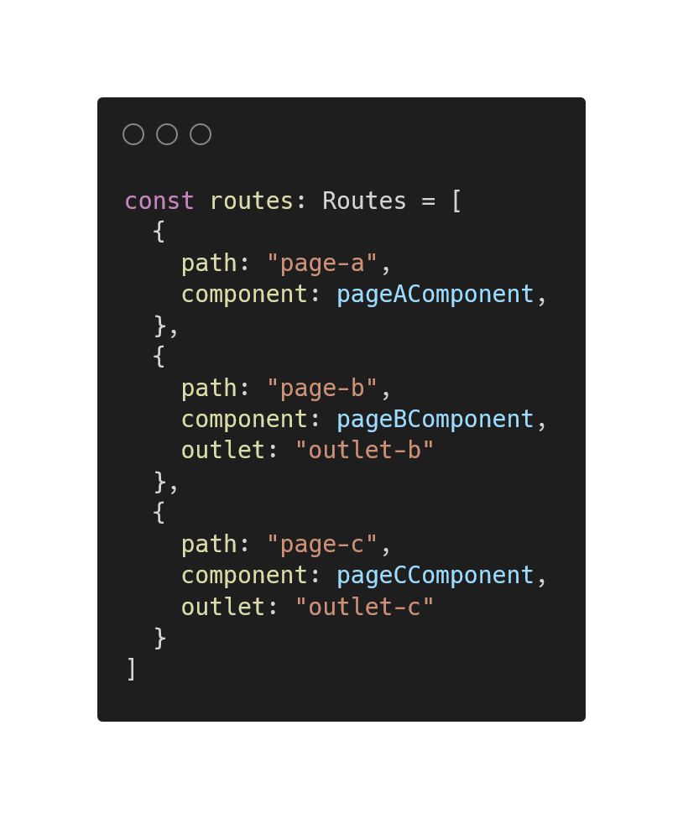
Configure the path
In the Routes object specify the target outlet of the paths.

Slide 9
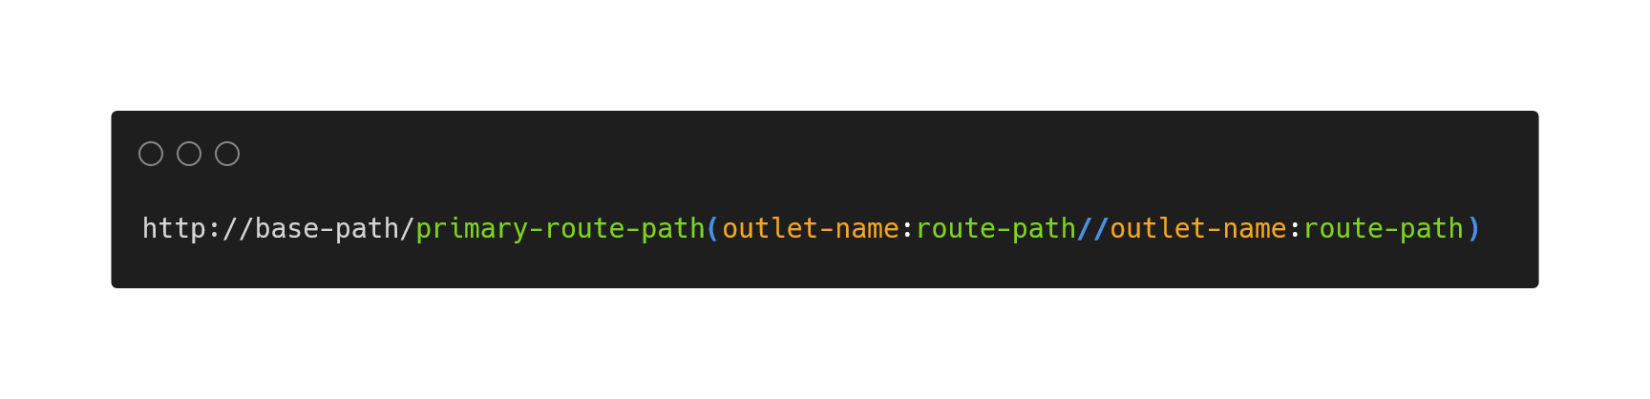
Syntax of the URL
The path of the primary outlet is specified outside the parenthesis
Every secondary soutes are specified within parentheisis.
Multiple secondary outlets are seperated by two slashes.

Slide 10
Demo Code

Slide 11
References
https://angular.io/api/router/RouterOutlet#description
https://onehungrymind.com/named-router-outlets-in-angular-2/
https://www.youtube.com/watch?v=9fH09nJGm-U
https://medium.com/time-machine/lazy-loading-router-outlets-named-router-outlets-in-angular-auxiliary-routes-b7eee6c79a53
https://lukeliutingchun.medium.com/angular-introduction-to-named-router-outlet-and-a-hack-for-custom-url-6ca1cd11fd2a
Alle Links wurden zuletzt am 11.09.2021 um 16:04 Uhr geöffnet.

Slide 12
Questions?

