Slide 1
An improved method for multi-label classification methods using deep neural language models with ensemble learning
AROB 2023
Osaka Metropolitan University
Yuuki Kusumoto, Makoto Okada, Naoki Mori

Slide 2
Agenda
1. Background
2. Proposed Method
3. Experiments
4. Summary and Future Issues
1

Slide 3
Aspect-Based Sentiment Analysis (ABSA)
aspect information
ex)
Breakfast and dinner
were delicious.
・entity of the text
・Attribute of the entity
entity
breakfast
dinner
attribute
delicious
2

Slide 4
Multi-Label Classification (MLC)
“This is a dog.”
To which category does this sentence belong?
dog?
cat?
animal?
MLC model
Ensemble
learning
This is a dog.
3

Slide 5
Multi-Label Classification (MLC)
MLC model
aspect 1
sub-classifier
aspect 2
sub-classifier
aspect 3
sub-classifier
・・・
sentence
4

Slide 6
Research Purpose
Following the problems of NLP, the research purpose is to improve the accuracy of MLC
Novelty
The novelty of the model compared to the model of Miura et al. is the incorporation of ensemble learning.
5

Slide 7
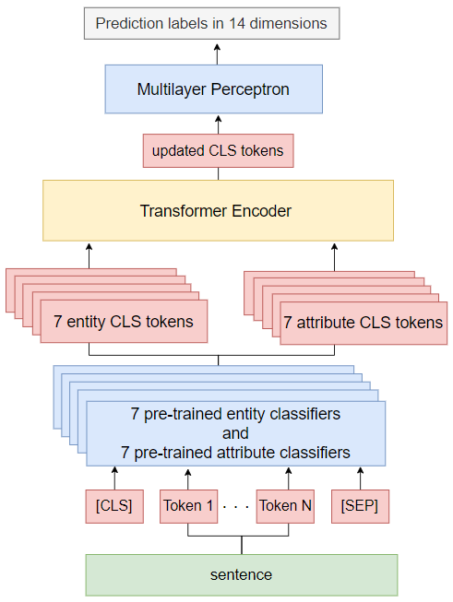
Mpm+T (Multi pretrained models Transformer)
novelty
6
Notes:
まずは本研究で提案するモデル全体を示します

Slide 8
Mpm+T (Multi pretrained models Transformer)
7
Notes:
まずは本研究で提案するモデル全体を示します

Slide 9
Mpm+T (Multi pretrained models Transformer)
8
Notes:
まずは本研究で提案するモデル全体を示します

Slide 10
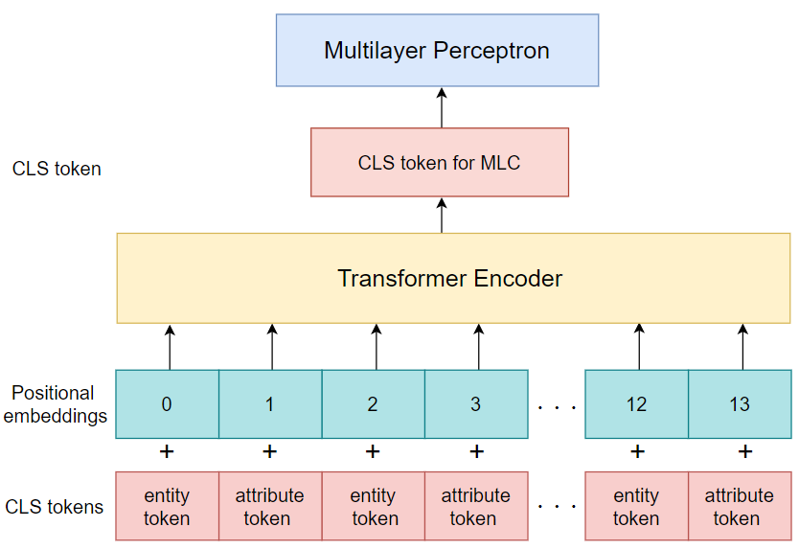
Mpm+T (Multi pretrained models Transformer)
9
Notes:
まずは本研究で提案するモデル全体を示します

Slide 11
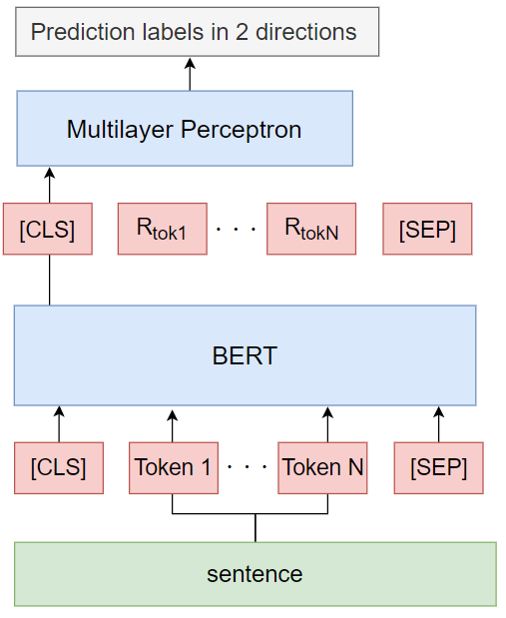
Model diagram of the sub-classifiers
10

Slide 12
Sub-classifiers for Two Types of Tasks
・entity classifiers Seven binary classification BERT models, one for each of
the following categories: Breakfast, Dinner, Bath,
Service, State, Facility, and Room
・attribute classifiers Seven binary classification BERT models determine whether a category is positive or negative
11
Notes:
カテゴリ CLS とポジネガ CLS は BERT で得られる分散表現ベクトルの先頭トークンです.

Slide 13
Experiments
・Performing 5-fold cross-validation with 24,000 training data and 6,000 validation data to verify the effectiveness of the proposed method on a Japanese customer review dataset
・Comparison methods are
BERT+Multilayer Perceptron (BERT+MLP), and the model of the previous research, Miura et al.
12
Notes:
その分類器の上にもう一つ分類器を作成で

Slide 14
Dataset
・" Rakuten Travel Reviews: Aspects and Sentiment-tagged
corpus" published by Rakuten Group, Inc
・ 76623 reviews of Rakuten Travel, with positive or negative tags in 7 categories: Breakfast, Dinner, Bath, Service, State, Facility, and Room
https://dsc.repo.nii.ac.jp/?action=pages_view_main&active_action=repository_view_main_item_detail&item_id=1752&item_no=1&page_id=13&block_id=21
https://global.rakuten.com/corp/
13

Slide 15
Dataset
Text | Breakfast and dinner were delicious.
Breakfast
Dinner
Bath
service
State
Facility
Room
positive
negative
positive
negative
positive
negative
positive
negative
positive
negative
positive
negative
positive
negative
1
0
1
0
0
0
0
0
0
0
0
0
0
0
14

Slide 16
Mpm+T Parameters during Training
Number of layers in BERT | 12
Input dimensions for BERT | 768
Output dimensions for BERT | 768
Input dimensions for Transformer | 768
Output dimensions for Transformer | 14
Number of Transformer blocks | 3
Number of heads | 4
Batch size | 4
Optimization function | Adam
Learning rate | 0.0000076
Loss function | Binary Cross Entropy Loss
epochs | 15
15

Slide 17
BERT＋MLP Parameters during Training
Number of layers in BERT | 12
Input dimensions for BERT | 768
Output dimensions for BERT | 14
Batch size | 40
Optimization function | Adam
Learning rate | 0.0000076
Loss function | Binary Cross Entropy Loss
epochs | 20
16
Notes:
384, 384, 192, 192, 96, 0.1, 0.1, 0.1, 0.1, 0.1

Slide 18
Model of Miura et al. Parameters during Training
Number of layers in BERT | 12
Input dimensions for BERT | 768
Output dimensions for BERT | 100
Input dimensions for Transformer | 768
Output dimensions for Transformer | 14
Number of Transformer blocks | 2
Number of heads | 4
Batch size | 4
Optimization function | Adam
Learning rate | 0.000057
Loss function | Binary Cross Entropy Loss
epochs | 20
17
Notes:
384, 384, 192, 192, 96, 0.1, 0.1, 0.1, 0.1, 0.1

Slide 19
Entity classifiers and attribute classifiers
5-fold cross-validation results for each sub-classifier
Accuracy in the test data for each model of entity classifiers
Accuracy in the test data for each model of attribute classifiers
breakfast | dinner | bath | service | state | facility | room
0.916 ± 0.002 | 0.923 ± 0.006 | 0.943 ± 0.005 | 0.888 ± 0.005 | 0.951 ± 0.001 | 0.868 ± 0.01 | 0.919 ± 0.001
breakfast | dinner | bath | service | state | facility | room
0.936 ± 0.001 | 0.922 ± 0.005 | 0.917 ± 0.001 | 0.926 ± 0.01 | 0.925 ± 0.003 | 0.908 ± 0.094 | 0.905 ± 0.007
18
Notes:
他のカテゴリに比べてデータが不均衡であったため

Slide 20
Experiment Results
 | Precision | Recall | micro-F1
Mpm+T | 0.846±0.019 | 0.872±0.028 | 0.858±0.017
BERT＋MLP | 0.683±0.005 | 0.772±0.009 | 0.724±0.005
Model of Miura et al. | 0.741±0.015 | 0.804±0.006 | 0.773±0.013
19

Slide 21
Definitions
・Completely correct
・Partially correct
✓
✓
✓
Correct label | 1 | 0 | 1
Prediction label | 1 | 0 | 1
✓
✓
×
Correct label | 1 | 0 | 0
Prediction label | 1 | 0 | 1
20

Slide 22
Content of test data.
2060 multi-label data
3940 single-label data
・6000 test data
・Content of 2060 multi-label data for test data
2 labels | 3 labels | 4 labels | 5 labels | 6 labels | 7 labels
1364 | 320 | 73 | 20 | 6 | 294
21

Slide 23
Content of test data.
2060 multi-label data
3940 single-label data
・6000 test data
・Content of 2060 multi-label data for test data
2 labels | 3 labels | 4 labels | 5 labels | 6 labels | 7 labels
1364 | 320 | 73 | 20 | 6 | 294
22

Slide 24
Percentage of completely correct
 | Completely correct
 | Multi-label data | Single-label data
Mpm+T | 1298 (0.630) | 3013 (0.764)
BERT＋MLP | 862 (0.418) | 2326 (0.641)
Model of Miura et al. | 1097 (0.533) | 2787 (0.706)
23

Slide 25
Content of test data.
2060 multi-label data
3940 single-label data
・6000 test data
・Content of 2060 multi-label data for test data
2 labels | 3 labels | 4 labels | 5 labels | 6 labels | 7 labels
1364 | 320 | 73 | 20 | 6 | 294
24

Slide 26
Accuracy of Completely Correct for Multi-label Data
 | 2 labels | 3 labels | 4 labels | 5 labels | 6 labels | 7 labels
Mpm+T | 879 (0.644) | 178 (0.556) | 38 (0.521) | 10 (0.5) | 0 (0) | 214 (0.728)
BERT＋MLP | 600 (0.439) | 83 (0.259) | 18 (0.247) | 3 (0.15) | 0 (0) | 158 (0.537)
Model of Miura et al. | 737 (0.540) | 136 (0.425) | 30 (0.411) | 5 (0.25) | 0 (0) | 208 (0.707)
25

Slide 27
Correct Example 3 Labels
Text | The location, facilities, and service were more than satisfactory for the price. | The food was delicious and close to the station.
Breakfast
Dinner
Bath
service
State
Facility
Room
positive
negative
positive
negative
positive
negative
positive
negative
positive
negative
positive
negative
positive
negative
0 | 1
0 | 0
0 | 1
0 | 0
0 | 0
0 | 0
1 | 0
0 | 0
1 | 1
0 | 0
1 | 0
0 | 0
0 | 0
0 | 0
26

Slide 28
Correct Example 7 Labels
Text | Thank you very much for a pleasant stay. | It ruined a trip I was looking forward to.
Breakfast
Dinner
Bath
service
State
Facility
Room
positive
negative
positive
negative
positive
negative
positive
negative
positive
negative
positive
negative
positive
negative
1 | 0
0 | 1
1 | 0
0 | 1
1 | 0
0 | 1
1 | 0
0 | 1
1 | 0
0 | 1
1 | 0
0 | 1
1 | 0
0 | 1
27

Slide 29
Incorrect Example 6 Labels
Text | Thank you very much for your kindness.
Correct label | Prediction label
1 | 1
0 | 0
1 | 1
0 | 0
1 | 1
0 | 0
1 | 1
0 | 0
0 | 0
0 | 0
1 | 0
0 | 0
1 | 1
0 | 0
Breakfast
Dinner
Bath
service
State
Facility
Room
positive
negative
positive
negative
positive
negative
positive
negative
positive
negative
positive
negative
positive
negative
28

Slide 30
Summary
・We proposed Mpm+T, a deep language model using ensemble learning to improve the multi-label classification
・The accuracy of MLC is improved by 8.5% from
related research
Future Issue
・We will work on improving the accuracy of
multi-label data, which has low classification accuracy.
29

Slide 31
Thank you for your attention

