Slide 1
dplyr Package
By Connor Humphray, Marnie Guy and Yuuki Hosokawa

Slide 2
An Introduction to Dplyr
Dpylr is a fast and powerful R programming package used to manipulate datasets. It makes working with data easier by constraining the options and providing simple functions to use.
It was released open-source January 7th, 2014 primarily authored by Hadley Wickham. The package includes five datasets to perform operations on: band_instruments, band_instruments2, band_members, starwars, and storms. The key object is a representation of a tabular data structure and it currently supports: data frames, data tables, Redshift, MySQL, Bigquery, and MonetDB
# If installing for the first time, use the install.packages function below # install.packages("dplyr") library(dplyr) # Loads the dplyr packages

Slide 3
Data Frames
The term data frame is a key data structure in statistics and R. The basic structure contains one observation per row and each column represents a variable of that observation. To better manage, interpret and visualize data sets we can use the dplyr package. This package makes tedious operations using base R easier to complete at higher efficiency and readability.
Columns
Rows

Slide 4
Selecting columns & filtering rows
There are many useful functions within dplyr. Below are some of the most commonly used and their usage. These functions are the five primary verbs that can be used in conjunction with the dozens of other functions within dplyr to “help you solve the most common data manipulation challenges”.
select() - Subset a dataframe by its columns.
filter() - Extract rows from a dataframe
mutate() - Creates new columns based on existing ones
arrange() - Sorts/reorders the rows in the data frame by the value of given columns
summarise() - Collapses given existing values to a single-row summary.

Slide 5
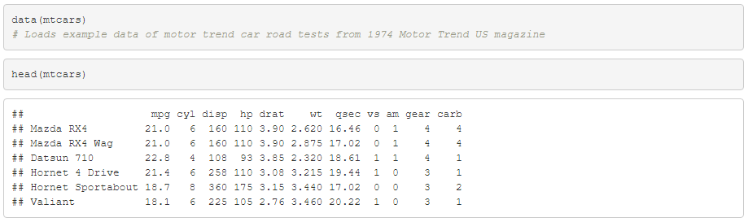
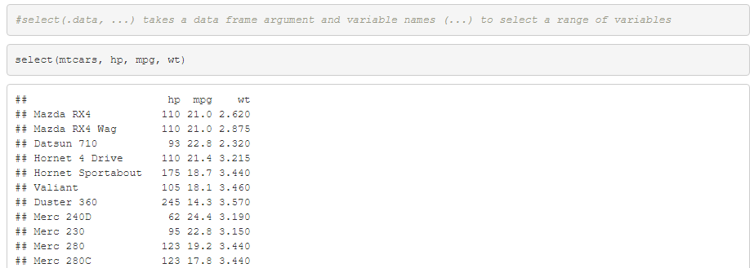

Slide 6
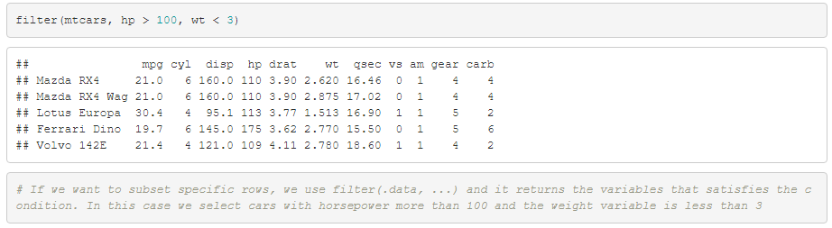
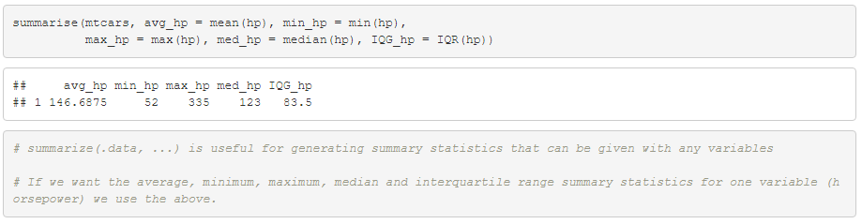

Slide 7
Pipe operator
The pipe operator %>% is used to take the output of one function and use it in the next. This new syntax is useful because it’s easier to read, write and tells the story of your analysis. Using this operator allows us to chain multiple dplyr commands together.
# Instead of this mtcars_gears <- group_by(mtcars, gear) # You can use pipe %>% and do mtcars %>% group_by(gear)

Slide 8
NA values
These are examples of functions that are used in order to replace or manipulate values that are Not Available (NA). This is helpful as it allows positions in a table to be left without a data point without it changing the columns and row numbers.
na_if() - Converts the value to NA
is.na() - Function that returns true or false for each value in a data set(whether it contains NA not). It can be used to find missing values
replace_na() - Used to replace NAs with specific values
na.omit() - Deletes the na values in your dataset
drop_na() - Drops any rows that contain na(missing values)
Instead of NA values which are missing values in the dataset, the value returned is the symbol NaN which represents Not a Number.

Slide 9
Advantages
Speed - Pre-dplyr, RPostgreSQL was much slower than our current package dylpr as it has the most important parts of its code written in Rcpp. This is a package that integrates R with C++ to accelerate computations. Although there is evidence to suggest that data.table package may be quicker.
Syntax - The code used in dplyr is relatively simple and easy to follow, as well as the inclusion of the pipe function which streamlines the code.
External databases - Instead of using a package like RMySQL in order to access a database dplyr has this access built in. Another example of good integration with databases is the collect() function that is delayed, by dplyr, until the last minute in order to reduce the number of requests that are sent to the database, reducing the stress and time it takes to interact.
Disadvantages
GGplot2 can be used to in the sameway as the %>% function and i predates it. The advantage of ggplot2 over dylpr is that ggplot2 is able to be manipulated more as it doesn’t look for the pipe name within code that can be non-standard evaluation. Therefore, it’s much harder to hack around the dplyr when using your own code.
There is also evidence to suggest that data.table package may be faster than dplyr when the number of groups increase. It also has a high overlap in functions.

Slide 10
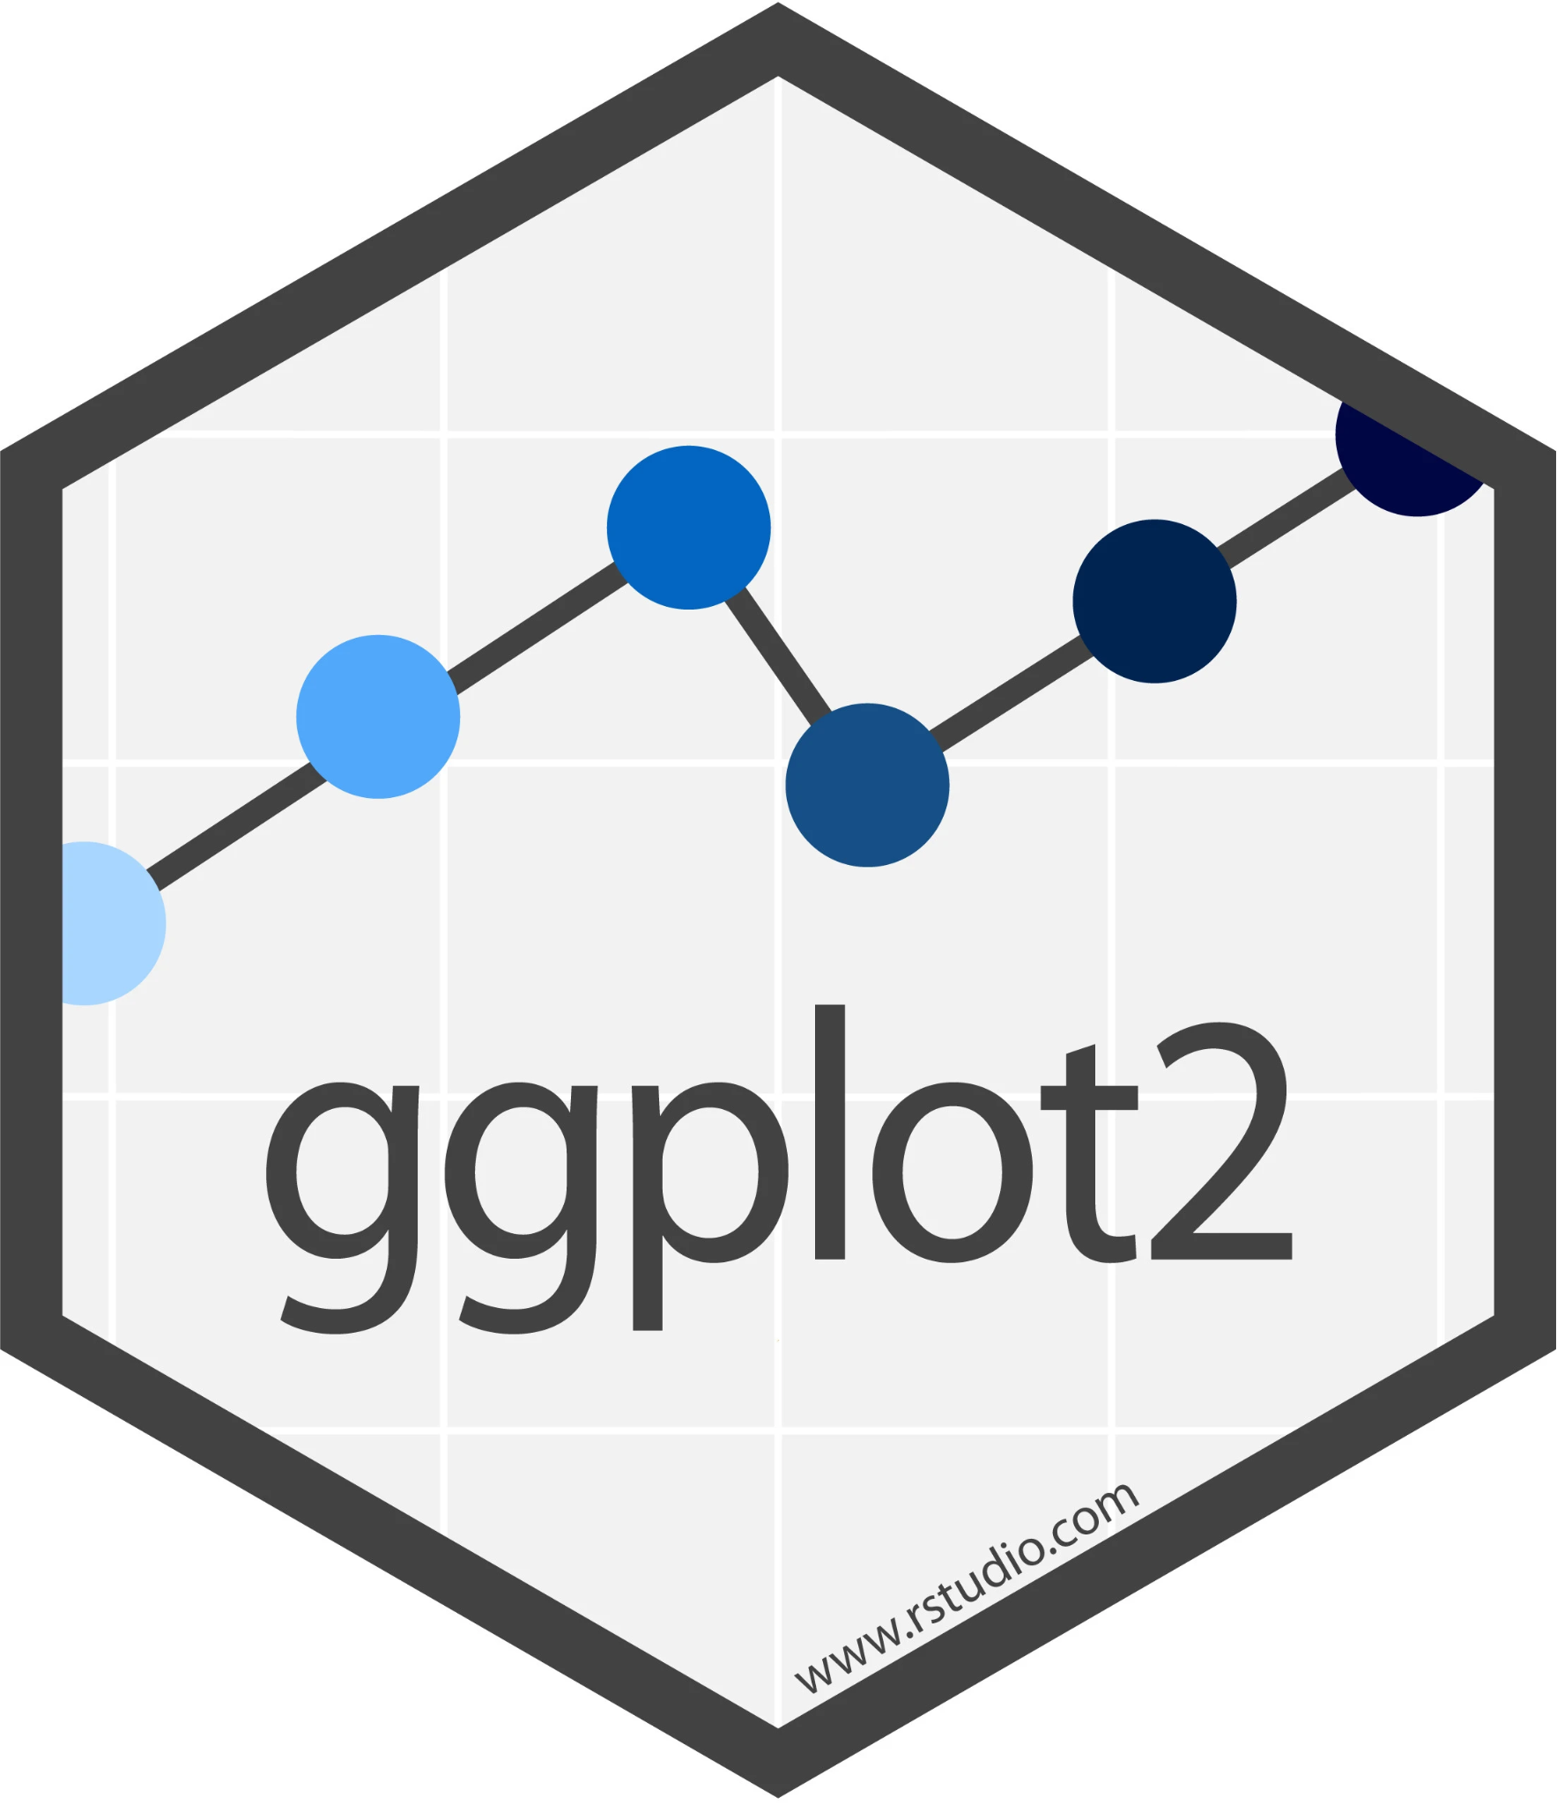

Integration
To use Tidyr (used for making code neater) with dplyr you need to take advantage of some of the reshaping functions.
Pivot_wider()/_longer() - These can be used in order to create new columns allowing for the structure of the table to be manipulated from tidyr to dplyr and vice versa
Ggplot can also be used easily to visualise the data used in dplyr.

Slide 11
Grouping data
The group_by() function is a very useful part of dplyr as it allows for very specific and targeted computation. The constraints passed as arguments of the function can access various properties of the group to be further analyzed or visualized (ex. summarize()). There are other functions that allow you to manipulate it more such as:
cur_data() - Returns the current group, removing grouping variables
ungroup() - Removes all grouping variables
group_keys() - Shows the underlying group data, one row for each group and a column for each grouping variable
cur_group_id() - The current group gets a unique numeric identifier
cur_group_rows() - Row indices for the current group are returned

Slide 12


Joining Tables
bind_cols() returns tables pasted next to each other whilst the bind_cols(...) variation combines the two tables into one
bind_rows() returns tables joined underneath each other or in other words by rows
intersect(x,y,...) joins rows and removes duplicates
set_diff(x,y,...) subsets the first parameter (requires same columns)
union(x,y,...) combines vectors and operates row-wise
Join functions attach columns to tables in different ways for example: left_join(x,y, by = “A”)
There is also a right_join(x,y, by= “A”) which appends x to y, inner_join() which only adds matching rows and a full_join() which joins all the data
By = c allows you to specify the columns to be joined at
semi _join(x,y, by= “A”,...) gives you x which match y anti_join(x,y, by= “A”,...) gives you x with no match with y
Table 1
Table 2

Slide 13
Have a great rest of the day!
Any questions?

