Slide 1
Quant Trading Bot
ShihYu Ho
Notes:
Hello everyone,
Thank you for being here today. I'm excited to share a proposal of Quant Trading Bot.
In the next few minutes, I'll walk you through the key points and why I believe this is not just a proposal, but a pathway to a business.

Slide 2

Hello!
I am Shihyu Ho
I am a first year master’s student majoring in ECE.
Notes:
Hello, let's keep it brief.
My name is Shihyu Ho, and I am a first-year master's student majoring in ECE.
What prompted me to undertake this project? I would say it's a simple truth – I love money, and people love money
As the comedian Ronny Chieng humorously pointed out, during Chinese New Year, the wish isn't just for happiness but also for prosperity. Inspired by this, I aim to create a service that helps people achieve financial success.

Slide 3
1.
Problem Space
Investment

Slide 4
Investment
Buy an item at a lower price
Sell an item at a higher price
sell
Short
Long
sell
Income
Income
buy
buy
Notes:
go long
go short

Slide 5



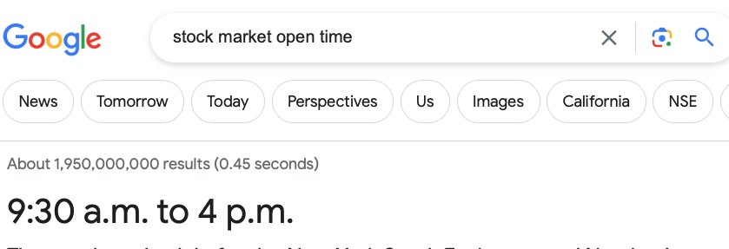
Market
Go to the market at the best time
Stay in the store for shopping
Notes:
even you know the market open time you still need buy stocks when the price is low
Passive income

Slide 6
What if the market doesn't go as I thought
People don't want to take on too much risk
Notes:
Individuals seek to generate income through investments while aiming to minimize risks
price fluctuation
when is the best time to buy it

Slide 7
What if I don’t want to read the Tape all day
People want to save time
Notes:
passive income
You don't want to (do any thing) actively manage your investments, yet you still desire your money to grow

Slide 8
Problems
High-Risk
Time-consumption

Slide 9
2.
Idea
Automation, Quant Trading

Slide 10

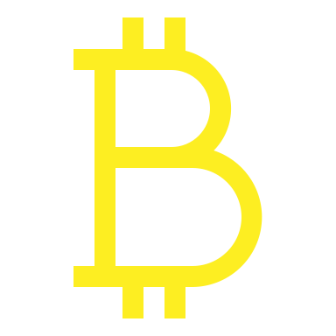


Quant Trading
Use Quant Trading to calculate the risk and practice the strategy
Notes:
Quantitative trading (quant trading) involves employing mathematical models and algorithms to analyze and execute trading strategies.
This allows us to calculate the probability of an investment, relying less on intuition and more on data-driven analysis

Slide 11
Arbitrage
What
In economics and finance, arbitrage is the practice of taking advantage of a difference in prices in two or more markets.
How
Arbitrage is buying a product in one market and simultaneously selling it in another at a higher price

Slide 12

Automation
Use a Trading Bot capable of executing transactions automatically

Slide 13
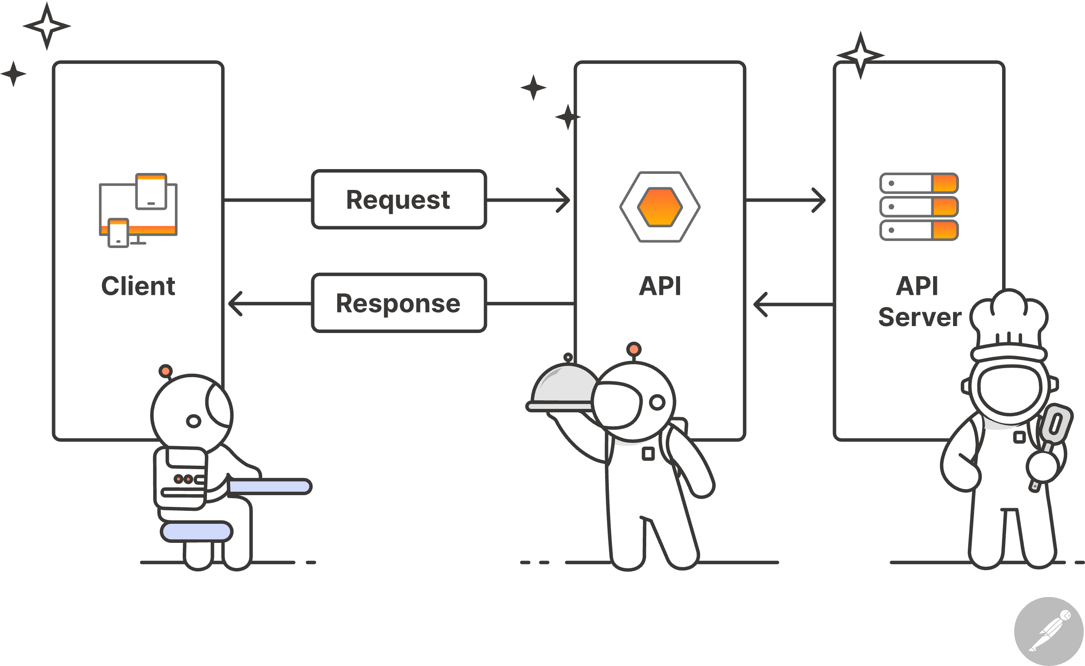
Binance API
Binance
Binance is an online exchange where users can trade cryptocurrencies
API
API stands for Application Programming Interface. Interface can be thought of as a contract of service between two applications.
source
Notes:
If I want to access information on various cryptocurrency symbols,
I can utilize an API. This enables me to retrieve data directly from Binance's server.

Slide 14
3.
Target
Quant Trading, Trading Bot

Slide 15

Main Goals
build a quant trading service using funding rate arbitrage of cryptocurrency based on the Binance Testnet API

Slide 16
What to do
Calculate Funding Rate
Quant Trading
Funding Rate Arbitrage Signal Detection
Quant Trading Bot
Cryptocurrency price accessing
Trading Bot
Programming cryptocurrency trading
Notes:
let it trade itself

Slide 17
Breakthroughs
1. Trading Bot
- Test the function of price accessing on the test net
- Test the function of buying and selling on the test net
2. Arbitrage signal
- Find an arbitrage transaction signal
- Backtest the transaction signal
3. Combination
- Test the arbitrage trading strategy on the test net using trading bot
Notes:
cryptocurrency market simulator

Slide 18
Roadmap
Use Machine Learning to optimize the strategy
Modularize the trading bot and make it customizable
Build the frontend of the service for users
1
3
5
2
4
Run the trading bot with real account and test the performance
Build the backend of the service for users

Slide 19
4.
Inplementation

Slide 20
Gantt chart
 | Week 1 |  |  |  |  |  |  | Week 2
 | 1 | 2 | 3 | 4 | 5 | 6 | 7 | 8 | 9 | 10 | 11 | 12 | 13 | 14
Document Study
Test net : price
Test net : buy
Test net : sell
Test net : future
Arbitrage Signal
Arbitrage Strategy

Slide 21
Gantt chart
 | Week 3 |  |  |  |  |  |  | Week4
 | 29 | 30 | 31 | 32 | 33 | 34 | 35 | 36 | 37 | 38 | 39 | 40 | 41 | 42
Document Study
Test net : price
Test net : buy
Test net : sell
Test net : future
Arbitrage Signal
Arbitrage Strategy

Slide 22
Gantt chart
 | Week 5 |  |  |  |  |  |  | Week 6
 | 43 | 44 | 45 | 46 | 47 | 48 | 49 | 50 | 51 | 52 | 53 | 54 | 55 | 56
Document Study
Test net : price
Test net : buy
Test net : sell
Test net : future
Arbitrage Signal
Arbitrage Strategy

Slide 23
Thanks!
Any questions?
You can find me at:
syho2@illinois.edu
Notes:
let's turn these ideas into action
Thank you for your time and engagement!"

Slide 24
What to do
Calculate Funding Rate
Quant Trading
Funding Rate Arbitrage Signal Detection
Quant Trading Bot
100%
spot : price, klines
future : price, klines
Cryptocurrency price accessing
Trading Bot
80%
spot : buying / selling
future : buying / selling
(need to integrate)
Programming cryptocurrency trading
Notes:
let it trade itself

Slide 25
Business Model Canvas
Key Partners
Insert your content
Key Activities
Insert your content
Value Propositions
Insert your content
Customer Relationships
Insert your content
Customer Segments
Insert your content
Key Resources
Insert your content
Channels
Insert your content
Cost Structure
Insert your content
Revenue Streams
Insert your content

