Slide 1
Quant Trading Bot
ShihYu Ho
Notes:
Hello everyone,
Thank you for being here today. I'm excited to share a proposal of Quant Trading Bot.
In the next few minutes, I'll walk you through the key points and why I believe this is not just a proposal, but a pathway to a business.

Slide 2

Main Goals
build a quant trading service using funding rate arbitrage of cryptocurrency based on the Binance Testnet API

Slide 3
What to do
Calculate Funding Rate
100%
Quant Trading
Funding Rate Arbitrage Signal Detection
75%
Quant Trading Bot
Cryptocurrency price accessing
100%
Trading Bot
Cryptocurrency trading automation
85%
Notes:
let it trade itself

Slide 4
Breakthroughs
1. Trading Bot
- Test the function of price accessing on the test net
- Test the function of buying and selling on the test net
2. Arbitrage signal
- Find an arbitrage transaction signal
- Backtest the transaction signal
3. Combination
- Test the arbitrage trading strategy on the test net using trading bot
Notes:
cryptocurrency market simulator

Slide 5
Funding Rate Arbitrage Signal Detection
50%
Backtest the funding rate
Access funding rate
Develop functions for funding rate arbitrage signal detection
75%
Use ML models to predict future funding rate > Linear Regression
Process funding rate data by using local database
> AWS cloud server fail
100%
Connect all together
Debugging

Slide 6
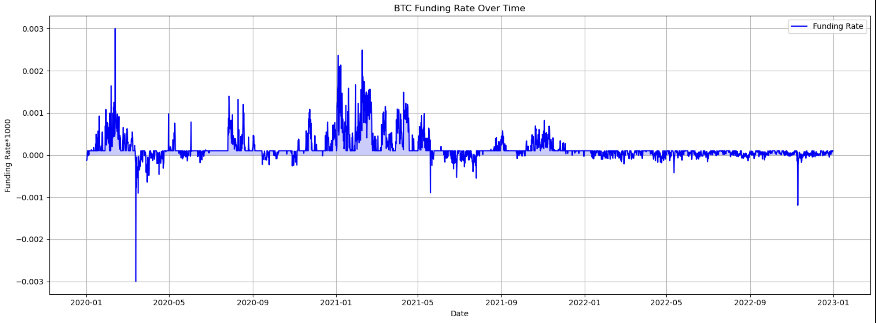
Backtest

Slide 7
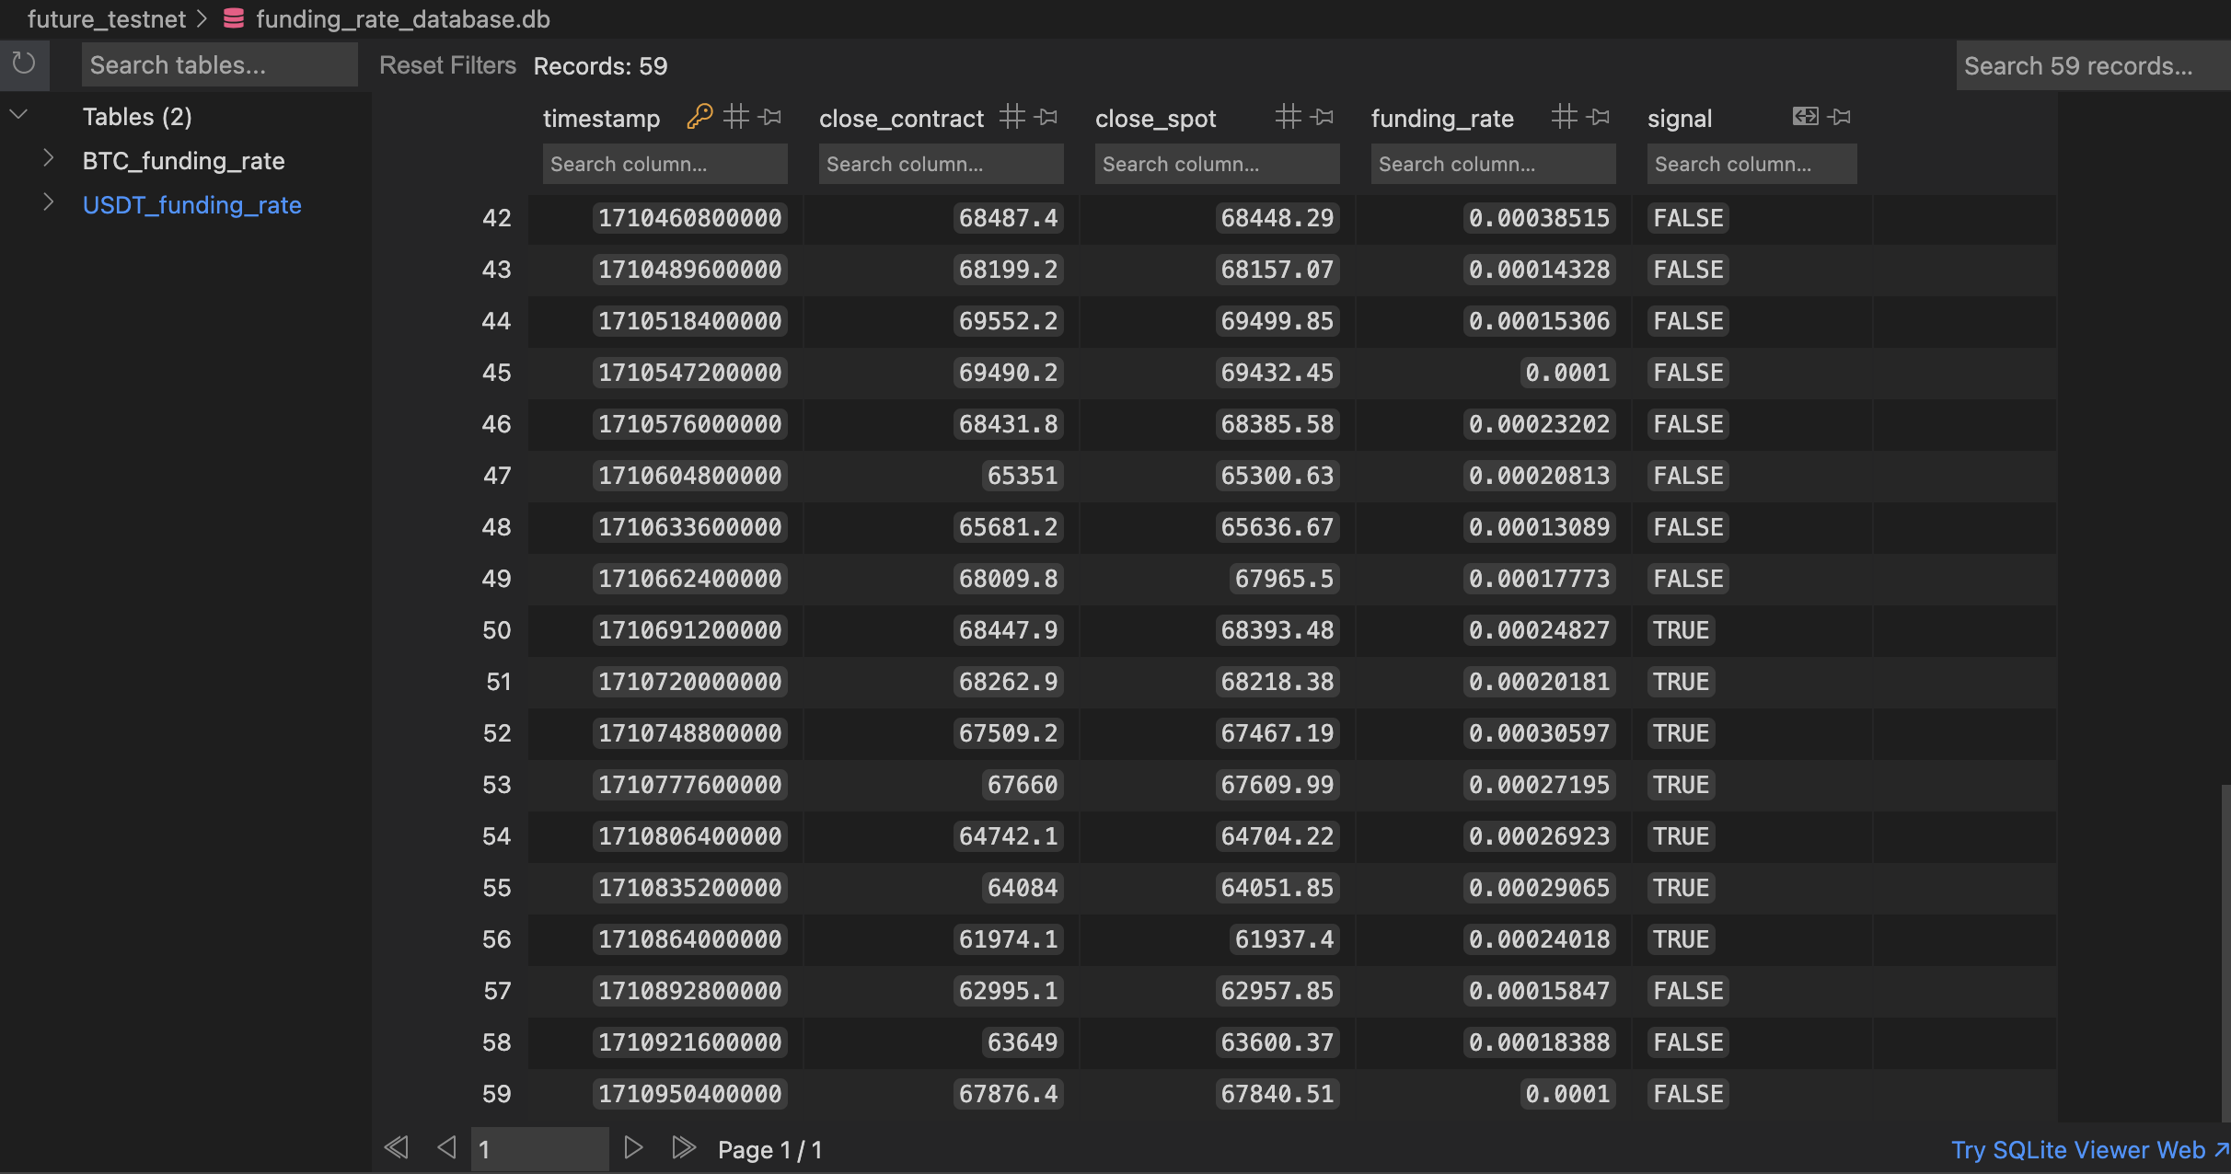
Backtest

Slide 8
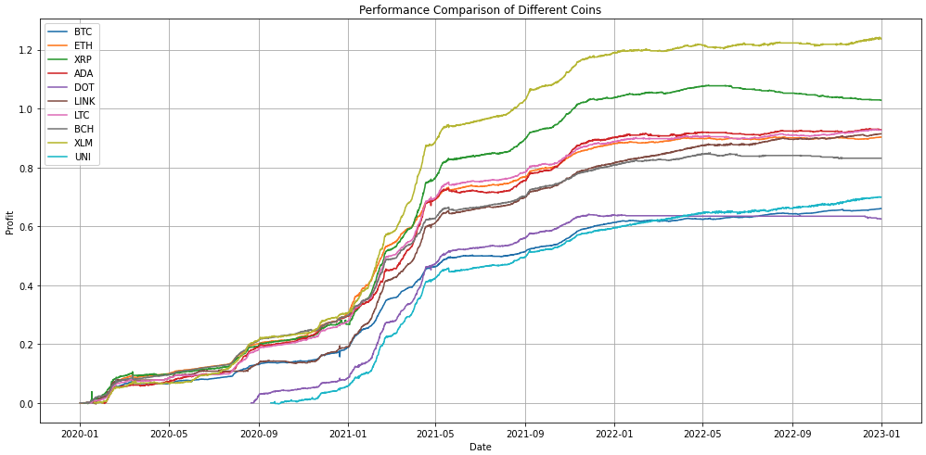
Backtest

Slide 9
Cryptocurrency trading Automation
80%
Develop functions for spot trading
Develop functions for future trading
Develop software system architecture
100%
Use docker for containerize functions

Slide 10
Docker
Needs a service that can automatically run programs
Needs Computers for automation
I don’t have money → Use Virtual Machines
Needs a good computer for running VM
I don’t have money → Use Docker

Slide 11
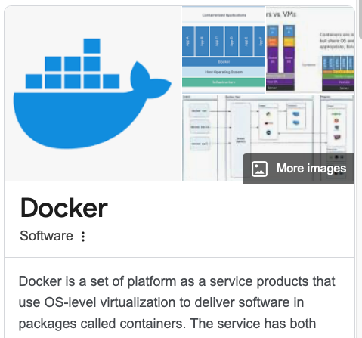
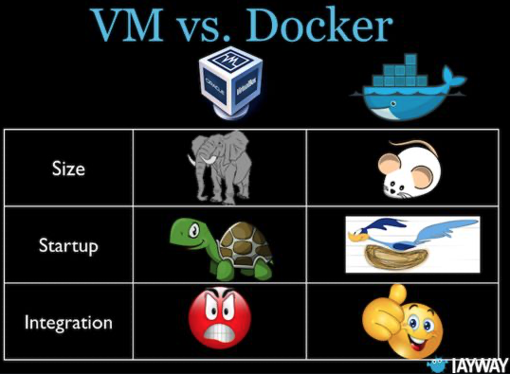
Docker

Slide 12



System Overview
funding rate detection
local database
trading

Slide 13
Docker

Slide 14
Thanks!
Any questions?
You can find me at:
syho2@illinois.edu
Notes:
let's turn these ideas into action
Thank you for your time and engagement!"

Slide 15
Business Model Canvas
Key Partners
Insert your content
Key Activities
Insert your content
Value Propositions
Insert your content
Customer Relationships
Insert your content
Customer Segments
Insert your content
Key Resources
Insert your content
Channels
Insert your content
Cost Structure
Insert your content
Revenue Streams
Insert your content

Slide 16
Outline
engaging introduction
clear problem description
persuasive introduction to project idea
Hypotheses and stakeholders
Projects goals, Remaining semester goals

