Slide 1
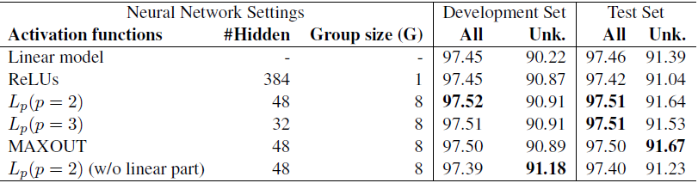
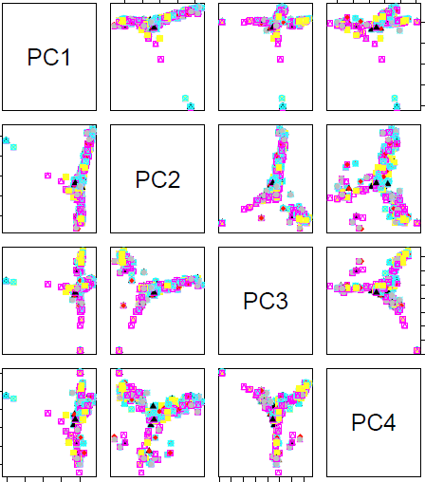
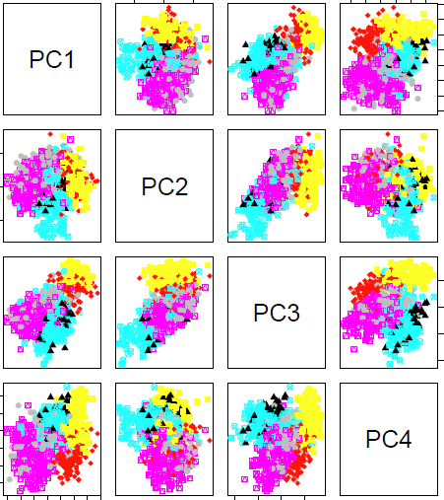

Neural Networks Leverage Corpus-wide Information for Part-of-speech Tagging
Yuta Tsuboi <yutat@jp.ibm.com>
IBM Research – Tokyo
Overview
Using a feature combination of
local context information and
corpus-wide information
State-of-the-art POS tagging accuracies
PTB-WSJ: 97.51% (ours) vs. 97.50% (Søggard, 2011)
CoNLL2009: 98.02%(ours) vs. 97.84%(Bohnet and Nivre, 2012)
A hybrid architecture
Linear model for local context features, e.g. the neighborhood of the target word
Sparse discrete vectors
Neural nets for corpus-wide features, e.g. the distribution of neighbor words
Dense continuous vectors
Four types of corpus-wide features
Word embeddings (w2v and glv)
word2vec (Mikolov et al., 2013) and GloVe (Pennington et al., 2014)
POS tag distribution (pos)
Pr(pos | w_{t}); Pr(pos | affix_{t}); Pr(pos | spelling_{t})
Supertag distribution (stag)
Pr(stag | w_{t}); Supertags are dependency labels and directions of parent/children, e.g. “nn/L” (Ouchi et al., 2014)
Context word distribution(cw)
Pr(w_{t-1} | w_{t}); Pr(w_{t+1} | w_{t}); (Schnabel and Sch¨utze, 2014)
Why neural net. for continuous features?
The non-linearity of discrete features has been exploited by the simple conjunction of the discrete features.
In contrast, the non-linear feature design of continuous features is not intuitive.
Activation Functions
Let v be a linear filter:
Rectified Linear Units (ReLUs)
Maxout networks (MAXOUT)
Normalized L_{p} pooling (L_{p})
h
v
Online learning of a left-to-right tagger
Deterministically predicts each tag using prediction history (Choi and Palmer, 2012)
Binary features: N-grams, affix, spelling types, etc.
A variant of the on-the-fly example generation algorithm (Goldberg and Nivre, 2012)
Using the prediction of the previously learned model as prediction history to overcome error propagation.
FTRLProximal algorithm (McMahan, 2011) with Adagrad (Duchi et al., 2010)
Multi-class hinge loss + L1/L2 regularization terms
Random hyper-parameter searches (Bergstra and Bengio, 2012)
Initial weights; initial weight range; momentum; learning rate; regularization, epoch to start the regularizations, etc. (256 initial weights are tried!)
h
v₁
_{MAXOUT}
L₂
v₂
pooling
v₁
v₂
…
v_{n-1}
v_{n}
Results on Penn Treebank (PTB-WSJ)
Evaluation of the hybrid model
Learned representations
Scatter plots of verbs for all combinations between the first 4 principal components of the raw features and the activation of hidden variables.
Feature engineering using linear model
Evaluation results of corpus-wide features on dev. set.
PCA of raw feature
PCA of hidden activations
All token accuracy (%). / Unknown token accuracy (%)
Binary feature only
97.36 / 88.96
+stag(w=1)
97.44 / 90.53
+w2v
+pos
+cw
97.15 / 86.81
+w2v+glv
97.40 / 90.44
97.44 / 90.17
+glv
97.34 / 89.55
+stag(w=3)
97.45 / 90.22

