Slide 1
Guide of Our System
how to run “volleyball-match-record-system”

Slide 2
How to Register Information

Slide 3
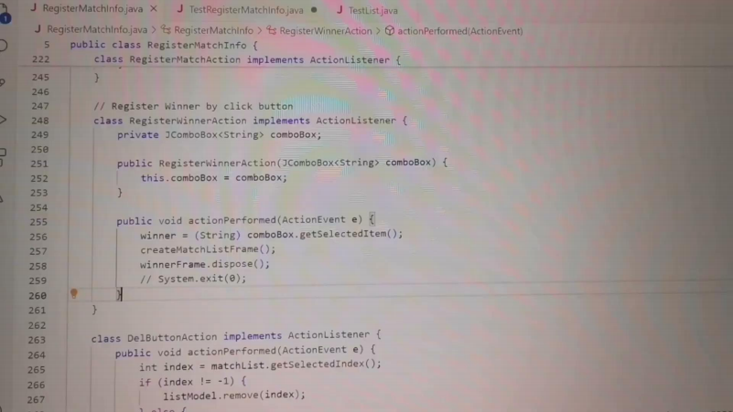
demo
demo

Slide 4
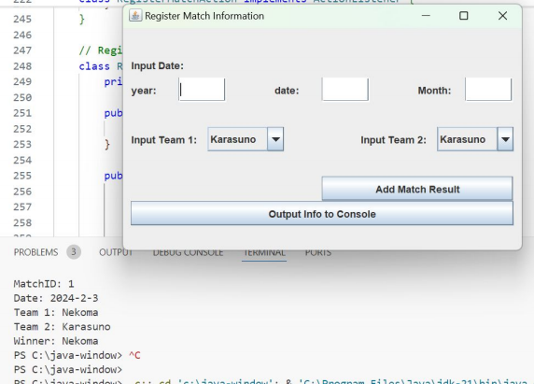
Register Match Information
When you run
"RegisterMatchInfo.java",
a window like the one
on the right will appear.

Slide 5
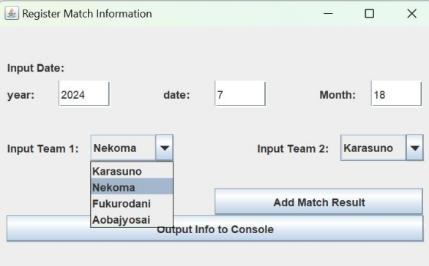
Step1 : Add Date and Team Information
Enter the date of the match and select the competing school.

Slide 6
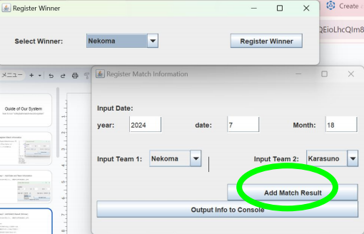
Step2-1 : Add Match Result
If match already finished, you can register winner team.
Click button “Add Match Result” (green color) then a new window “Register
Winner” will appear.
Point :
Registration not allowed until the match ends ×
Register as soon as the competing school is known (Should be able to register even before the match)
click here

Slide 7
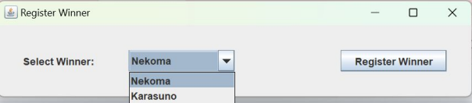
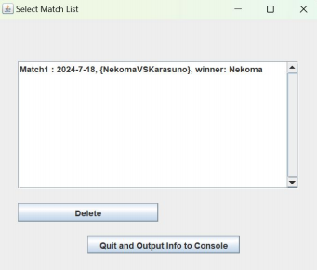
Step2-2 : Add Match Result
Select winner and click button “Register Winner” .
Then new window “Select Match List” will appear.
If you register a wrong information, you can delete it by select line in the field and click delete button.

Slide 8
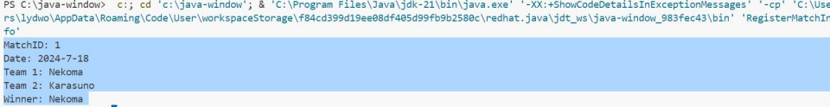
Step3 : Output information
If you click the button “Quit and Output Info to Console”, you can see the output as below.

Slide 9
How to Get Information

Slide 10
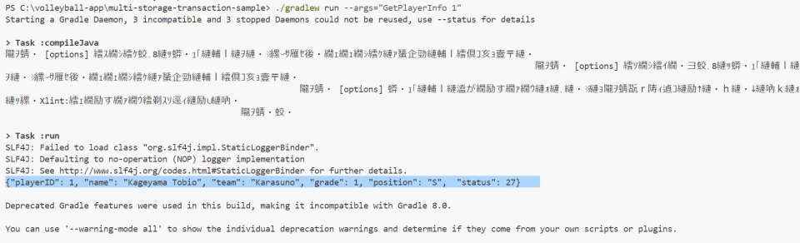
Try 1: Get information of Player 1
Command: ./gradlew run --args="GetPlayerInfo 1"
Successful output: You can see a similar output as below

Slide 11
How to run sample app

Slide 12
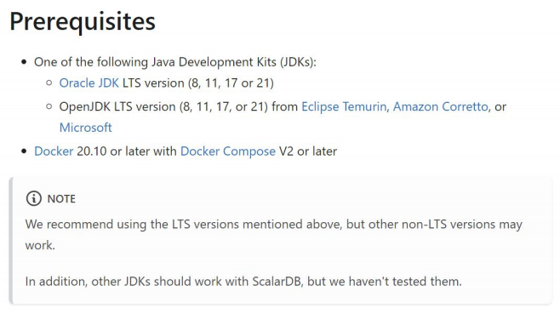
Step 0 : Download JAVA
Recommend to download Java 8, 11, 17, 21
We use version 21

Slide 13
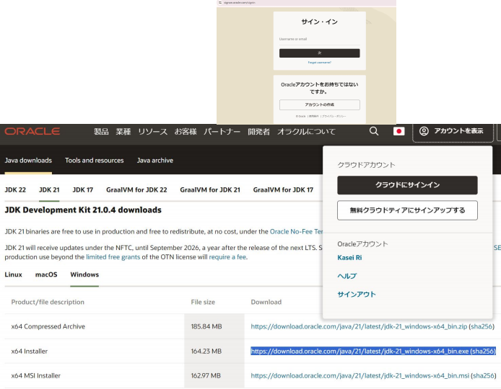
Step 0: Download Java
You might be required to create oracle account
Step for Windows →

Slide 14
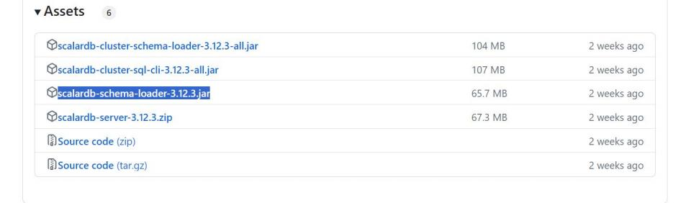
Step 0 : Download schema loader
Schema loader Download
Please select the highlighted section below

Slide 15
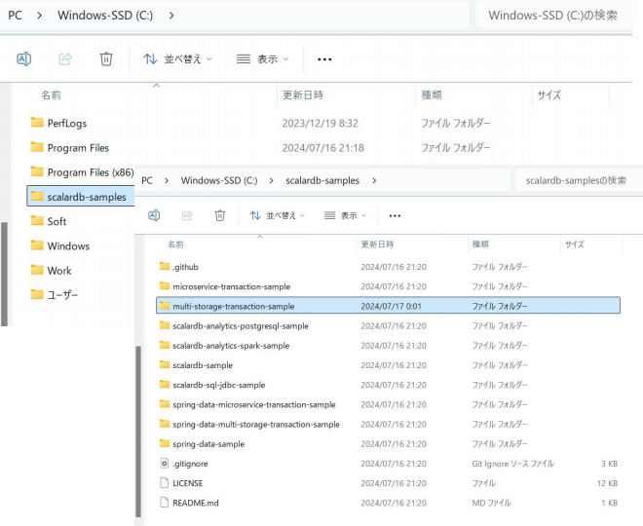
Step 1 : Git clone
Clone succesfully

Slide 16
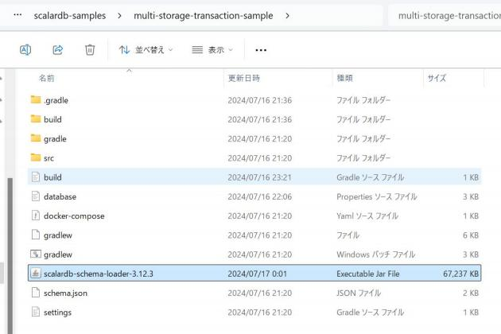
Step 3 : Check and Move schema loader
As shown in the figure
on the right
<Check the version>
We use 3.12.3
it will be used at nextstep

Slide 17
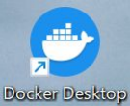
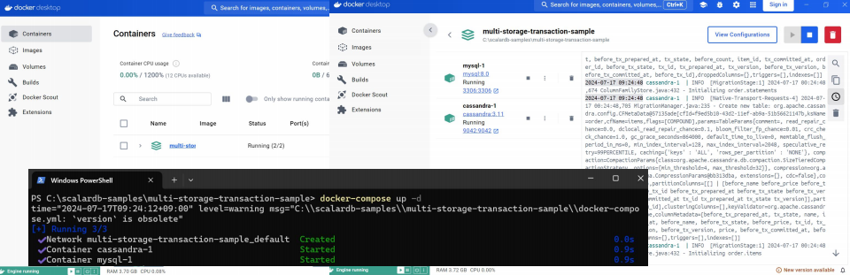
Step 4 : Start cassandra and mysql
Use Docker
Open “Docker Desktop” first
and input Command: docker-compose up -d

Slide 18
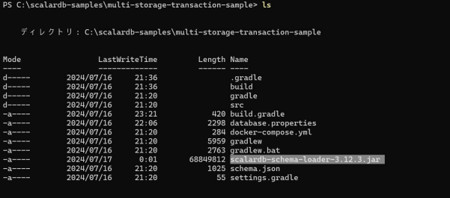
Step 5 : Load schema
Command: java -jar scalardb-schema-loader-<VERSION>.jar --config database.properties --schema-file schema.json --coordinator
Replace <VERSION>
java -jar scalardb-schema-loader-3.12.3.jar --config database.properties --schema-file schema.json
--coordinator

Slide 19
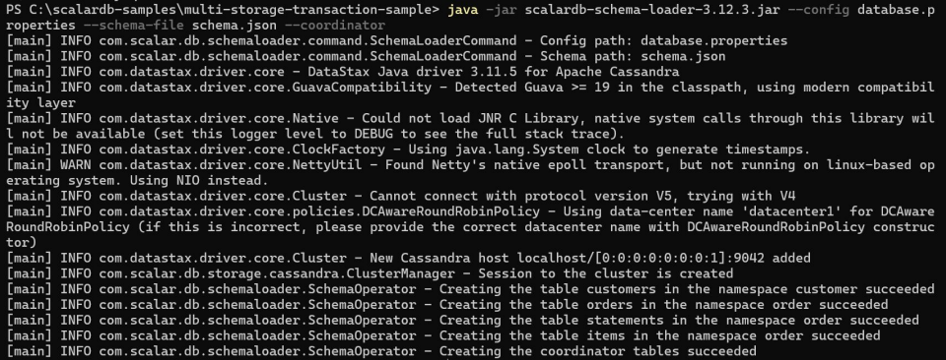
Step 5
The successful result is shown below

Slide 20
Step 6 : Load initial data
Command:
./gradlew run --args="LoadInitialData"
<Attention> If you use Command prompt then use
gradlew run --args="LoadInitialData"
or
gradlew.bat run --args="LoadInitialData"

Slide 21
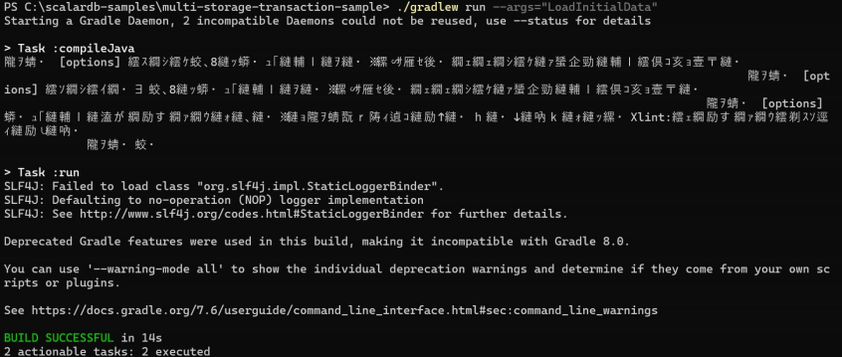
Step 6: Expected reaction
<Notice> Use java 21: Garbled text will appear → (you can use java 8)

Slide 22
Let’s use sample app
how to get information from database

Slide 23
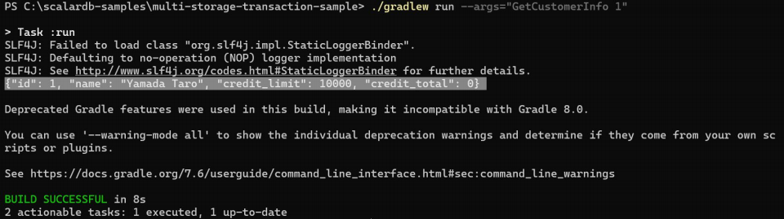
Try 1 : Get player information from database
Successful output: You can see a similar output as below
{"id": 1, "name": "Yamada Taro", "credit_limit": 10000, "credit_total": 0}

Slide 24
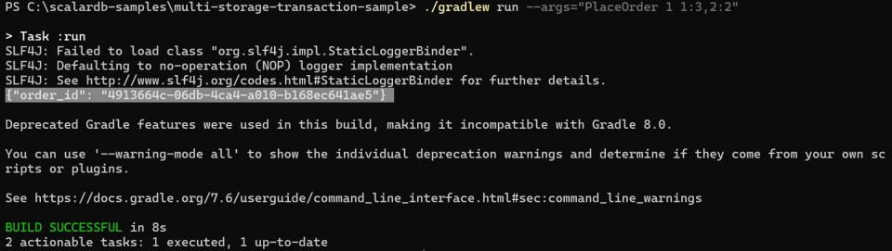
Try 2 : customer order
Then, customer (ID 1) place an order for three apples and two oranges by running the following command:

Slide 25
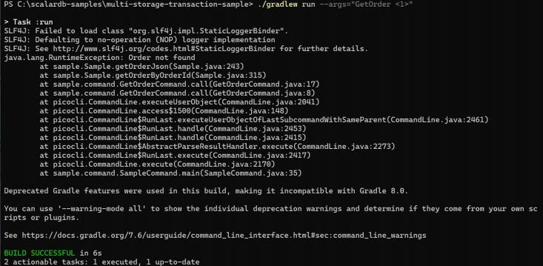
Try 3 :
This is error output

Slide 26
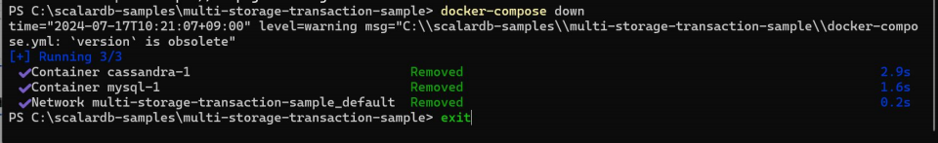
The last
docker-compose down exit

Slide 27
Appendix

Slide 28
Cannot load schema
./gradlew run --args="LoadInitialData" → error
Check java version and reload schema (step 5)
Check your environment path “JAVA_HOME”

