Slide 1
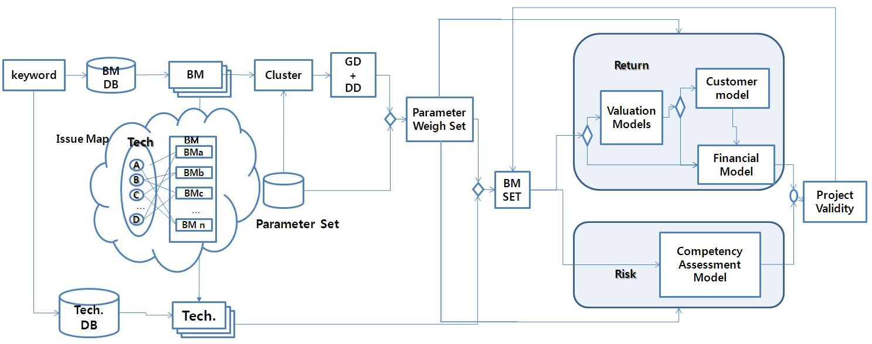
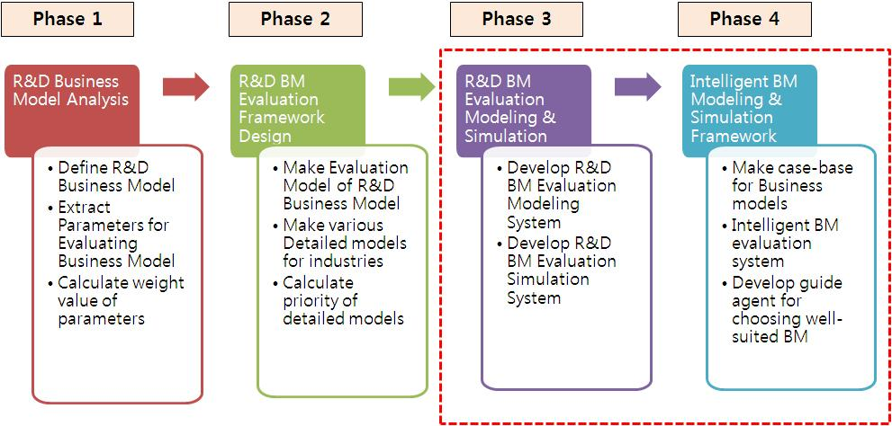
Developing R&D Business Modeling and Simulation System IM Kwang-Hyukª, LEE Sang-Chul^{b}, PARK Sang-Chan^{c} a Department of Electronic Commerce, Pai Chai University, 14 Yeonja-1-Gil, Seo-Gu, Daejeon 302-735, South Korea khim@pcu.ac.kr b Department of Management Information Systems, Korea Christian University, San 204, Hwagok 6-Dong, Kangseo-Ku, Seoul 157- 722, South Korea leecho@kcu.ac.kr c School of Business Administration, Kyung Hee University, 1 Hoegi-Dong, Dongdaemoon-Gu, Seoul 130-701, South Korea sangchan@khu.ac.kr
Introduction
R&D project's success rate has not increased. Success or failure of the R&D project is mainly decided by the external factors such as the exposure to the global R&D environment, diversification of the principal agent of R&D, competition, shorter and shorter R&D cycles and technological change than the internal factors. Therefore, we must respond to changes in external factors such as business, market, technology, and so on in execution of the R&D project.
Until now, we have derived and performed R&D project from a technical standpoint. In the future, we have to select R&D project that seems to be hot favorite for the business in the beginning of the R&D project. Therefore, feasibility analysis of the business model has to be conducted from the R&D planning stage.
R&D business M&S (Modeling & Simulation) system shows various commercialization models of target technologies that are developed by R&D activities and analyze economic feasibility of the commercialization models by the simulation.
We can describe the business models classified by Timmers, Rappa, and so on. We can describe the components proposed by Chesbrough and Rosenbloom, Amit and Zott, Mark W. J., and so on. Existing business models and components have relationship. If all business models have relationship a component, the component is selected common component(G.D). If a few business models have relationship a component, the component is selected distinguishing component(D.D).
Figure 2. Process of Business Model Evaluation
Framework of R&D business M & S system
R&D Business M&S(Modeling & Simulation) system has four major functions.
- Business modeling support system:
- Business model evaluation system
- Modeling & Simulation of business models
- Intelligent modeling and simulation
Development process for R&D business M&S system consists of four phases as shown in figure 1.
Figure 1. Development Process
Value evaluation of Business Model
The value of business model is evaluated by Return and Risk aspect. Return aspect means how much profit is returned by this business model. Risk aspect means how much risk is occurred by this business model. The Return and Risk evaluation model of business model has four components:
- Value Model: Define business value and business actors.
- Customer Model: Define target customers and analyze the characteristic of customer
- Finance Model: Formulate profit and Cost model in performance business
- Competency Assessment Model: Evaluate company(or organization)’s competency
Figure 2 show process of value evaluation of business model.
Conclusion
To increase R&D project's success rate, we should perform business model assessment as well as technical assessment in the R&D planning stage. This study proposes modeling and simulation system for evaluating business models utilized in the R&D planning stages.
The System shows various commercialization models of target technologies that are developed by R&D activities and analyze economic feasibility of the commercialization models by the simulation. Users can set up business model for new technology and can predict about the economic feasibility of the technology at the time of R&D planning, the system can simulate the priorities of the business models that increase economic value added through the R&D and can automatically recommend the best business model.
Business Model Components
In phase 1, we extract parameters for evaluating business model and calculate weight value of parameters.
To extract the parameters of our business model evaluation, we analyze correlation between business models classified by existing criteria and components proposed by many researchers. If we can extract common components and distinguishing components of existing business models with correlation analysis, it is quite probable that the extracted components are selected as a parameter for evaluating.

