Slide 1

Integrating Terminal-based Communication and Collaboration: Enhancing Developer Productivity
(Zeroth Review)
Done by:
¹VLADIMIR JOSH - 211061101508
²VAIBHAV MUNDRA - 211061101482
³NAGA MANIKANTA - 211061101481
COORDINATORS:
Mrs. ¹SONIYA PRIYATHARSHANI
Mr. ²G.SENTHIL VELAN

Slide 2
CONTENTS
Objective
Abstract
Literature Survey
Existing System
Proposed System
Conclusion
References:
Abstract – Xinlong Yu, Hong Liu
Authors: Vladimir Josh, Vaibhav Mundra, Naga Manikanta

Slide 3
OBJECTIVE
This interaction model fosters a streamlined workflow, particularly suited to tasks that require frequent and repetitive commands.
Our tool incorporates Vim-like motions into the TUI environment.
By enhancing TUIs, this aims for advanced navigation features, and real time collaboration features.

Slide 4
ABSTRACT
In recent years, terminal user interfaces (TUIs) have re-emerged as powerful tools for developers, offering simplicity and efficiency that graphical user interfaces (GUIs) often lack.
However, many existing TUIs fail to seamlessly integrate modern development workflows with the intuitive, fast navigation that advanced text editors like Neovim provide.
This work merges classic TUIs with modern text editors for a streamlined, productive developer environment.

Slide 5

Literature Survey
S. No | Title of paper | Author/Year | Description | Journal Name
1 | Using Terminal-based apps for Data Exchanging in Web Service Applications | Dunlu PENG, Lidong CAO(2022) | presents comparison of XML and JSON and how XML is inefficient as it needs to be parsed before it can be consumed both at the client and server end and can be improved through terminal emulation | Popular mechanics magazine
2 | Terminals on Mobile: is there an Efficient TUI | Ricardo Queirós (2023) | The author under the research paper titled “Terminals on Mobile: is there an Efficient TUI?” talks about the two major battery consumption reasons on mobile devices wherein one is Display and the other one is Network operations | New Scientist
3 | The Terminal data exchange network | T. Bray, Ed. (2023) | presents rectifications to the earlier RFC detailing the standards and formatting rules to be followed for transmission of data in using Terminal user interfaces. | Science Advances

Slide 6
Literature Survey
S. No | Title of paper | Author/Year | Description | Journal Name
5 | GZIP file format specification version 4.3 for Terminals | P. Deutsch (2019) | presents specifications around compression techniques for all the Terminal data that gets transmitted over the internet. | Nature
6 | Terminal superplexer format and emulator | D. Crockford (2008) | talks about the standards and formatting rules to be followed for transmission of data in using JSON on Wezterm terminal. | New Scientist
7 | TUI Rules | Adrian Giurca (2020) | Rule Language” which is based on Vimscript thereby providing Terminal 2.0 based applications rule based deduction capabilities. | Science Advances

Slide 7

Existing System
Vim and Emacs:
Vim and Emacs have long been pillars of text-based development environments. Vim's modal editing and powerful text manipulation capabilities make it a favorite for many developers.
Despite the strengths of these existing systems, several shortcomings highlight areas for improvement:
Lack of Integration
Limited Colloborative features
Absence of Intelligent Assistance

Slide 8

Proposed System
Vim-like Motions:
The chat application will support Vim-like motions, allowing users to navigate through messages, code snippets, and threads with the same efficiency and fluidity as they would in a text editor like Neovim.
Code Sharing with LSP and Tree-sitter Integration:
Users will be able to share code snippets seamlessly within the chat.

Slide 9
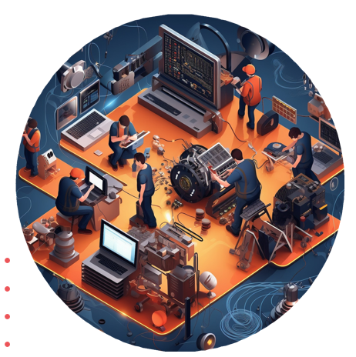
Enhancing Developer Productivity
Terminal-based communication and collaboration are essential for modern software development. Integrating these tools can significantly improve developer productivity by streamlining workflows, fostering team coordination, and facilitating seamless information exchange.

Slide 10
Frontend Frameworks for TUIs
Ncurses
Textual
Blessings
Urwid
Brick ncurses is a widely used library for creating text-based user interfaces. It provides functions to manipulate the terminal screen, handle user inputs, and manage windows and panels.

Slide 11
CONCLUSION:
Challenges and Considerations:
Complexity: Building a TUI from scratch requires handling low-level details and can be time-consuming. It involves managing the state of the terminal and ensuring compatibility across different terminal emulators.
Portability: Ensure that the escape codes used are supported by all target terminals. While most modern terminals support ANSI escape sequences, there can be variations in implementation.

Slide 12
THANK
YOU

