Slide 1

INTEGRATING TERMINAL-BASED COMMUNICATION AND COLLABORATION: ENHANCING DEVELOPER PRODUCTIVITY
Second Review
PROJECT COORDINATOR
Dr.G.Sonia Priyatharshini/Prof – CSE
Mr.G.Senthil Velan/Asst.Prof – CSE
PROJECT GUIDE
Dr.M.Anand
Presented by:
Mr. Vladimir Josh (211061101508)
Mr. Vaibhav Mundhra (211061101482)
Mr. Naga Manikanta (211061101481)
Notes:
The Integrated Developer Collaboration Suite (IDCS) is a powerful terminal-based platform designed to enhance developers' productivity and collaboration. By offering a clean, minimalist interface, IDCS integrates key developer features like live syntax parsing, GitHub integration, and ChatGPT-powered assistance. This suite is specifically built for developers who value efficiency and streamlined workflows. Whether you're coding solo or collaborating with a team, IDCS redefines the terminal-based development environment with cutting-edge functionality.

Slide 2
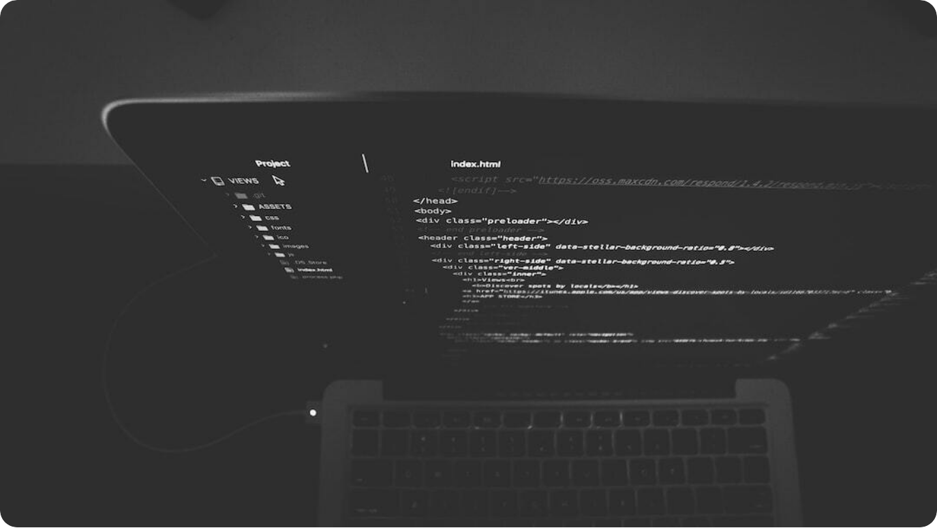
Introduction to Integrated Developer Collaboration Suite (IDCS)
Revolutionizing Terminal-Based Developer Tools
Aimed at modern developers: IDCS enhances terminal-based developer workflows, focusing on collaboration, code sharing, and seamless communication.
Efficiency and Streamlined Workflow: Designed with performance and efficiency in mind, IDCS supports advanced features for improved productivity.
Minimalist and Sophisticated Interface: IDCS's design integrates essential developer tools with a clean and intuitive interface for an optimized user experience.
Photo by Nate Grant on Unsplash
Notes:
The Integrated Developer Collaboration Suite (IDCS) is a powerful terminal-based platform designed to enhance developers' productivity and collaboration. By offering a clean, minimalist interface, IDCS integrates key developer features like live syntax parsing, GitHub integration, and ChatGPT-powered assistance. This suite is specifically built for developers who value efficiency and streamlined workflows. Whether you're coding solo or collaborating with a team, IDCS redefines the terminal-based development environment with cutting-edge functionality.

Slide 3

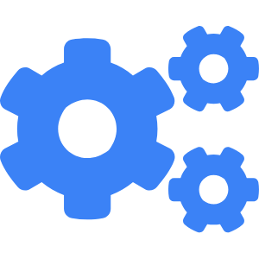

The Problem with Current Tools
Challenges in Terminal-Based Development
Lack of Collaboration Features
Current terminal-based tools are limited in terms of collaboration, hindering seamless communication and team workflows.
Inefficient Workflow
Many terminal tools require complex setups and manual steps, making workflows slower and more error-prone.
Poor Integration with Modern Tools
Current tools lack robust integrations with popular platforms like GitHub, limiting developers' ability to track projects and share code easily.
Notes:
Current terminal-based developer tools often fall short in providing the features that modern development workflows demand. While powerful, they typically lack built-in collaboration capabilities, which can hinder communication between developers. Additionally, these tools often require manual configuration and don't offer seamless integrations with modern tools like GitHub, slowing down the development process. The absence of real-time collaboration or code sharing makes it harder to work efficiently in team environments. IDCS aims to address these issues and revolutionize the terminal-based development experience.

Slide 4
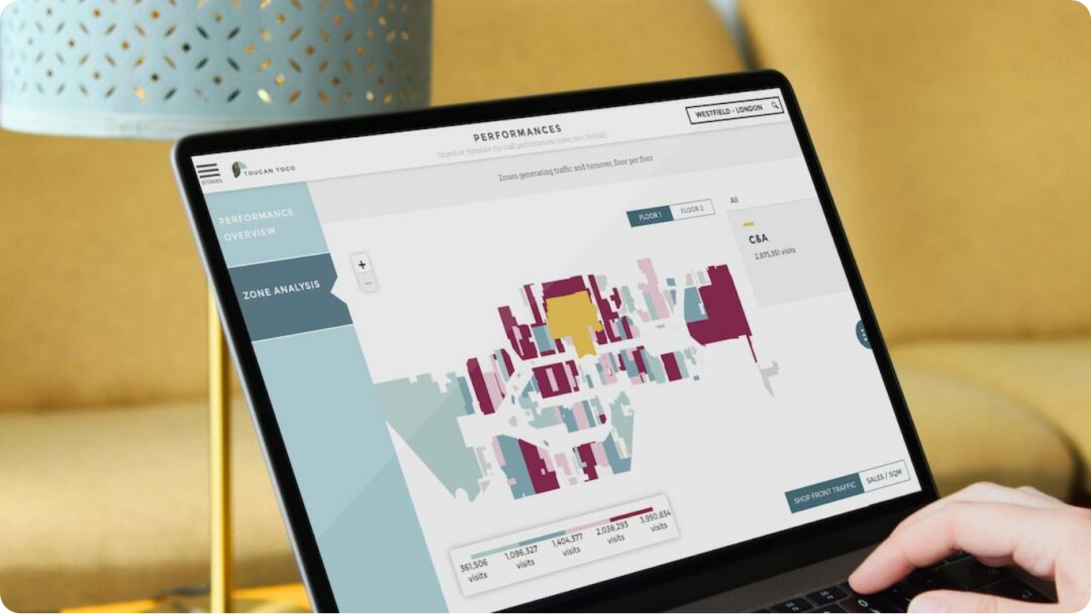
Key Features of IDCS
Powerful Tools for Modern Developers
Live Syntax Parsing (LSP): Provides real-time code validation and contextual editing, ensuring your code is always error-free.
ChatGPT Assistance: AI-powered code generation, suggestions, and automated refactoring to enhance developer efficiency.
GitHub Integration: Seamless integration with GitHub for version control and project tracking, facilitating collaborative coding.
Photo by Adrien WIESENBACH on Unsplash
Notes:
IDCS comes equipped with several powerful features that make it stand out in the terminal-based development space. The Live Syntax Parsing (LSP) ensures that developers can validate their code in real-time, making editing faster and more accurate. The ChatGPT-based assistance empowers developers with on-the-fly code generation, contextual suggestions, and automated refactoring. Furthermore, seamless GitHub integration makes it easier to track changes, share code, and collaborate in real time. These features come together to create a fully integrated, efficient, and collaborative development environment.

Slide 5
Live Syntax Parsing (LSP)
Real-time Code Validation and Contextual Editing
Error-Free Code: Live Syntax Parsing ensures your code is error-free in real-time, reducing the likelihood of bugs.
Contextual Editing: Enables smarter, context-aware code suggestions, improving coding speed and accuracy.
Faster Development Cycles: Real-time feedback helps reduce back-and-forth between editing and testing, speeding up development.
Photo by Nate Grant on Unsplash
Notes:
Live Syntax Parsing (LSP) is one of the core features of IDCS, providing real-time feedback as developers write code. This ensures that errors are caught instantly, leading to fewer bugs and higher code quality. LSP also empowers developers with contextual editing, meaning code suggestions are relevant to the specific context of the code being written, helping developers write more efficiently. With faster error detection and smarter suggestions, LSP accelerates the development cycle, allowing developers to focus on building instead of debugging.

Slide 6
Syntax Highlighting with Tree-sitter
Enhancing Code Readability in Real-Time
Improved Readability: Tree-sitter enables real-time syntax highlighting, making code easier to read and understand.
Contextual Awareness: Tree-sitter provides context-aware highlighting, enhancing developers' ability to focus on relevant code sections.
Dynamic Parsing: Code is parsed dynamically, which reduces the time it takes to display syntax highlights as developers type.
Photo by Nate Grant on Unsplash
Notes:
Tree-sitter provides dynamic and real-time syntax highlighting, significantly improving the readability of code in IDCS. As developers write, the tool parses the code and highlights syntax in a way that makes the code easier to understand. This highlighting is context-aware, meaning the color-coding adjusts based on the context of the code. The result is an efficient coding environment that helps developers focus on the important sections of their code. This dynamic parsing capability ensures that code is highlighted almost instantly, which is key for a smooth and productive development experience.

Slide 7



ChatGPT Assistance
AI-Powered Code Generation and Suggestions
In-line Suggestions
ChatGPT offers contextual, in-line code suggestions, helping developers write faster and more accurately.
Automated Code Refactoring
ChatGPT helps automate code refactoring, ensuring cleaner and more maintainable code.
Real-Time Troubleshooting
With AI-driven error detection, developers get real-time solutions for issues as they code.
Notes:
The integration of ChatGPT into IDCS brings AI-powered code assistance to developers in real-time. Whether it's offering in-line suggestions, automating code refactoring, or troubleshooting errors, ChatGPT enhances the developer's experience by providing quick, context-sensitive assistance. This allows developers to stay focused on their tasks without spending time searching for solutions or debugging. By leveraging AI, IDCS turns coding into a more efficient and less error-prone process, making developers' lives easier.

Slide 8
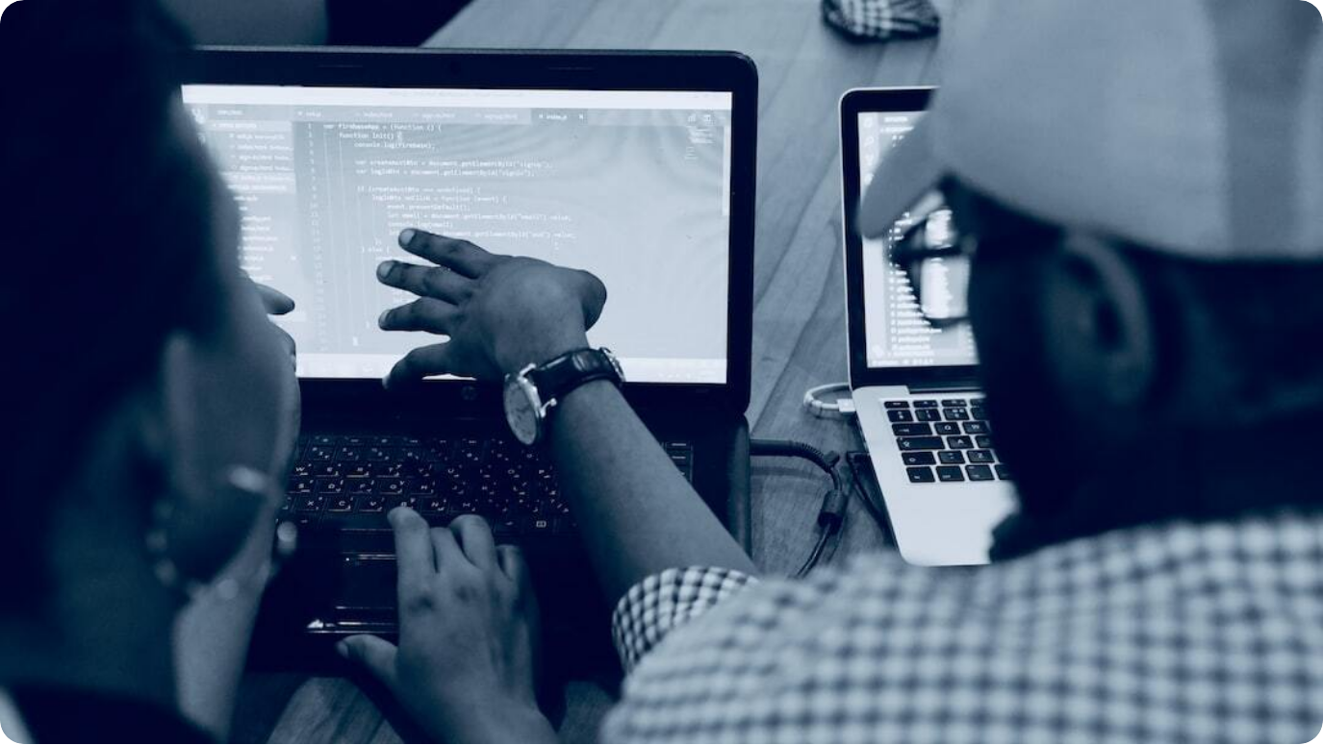
GitHub Integration
Seamless Version Control and Project Tracking
Version Control: IDCS integrates with GitHub for easy version control and seamless code sharing across team members.
Project Tracking: Track and manage development progress directly from the terminal with GitHub project tracking integration.
Collaboration: IDCS's GitHub integration fosters better collaboration, allowing developers to share code efficiently and manage pull requests.
Photo by Desola Lanre-Ologun on Unsplash
Notes:
GitHub integration is at the core of IDCS, allowing developers to easily manage code with version control and track project progress. By syncing with GitHub, IDCS provides a seamless experience for collaboration, enabling developers to share code, manage pull requests, and track issues directly from the terminal. This integration removes friction in managing project changes and enhances productivity, making version control a natural part of the development workflow.

Slide 9
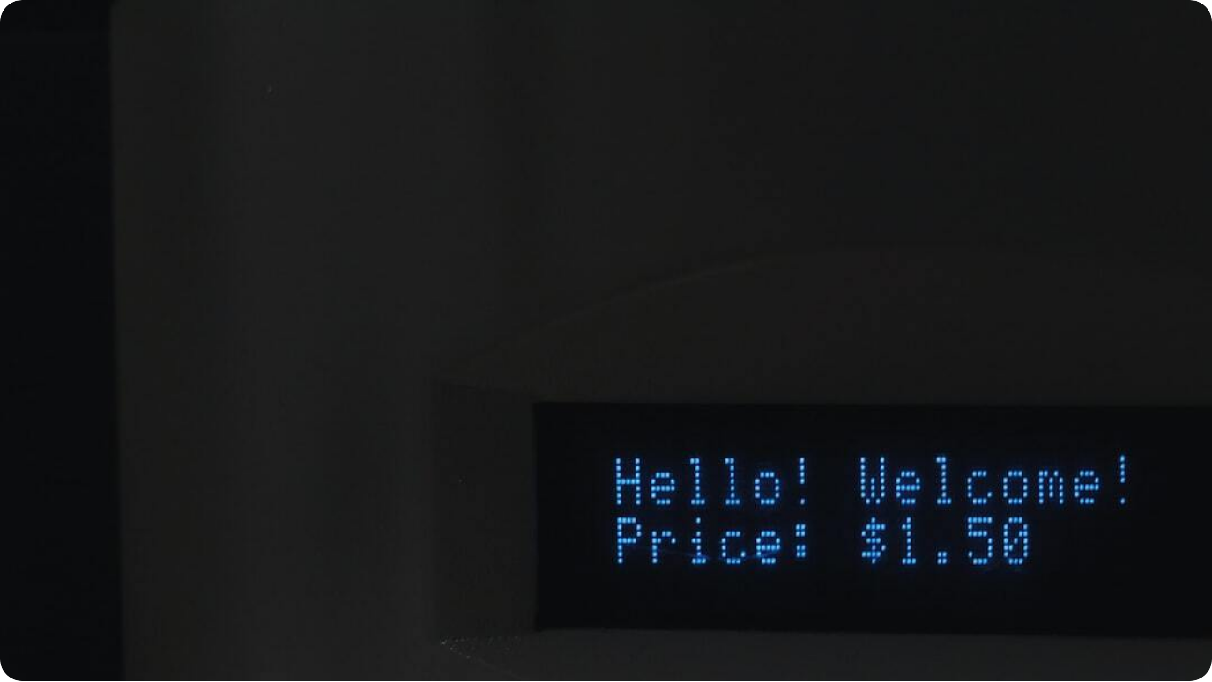
Neovim-inspired Motion & Commands
Efficient Navigation with Vim-like Shortcuts
Familiar Navigation: IDCS uses Vim-like keybindings for fast and efficient navigation, reducing the learning curve for developers familiar with Neovim.
Keyboard-Driven Interaction: All commands can be executed via the keyboard, allowing developers to work without relying on a mouse or additional input devices.
Rapid Development: Neovim-inspired motions and commands streamline common tasks, speeding up the development process and improving workflow efficiency.
Photo by Algernai Hayes on Unsplash
Notes:
Inspired by Neovim, IDCS integrates Vim-like motions and commands for rapid navigation and task execution. Developers who are familiar with Neovim's keybindings will feel right at home, making the transition to IDCS seamless. The platform supports keyboard-driven interaction, meaning that developers can navigate, edit, and perform actions quickly without the need to switch to a mouse. These commands help speed up development by making repetitive tasks faster and more efficient.

Slide 10
Customization & Efficiency
Tailoring the Development Experience
Highly Customizable Design: IDCS provides a customizable environment where developers can adjust settings, themes, and functionalities to suit their workflow.
Efficient Workflow Integration: Customization options allow for better integration with existing workflows, streamlining tasks and improving productivity.
Performance Optimization: IDCS is built to be lightweight and efficient, ensuring fast performance even with large codebases or complex workflows.
Photo by Nate Grant on Unsplash
Notes:
IDCS is designed to be highly customizable, giving developers the flexibility to tailor their terminal environment to their specific needs. From changing themes to adjusting functionality, the platform allows users to create a personalized workflow that maximizes their productivity. IDCS's lightweight design ensures that performance is never compromised, even when dealing with large codebases or resource-intensive tasks. This focus on customization and performance makes IDCS a powerful tool for developers who demand both flexibility and speed.

Slide 11
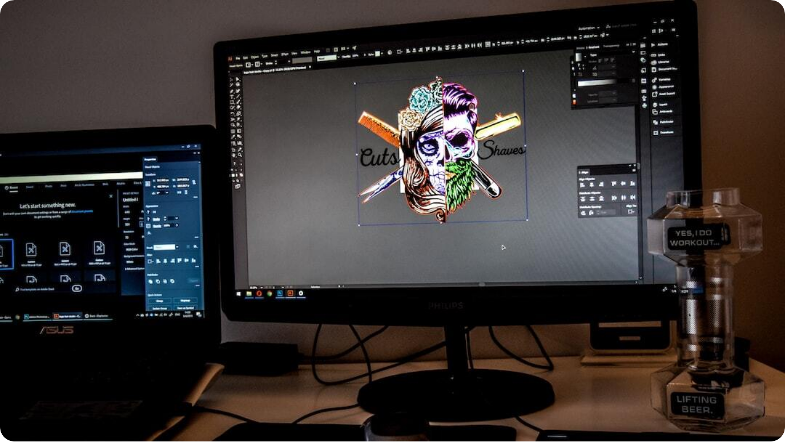
Usability and Performance
Optimized for Developer Experience
Lightweight Design: IDCS is designed to be lightweight, ensuring fast performance without unnecessary overhead.
Efficient Resource Usage: Optimized to run efficiently, IDCS minimizes resource usage, even when managing large codebases.
Smooth User Experience: IDCS provides a streamlined and responsive interface, enhancing the overall developer experience.
Photo by Digitawise Agency on Unsplash
Notes:
IDCS’s performance is a standout feature. Designed with speed and responsiveness in mind, IDCS provides developers with a highly efficient environment. Its lightweight design ensures that it runs smoothly even with large codebases or resource-intensive tasks, without compromising on usability. The system’s efficient resource usage allows developers to focus on their code, rather than dealing with lag or performance issues. Together, these elements create a seamless and productive development experience.

Slide 12


Collaborative Development
Fostering Team-Based Coding in Real-Time
Real-Time Collaboration
IDCS supports real-time collaboration, allowing developers to code and troubleshoot together instantly.
Seamless Code Sharing
Share your code effortlessly with teammates, thanks to built-in GitHub integration and instant syncing.
Instant Feedback
Collaborators can provide instant feedback on code, improving the development process and accelerating project timelines.
Notes:
IDCS enhances the collaborative development experience by allowing developers to work together in real time. With seamless code sharing through GitHub integration and instant feedback loops, developers can rapidly troubleshoot and enhance each other's work. Real-time collaboration ensures that teams can stay in sync and improve code quality more effectively, which is essential for fast-paced development environments.

Slide 13

Competitive Advantage
How IDCS Stands Out in the Developer Ecosystem
Enhanced Collaboration
IDCS offers real-time collaboration, setting it apart from traditional terminal tools and basic text editors.
AI-Powered Assistance
With ChatGPT integration, IDCS delivers in-line code suggestions, refactoring, and troubleshooting, a feature not commonly found in terminal apps.
Modern Integrations
Unlike traditional terminal apps, IDCS integrates seamlessly with GitHub for version control and project tracking, streamlining development workflows.
Notes:
IDCS offers several competitive advantages over traditional terminal tools. First, its real-time collaboration feature empowers developers to work together seamlessly, something that most terminal-based tools lack. The integration of ChatGPT adds AI-powered assistance, allowing developers to generate code, refactor, and troubleshoot on the fly. Furthermore, with modern integrations like GitHub, IDCS simplifies version control and project tracking, which is crucial for efficient teamwork. These features position IDCS as a next-generation tool for developers who want to boost productivity and collaboration.

Slide 14


Conclusion & Future Outlook
The Future of Developer Tools with IDCS
Revolutionizing Developer Collaboration
IDCS transforms terminal-based development by enabling real-time collaboration and AI-powered assistance.
Fostering a Developer-First Environment
With customization, performance optimization, and modern integrations, IDCS creates a streamlined development environment.
Future Developments
The potential for IDCS to further integrate with emerging technologies, including AI and advanced version control systems, is vast.
Notes:
IDCS is set to revolutionize the way developers collaborate and code in the terminal. By integrating powerful tools like real-time collaboration, AI-driven code suggestions, and modern integrations with GitHub, IDCS creates a developer-first environment that maximizes productivity. As technology continues to evolve, the future of IDCS looks bright, with opportunities for further integration of AI, advanced version control, and other cutting-edge features to keep developers at the forefront of innovation.

Slide 15
THANK YOU

