Slide 1















WARCAST
-News aggregator-
Presented by : Pune Institute of Computer Technology [PICT]
- Yuvraj Sanghai
- Pranjal Sapkale
- Gopal Dose
- Hanishka Baviskar

Slide 2
Problem Statment :
The Challenge:
In today’s digital age, there is an overload of news content, making it difficult for users to find and access strategic defense-related news that is relevant to their interests. Current news aggregators focus primarily on general news, leaving a gap in the market for highly specific, curated content tailored to user preferences.
Impact:
Professionals in the defense and strategic sectors struggle to keep up with critical news amidst a flood of irrelevant information. There is a growing need for tools that provide targeted, personalized news to enhance decision-making and awareness.

Slide 3
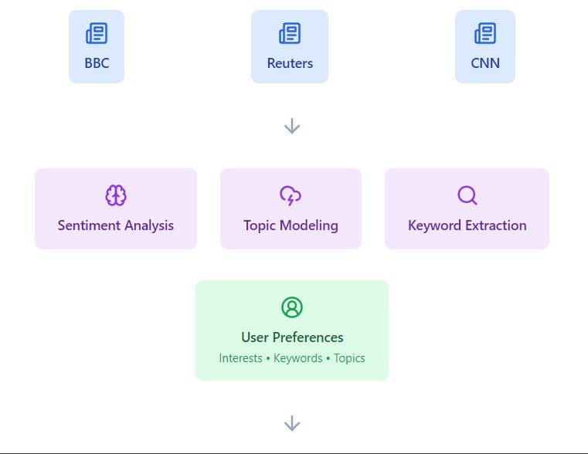
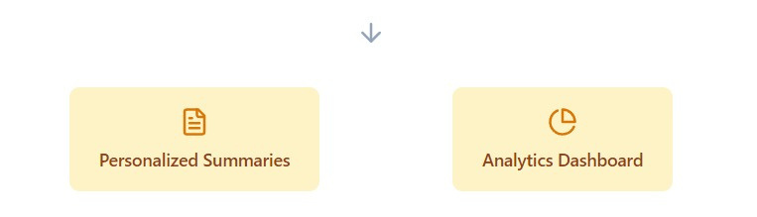
Solution :
Proposed Solution:
-Build an AI-based web and mobile news aggregator that collects and recommends strategic defense-related news from both domestic and international sources.
-Use NLP (Natural Language Processing) for content analysis, summarization, and sentiment detection.
-Provide users with personalized recommendations based on their preferences and feedback.

Slide 4
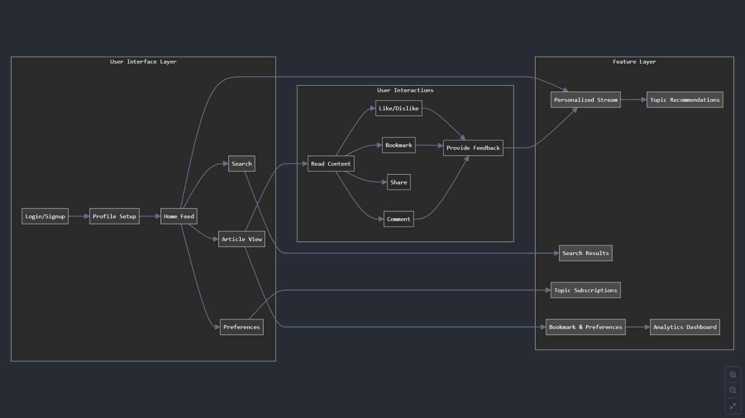
App Flow:

Slide 5
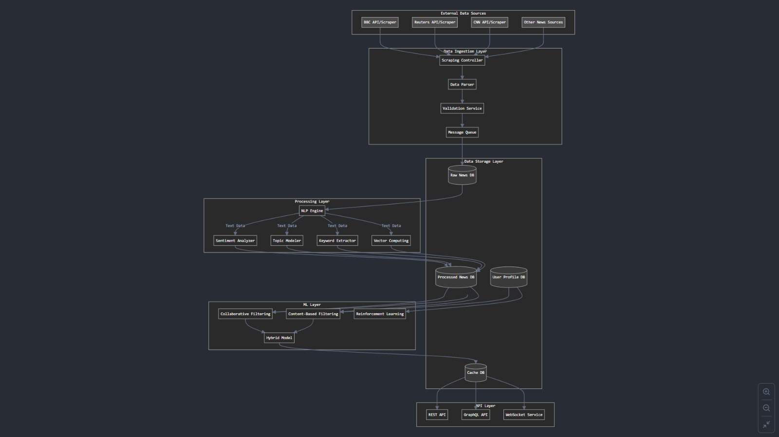
Data Flow :

Slide 6












Tech Stack :
APIs :
Google Translate API
Google Cloud Natural Language API
Google Cloud Sentiment Analysis API
Google Recommendations AI API
Google Cloud Storage API

Slide 7
Data Cleaning
&
Preprocessing Methods
01
02
03
04
Data Cleaning Process :
Handle Missing Data:
Enhanced Process:
Instead of simply dropping missing rows or filling them with placeholder values:
Log rows being dropped or handled.
Raise warnings for rows missing critical fields to notify the data quality team.
Use batch processing to ensure scalability across millions of records.
:
Remove Duplicates:
Enhanced Process:
Use hashing techniques to identify duplicate articles based on key columns (title, link, summary), ensuring better performance with large datasets.
Normalize Text Data:
Enhanced Process:
Use vectorized operations and parallel processing for large datasets.
Regex handling for complex text patterns
Standardize Dates:
Enhanced Process:
Specify date formats for faster parsing and log invalid dates for investigation

Slide 8
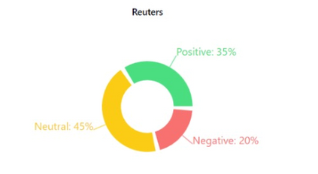
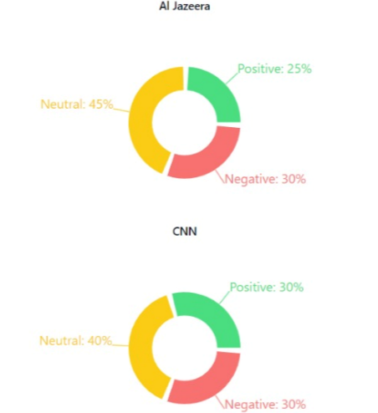
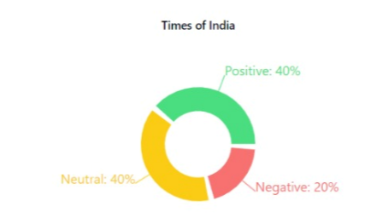
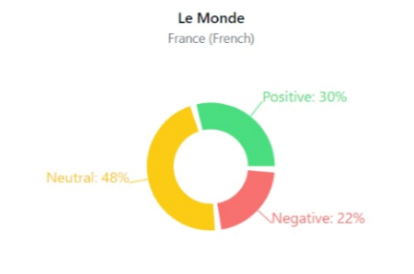
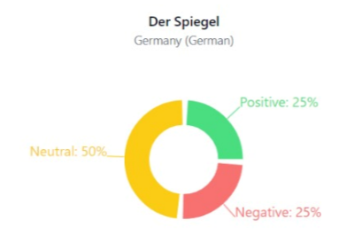
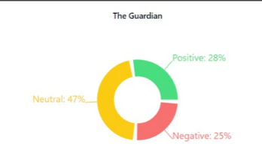
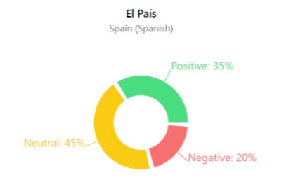
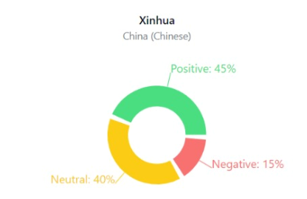
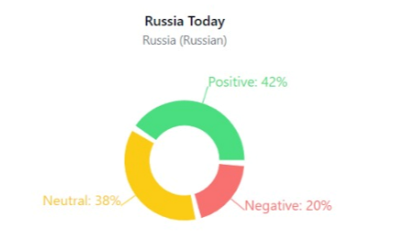
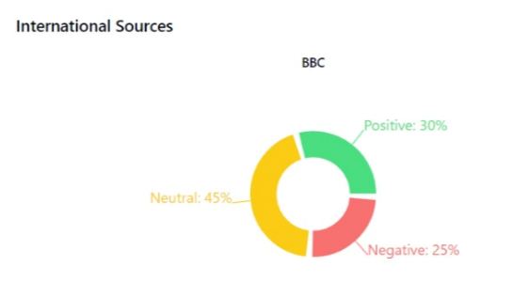
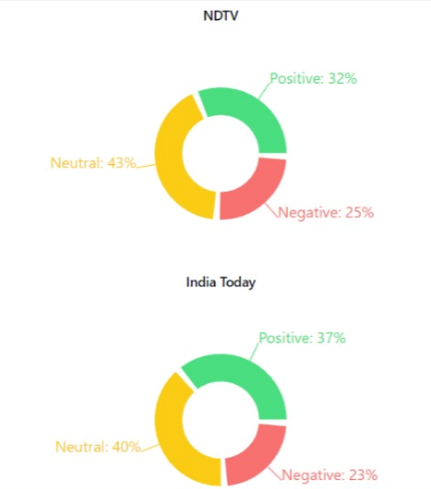
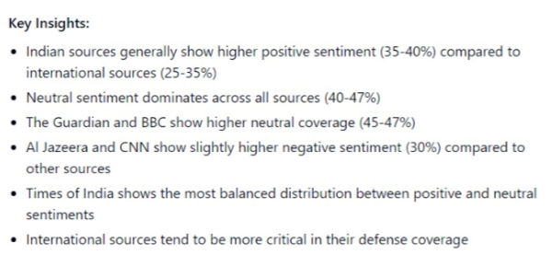
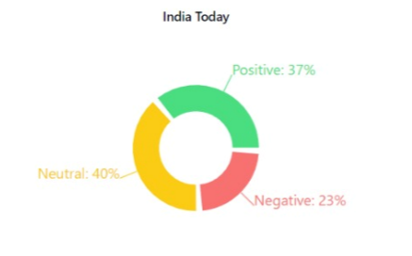
Sentiment Analysis:

Slide 9
Model Development Algorithm
( Personalized News Aggregator ) :
1. Data Collection (Web Scraping)
Use tools like BeautifulSoup, Selenium, or NewsAPI to collect news articles (titles, summaries, text, etc.).
Store the data in MongoDB or CSV for further processing.
2. Data Preprocessing
Content-Based: Tokenize and generate BERT embeddings for article content.
Collaborative Filtering: Create a user-item interaction matrix (clicks, likes).
3. Content-Based Model (BERT)
Fine-tune BERT to extract article embeddings for predicting user interactions.
4. Collaborative Filtering Model
Use self-attention to model user-item interactions.
5. Hybrid Transformer Model
Combine predictions from the content-based and collaborative filtering models.
6. Training
Use Binary Cross-Entropy Loss and optimize with Adam.
7. Evaluation
Measure performance using Precision, Recall, F1-Score, and ROC-AUC.
8. User Feedback
Continuously update the model based on user interaction data to improve recommendations.

Slide 10
Sentiment Analysis &
Text summarization Algorithm :
1.Sentiment Analysis
Goal: Classify news articles as positive, neutral, or negative.
Method:
Text Cleaning: Remove unnecessary elements and tokenize.
Model: Use VADER or BERT to classify sentiment:
Positive: Score > 0.05
Neutral: -0.05 ≤ Score ≤ 0.05
Negative: Score < -0.05
Articles are tagged with sentiment labels for filtering.
2. Text Summarization
Goal: Generate concise summaries (100-150 words).
Method:
Extractive Summarization: Use TextRank to extract key sentences.
Ideal for shorter, straightforward content.
Abstractive Summarization: Use BART or T5 to rewrite summaries.
Suited for longer, complex articles.

Slide 11
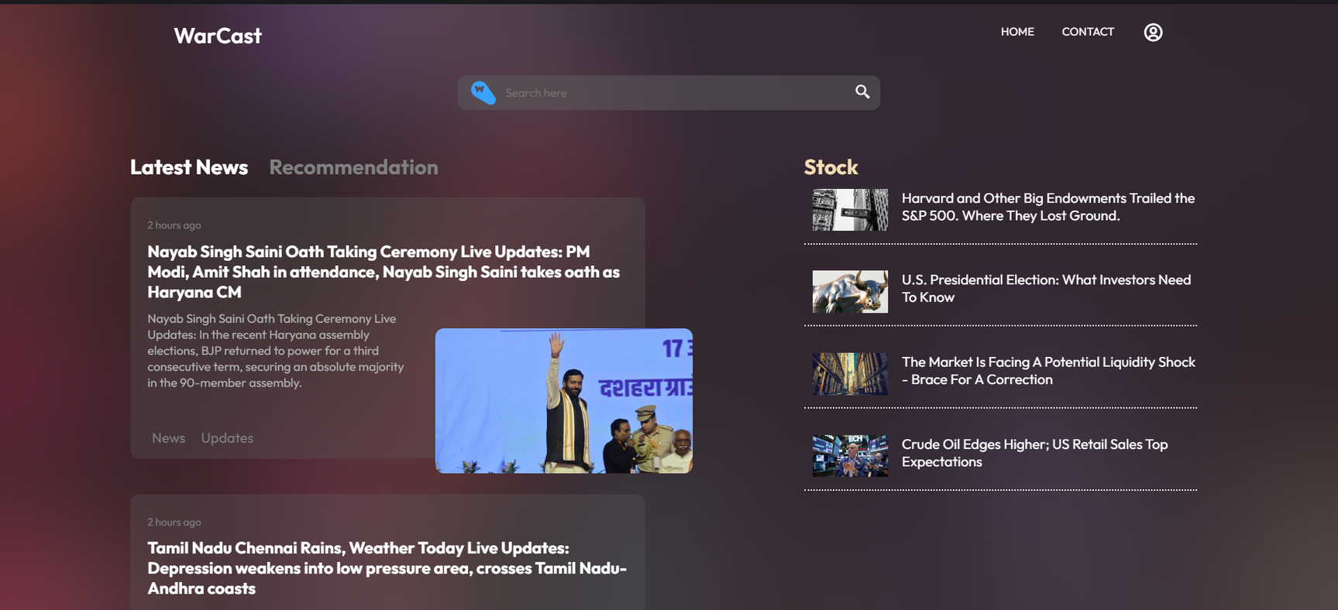
MVP :
Multilingual News Aggregation
Real-Time Translation
User Preference Customization
Global Reach and Coverage
User-Centric Feedback Mechanism
Seamless User Interface
Scalable and Adaptive
output metrices
Metric | Value
Precision | 0.65
Recall | 0.60
F1-Score | 0.62
AUC-ROC | 0.70

Slide 12
Thank you very much!

