Slide 1
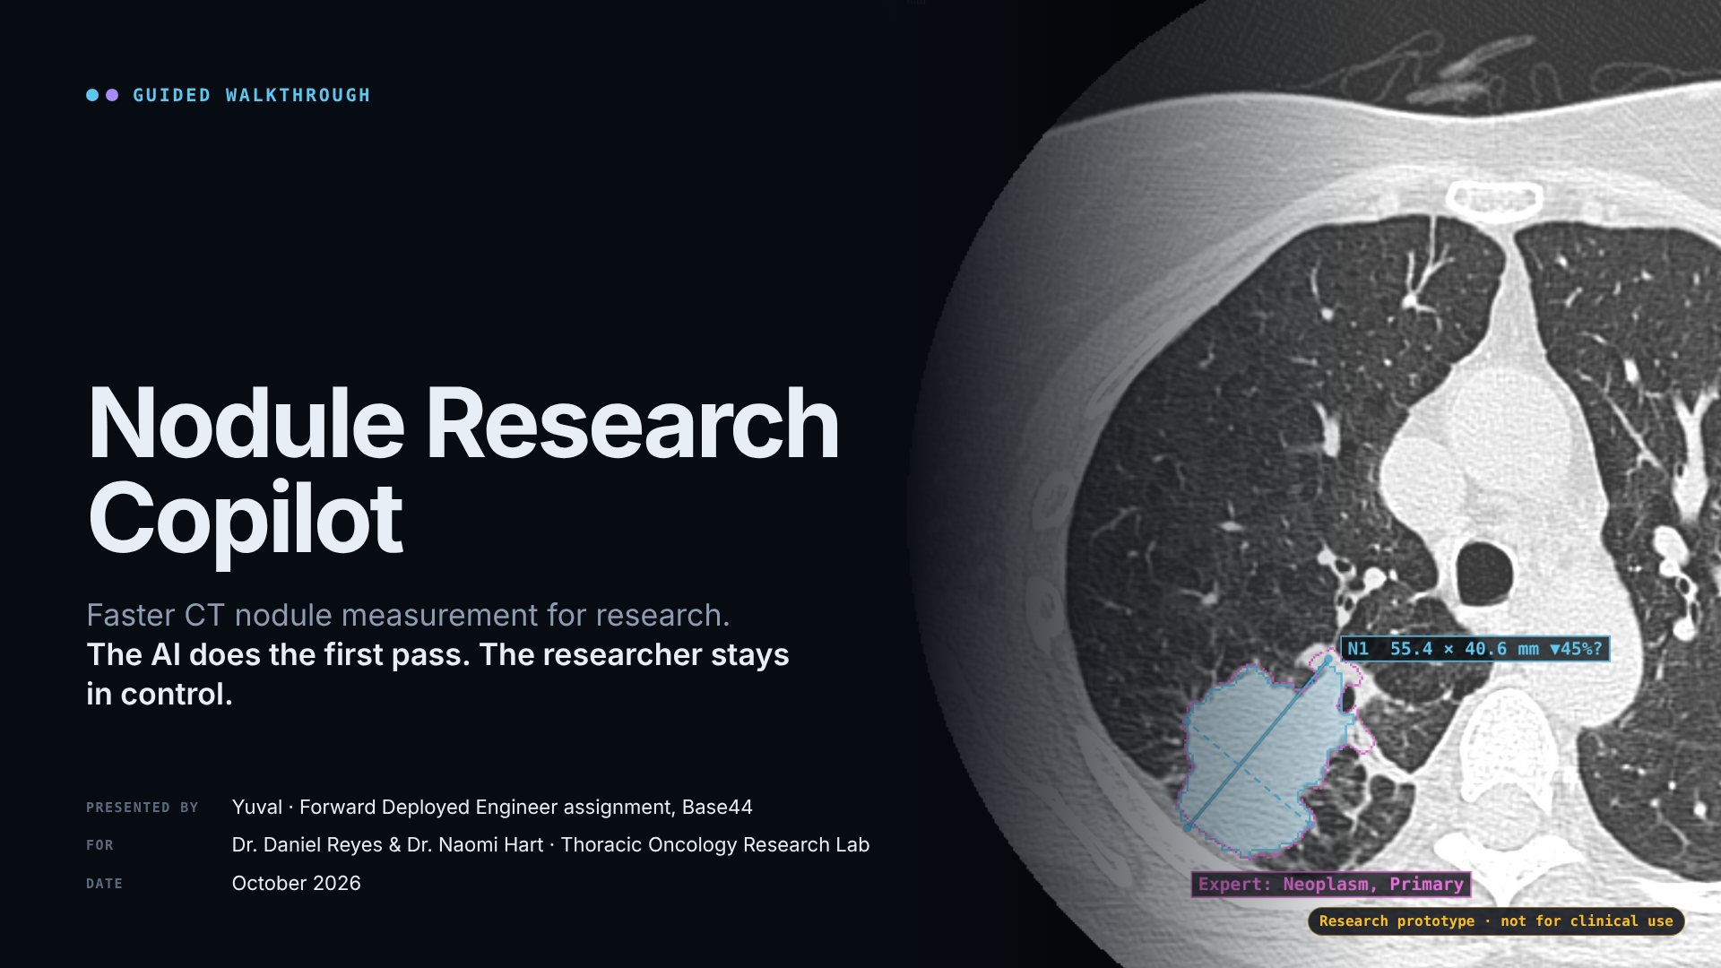
Notes:
· Nodule Research Copilot (0.5 min)
- "I'm Yuval. This is a research tool for your lab: the AI does the first pass on a chest CT, and you stay in
control of every number."
- Point at the image: a real public scan, with the AI outline and the expert's outline. Research prototype, not
for clinical use.

Slide 2
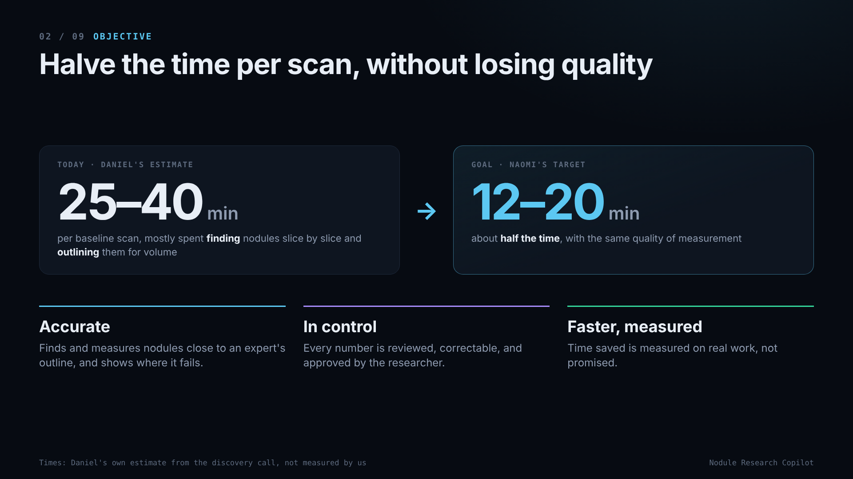
Notes:
· Objective (1.5 min)
- Today: 25–40 minutes per baseline scan, in Daniel's own estimate (E1). Most of it is finding nodules (10–20 min,
two passes through 250–400 slices) and outlining for volume (15–25 min per nodule, which is why he only does it
for about 1 in 5). The rest: ruler measurements, re-typing into the sheet, and ~10 min extra on follow-ups.
- Goal: about half (Naomi's target, E2), so 12–20 minutes.
- Three tests for success: accurate, in his control, and faster as *measured*, not promised.

Slide 3
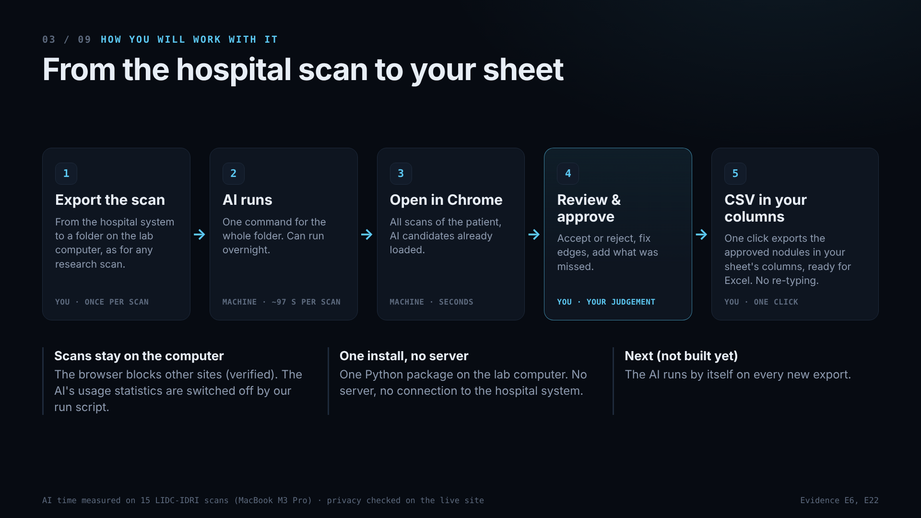
Notes:
· From the hospital scan to your sheet (2 min)
- Walk left to right. He exports the scan as for any research scan → one command runs the AI (~97 s per scan,
measured; can run overnight) → he opens the folder in Chrome → he reviews, fixes and approves → one click exports
the approved nodules as a CSV in his sheet's columns (opens in Excel).
- Only step 4 needs his judgement; step 5 is one click. The rest is machine time.
- Scans stay on the lab computer: the browser blocks connections to other sites (verified, E22). The AI model
sends anonymous usage statistics by default; our run script switches that off before every run.
- Setup is one Python install (TotalSegmentator) on the lab computer. No server and no hospital connection, so no
integration project. Whether installing Python on a hospital laptop needs IT sign-off is their policy; ask.
- Honest: export and the AI command are manual today. Next (not built): the AI runs by itself on new exports.
Writing results back to the hospital system only if the hospital wants it (standard DICOM SEG).

Slide 4
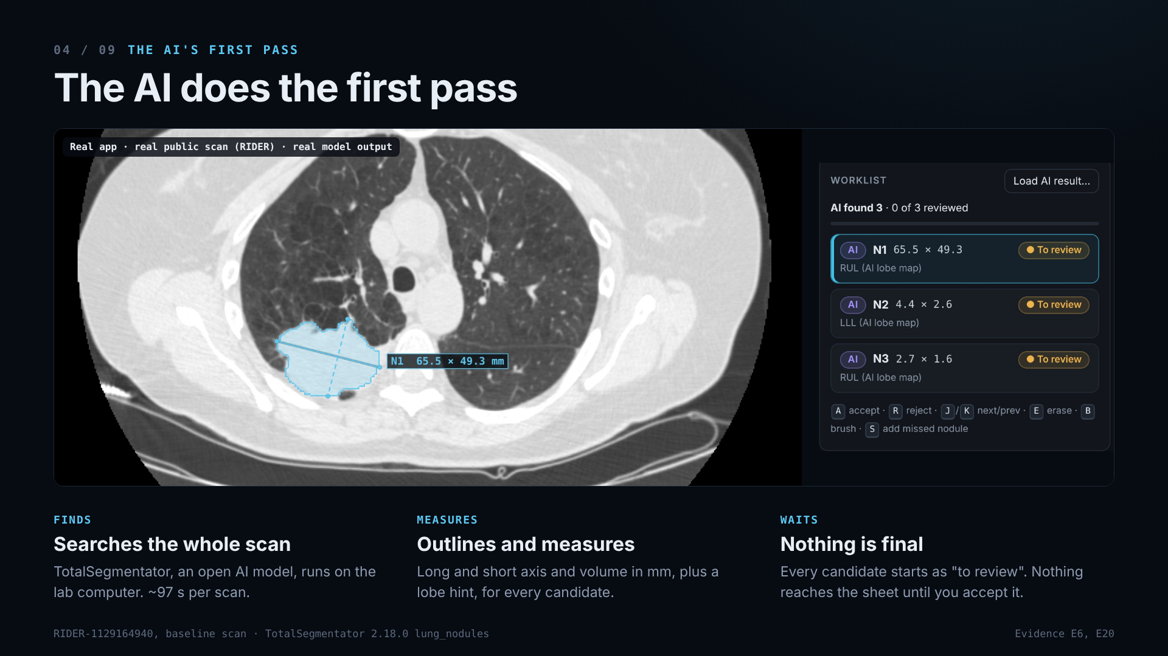
Notes:
· The AI does the first pass (1.5 min)
- A real screenshot: public RIDER scan, real output of TotalSegmentator 2.18.0, an open model. It searched the
whole scan, and nothing told it where to look (E20).
- Each candidate is outlined in 3-D and measured: long and short axis on the largest slice, volume from the voxels,
plus a lobe hint from the AI's lung-lobe map.
- Here: N1 65.5 × 49.3 mm (79.7 mL), plus two tiny candidates. All start as "to review".

Slide 5
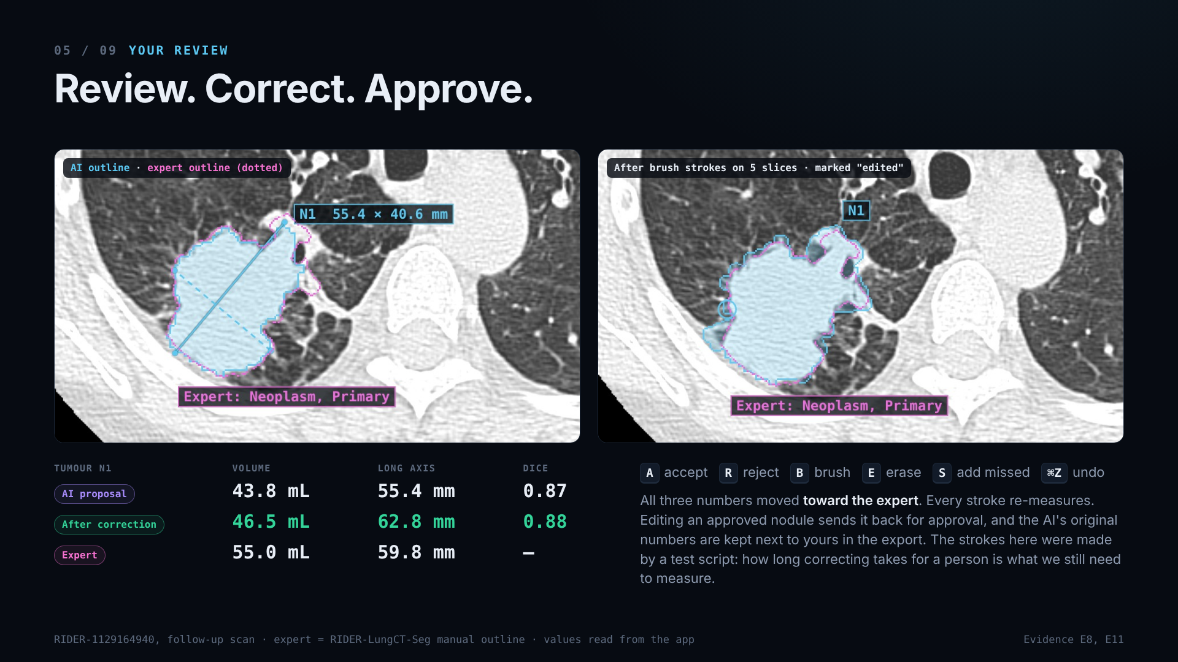
Notes:
· Review. Correct. Approve. (2 min)
- Left: the AI outline (cyan) and the expert's (dotted magenta). Right: after brush strokes on 5 slices.
- All three numbers moved toward the expert: volume 43.8 → 46.5 mL (expert 55.0), long axis 55.4 → 62.8 mm
(expert 59.8, error 4.4 → 3.0 mm), Dice 0.87 → 0.88 (E8). Every stroke re-measures, so a wrong stroke shows at
once and is one undo away.
- Say plainly: the strokes were made by our test script, so this shows the mechanism, not how long it takes a
person. Correction time is the open question (slide 8).
- Keys: A accept, R reject, B brush, E erase, S click to add a missed nodule (logged as added by the researcher), ⌘Z undo.
- If he edits a nodule he already approved, it goes back to "Re-approve" and is left out of the export until he accepts
it again. The AI's original numbers stay in the export next to his.
- A nodule outlined on one slice only gets diameters, no volume; the app says so.

Slide 6
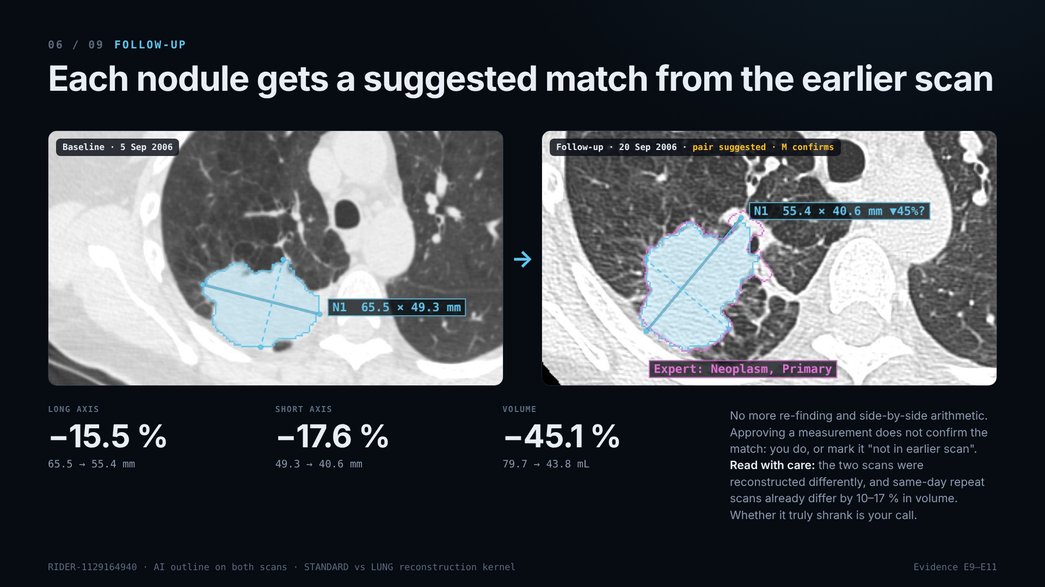
Notes:
· Each nodule gets a suggested match from the earlier scan (1.5 min)
- Baseline 5 Sep 2006 and follow-up 20 Sep 2006, same patient. The app paired N1 with its earlier self (38 mm
apart, closest first) and computed the change. The "?" stays until he confirms:
accepting the measurement (A) does not confirm the match. M confirms it; "Not in earlier scan" records no match (E9).
- Caution: the two scans were reconstructed differently (STANDARD vs LUNG kernel), there is no expert outline on
the baseline, and same-day repeat scans already differ by a median of 9.5 % (our click) to 17 % (expert) in
volume (E10). The app does the re-finding and the arithmetic; whether it shrank is his call.

Slide 7
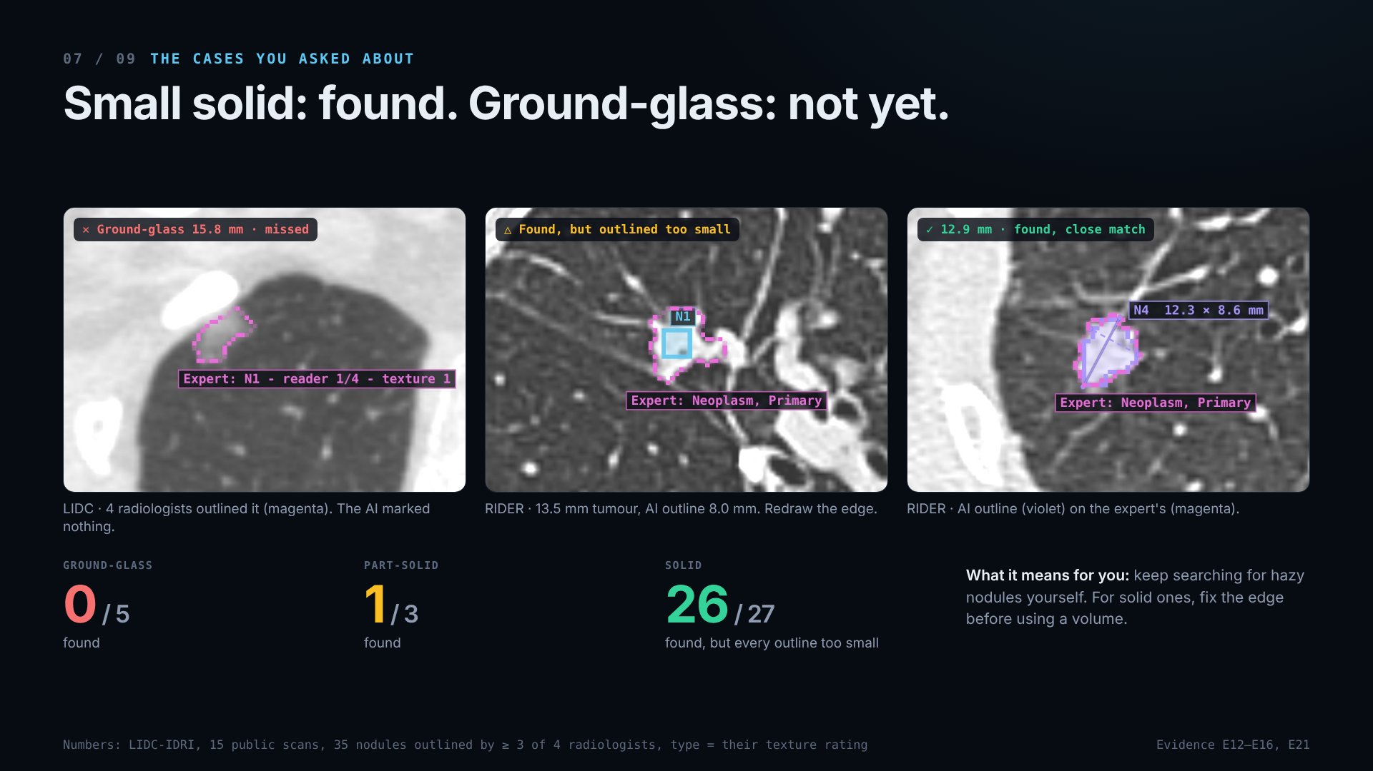
Notes:
· Small solid: found. Ground-glass: not yet. (2.5 min)
- "This is the slide you asked for." LIDC-IDRI: 15 public scans selected by fixed rules, 35 nodules each outlined by
at least 3 of 4 radiologists, with their own texture ratings (E16).
- Solid: 26 of 27 found, 15 of 16 at ≤ 10 mm. But every outline the AI produced was too small (−26 % to −91 % in
volume), so he redraws before using a volume.
- Part-solid 1 of 3. **Ground-glass 0 of 5.** Show the 15.8 mm ground-glass nodule with nothing on it (E21). For hazy
nodules the AI does not help today; he keeps searching for them himself.
- Images 2 and 3 are from RIDER: a 13.5 mm tumour outlined at 8.0 mm (and missed entirely on a repeat scan 15
minutes later, E14), and a 12.9 mm tumour matched closely (Dice 0.81, E15).
- If asked how we know the scoring is right: we caught a bug in our own scorer (outlines flipped on 5 scans) before
reporting, and the AI's candidates landing on the radiologists' nodules confirmed the fix.

Slide 8
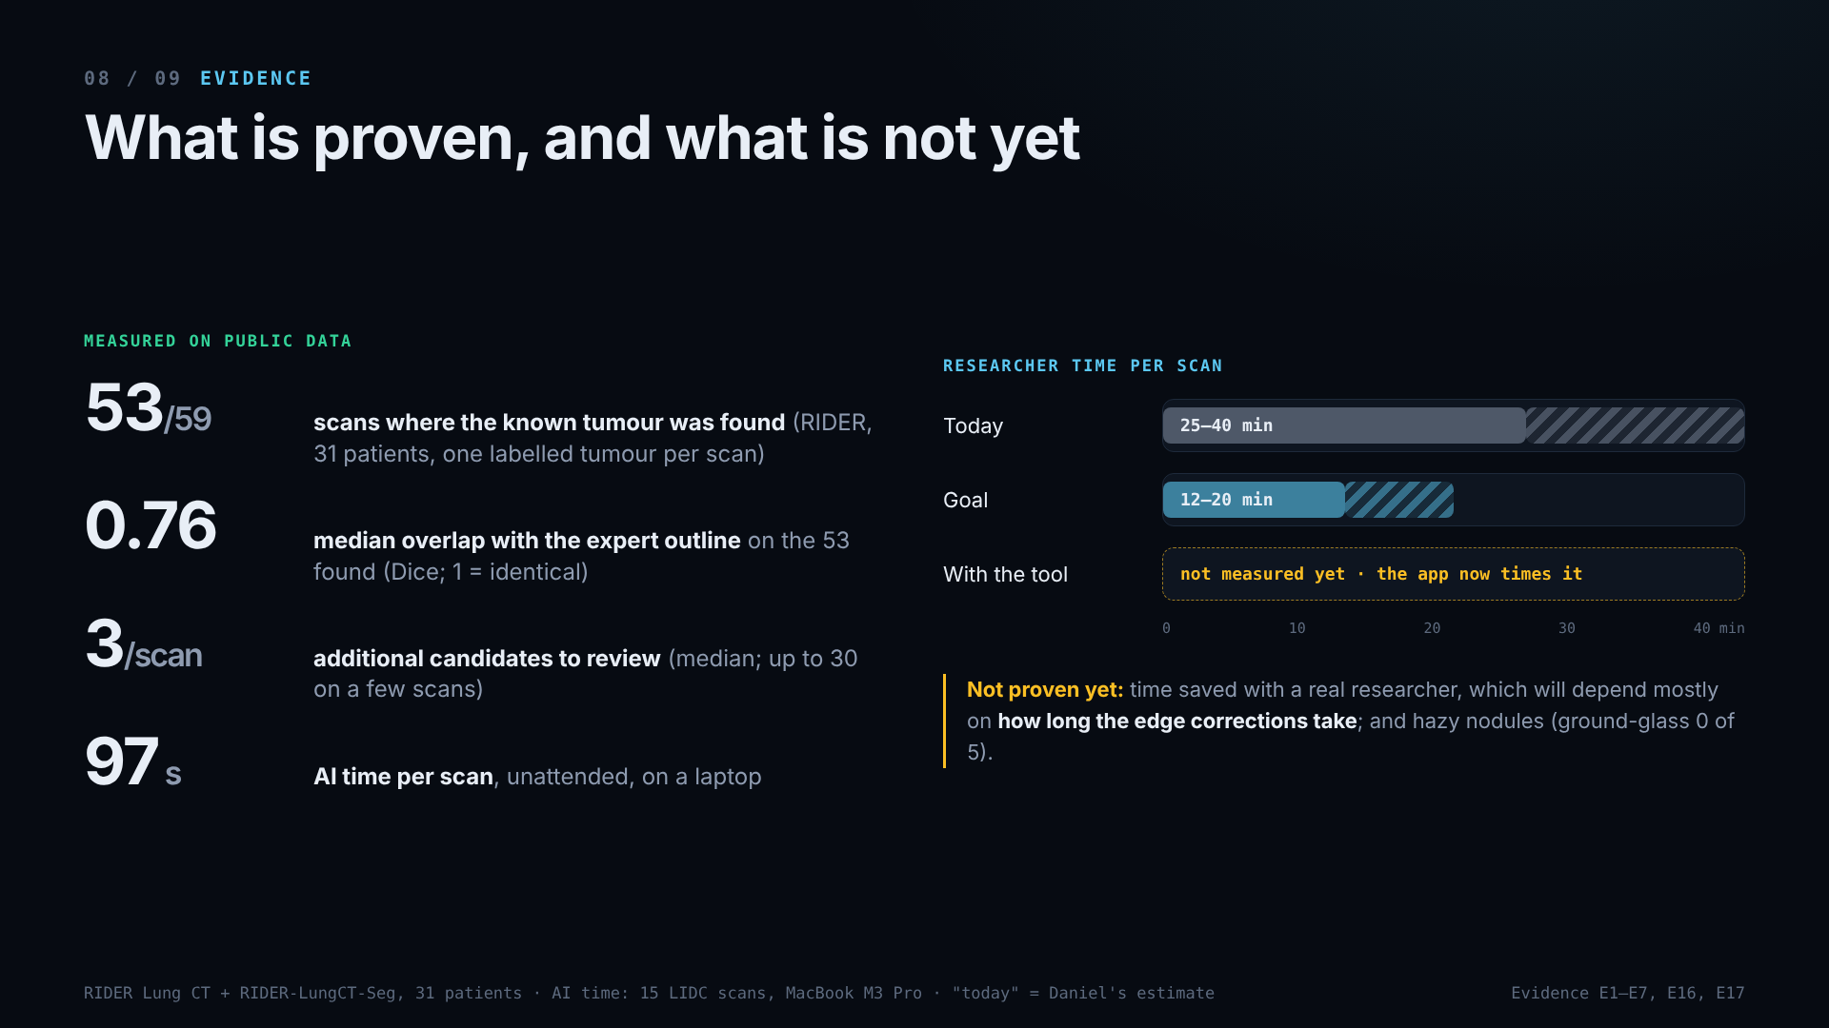
Notes:
· What is proven, and what is not yet (2 min)
- Measured on RIDER: 59 scans of 31 patients (TEST + RETEST), one expert-labelled tumour per scan. The tumour was
found on 53 (90 %; stricter Dice ≥ 0.5: 43/59). Median Dice 0.76 over the 53 found (misses excluded, listed
separately). A median of 3 additional candidates per scan to review, up to 30 on a few scans (not adjudicated, so not called false positives). AI time 97 s (E3–E6). Context, not equivalence: on one scan, 5 readers using a
semi-automatic tool scored 0.77–0.90 against the same expert (E19).
- Time: today 25–40 min (his estimate), goal 12–20 min, with the tool **not measured yet** (E17). The app now
times a task explicitly (Start → Finish, pauses excluded, expert outline hidden) and splits review, correction and
export time. Time saved needs manual sessions on the same scans as well, timed by an observer.
- Not proven: researcher time saved, and ground-glass. Time saved will depend mostly on how long the edge
corrections take, since every solid outline came out too small. False positives are only an upper bound (LIDC:
a median of 1 extra candidate per scan).

Slide 9
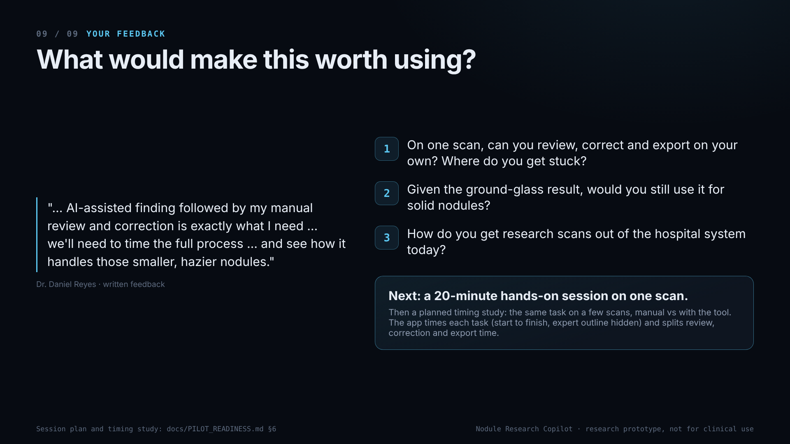
Notes:
· What would make this worth using? (1 min + discussion)
- Read his quote. It is his written feedback, not an observation of him using the tool (E18).
- Ask the three questions and write the answers down word for word. Question 1 is a task, not an opinion: he already
said the flow fits; now we want to see where he gets stuck.
- Next step: a 20-minute hands-on session on one scan (`docs/PILOT_READINESS.md` §6a). It is about where he gets stuck;
its times are not used for time saved. Then a planned timing
study: the same task on a few scans, manual vs with the tool, with correction time measured separately and the
order swapped to limit learning effects (`docs/PILOT_READINESS.md` §6b).
If asked:
- *"Is it as good as a radiologist?"* We don't claim that. See slide 8 context: one scan, semi-automatic readers.
- *"False positives?"* Not measurable on RIDER (one tumour labelled per scan). LIDC gives an upper bound: median 1
extra candidate per scan.
- *"Does data leave the computer?"* No. The browser blocks other sites (CSP), and the AI runs locally.
- *"Why not write results back to PACS?"* It's a research tool, and his output today is a research sheet. Writing
back is possible (DICOM SEG) but needs the hospital's IT, so it's a phase-2 choice for them.

