Slide 1


Blockchain-Based E-Tender Management System
GovTender — A Micro Project by Sri Manakula Vinayagar Engineering College
Notes:
1

Slide 2


The Problem
No Tamper-Evident Audit Trail
Manual tender processes lack transparency; records can be altered without detection.
Bid Confidentiality at Risk
Unauthorized access to bid data undermines fairness and procurement integrity.
Slow, Reactive Evaluation
Manual scoring is time-consuming with no predictive risk analysis before award.
Post-Award Blind Spots
Project delays and cost overruns go undetected without continuous monitoring.
Notes:
2

Slide 3




Our Solution: GovTender
Hyperledger Fabric
Smart Contracts
Machine Learning
Integrated Monitoring
Tamper-evident blockchain records for every tender transaction — immutable and verifiable.
Automate bid validation, eligibility checks, and payment authorization without manual steps.
Predict contractor risk, project delays, and cost overruns before they materialize.
Track milestones, payments, and audit records end-to-end across the full lifecycle.
Notes:
3

Slide 4
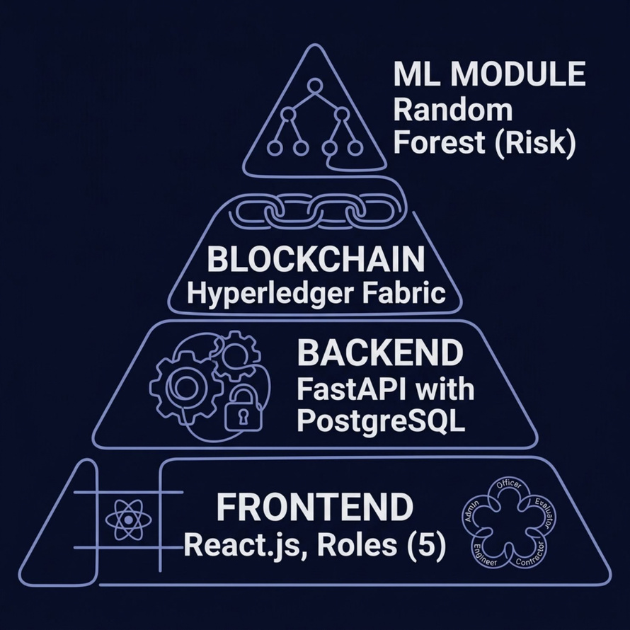
System Architecture
Technology Stack
Frontend: React.js with role-based access control — five distinct user roles ensure each stakeholder sees only what they are authorized to access.
Backend: FastAPI paired with PostgreSQL delivers fast, secure data management and a clean API layer between the UI and blockchain.
Blockchain: Hyperledger Fabric writes immutable transaction records, ensuring no record can be silently altered after submission.
ML Module: Random Forest models trained on historical project data power the risk prediction engine.
Notes:
4

Slide 5
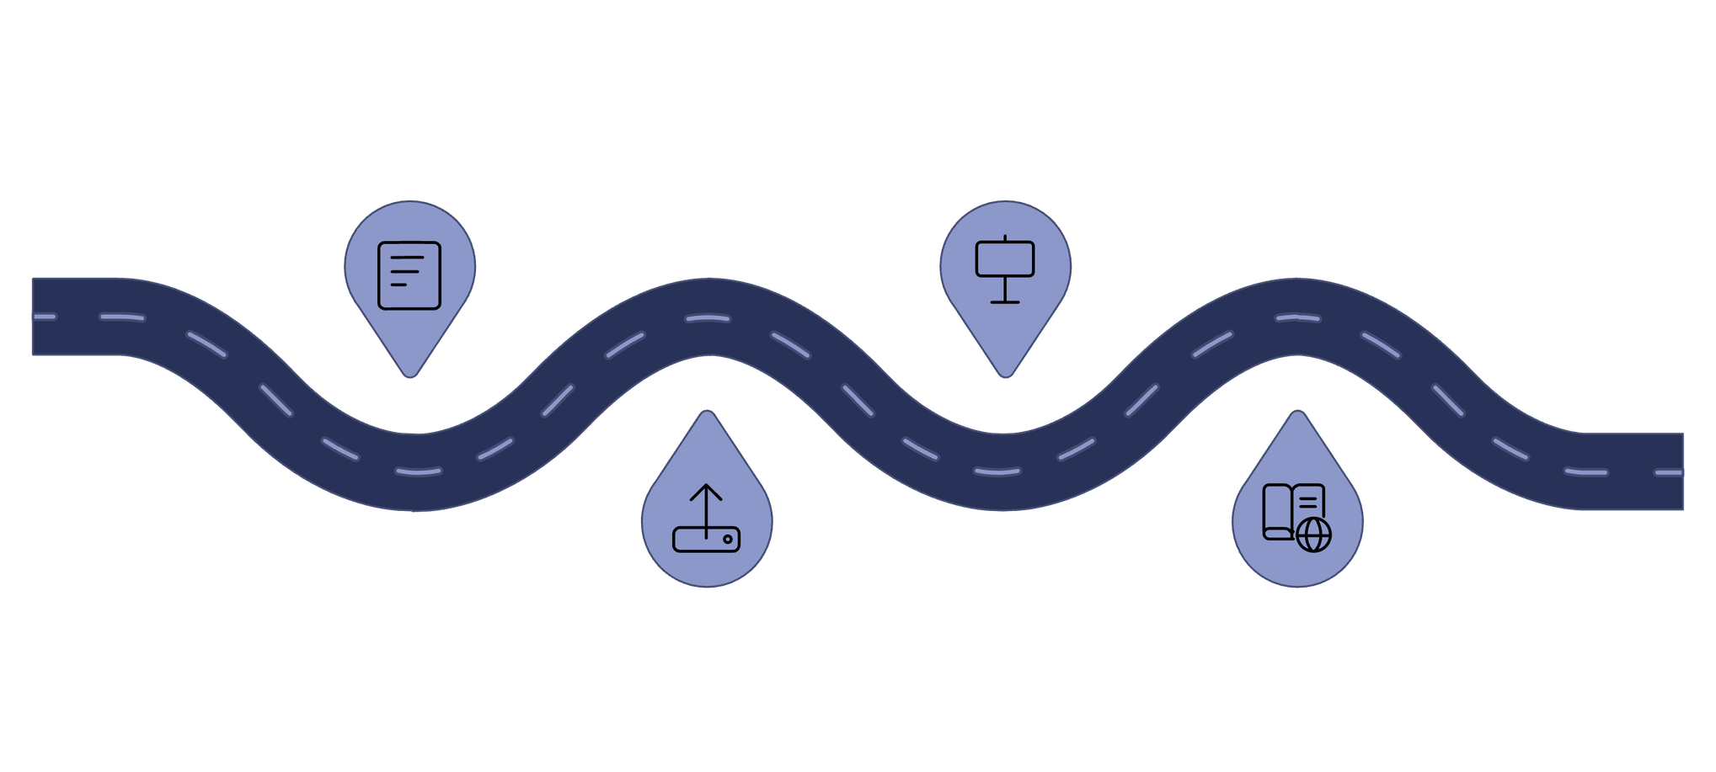
Tender Lifecycle Flow
Creation
Execution
Publish tender with blockchain seal
Track milestones; smart payments
Submission
Audit Trail
Bids filed; ML risk evaluation
Complete verifiable project history
Every phase produces an immutable blockchain record, creating a continuous and verifiable chain of custody from tender creation through final project close-out.
Notes:
5

Slide 6




Key Features
Transparent Allocation
Secure Bidding
Blockchain eliminates manual intervention; every change is traceable and attributable.
Role-based access control protects confidential bid information throughout the process.
Risk Prediction
Real-Time Monitoring
ML analyzes contractor experience, past delays, and cost patterns before award decisions.
Dashboard tracks progress, payments, and overall project health continuously.
Notes:
6

Slide 7

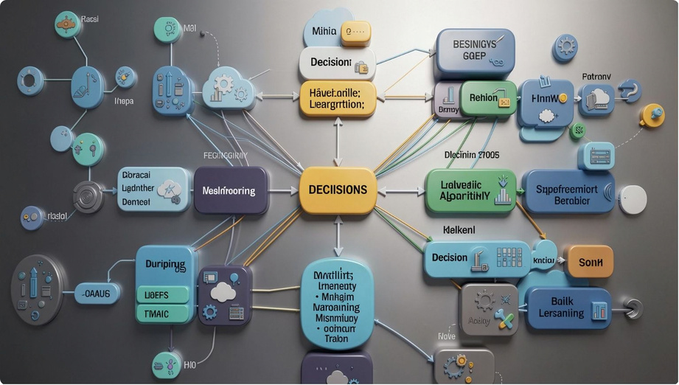


Machine Learning Models
Three Predictive Models — Random Forest
Contractor Risk
1
Predicts contractor reliability based on years of experience, past project outcomes, and historical performance scores.
Project Delay
2
Identifies timeline risks by learning from historical project schedules, scope changes, and environmental factors.
Cost Overrun
3
Forecasts budget deviations before they occur, enabling proactive corrective action and fund reallocation.
Notes:
7

Slide 8

Results & Impact
Reduced Manual Intervention
Automated smart contracts handle validation and payment steps without human bottlenecks.
Immutable Transparency
Blockchain audit trail makes every tender action verifiable by any authorized auditor.
Early Risk Detection
ML predictions enable proactive decision-making before delays or overruns occur.
Enhanced Accountability
All stakeholders — from officers to contractors — are held to a traceable, tamper-proof record.
Notes:
8

Slide 9





Future Enhancements & Scalability
System Integration
Seamlessly connect with existing government ERP, finance, and citizen service platforms for holistic data flow.
Advanced Analytics
Implement sophisticated dashboards and predictive models for deeper insights into procurement trends and performance.
Mobile Application
Develop intuitive mobile apps for officers and contractors, enabling on-the-go tender management and real-time updates.
Multi-Chain Support
Expand GovTender to support multiple blockchain networks, increasing interoperability and resilience.
Massive Scalability
Optimize infrastructure to handle exponentially larger volumes of tenders across various departments and states.
Notes:
9

Slide 10





Implementation & Deployment
Our development process prioritized agility, rigorous testing, and a robust deployment strategy to ensure a high-quality, scalable system for GovTender.
Agile Development
Iterative sprints and continuous integration ensured rapid feature delivery and adaptability to evolving requirements.
Rigorous Testing
Comprehensive unit, integration, and system tests validated every component for functionality, security, and performance.
Tech Stack Integration
Seamlessly integrated React.js, FastAPI, PostgreSQL, Hyperledger Fabric, and ML models into a cohesive architecture.
Smart Contract Development
Developed and audited secure smart contracts for automated bid validation and payment processing on Hyperledger Fabric.
Cloud Deployment
Implemented a scalable cloud-native deployment strategy ensuring high availability and robust performance for the platform.
Notes:
10

Slide 11

Conclusion
What GovTender Delivers
GovTender combines blockchain, smart contracts, and machine learning into a unified platform for secure, transparent government procurement.
  Addresses critical gaps in existing e-tendering systems — especially in post-award monitoring where most systems fall silent.
  Extends the tender lifecycle beyond award into active project execution tracking and milestone-based payment control.
  Scalable architecture designed to improve public fund management and deliver better project outcomes across government departments.
GovTender is a step toward accountable, data-driven, and corruption-resistant public procurement.
Notes:
11

