Slide 1

MALLA REDDY COLLEGE OF ENGINEERING & TECHNOLOGY (Autonomous Institution – UGC, Govt. of India) DEPARTMENT OF COMPUTER SCIENCE AND ENGINEERING
An Agentic AI-Based Secure Document Management System
Team – C2 P. Yuva Akhil -22N31A05G9 P. Bhargava sai-22N31A05J9 M. Irfan -22N31A05E0
Under the Guidance of
Mrs. Dr. D. Radha

Slide 2
AGENDA
Abstract
Introduction
Existing system
Proposed system
Software and Hardware Requirements
Literature survey
UML Diagrams
Technologies
Modules Explanation
Output screens
Conclusion
Future scope
References

Slide 3
Abstract
The TrustAgent project presents an agentic AI–based secure document management system that enables users to store, classify, share, and verify sensitive documents such as identity proofs, certificates, and resumes in a secure and privacy-preserving manner. The system integrates artificial intelligence with decentralized technologies to reduce dependency on centralized trust models. TrustAgent uses an AI-driven intent detection mechanism to autonomously understand user requests and manage document workflows. Uploaded documents are analyzed using OCR and content-based classification techniques to accurately identify document types. The documents are stored on the InterPlanetary File System (IPFS), while their cryptographic content identifiers are anchored on the Stellar blockchain to ensure immutability and tamper resistance. The application supports time-bound, expirable sharing links, allowing users to securely share documents with controlled access. The system is accessible through a Telegram bot and a webbased interface, providing an intuitive and user-friendly experience. By combining agentic AI, decentralized storage, and blockchain verification, TrustAgent enhances document security, transparency, and user privacy, making it suitable for trust-critical digital interactions.

Slide 4
Introduction
Digital documents are widely shared for jobs, education, banking, and government services, but they are often sent through insecure channels like email or messaging apps.
Once shared, users lose control over who can access, copy, or misuse their sensitive documents such as Aadhaar, PAN, and certificates.
Fake and tampered documents are a growing problem, making it difficult for organizations to trust the authenticity of shared files.
Traditional document storage systems rely on centralized databases, which are vulnerable to data breaches and unauthorized access.
There is a strong need for a secure, verifiable, and privacy-preserving system that allows users to share documents safely and temporarily.
TrustAgent addresses this problem by combining AI, secure storage, time-limited access, and blockchain-based verification to ensure trust and control.

Slide 5
Existing system
Insecure Document Sharing Documents are shared via email, WhatsApp, cloud links, or messaging apps. Once shared, files can be forwarded or downloaded without the owner’s control.
No Access Control or Expiry Shared documents remain accessible indefinitely. There is no time limit, download restriction, or automatic revocation.
Lack of Document Verification Receivers cannot verify whether a document is original or tampered. Fake or modified documents are hard to detect.
Centralized Storage Risks Documents are stored on centralized servers or devices. This makes them vulnerable to data leaks, hacking, or unauthorized access.
No Audit Trail or Transparency There is no tracking of who accessed the document and when. Owners have no visibility once the document is shared.

Slide 6
Proposed system
Secure Document Upload & Storage Users upload sensitive documents (Aadhaar, PAN, Resume, etc.) through TrustAgent. Documents are securely stored with encrypted references instead of raw files.
Agent-Based Interaction Users interact with the system using natural language (chat-based interface). The AI agent understands commands like upload, show documents, and share for X minutes.
Time-Bound Access Control Documents are shared using temporary, expiring links. Access is automatically revoked after the specified time, preventing misuse.
Blockchain-Backed Integrity Document hashes and access records are stored on blockchain. This ensures immutability, tamper-proof verification, and trust.
Fine-Grained User Control Users can decide what to share, with whom, and for how long. Admins can monitor, verify, and audit document access securely.

Slide 7
Software Requirements
Operating System Windows / Linux / macOS
Frontend Technologies React.js HTML5, CSS3, JavaScript
Backend Technologies Node.js Express.js
Database MongoDB
AI & Agent Components Large Language Model (LLM) API (for intent detection and agent logic)
Blockchain Platform Stellar Blockchain (for immutable records and verification)
Storage Services IPFS (via Pinata API) for decentralized document storage

Slide 8

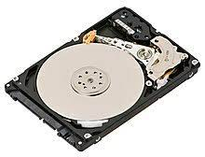

Hardware Requirements
Development Machine:
Processor: Intel i5 or higher (or equivalent AMD).
RAM: Minimum 8 GB (16 GB recommended for model training).
Storage: At least 25 GB (SSD preferred for faster data handling).

Slide 9
Literature Survey
S.no. | Author(s) & Journal Details
1
2 |  | Secure Document Management Systems | importance of encrypted storage, access control, and secure link sharing mechanisms.
3 |  |  | Uses machine learning models to automatically classify documents based on extracted textual content.
Title of the paper
Title of the paper
Outcome
Outcome
Blockchain-Based Secure Data Sharing
Demonstrates use of blockchain for tamper-proof data storage and integrity verification.
Z. Zheng et al., IEEE Access
A. Al-Shaikh et al., Int. Journal of Highlights ComputerApplications
AI-Based Document Classification Using NLP
S. Liu, Y. Wang, Journal of AI Research

Slide 10
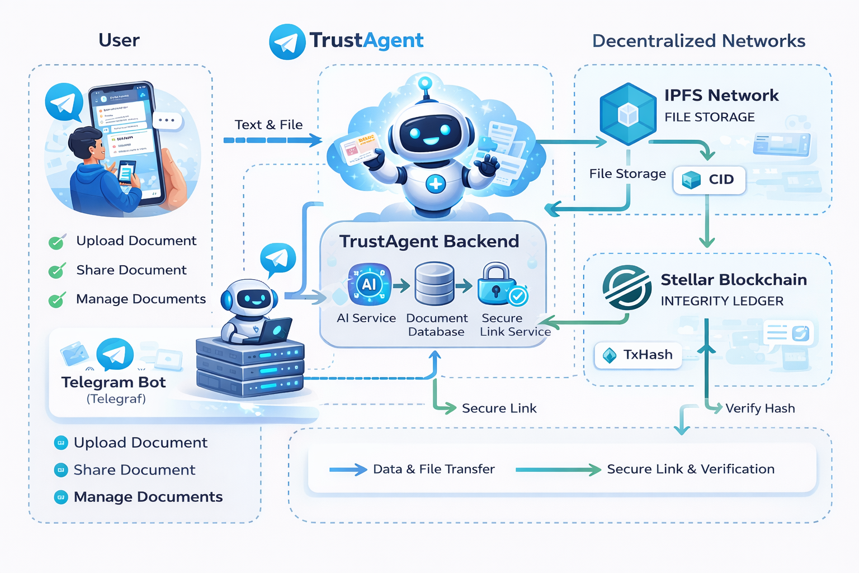
Architecture

Slide 11
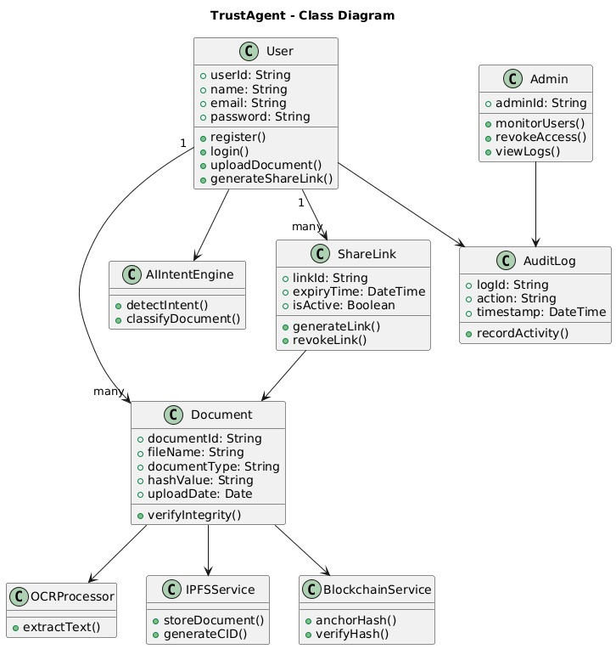
UML Diagrams 1.Class Diagram

Slide 12
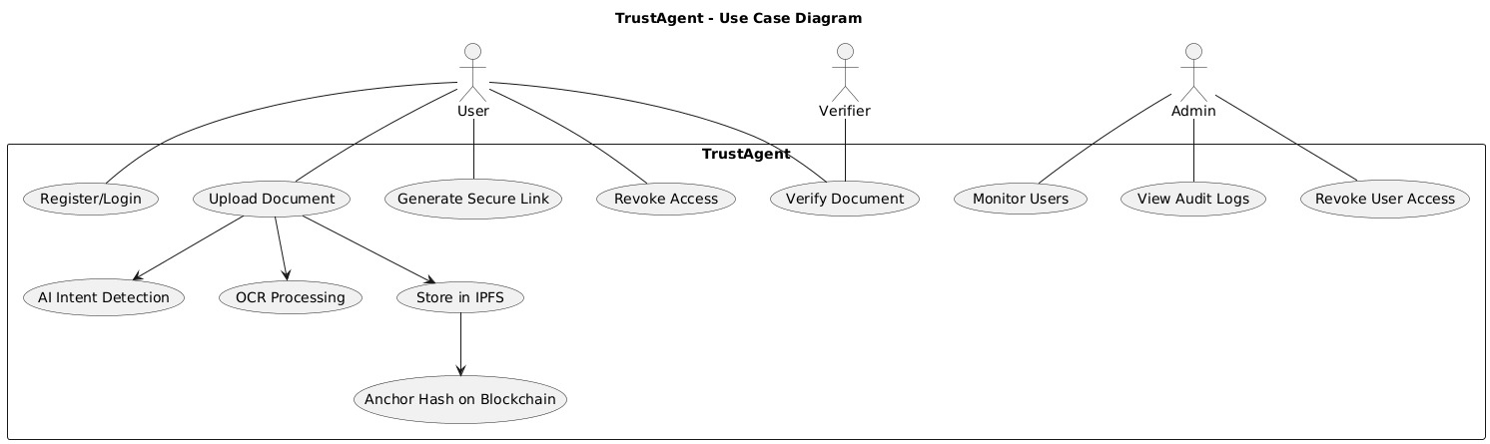
2.Use Case Diagram

Slide 13
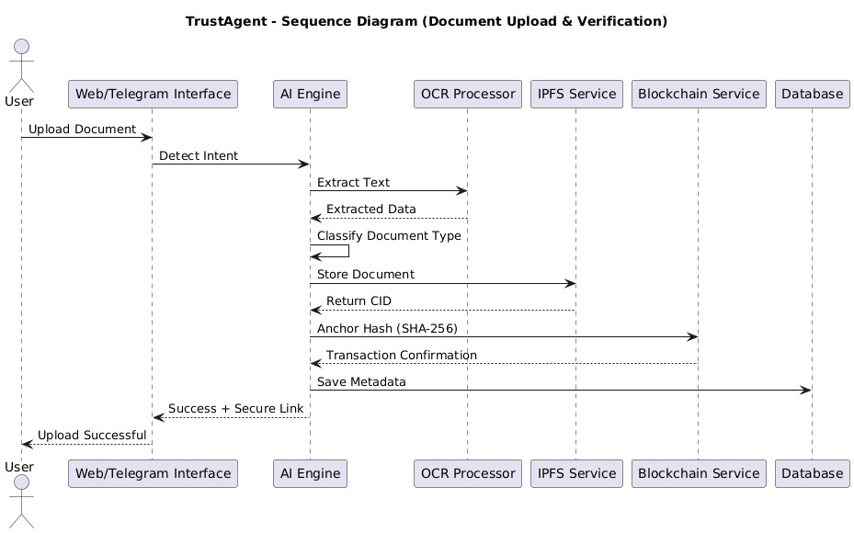
3.Sequence Diagram

Slide 14
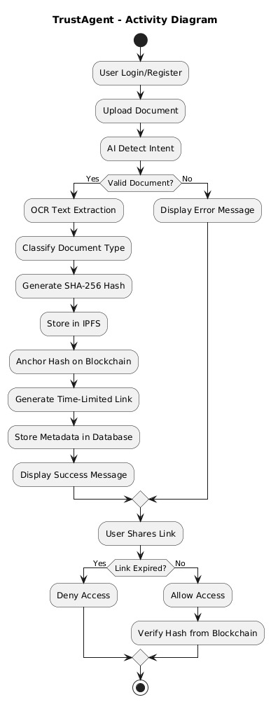
4.Activity Diagram

Slide 15
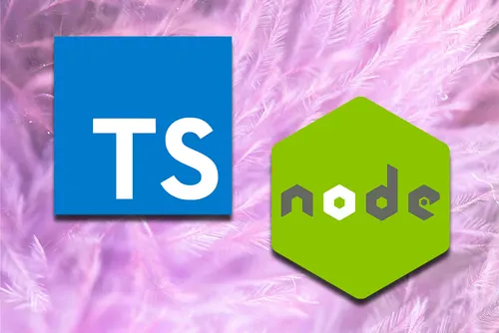

Technologies
Node.js + Express.js – Backend server for handling APIs, document processing, and secure link generation.
Telegram Bot (Telegraf.js) – User interface layer for uploading, managing, and sharing documents via chat.
MongoDB – Database for storing document metadata, user records, CIDs, and blockchain transaction hashes.
IPFS (InterPlanetary File System) – Decentralized storage for secure, content-addressed document storage.
Stellar Blockchain – For anchoring document hash (CID) to ensure tamper-proof integrity verification.
OCR (Tesseract / OCR Service) – Extracts textual data from uploaded images and PDF documents.
Secure Link Service (UUID + Expiry Logic) – Generates time-bound, unique access links.
Axios – Handles communication between Telegram bot and backend APIs.

Slide 16
Modules Description
User Interaction Module - Handles communication between users and the system via Telegram Bot for uploading, retrieving, sharing, and deleting documents.
AI Intent & Document Classification Module - Uses AI to detect user commands and automatically classify uploaded documents based on extracted text.
Secure Link & Access Control Module - Generates time-bound secure links and manages controlled document access and deletion.
Secure Document Storage Module (IPFS)- Stores uploaded documents in decentralized IPFS storage using content-based hashing (CID).
Blockchain Verification Module - Anchors document hash to the Stellar blockchain to ensure tamper-proof integrity verification.

Slide 17
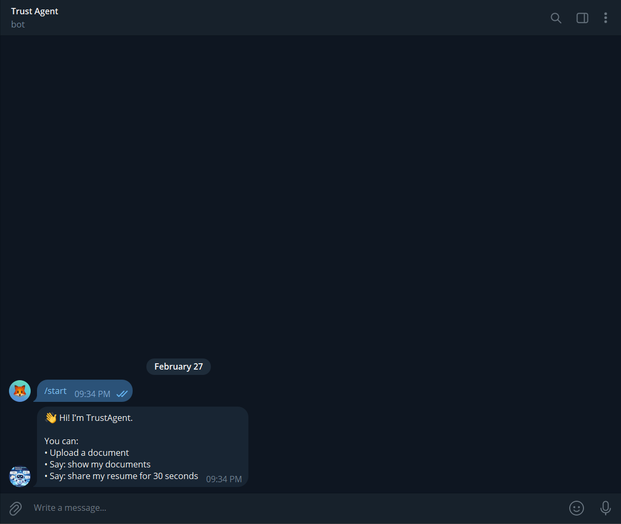
Output Screens

Slide 18
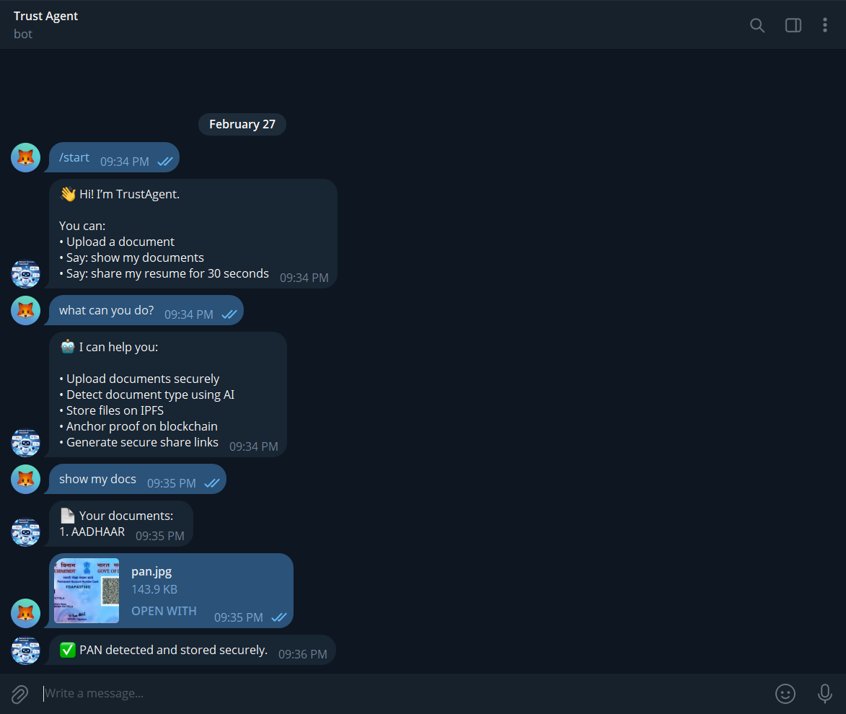
Output Screens

Slide 19
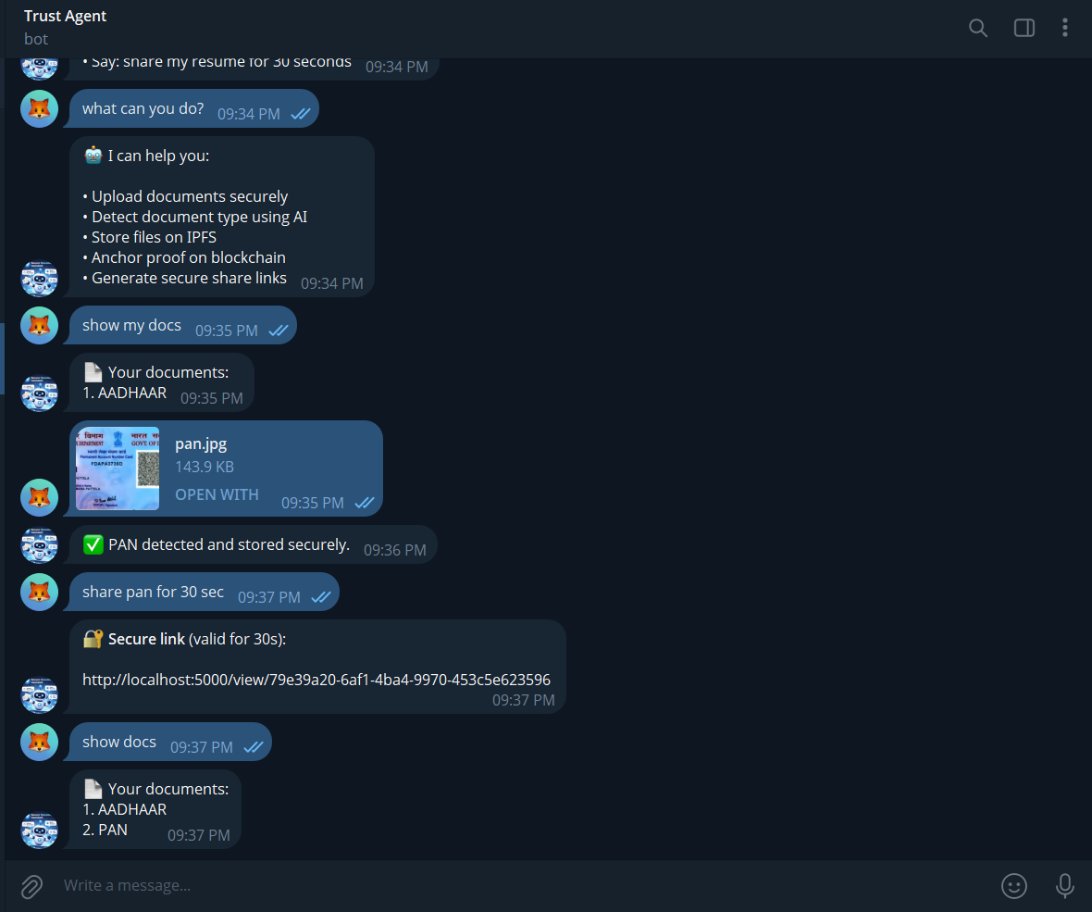
Output Screens

Slide 20
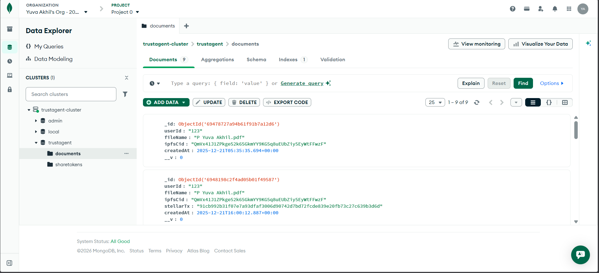
Output Screens

Slide 21
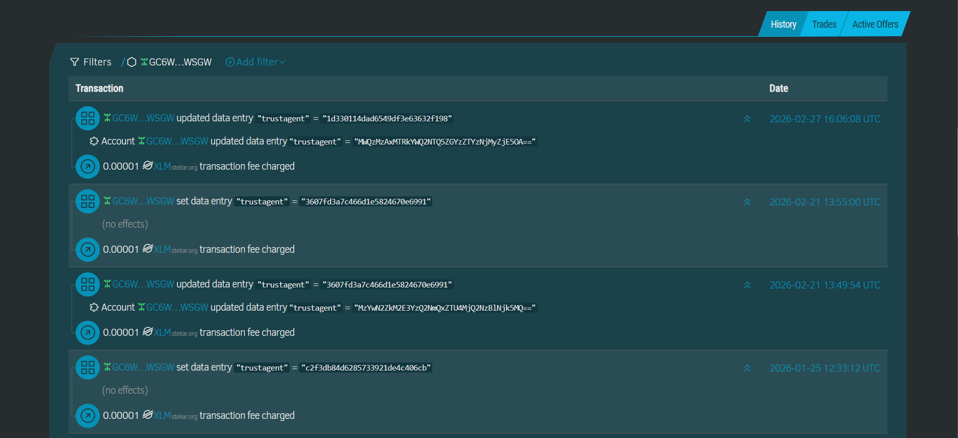
Output Screens

Slide 22
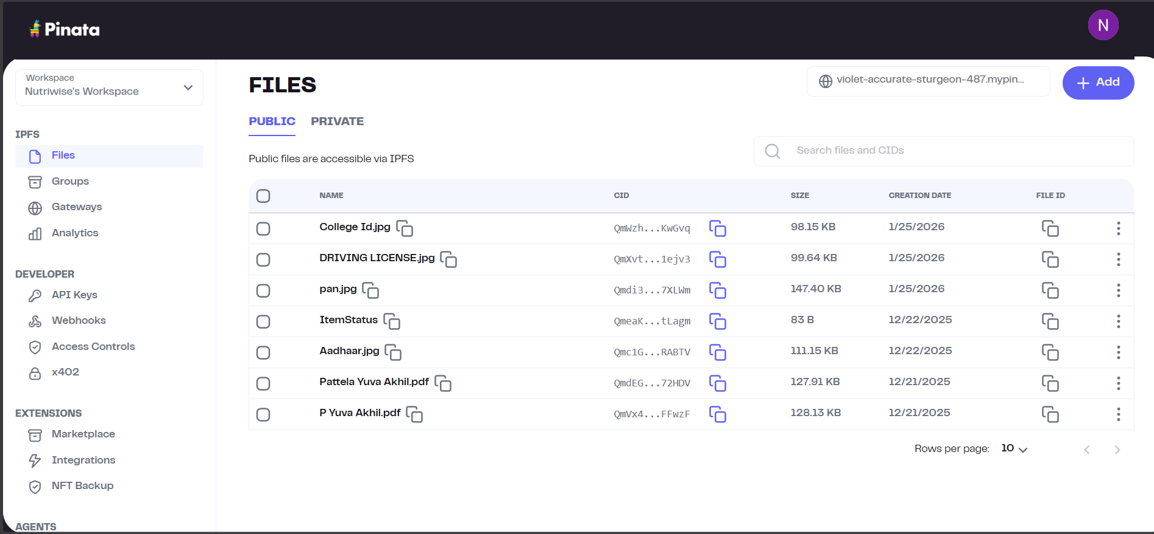
Output Screens

Slide 23
Conclusion
Successfully developed an AI-based secure document management system using a Telegram bot interface.
Implemented automatic document classification using OCR and AI techniques.
Ensured secure and decentralized storage of documents using IPFS.
Achieved tamper-proof integrity verification by anchoring document hashes on the Stellar blockchain.
Enabled time-bound, secure document sharing through unique expiring links and QR codes.
Improved document security, integrity, and controlled access compared to traditional storage methods.
Designed a scalable and modular architecture that can be extended with additional security features.

Slide 24
Future Scope
➤ Smart Contract Integration – Implement on-chain smart contracts to enforce automated access control and revocation policies.
➤ End-to-End Encryption – Add encryption before IPFS upload to ensure documents remain private even in decentralized storage.
➤ Download Tracking & Audit Logs – Introduce real-time access monitoring to track who accessed or downloaded shared documents.
➤ Web & Mobile Application Interface – Expand beyond Telegram to a full-featured web and mobile platform for broader usability.
➤ Biometric or Multi-Factor Authentication – Enhance security by adding OTP, face verification, or biometric authentication before document access.

Slide 25
References
Zheng, Z., Xie, S., Dai, H., Chen, X., & Wang, H. (2017). An Overview of Blockchain Technology: Architecture, Consensus, and Future Trends. IEEE International Congress on Big Data.
Benet, J. (2014). IPFS – Content Addressed, Versioned, P2P File System. arXiv preprint arXiv:1407.3561.
Smith, R. (2007). An Overview of the Tesseract OCR Engine. Proceedings of ICDAR 2007, IEEE.
Goodfellow, I., Bengio, Y., & Courville, A. (2016). Deep Learning. MIT Press.
Narayanan, A., Bonneau, J., Felten, E., Miller, A., & Goldfeder, S. (2016). Bitcoin and Cryptocurrency Technologies. Princeton University Press.
Stellar Development Foundation. (2023). Stellar Blockchain Documentation. [Online]. Available: https://developers.stellar.org
Pinata. (2023). IPFS & Decentralized Storage Solutions. [Online]. Available: https://pinata.cloud
Telegraf Documentation. (2023). Telegram Bot Framework for Node.js. [Online]. Available: https://telegraf.js.org
MongoDB Inc. (2023). MongoDB Official Documentation. [Online]. Available: https://www.mongodb.com/docs

Slide 26
Thank You

