Slide 1


Video Classification of Child Safety
D. YUVA AKHIL - BL.SC.U4AIE24013
Y. PRANNAV – BL.SC.U4AIE24055
P.JAY VARDHAN – BL.SC.U4AIE24064

Slide 2

Outline of Presentation
1. Introduction 2. Problem Statement 3. Objectives 4. Literature Review 5. Dataset Overview 6. Complete Project Pipeline

Slide 3
Outline of Presentation
8. Machine Learning Models 9. Stacking Ensemble Learning 10. Results and Evaluation 11. Streamlit Application 12. Advantages, Limitations & Future Scope 13. Conclusion

Slide 4
Introduction
• Video classification assigns labels to complete video sequences.
• This project focuses on Safe and Unsafe activity classification.
• The system uses Computer Vision and Machine Learning techniques.
• CNN embeddings are extracted from sampled video frames.
• Multiple machine learning classifiers are trained and compared.
• Stacking ensemble learning improves classification robustness.
• Applications include surveillance and child-safety-oriented monitoring.

Slide 5
Problem Statement
Manual monitoring of videos is time-consuming and inconsistent.
Unsafe activities may occur briefly and be missed easily.
Human attention decreases during long surveillance sessions.
Crowded scenes and motion blur increase monitoring difficulty.
Simple rule-based systems are unreliable for activity classification.
AI systems can learn visual and temporal activity patterns automatically.
Intelligent monitoring systems are required for automated Safe/Unsafe analysis.

Slide 6
Objectives
• Build a complete Safe and Unsafe video classification system.
• Extract multimodal visual features from uploaded videos.
• Convert videos into fixed-length feature vectors.
• Train and compare multiple machine learning classifiers.
• Apply stacking ensemble learning for robust prediction.
• Generate explainable outputs and visualizations.
Build a Streamlit web application for uploaded-video prediction.

Slide 7
LITERATURE REVIEW
• YOLO research inspired object-detection and localization concepts.
• ResNet research inspired CNN embedding feature extraction.
• Two-Stream CNN research inspired motion-analysis concepts.
• MobileNet research inspired lightweight transfer-learning architectures.
• Stacking Generalization research inspired ensemble-learning methodology.
• SHAP and LIME research inspired explainable AI concepts.
• Human Action Recognition research inspired activity-analysis techniques.

Slide 8
COMPLETE PROJECT PIPELINE
Video Input
[] ↓
↓
↓
↓
↓
Preprocessing
Feature Extraction
Feature Fusion
ML Models + Stacking
Safe / Unsafe Prediction

Slide 9
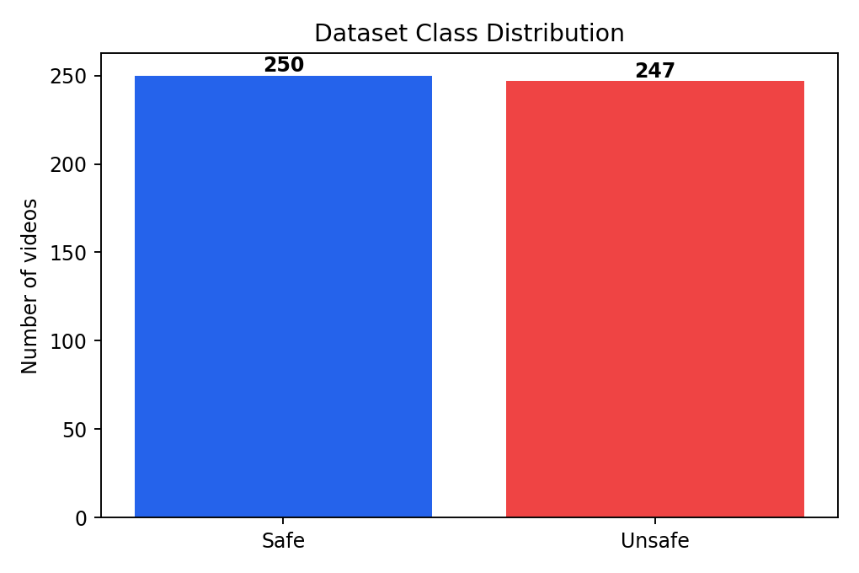
Dataset Overview
The project uses a labelled Safe and Unsafe video dataset.
Total processed videos used for classification: 497.
• Safe videos: 250.
• Unsafe videos: 247.
• The dataset is nearly balanced across both classes.
• Balanced datasets reduce class bias during training.
• The dataset supports supervised binary classification.

Slide 10
Frame Extraction
• Videos contain multiple frames and varying durations.
• Representative frames are sampled from each video timeline.
• Frame sampling reduces computational complexity.
• Temporal coverage is preserved during frame extraction.
• Extracted frames act as visual evidence for classification.
• Frame-level information is later aggregated into video-level features.
• Frame extraction improves processing efficiency and stability.

Slide 11
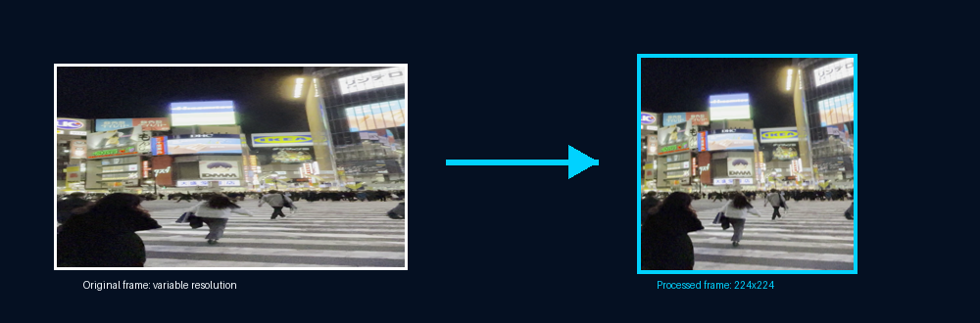
Frame Resizing & Pixel Normalization
• All sampled frames are resized to 224×224 before CNN processing.
• CNN architectures require fixed-dimensional input tensors.
• Resizing ensures dimensional consistency across all videos.
• Pixel normalization converts values from 0–255 into 0–1 range.
• Normalization stabilizes CNN feature extraction.
• Same-size inputs improve feature comparability.
• Preprocessing improves overall model reliability and consistency.

Slide 12
SAME-DIMENSION PROOF
• Every processed video becomes one fixed-length feature vector.
• All processed videos contain the same feature columns.
• Machine learning classifiers require fixed-dimensional input vectors.
• Resizing standardizes frame dimensions across videos.
• Temporal aggregation standardizes varying video durations.
• Z-score standardization normalizes feature scales.
• All videos become mathematically comparable after preprocessing.

Slide 13
CNN Feature Extraction
• Transfer learning is used because the dataset size is limited.
• ResNet generate CNN embedding features.
• CNN embeddings capture high-level visual patterns automatically.
• The project extracts 512 descriptive CNN features.
• Features represent texture, object, activity, and safety context.
• CNN embeddings reduce manual feature engineering requirements.
• Transfer learning improves classification stability and efficiency.
Frames -> CNN Model(Resnet) ->512 features

Slide 14
Feature Group table
Feature Range | Feature Group
1–128 | Edge / Texture
129–256 | Object / Body
257–384 | Scene / Activity
385–512 | Safety Context

Slide 15
YOLO / OBJECT FEATURES
• YOLO-inspired object analysis provides contextual information.
• Person count supports crowd and interaction analysis.
• Crowd density estimates environmental complexity.
• Object confidence improves scene understanding.
• Suspicious-object proxy scores add contextual evidence.
• Object-level understanding improves classification robustness.
• Final prediction depends on fused multimodal evidence.

Slide 16
EXPRESSION & ACTIVITY FEATURES
• Expression features act as lightweight behavior proxies.
• Aggression scores estimate suspicious activity patterns.
• Stress and fear proxies support activity understanding.
• Activity features summarize movement intensity and behavior.
• Temporal smoothing reduces frame-level fluctuations.
• Expression features support explainable prediction logic.
• Behavioral cues improve Safe and Unsafe classification.

Slide 17
Feature Fusion
• Multiple feature groups are combined into one unified vector.
• CNN features capture high-level visual semantics.
• Motion features capture temporal behavior patterns.
• YOLO features provide object-level contextual information.
• Expression and activity features provide behavioral evidence.
• Multimodal fusion improves classification robustness.
• Combined features improve Safe and Unsafe separation capability.

Slide 18
FEATURE STANDARDIZATION
• Different features naturally use different numeric ranges.
• CNN embeddings, motion values, and object scores are not directly comparable.
• Z-score standardization normalizes feature distributions.
• Standardization centers features around zero.
• SVM and KNN require normalized feature scales.
• Feature scaling stabilizes classifier learning.
• Standardization prevents large-value features from dominating prediction.

Slide 19
MACHINE LEARNING CLASSIFIERS
• Multiple classifiers are trained and compared on the same feature set.
• Logistic Regression acts as a linear baseline classifier.
• Decision Tree supports interpretable rule-based learning.
• Random Forest improves robustness using tree ensembles.
• SVM performs strongly on high-dimensional CNN embeddings.
• XGBoost performs boosted ensemble learning on tabular features.
• MLP provides neural-network-based classification for fused features.

Slide 20
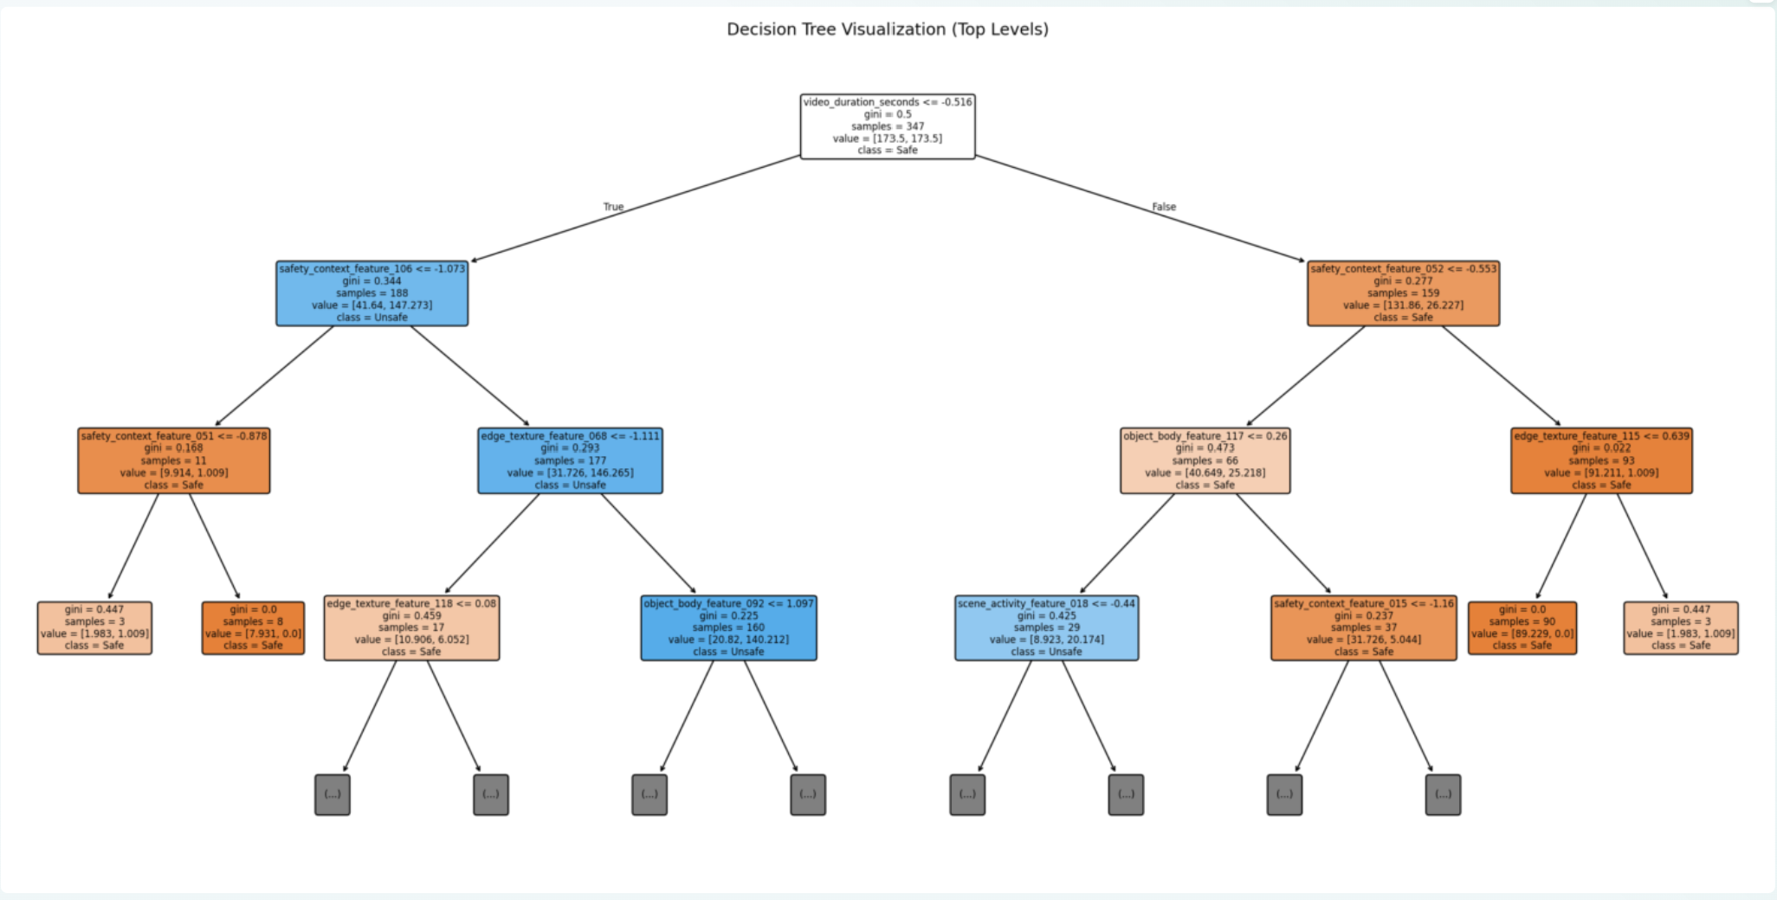
DECISION TREE VISUALIZATION
• Decision Tree splits data using feature thresholds.
• Tree-based learning supports interpretable classification.
• Decision Tree acts as a baseline comparison classifier.
• Rule-based learning improves explainability.
• Feature thresholds guide Safe and Unsafe prediction.
• Random Forest extends the concept using multiple trees.
• Tree visualization improves understanding of classification logic.

Slide 21
STACKING ENSEMBLE LEARNING
• Stacking combines predictions from multiple classifiers.
• Random Forest, SVM, XGBoost, and MLP act as base learners.
• Logistic Regression acts as the meta learner.
• Probability outputs are combined for final prediction.
• Different models learn different decision boundaries.
• Ensemble learning improves robustness and generalization.
• Stacking reduces weaknesses of individual classifiers.

Slide 22
CLASSIFIER COMPARISON RESULTS
• Multiple classifiers were evaluated using the same standardized feature vectors.
• SVM achieved the best accuracy of 84.67%.
• Stacking classifier achieved 83.33% accuracy.
• KNN and MLP also performed competitively.
• ROC-AUC values confirm strong classification capability.
• Ensemble learning improved overall robustness.
• Classifier comparison validates model-selection reliability.

Slide 23
Confusion Matrix
• Confusion matrix evaluates class-wise prediction performance.
• True Positives and True Negatives represent correct predictions.
• False Positives represent Safe predicted as Unsafe.
• False Negatives represent Unsafe predicted as Safe.
• Reducing false negatives is important for safety systems.
• Error analysis improves understanding of model behavior.
• Confusion matrices support reliable result interpretation.

Slide 24
ROC CURVE & AUC
• ROC curve evaluates classifier discrimination capability.
• ROC compares true positive rate against false positive rate.
• AUC summarizes Safe and Unsafe separation quality.
• Higher AUC values indicate stronger classification performance.
• ROC analysis is threshold independent.
• SVM achieved strong ROC-AUC performance.
• ROC curves support reliable classifier comparison.

Slide 25
Cross-Validation & Generalization
• 5-fold cross-validation is used to evaluate model generalization.
• Cross-validation reduces dependence on one train-test split.
• Multiple dataset splits improve evaluation reliability.
• SVM achieved the best cross-validation accuracy.
• Low standard deviation indicates stable performance.
• Cross-validation helps identify overfitting risk.
• Generalization analysis improves project reliability.

Slide 26
Advantages
• Lightweight architecture suitable for limited datasets.
• Transfer learning improves feature extraction quality.
• Feature fusion improves classification robustness.
• Stacking ensemble learning improves prediction stability.
• Explainable AI improves interpretability.
• Streamlit deployment supports interactive demonstration.
• The project is suitable for academic and surveillance applications.

Slide 27
FUTURE SCOPE
• Larger datasets can improve generalization performance.
• Real-time video-stream integration can be added.
• Custom YOLO models can improve object understanding.
• CNN-LSTM architectures can improve temporal learning.
• Cloud deployment can improve accessibility.
• Stronger activity-recognition models can be explored.
• Explainability methods can be further improved.

Slide 28
CONCLUSION
• The project successfully implements Safe and Unsafe video classification.
• CNN embeddings capture meaningful visual patterns automatically.
• Motion and object features improve activity understanding.
• Feature fusion improves multimodal classification robustness.
• SVM and Stacking achieved strong classification performance.
• Cross-validation supports acceptable model generalization.
• The project demonstrates a complete ML/CV workflow from preprocessing to deployment.

Slide 29
References
[1]. A. Ur Rehman, S. B. Belhaouari, M. A. Kabir and A. Khan, “On the Use of Deep Learning for Video Classification,” Applied Sciences, vol. 13, no. 4, 2023.
[2]. T. Diwan, G. Anirudh and J. V. Tembhurne, “Object Detection using YOLO: Challenges, Architectural Successors, Datasets and Applications,” Multimedia Tools and Applications, 2023.
[3]. K. He, X. Zhang, S. Ren and J. Sun, “Deep Residual Learning for Image Recognition,” Proceedings of the IEEE Conference on Computer Vision and Pattern Recognition (CVPR), 2016.
[4]. H. Ye, Z. Wu, R. W. Zhao, X. Wang and Y. G. Jiang, “Evaluating Two-Stream CNN for Video Classification,” Proceedings of the 5th ACM International Conference on Multimedia Retrieval, 2015.
[5]. M. P. Sesmero, A. I. Ledezma and A. Sanchis, “Generating Ensembles of Heterogeneous Classifiers Using Stacked Generalization,” Wiley Interdisciplinary Reviews: Data Mining and Knowledge Discovery, vol. 5, no. 1, pp. 21–34, 2015.
6]. C. I. Nwakanma, E. C. Nkoro and L. A. C. Ahakonye, “Explainable Activity Detection and Classification: SHAP vs LIME,” Korean Institute of Communications and Information Sciences Conference, 2023.

Slide 30
References
[7]. A. Ullah, J. Ahmad, K. Muhammad, M. Sajjad and S. W. Baik, “Action Recognition in Video Sequences Using Deep Bi-Directional LSTM with CNN Features,” IEEE Access, vol. 6, pp. 1155–1166, 2017. [8]. P. Pareek and A. Thakkar, “A Survey on Video-Based Human Action Recognition: Recent Updates, Datasets, Challenges, and Applications,” Artificial Intelligence Review, vol. 54, pp. 2259–2322, 2021. [9]. F. U. M. Ullah, M. S. Obaidat, A. Ullah, K. Muhammad and V. H. C. de Albuquerque, “A Comprehensive Review on Vision-Based Violence Detection in Surveillance Videos,” ACM Computing Surveys, vol. 56, no. 2, 2023. [10]. M. Rani and M. Kumar, “MobileNet for Human Activity Recognition in Smart Surveillance Using Transfer Learning,” Neural Computing and Applications, Springer, 2025.

Slide 31
Thank You

