Slide 1
APEXPLANET · TASK 4
From Raw Orders to
Business Decisions
A Data Story & Statistical Validation of 1,000 Sales Orders
DATASET Cleaned_Sales_Dataset.xlsx · 1,000 orders
PERIOD Jan 2025 – Jan 2026
PREPARED FOR Business Stakeholders & Leadership
Data Storytelling & Statistical Validation
ApexPlanet Sales Analytics

Slide 2




What This Deck Covers
Turning three parts of analysis into one story leadership can act on — then stress-testing the two most decision-relevant patterns with formal statistics.
01
02
03
04
The Business Snapshot
The Story in the Numbers
Putting Patterns to the Test
Recommendations
Headline revenue, orders, and where the money is coming from.
Category, product, city, seasonal and customer patterns worth acting on.
Two hypotheses, validated with a T-test and a Chi-squared test.
What to act on now, and what to keep watching.
Section 0 · Overview
ApexPlanet Sales Analytics

Slide 3
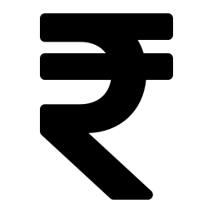




The Business Snapshot
One year of orders, at a glance.
₹13.94 Cr
1,000
₹1,39,399
Total Revenue
Orders Placed
Avg. Order Value
Electronics
Patna
36–45 yrs
Leading Category (₹5.08 Cr)
Top City by Revenue
Highest-Spending Age Group
Section 1 · Business Snapshot
ApexPlanet Sales Analytics

Slide 4
Electronics Leads — but the Portfolio Is Balanced
No single category dominates revenue — a healthy sign for resilience against category-specific slowdowns.
Electronics = 36% of revenue
Laptops & mobiles are the anchor of the catalog.
5 categories, no dead weight
Fashion, the smallest, still contributes ₹1.98 Cr.
Product-level story matches
Laptop (₹2.54 Cr) and Mobile (₹2.53 Cr) are the top 2 SKUs.
Section 2 · The Story in the Numbers
ApexPlanet Sales Analytics

Slide 5
Revenue Peaks in March and Dips Every Late Summer
A repeatable seasonal dip appears in August–September — worth planning promotions around.
Section 2 · The Story in the Numbers
ApexPlanet Sales Analytics

Slide 6

Demand Is Spread Across Nine Cities
Patna edges out Kolkata and Bengaluru for top revenue city — but the top 5 are within 15% of each other.
Top city: Patna
₹1.93 Cr in revenue, 135 orders — a strong but not runaway lead over #2 Kolkata.
Weekday spread is even
No single weekday dominates order volume — Wednesday leads revenue slightly (₹2.15 Cr) but the spread across the week is narrow.
Section 2 · The Story in the Numbers
ApexPlanet Sales Analytics

Slide 7
Customers Are Evenly Split Across Gender & Age
A broad, balanced customer base — no single segment is being over- or under-served.
Section 2 · The Story in the Numbers
ApexPlanet Sales Analytics

Slide 8
Before We Act — Let's Validate the Patterns
Charts can suggest a story — but only a statistical test can confirm it isn't just noise.
We put two of the most decision-relevant patterns to the test.
T-Test · Weekday vs. Weekend Spend
Chi-Squared Test · Category vs. Gender
Section 3 · Putting Patterns to the Test
ApexPlanet Sales Analytics

Slide 9
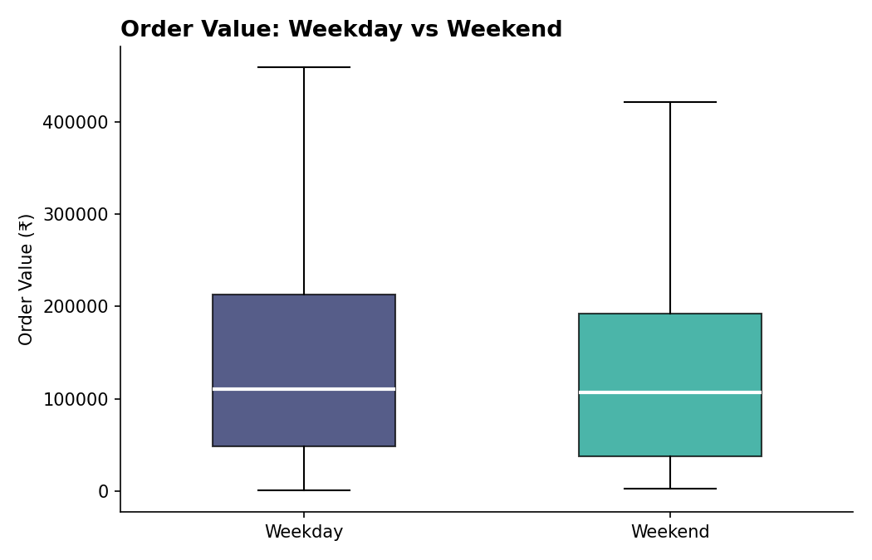

H1 · Does Order Value Change on Weekends?
"Orders placed on weekends have a statistically significant different value than weekday orders."
-1.087
0.2773
-0.076
t-statistic
p-value
Effect size (d)
NOT SIGNIFICANT (p ≥ 0.05)
Fail to reject H0 — no real difference detected.
Business read:
Weekday avg ₹1,41,894 vs. weekend avg ₹1,33,233 — a ₹8,661 gap that's small next to the spread in the data (95% CI crosses zero). Don't plan weekend pricing around a 'bigger weekend basket' assumption; grow weekend revenue through order volume instead.
Section 3 · Putting Patterns to the Test
ApexPlanet Sales Analytics

Slide 10
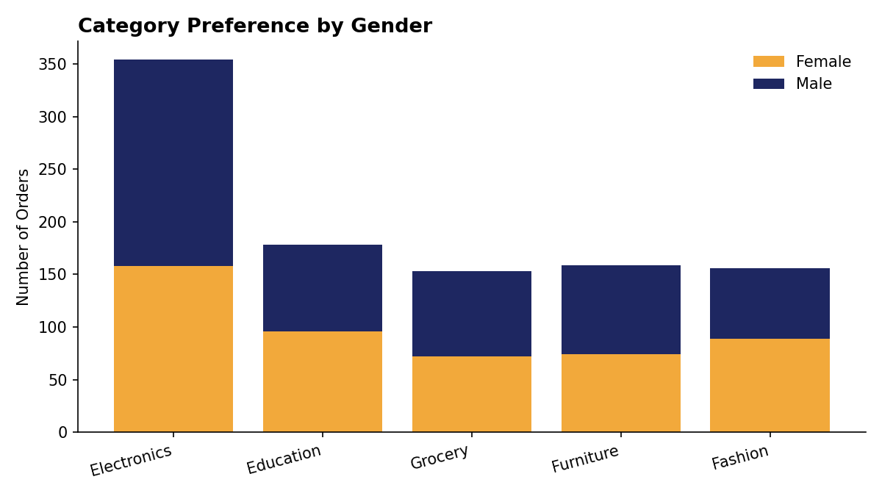
H2 · Is Category Choice Linked to Gender?
"The product category a customer buys from is associated with their gender."
9.094
0.0588
0.095
Chi² statistic
p-value
Cramer's V
BORDERLINE — NOT SIGNIFICANT
p = 0.0588, just above the 0.05 cutoff.
Business read:
Electronics leans slightly male (196 vs 158) and Fashion slightly female (89 vs 67), but a Cramer's V of 0.095 means any real link is very weak. Don't restructure category marketing by gender yet — but it's the one pattern worth re-testing as more orders come in, since it's a near-miss with directionally sensible results.
Section 3 · Putting Patterns to the Test
ApexPlanet Sales Analytics

Slide 11

Recommendations & Next Steps
What the validated evidence supports doing right now.
Double down on Electronics & top cities
Plan for the Aug–Sep dip
Protect and grow the categories and cities already proven to drive revenue — Electronics, Patna, Kolkata, Bengaluru.
Use the confirmed seasonal trend to schedule promotions ahead of the historical late-summer slowdown.
Don't build weekend-only pricing
Hold off on gender-targeted category ads
The T-test found no significant difference in weekend vs weekday basket size — that assumption isn't supported.
The Chi-squared test came in just short of significance — re-test with more data before committing spend.
Section 4 · Recommendations
ApexPlanet Sales Analytics

Slide 12
Thank You
Questions, pushback, and requests for deeper cuts of the data are welcome — the goal is a story the business trusts enough to act on.
Deliverables
Final_Presentation.pptx · Hypothesis_Testing_Summary.docx · hypothesis_testing.py
ApexPlanet Sales Analytics · Task 4
ApexPlanet Sales Analytics

