Slide 1
Welcome!
Find your match card.
This will have 4 people you should chat to tonight (and that should be attending), based on AI-driven predictions of your research interests.
You will also see your top connection from those that have filled out the form but were unable to attend tonight, in case you wanted to connect offline.
Note your top connections may not be reciprocal: you might appear on someone’s top connection list even if they don’t appear on yours!

Slide 2
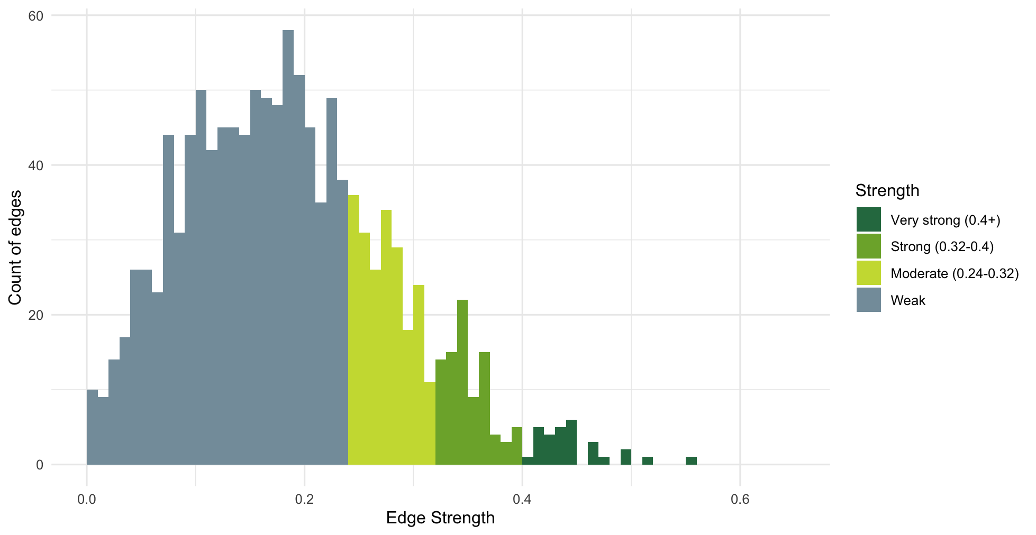
Strength of Edges

Slide 3
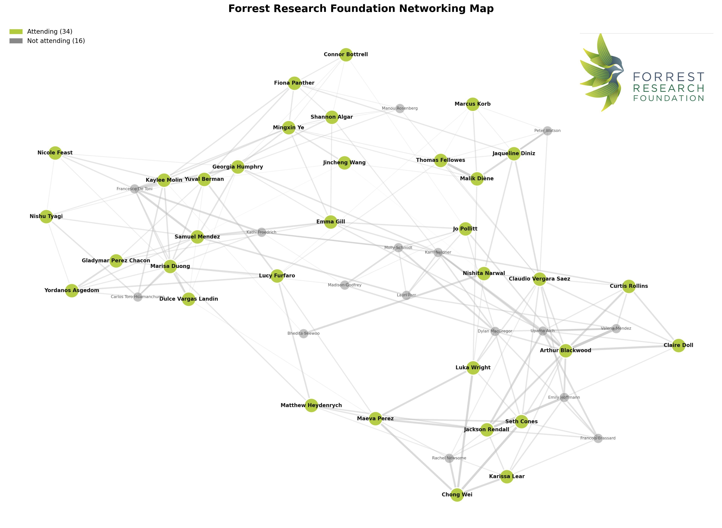

Slide 4
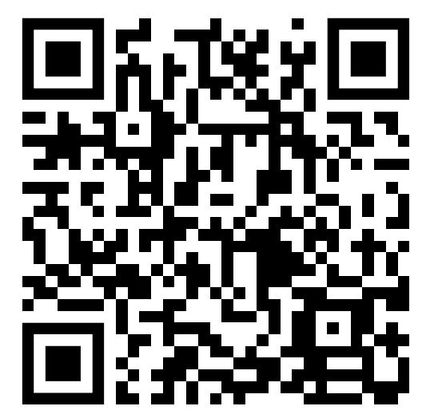
Interactive network
Or head to
https://yuval-b.github.io/frf-collab/output/network_interactive.html

