Slide 1
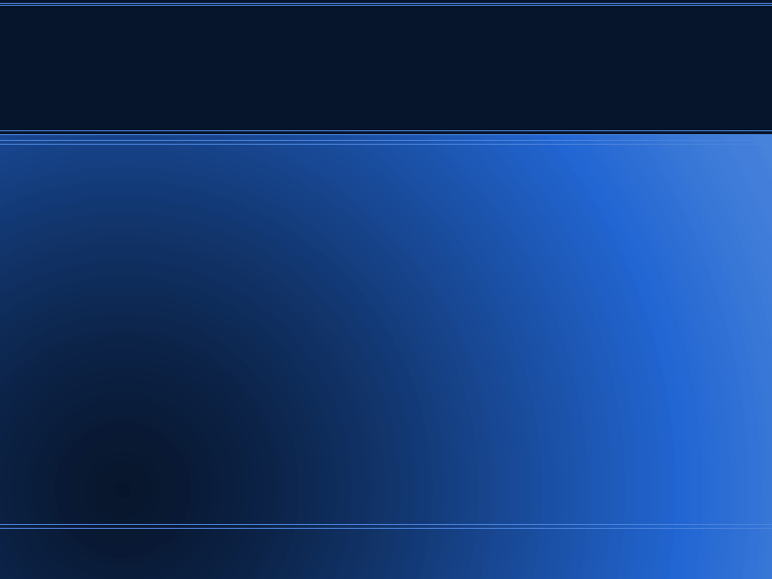
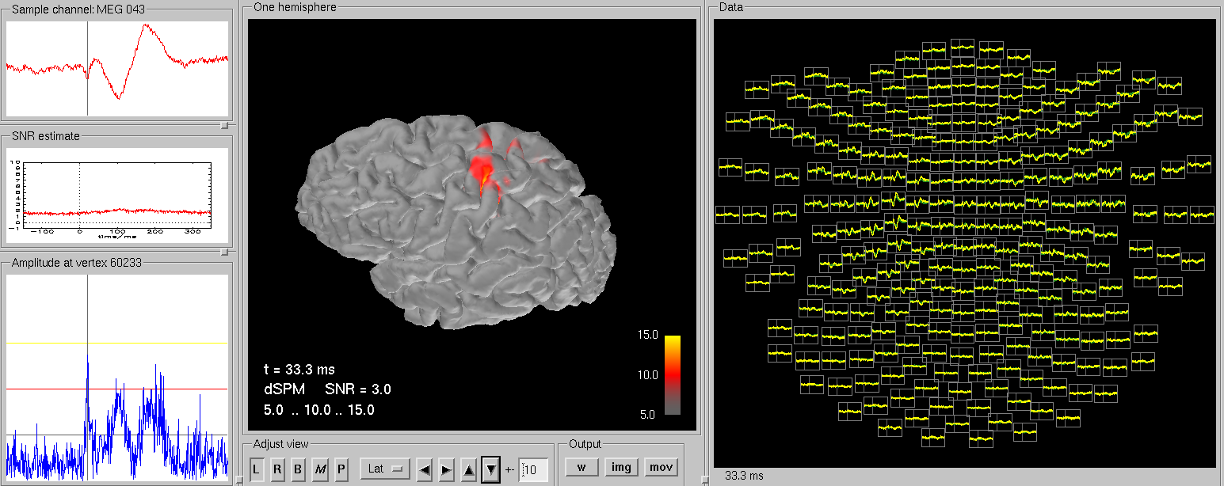
MNE a la Harvard using 4D data
Dr. Yuval Harpaz

Slide 2
FreeSurfer
MNE requires cortex surface (individual MRI).
You do it with FreeSurfer, it may take 12h.
Using current Ubuntu version (LTS) 14.04 and a freesurfer 5.1 I had to fix library issue but it should be fine with v 5.3.

Slide 3
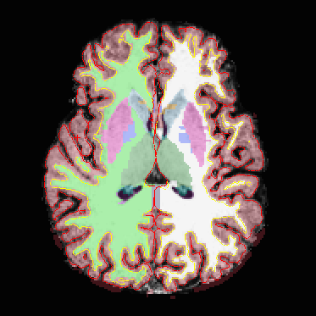
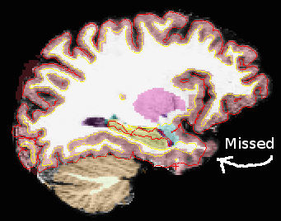
FreeSurfer
After instalation of freesurfer run:
To view results use tkmedit
May require manual labour
recon-all -all -s Maor -i 20110815151552288.dicom
tkmedit Maor brainmask.mgz -aux T1.mgz -surfs -aseg

Slide 4
MNE commands make BEM model and stuff
You need to install MNE, including MNE python for following procedures
export SUBJECT=Maor
mne_watershed_bem --atlas
mne_setup_mri --overwrite

Slide 5
Make MNE read 4D data export to .fif
You need bti2fiff.py
I have it there: ~/mne-python/mne/commands/mne_bti2fiff.py
This converts the 4D-neuroimaging data to a *.fif (neuromag) data file in a terminal run:
Thank you Denis Engemann for this function
mne_bti2fiff.py -p c,rfhp0.1Hz -o maor_raw.fif

Slide 6
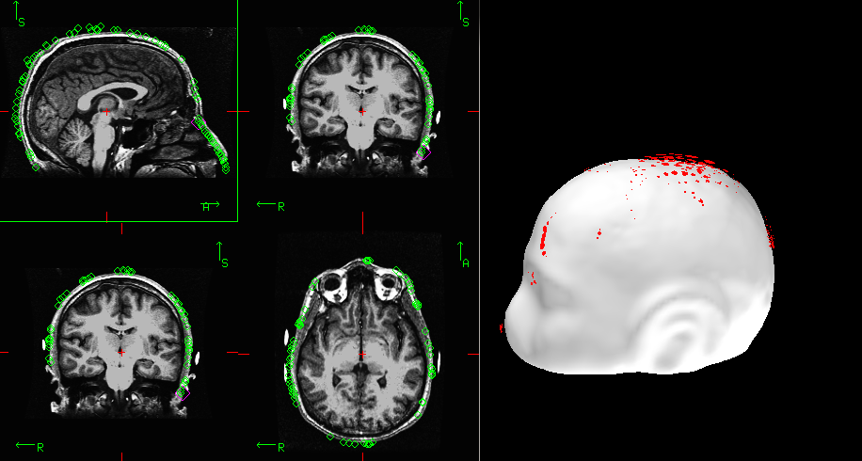
Coregistration of MRI to headshape
in a terminal:
Load the digitization points from the *raw.fif file
Load the surface (I use pial, doesn't mater which one)
In View tab you open viewer and MRI viewer. For both you should look for options – show digitizer data
Choose Adjust – Coordinate Alignment You have to mark fiducials on the scalp (white), then nudge or use automatic alignment. Here the nose is off by a few degrees. When done save transformation matrix using the button Save default (Maor_raw-trans.fif)
Export SUBJECT=Maor
mne_analyze

Slide 7
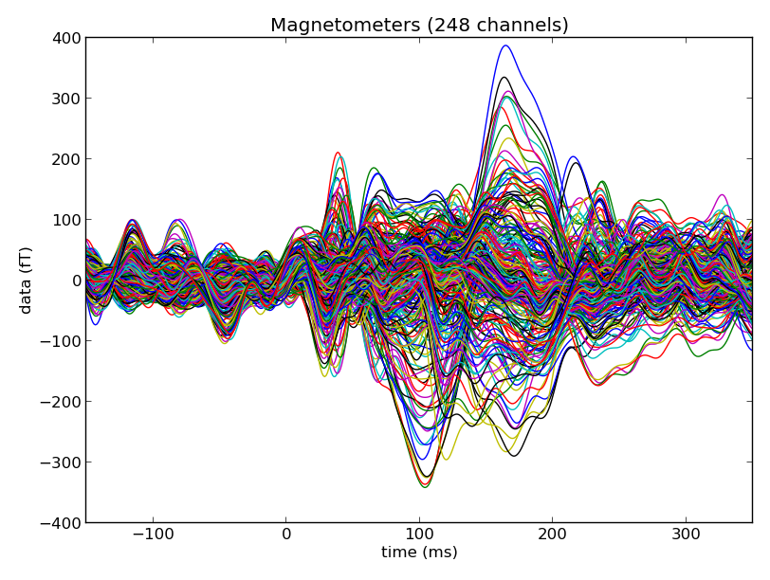
MNE pipeline
2. processing MEG with python use ipython terminal
import mne
import numpy
# read the data
raw = mne.fiff.Raw('maor_raw.fif',preload=True)
# bandpass filter
picks = mne.fiff.pick_types(raw.info, meg=True)
raw.band_pass_filter(picks, 1.0, 50.0, filter_length=2048)
raw.save('maorf_raw.fif')
# averaging
import mne
raw = mne.fiff.Raw('maorf_raw.fif')
events = mne.find_events(raw, stim_channel='STI 014')
event_id = 102 # the event number in events
tmin = -0.15 # start of each epoch (200ms before the trigger)
tmax = 0.35 # end of each epoch (500ms after the trigget)
picks = mne.fiff.pick_types(raw.info, meg=True, eeg=False, eog=False)
baseline = (None, 0)
reject = dict(mag=4e-12)
epochs = mne.Epochs(raw, events, event_id, tmin, tmax, proj=True,picks=picks, baseline=baseline, preload=True,reject=reject)
epochs_data = epochs.get_data()
evoked = epochs.average()
# plot
from mne.viz import plot_evoked
plot_evoked(evoked)
# save
evoked.save('maorf_evoked.fif')

Slide 8
MNE pipeline
3. calculate noise covariance, forward and inverse solution
Whitening – unit independent. Allows eeg + meg model
Inverse solution is depends on noise cov only
cov = mne.compute_covariance(epochs, tmin=None, tmax=0)
cov.save('maorf_raw-cov.fif')
mne_setup_source_space --ico -6 --overwrite
mne_setup_forward_model --homog --surf --ico 4 --overwrite
MEG_FN='maorf_raw.fif'
mne_do_forward_solution --spacing oct-6 mindist --overwrite --meas $MEG_FN --megonly --noisecov
mne_do_inverse_operator --fwd maorf_raw-oct-6-fwd.fif --deep --loose 0.2 --meg

Slide 9
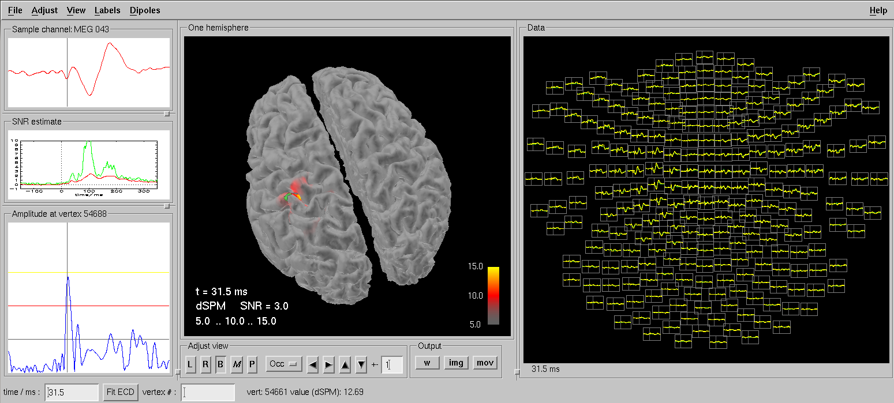
mne_analyze
We used it for corregistration, now for visualizing sources

Slide 10
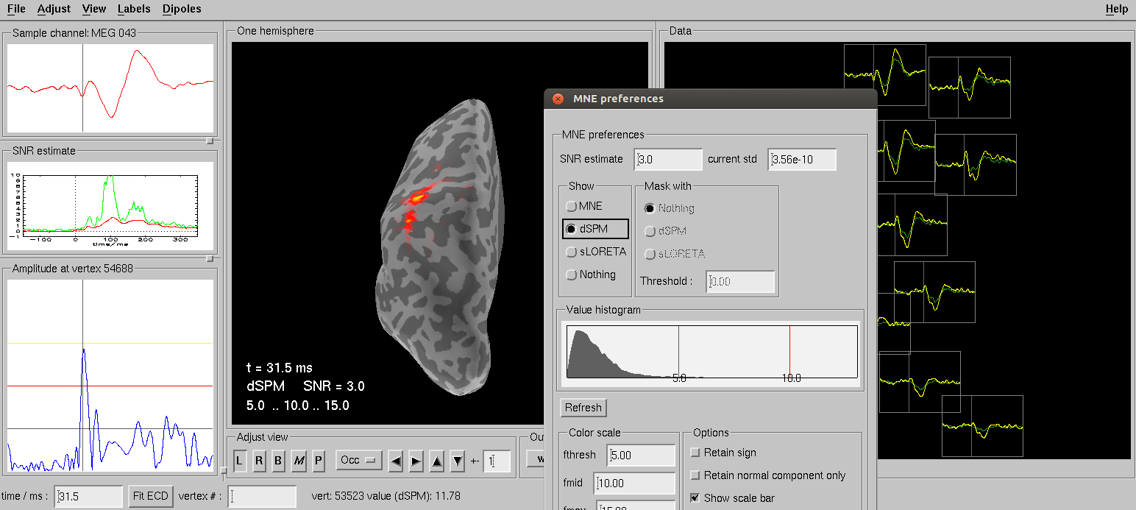
mne_analyze
SLORETA, inflated brain, all sorts

Slide 11
Did I thank Denis?
Not enough
Thank you Denis.

