Slide 1

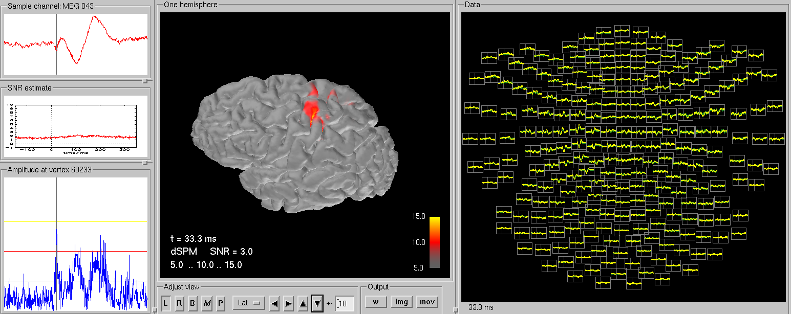
MNE a la Harvard using 4D data
Dr. Yuval Harpaz

Slide 2
FreeSurfer
MNE requires cortex surface (individual MRI).
You do it with FreeSurfer, it may take 12h.
Using current Ubuntu version (LTS) 14.04 and a freesurfer 5.1 I had to fix library issue but it should be fine with v 5.3.

Slide 3
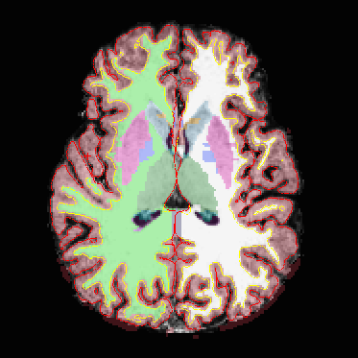
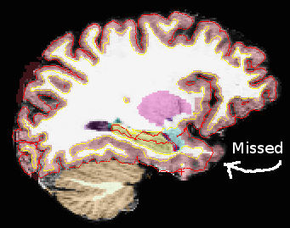
FreeSurfer
After instalation of freesurfer run:
To view results use tkmedit
May require manual
labour
recon-all -all -s Maor -i 20110815151552288.dicom
tkmedit Maor brainmask.mgz -aux T1.mgz -surfs -aseg

Slide 4
MNE commands make BEM model
and stuff
You need to install MNE, including MNE python for following procedures
There is a naming issue, so after watershed make a link so you have a *.surf file
export SUBJECT=Maor
mne_watershed_bem --atlas
mne_setup_mri --overwrite
ln -s /usr/local/freesurfer/subjects/Maor/bem/watershed/Maor_inner_skull_surface /usr/local/freesurfer/subjects/Maor/bem/Maor-inner_skull.surf

Slide 5
Make MNE read 4D data
export to .fif
You need bti2fiff.py
I have it there: ~/mne-python/mne/commands/mne_bti2fiff.py
This converts the 4D-neuroimaging data to a *.fif (neuromag) data file
in a terminal run:
Thank you Denis Engemann for this function
You can look at the bash script 4Dtofiff for easy convert the data
mne_bti2fiff.py -p c,rfhp0.1Hz -o maor_raw.fif

Slide 6
Running python scripts
I had issues running py scripts
my current work setup is using python3 on ubuntu.
I had to install on python3 the following:
To run a script:
sudo apt-get pyhton3-numpy
sudo apt-get pyhton3-matplotlib
sudo apt-get pyhton3-scipy
python3 ~/MNE4D/pyScripts/average2048.py

Slide 7
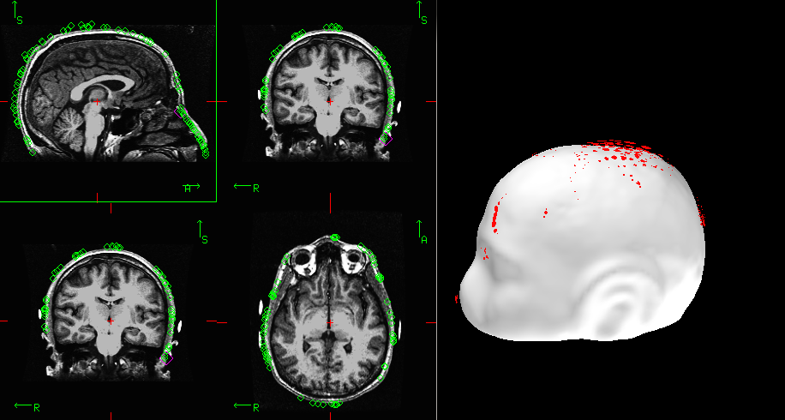
Coregistration of MRI to headshape
in a terminal:
Load the digitization points from the *raw.fif file
Load the surface (I use pial, doesn't mater which one)
In View tab you open viewer and MRI viewer.
For both you should look for options –
show digitizer data
Choose Adjust – Coordinate Alignment
You have to mark fiducials on the
scalp (white), then nudge or use
automatic alignment. Here the
nose is off by a few degrees. When done
save transformation matrix using the button
Save default (Maor_raw-trans.fif)
Export SUBJECT=Maor
mne_analyze

Slide 8
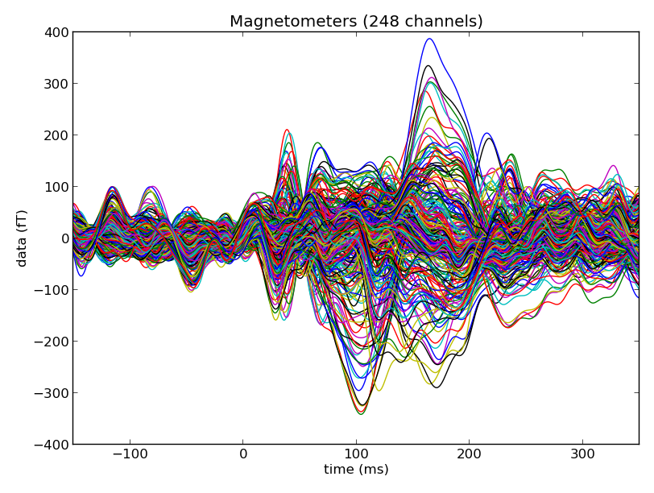
MNE pipeline
Use MNE website for many examples
Here is an example missing a line for filtering
See more examples at MNE4D/pyScripts
import os
_, folder = os.path.split(os.getcwd())
import mne
raw=mne.io.Raw('MNE/'+folder+'_raw.fif');
events = mne.find_events(raw, stim_channel='STI 014')
event_id = 2048 # the event number in events
tmin = -0.5 # start of each epoch (200ms before the trigger)
tmax = 0.8 # end of each epoch (500ms after the trigget)
picks = mne.pick_types(raw.info, meg=True, eeg=False, eog=False)
baseline = (None, 0)
#reject = dict(mag=4e-12)
epochs = mne.Epochs(raw, events, event_id, tmin, tmax, proj=True,picks=picks, baseline=baseline, preload=True)
epochs_data = epochs.get_data()
evoked = epochs.average()
# plot
from mne.viz import plot_evoked
plot_evoked(evoked)
# save
evoked.save('MNE/'+folder+'_wbw-ave.fif')

Slide 9
MNE pipeline
Note that the events are read from the trigger channel STI 014
You can make an event file and use mne.read_events to read it
First column is the sample of each event, second column is from which trigger value the event goes up (zero) and the 3rd column is to which trigger value it rises (say 100 for one condition and 102 for another)
In matlab you can do something like:
evt=[2512 0 100; 3721 0 102; 5010 0 100];
mne_write_events('sub1-eve.fif',evt);
The function is in fieldtrip toolbox.
Alternatively you can save the three columns as a text file called sub1-eve.txt
Note that sample number 1 in matlab is sample number 0 in python!

Slide 10
MNE pipeline
calculate noise covariance, forward and inverse solution python:
Bash (terminal):
Whitening – unit independent. Allows eeg + meg model
Inverse solution is depends on noise cov only
cov = mne.compute_covariance(epochs, tmin=None, tmax=0)
cov.save('maorf_raw-cov.fif')
mne_setup_source_space --ico -6 --overwrite
mne_setup_forward_model --homog --surf --ico 4 --overwrite
mne_do_forward_solution --spacing oct-6 mindist --overwrite --meas maor_raw.fif --megonly --noisecov
mne_do_inverse_operator --fwd maor_raw-oct-6-fwd.fif --deep --loose 0.2 --meg

Slide 11
MNE pipeline
Get source activity (virtual sensors)
from mne.datasets import sample
from mne.minimum_norm import read_inverse_operator
from mne import read_evokeds
from mne.minimum_norm import apply_inverse, read_inverse_operator
fname_evoked='ft_WbW-ave.fif'
fname_inv = 'ohad_raw-oct-6-meg-inv.fif'
snr = 3.0
lambda2 = 1.0 / snr ** 2
method = "dSPM" # use dSPM method (could also be MNE or sLORETA)
# Load data
evoked = read_evokeds(fname_evoked, condition=0, baseline=(None, 0))
inverse_operator = read_inverse_operator(fname_inv)
stc = apply_inverse(evoked, inverse_operator, lambda2, method, pick_ori=None)
stc.save('mne_%s_inverse' % method)

Slide 12
MNE pipeline
Morph – move subject data to average subject “fsaverage”
import mne
import numpy as np
from mne.datasets import sample
subject_from = 'aliceOhad'
subject_to = 'fsaverage'
fname='mne_dSPM_inverse'
stc_from = mne.read_source_estimate(fname)
vertices_to = [np.arange(10242), np.arange(10242)]
stc_to = mne.morph_data(subject_from, subject_to, stc_from, n_jobs=1, grade=vertices_to)
stc_to.save('%s_wbw-meg' % subject_to)

Slide 13
MNE pipeline
Use PySurfer to view the results
# for the figure to open well run this script
# in ipython, call it like this: ipython --gui=wx
#taken from http://pysurfer.github.io/auto_examples/plot_meg_inverse_solution.html
import numpy as np
from surfer import Brain, TimeViewer
from surfer.io import read_stc
brain = Brain('fsaverage', 'both', 'pial', views='caudal')
stc = read_stc('fsaverage_wbw-meg-lh.stc')
data = stc['data']
vertices = stc['vertices']
time = 1e3 * np.linspace(stc['tmin'], stc['tmin'] + data.shape[1] * stc['tstep'], data.shape[1])
colormap = 'hot'
time_label = 'time=%0.2f ms'
brain.add_data(data, colormap=colormap, vertices=vertices, smoothing_steps=10,
time=time, time_label=time_label, hemi='lh')
stc = read_stc('fsaverage_wbw-meg-rh.stc')
data = stc['data']
vertices = stc['vertices']
brain.add_data(data, colormap=colormap, vertices=vertices, smoothing_steps=10,
time=time, time_label=time_label, hemi='rh')
#brain.set_data_time_index(2)
#brain.scale_data_colormap(fmin=13, fmid=18, fmax=22, transparent=True)
viewer = TimeViewer(brain)

Slide 14
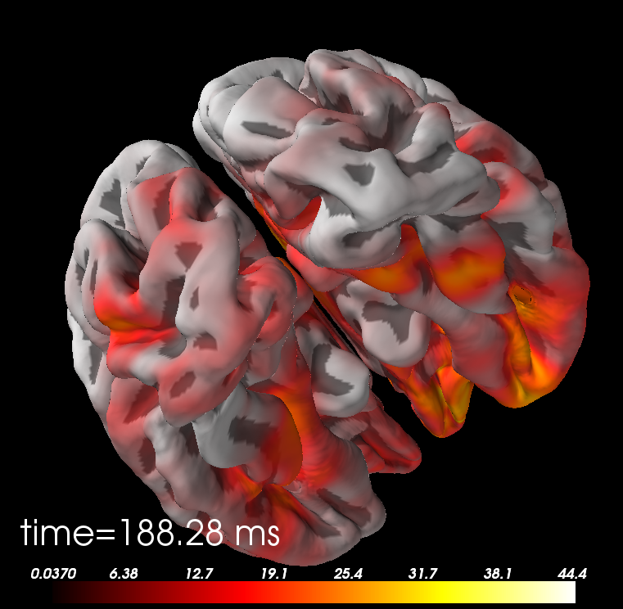
MNE pipeline
See activity by the millisecond

Slide 15
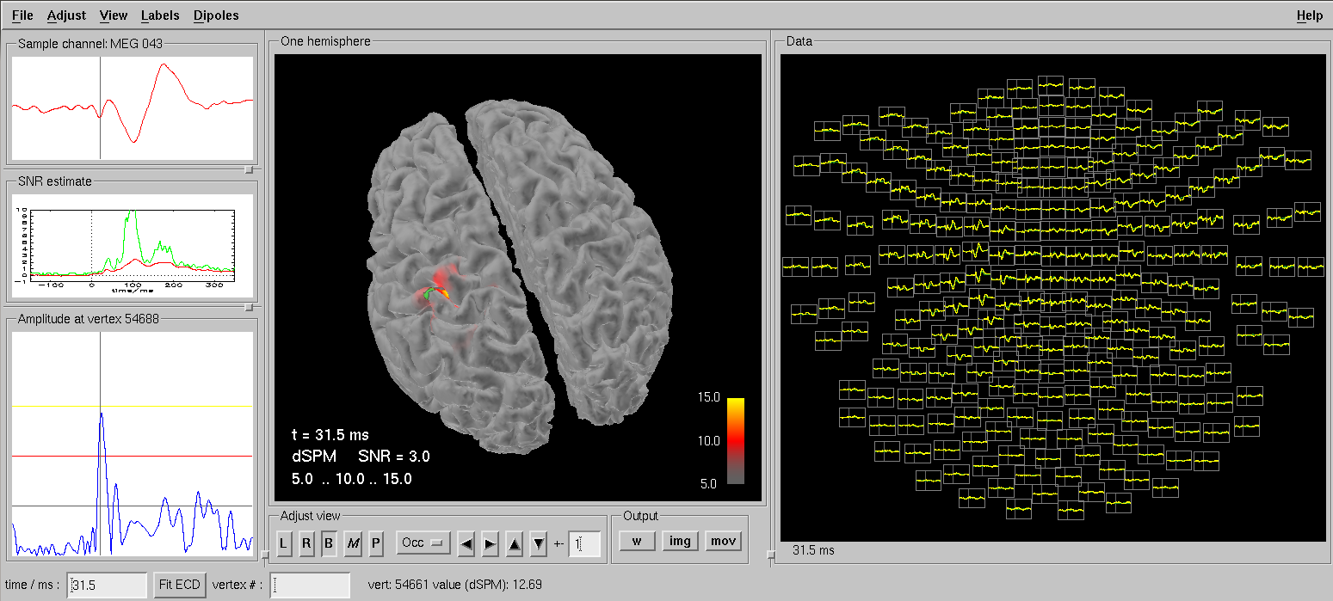
mne_analyze
You can use mne_analyze command line tool. We used it for corregistration, now for visualizing sources

Slide 16
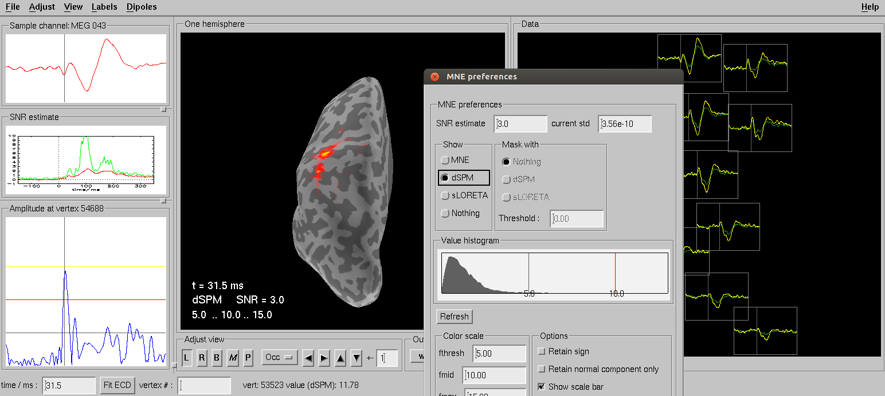
mne_analyze
SLORETA, inflated brain, all sorts

Slide 17
Did I thank Denis?
Not enough
Thank you Denis.

