Slide 1

Creating Nolte head model
In the following commands the bang (!) tels matlab to use system command. You can also run the commands in a linux terminal without the bang. In our labYou may have to change ~/abin with /home/megadmin/abin. Here we go.
This takes a few minutes. It creates brain surface from the MRI.
!~/abin/3dSkullStrip -input warped+orig -prefix mask -mask_vol -skulls -o_ply ortho

Slide 2
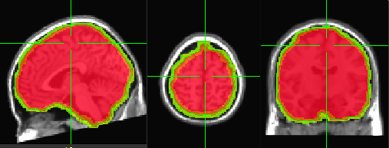
Viewing the brainhull
Viewing the brain-shape: in a linux terminal write:
afni -niml -dset warped+orig mask+orig &
Then display warped as underlay and mask as overlay. See that the mask sits well around the brain like this:
You can see the hull by running SUMA:
suma -niml -i_ply ortho_brainhull.ply -sv warped+orig -novolreg
click anywhere in the suma window and press 't' on the keyboard. (see next slide in a moment).

Slide 3
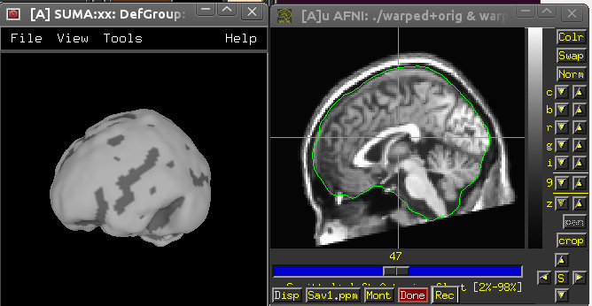
Viewing the brainhull
SUMA AFNI

Slide 4
Move data to MNI space
In a terminal
move the MRI (ortho+orig*) to tlrc (MNI really):
@auto_tlrc -base ~/abin/MNI_caez_N27+tlrc -input ortho+orig -suffix mni
The output will be orthomni+orig

Slide 5
Move data to MNI space
This function creates the positions of each grid point based on the individual MRI:
load template_grid_10mm; % or 5mm
pos=tlrc2orig(template_grid.pos,'orthomni'); % pos in PRI(mm)
The output ‘pos’ should replace the ‘pos’ field in the template grid:
grid = template_grid;
grid.pos = pos./1000;
grid.unit='m';
The resolution of the grid points is in mm. transfer to meters to make the grid fit the head model on the next step.

Slide 6
Create volume
Now we have a grid of points, moved from MNI coordinates to orig, MEG space. We need vol, head model, for source analysis. We use the ortho.ply to create realistic head model (should be better than sphere based model).
vol=ply2vol('ortho.ply');
Both vol and grid should be in PRI order and in meters. You can view them together like this:
plot3pnt(vol.bnd.pnt,'.');
hold on;
plot3pnt(grid.pos,'xk');

Slide 7
Create volume
Now you can use both for ft_sourceanalysis, specify:
cfg.grid=grid;
cfg.vol=vol;

