Slide 1

SAM tutorial
Analyzing MEG with SAM beamformer
(ver 3.3)
Yuval Harpaz
Bar Ilan University
Thanks to Dr. Robinson for the software and code!

Slide 2
System requirements and software
We work with Ubuntu (Linux) 64bit. The software is written for Ubuntu 32bit and should work well on 32 machine. For 64 machine (and 64bit Ubuntu) install getlibs and run it.
You need to create a bin file in your home directory and to put in it the SAM executable files.
Also install AFNI (gcc33_64) after downloading and extracting put the abin file in your home directory.
Add the bin and abin folders to the path of the terminal (.bashrc) and change permissions to allow executing the files in them.
brainhull
tcsh (sudo apt-get tcsh)
matlab and optionally git (sudo apt-get git-core) to update matlab scripts.
After installing git clone our matlab scripts repositories:
sudo git clone git://github.com/yuval-harpaz/cleanMEG_BIU.git
sudo git clone git://github.com/yuval-harpaz/SAM_BIU.git
sudo git clone git://github.com/yuval-harpaz/ft_BIU.git

Slide 3
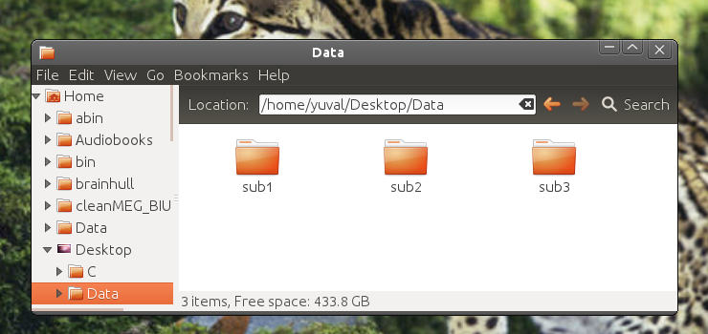
How to organize the data
First there must be a folder (e.g. Data) with folders in it (e.g. sub1 sub2 ...), one for each subject. If there were more than one run per subject (stopped the MEG acquisition and started a new acquisition later) the data of every run should be put in separate folders (e.g. sub1run1 sub1run2 sub2run1 sub2run2 ...).

Slide 4
Content of individual folders:
The data (e.g. 'c,rfhp0.1Hz')
hs_file
Config
If Nolte model is to be used a hull.shape file should also exist, this will be described later.
Real time weights file (e.g. 'sub1.rtw')
this can be created on megdaw or megmaps desktop by posting the data file and run: print_table -posted WP both > sub1.rtw (see next slide).
if the scan is the same (0.14d1) for all subjects the same weight file can be copied and renamed for all subjects.
Note that subjects before and after maintenance (during summer vacation) will require a different file.

Slide 5
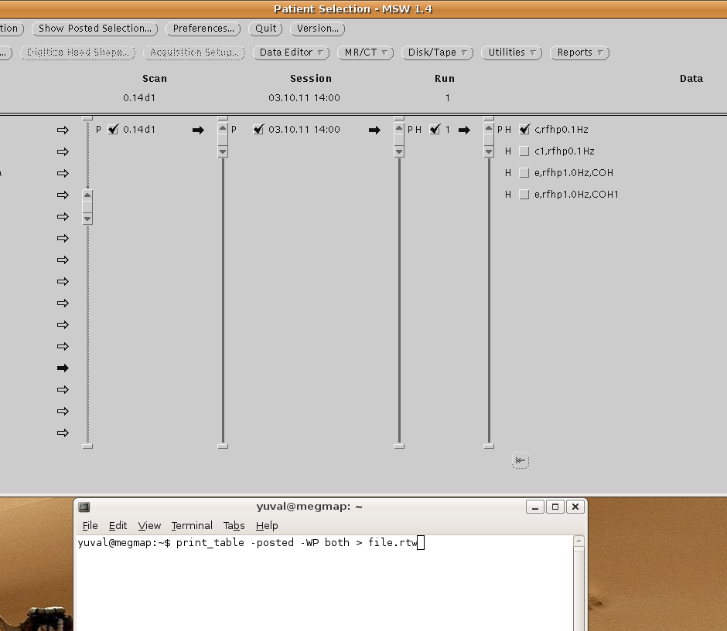
creating the *.rtw file

Slide 6
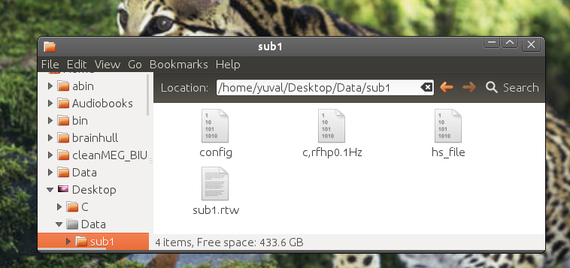
Content of individual folders:

Slide 7
View the data
The most basic thing to do is to create a list of trials by reading the trigger channel with readTrig_BIU (matlab). In the end you need a vector of one row, e.g. [12.345 14.565 16.791 …], for every condition.
Example:
trig=readTrig_BIU('c,rfhp0.1Hz'); %read the trigger channel
trig=clearTrig(trig); %cleaning 50Hz and visual markers
Htrig=(find(trig==200)); % finding trials with trigger 200 (Humus condition)
Ttrig=(find(trig==202)); % finding trials with trigger 202 (Tahini condition)
Then create a text file with this info for SAM with Trig2mark:
Trig2mark('Humus', Htrig,'Tahini',Ttrig);
However, trials with muscle or “jump” artifact should be rejected so you want to see the data first. We use fieldtrip(ft) for this but this is not a ft tutorial. You can see ft example scripts in our ft_BIU repository.
Another reason you want to view the data is because you want to know how the averaged data looks like or how the power at different frequencies looks like for specifying time and frequency of interest later.

Slide 8
Using FieldTrip trl matrix
Using our fieldtrip version with BIUtrialfun will give a trl matrix with rows for trials and columns for first sample, last sample offset and trigger value for every trial. Example of one row trl:
[13576 14738 -305 202]. -305 here means that the first sample is 305 samples before time zero. So to use this trl matrix in Trig2mark we have to get the sample of time zero which is trl(:,1)-trl(:,3) and devide it by the sampling rate (1017.25 for this example). Then we find Humus and Tahini trials and it all looks like this in the Trig2mark function:
trigTime=(trl(:,1)-trl(:,3))./1017.25;
Trig2mark(...
'Humus',trigTime(find(trl(:,4)==200),1)',...
'Tahini',trigTime(find(trl(:,4)==202),1)');

Slide 9
MarkerFile.mrk example
The output file of Trig2mark will start like this:
NUMBER OF MARKERS:
2
NAME:
Humus
NUMBER OF SAMPLES:
64
TRIAL NUMBER TIME FROM SYNCH POINT (in sec.)
+0 +997.091177
+0 +1000.123863
+0 +1003.155566
+0 +1006.188253
+0 +1009.220939
+0 +1012.252642
+0 +1015.285328
+0 +1018.318014
+0 +1045.759646
+0 +1048.791349

Slide 10
Choosing analysis steps
SAMcov and SAMwts are the first steps.
Decide which head model to use for SAMwts: Multiple spheres (does not require MRI) or Nolte (more accurate, particularly for basal areas where the cortex looks nothing like a sphere).
After SAMwts:
To localize event related fields (components of averaged data) use SAMerf.
To localize unaveraged activity (e.g. alpha) use SAMspm.
More options such as SAMtime and SAMepi are also possible but will not be discussed here
Choose time windows for active and control conditions.
Choose frequency band of interest.

Slide 11
Preparing template MRI
For multiple sphere model one needs headshape (digitized scalp points) only. However, in order to transfer SAM results to Talairach space (for group statistics) one needs MRI. For Nolte model MRI is required also for SAM. When individual MRI is not available a template can be used (Colin 27). to fit the template MRI to individual head size cd your matlab to subjects directories and:
fitMRI2hs('c,rfhp0.1Hz') % enter the correct file name
hs2afni
The last command converts the head shape to AFNI format for nudging (next slide).
Dealing with individual MRI will not be described here for the time being.

Slide 12
AFNI Nudger
Now there should be a pair of files beginning with 'warped' in the subjects directories which are the template MRI after shrunk or inflated to fit individual scalps and positioned more or less as put in the MEG. Now a fine tuning of head position in the MEG is needed.
cd a linux terminal to the subjects directory and type afni.
Then choose the warped as underlay and HS as overlay.
Click image image image to see something.
Then click on define data mode, plugins, Nudge dataset. Click 'Choose Dataset' button and choose warped.

Slide 13
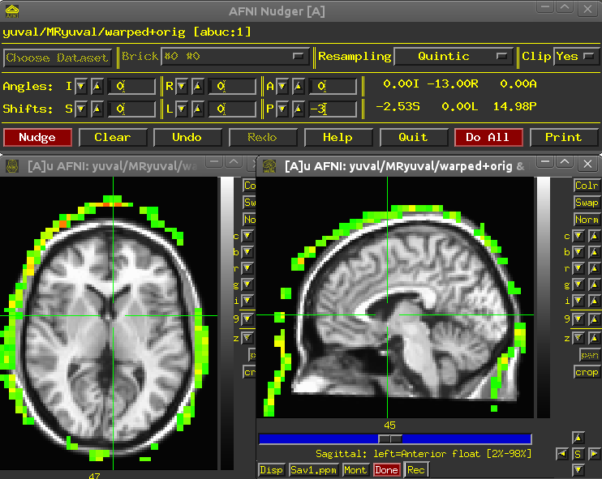
AFNI Nudger
Here we need to push the MRI forward
In the 'Shifts' row write -3
(or any other number of mm)
in the rightmost field
(Anterior Posterior shifts).
Nudge. Nudge again if needed.
Angles are tricky. Play and see.
Write zero before moving to
another filed.
When you finish click Do All
or you are dead.

Slide 14
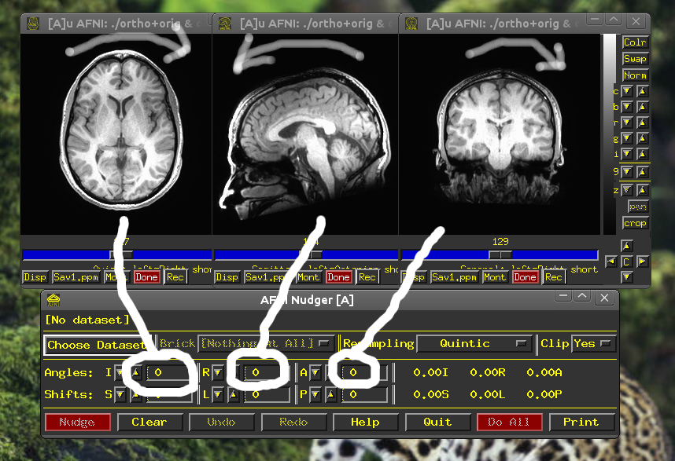
Angles nudging arrows indicate the effect of positive values

Slide 15
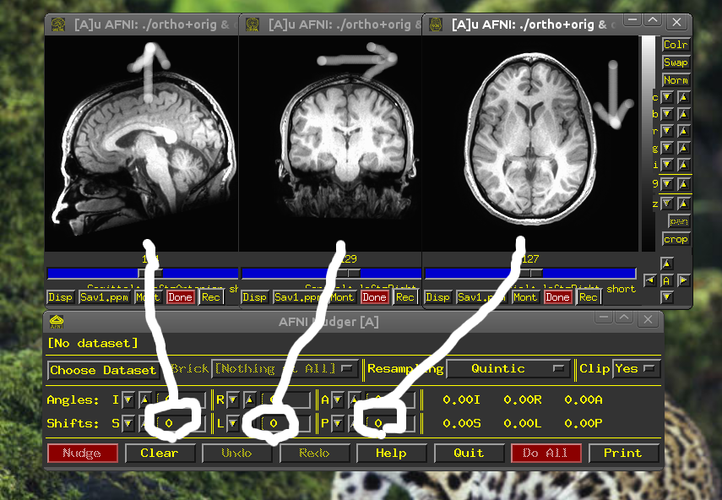
Shifts nudging

Slide 16
Creating Nolte head model
In the following commands the bang (!) tels matlab to use system command. You can also run the commands in a linux terminal without the bang. In our labYou may have to change ~/abin with /home/megadmin/abin. Here we go.
This takes a few minutes. It creates brain surface from the MRI.
!~/abin/3dSkullStrip -input ortho+orig -prefix mask -mask_vol -skulls -o_ply ortho

Slide 17
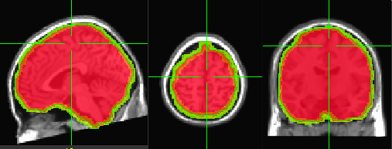
Viewing the brainhull
Viewing the brain-shape: in a linux terminal write:
afni -niml -dset warped+orig mask+orig &
Then display warped as underlay and mask as overlay. See that the mask sits well around the brain like this:
You can see the hull by running SUMA:
suma -niml -i_ply ortho_brainhull.ply -sv warped+orig -novolreg
click anywhere in the suma window and press 't' on the keyboard. (see next slide in a moment). Whether you view the mask / hull or not, you must run meshnorm to create a hull.shape file for SAM (bang for matlab)::
!meshnorm ortho_brainhull.ply > hull.shape

Slide 18
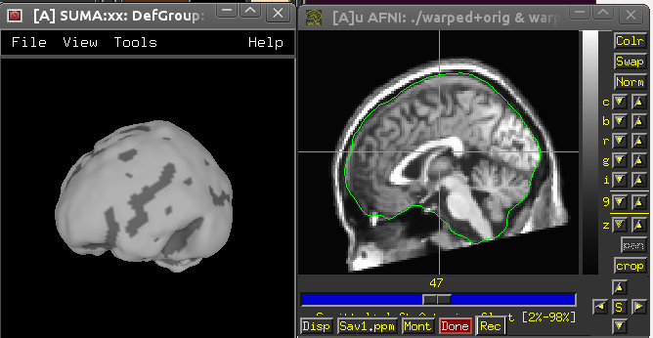
Viewing the brainhull
SUMA AFNI

Slide 19
Creating a param file
SAM now uses a text file with a lot of configuration info such as bandwidth of interest. Be careful with it, don't change it after you ran it, it is a document of what SAM did. You make it once for all subjects and put it in the parent directory.
Here is an example file found there- SAM_BIU/docs/SPMemp.param
NumStates 2
DataBand 3 35
ImageBand 3 35
DataSegment -0.2 0.6
XBounds -12.0 12.0
YBounds -9.0 9.0
ZBounds -2.0 15.0
ImageStep 0.5
ImageMode U-Test
ImageMetric Power
Model Nolte
CovSum TRUE
LogP TRUE
Active Pain 0.1 0.2
Control NoPain 0.1 0.2

Slide 20
Creating a param file
There is a function for writing such a text file, it helps avoiding errors. In the example below I want the param file to be called 'Hum' because I measure Humus evoked magnetic fields. I want to run SAMerf, the active state is 'Humus' between 50 and 1000s and the control is 'Humus' again but between -300 and 0ms. The frequency band I want is 3-35Hz and the data segment for calculating covariance is the whole trial, -300 to 1000ms. Times are given in seconds.
CreatePARAM('Hum','ERF','Humus',[0.05 1],'Humus',[-0.3 0],[1 35],[-0.3 1]);
Now I want to prepare param for SAMspm, comparing directly the humus and tahini conditions between 130 to 250ms in the alpha range. I also want Pseudo-Z rater thann the default statistic (open createParam to see all the defaults).
CreatePARAM('HvsT','SPM',Humus',[0.13 0.25],'Tahini',[0.13 0.25],[7.5 13.5],[-0.3 1],'Pseudo-Z');

Slide 21
SAM
This is it. For SAMerf:
!SAMcov -r sub1 -d c,rfhp0.1Hz -m Hum -v
!SAMwts -r sub1 -d c,rfhp0.1Hz -m Hum -c Humusa -v
!SAMspm -r sub1 -d c,rfhp0.1Hz -m Hum -v
For SAMspm:
!SAMcov -r sub1 -d c,rfhp0.1Hz -m Hum -v
!SAMwts -r sub1 -d c,rfhp0.1Hz -m Hum -c Sum -v
!SAMspm -r sub1 -d c,rfhp0.1Hz -m Hum -v
Note differences in SAMwts for -c flag. Add 'a' to the active condition for erf. For spm just use Sum.
svl files will be created in SAM directory. Overlay them with AFNI on the warped MRI to view them. Later we'll talk about group statistics. Good luck.

