Slide 1
correctHB and correctLF functions
Monitoring automatic cleaning and adjusting parameters
Examples are given for dealing with unusual cases

Slide 2
Prepare for cleaning
Download cleanMEG_BIU from
http://yuval-harpaz.github.io/cleanMEG_BIU/
Set path, add cleanMEG_BIU/cleanMEG with subfolders
To clean whole 4D datasets, in Matlab cd to where it is, and:
clean=correctLF; or clean=correctHB;
you can then rewrite a 4D file by:
rewrite_pdf(clean); % you can specify a file-name
Other input options:
CorrectHB('c1,rfhp0.1Hz'); % to specify which file to take
correctHB(clean,678.17); % not RAM friendly, may be a problem with large files
CorrectHB('clean.mat',678.17);
I prefer cleaning LF before HB

Slide 3
Prepare for cleaning
If you want to clean a certain part of the data you can read it with pdf4D (first 100s)
taken from here: http://biomag.wikidot.com/msi-matlab
pdf=pdf4D('c,rfhp0.1Hz');
sRate = get(pdf, 'dr');
time0=5;time1=100;
lat=round(sRate*[time0 time1]);
chi = channel_index(pdf, 'meg', 'name');
chn = channel_name(pdf, chi);
data=read_data_block(pdf,lat,chi);
or use FieldTrip (less RAM friendly)

Slide 4
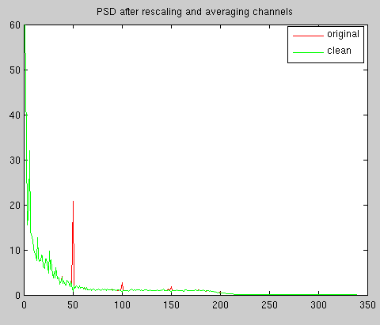
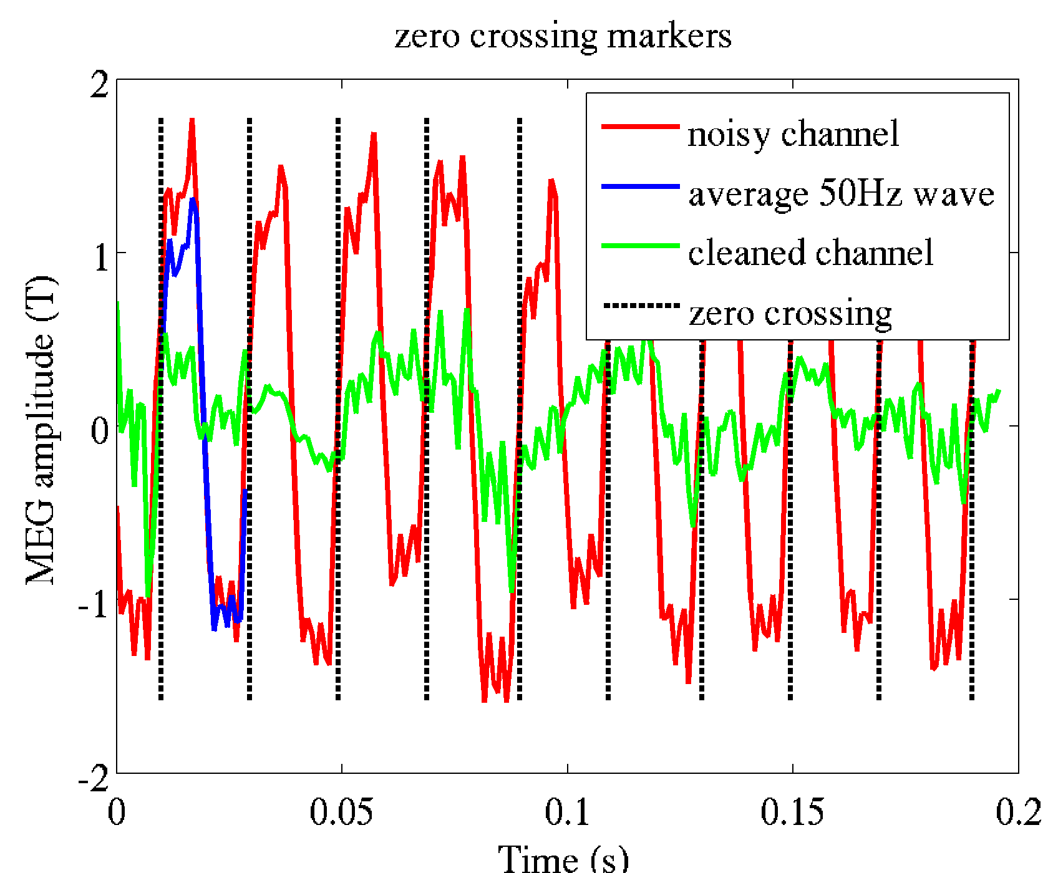
Cleaning Line Frequency
clean=correctLF;
- The function checks if you have 50 or 60Hz
- It finds the channel with most 50Hz for zero crossing detection
- The data is averaged to create 50Hz waveform template for each channel
- A chain of templates is subtracted from the data

Slide 5
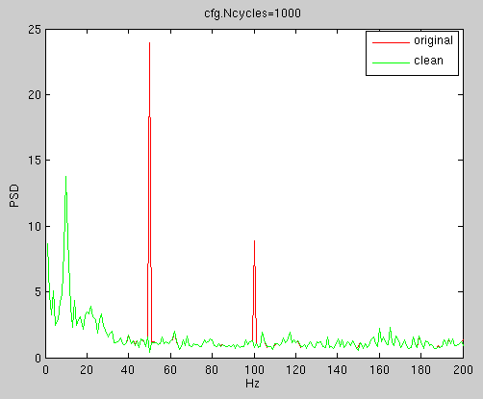
Cleaning Line Frequency

Slide 6
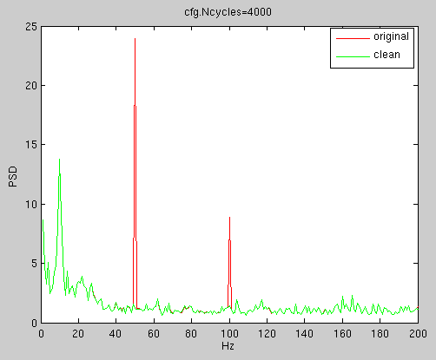
Cleaning Line Frequency

Slide 7

Cleaning Line Frequency

Slide 8
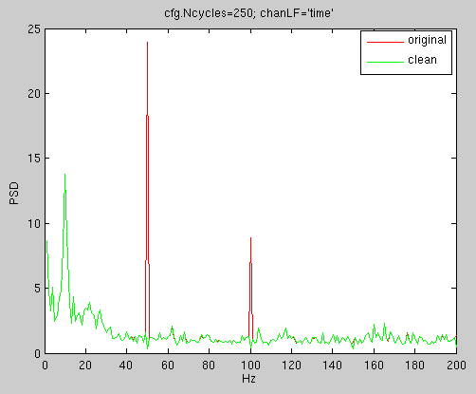
Cleaning Line Frequency

Slide 9
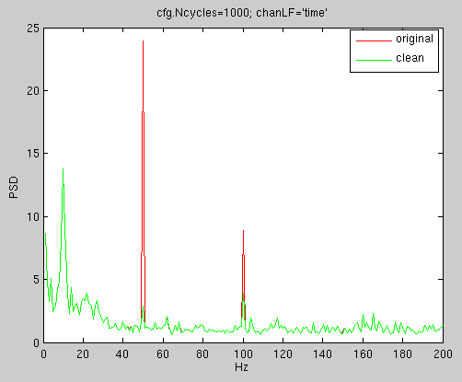
Cleaning Line Frequency

Slide 10
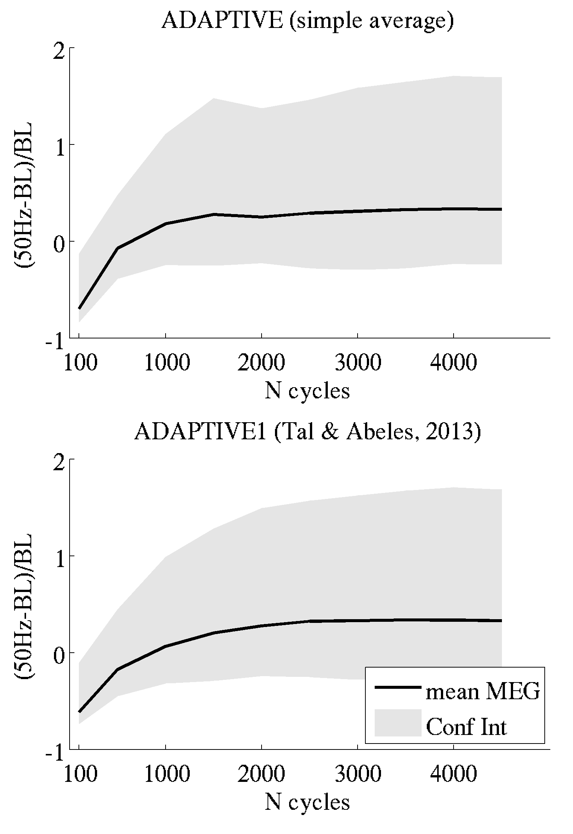
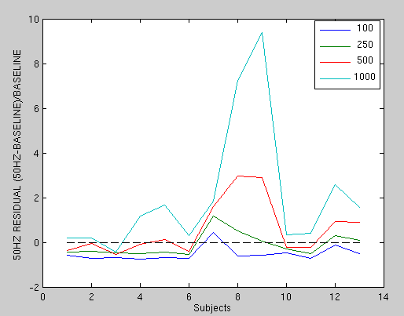
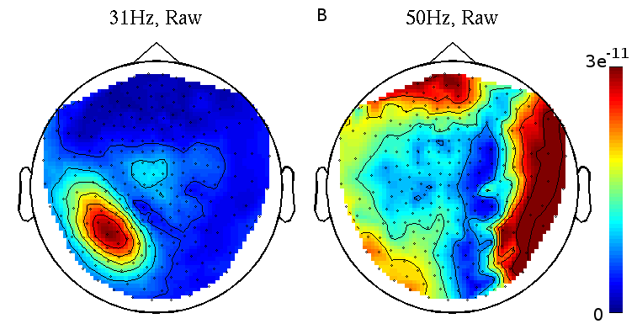
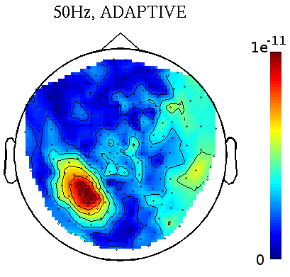
Cleaning Line Frequency
The 50Hz waveform may change shape over time, the template has to change adaptively. The default is to average Ncycles = 400. Averaging less Ncycles may reduce random noise but also brain 50Hz (notch). Averaging more Ncycles may clean less effectively.
Empty room, BIU data 13 subjects, Erlangen data Seizure (BIU)
Ncycles=500
cfg=[];
cfg.Ncycles=1000;
clean=correctLF([],[],[],cfg);

Slide 11
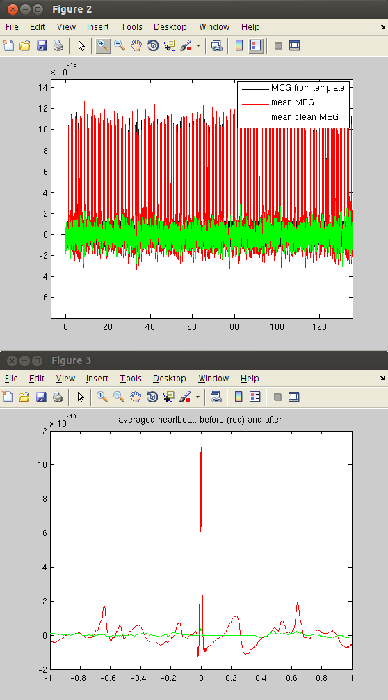
Viewing the cleaned data
After cleaning the data you see the averaged HB before and after cleaning (averaging all heartbeats and then all the MEG channels). You also see the mean MEG channel before and after cleaning, and the artifact estimate (MCG). There, Red – Black = Green.
You must zoom in to see single heartbeats to see that they are chained together well

Slide 12
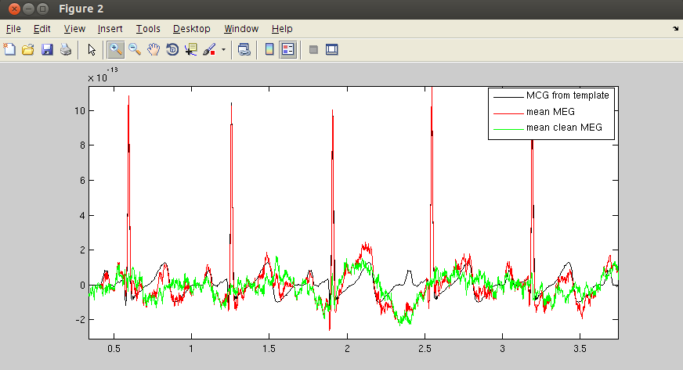
Viewing the cleaned data

Slide 13
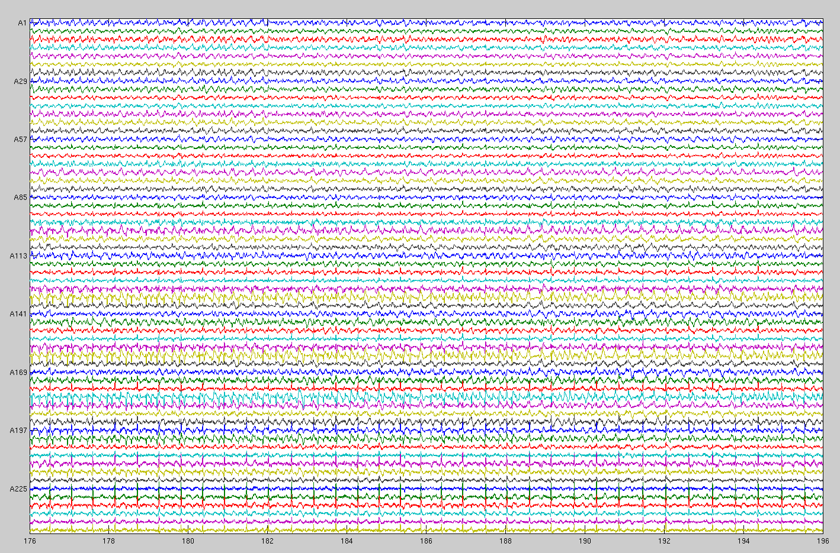
Before cleaning

Slide 14
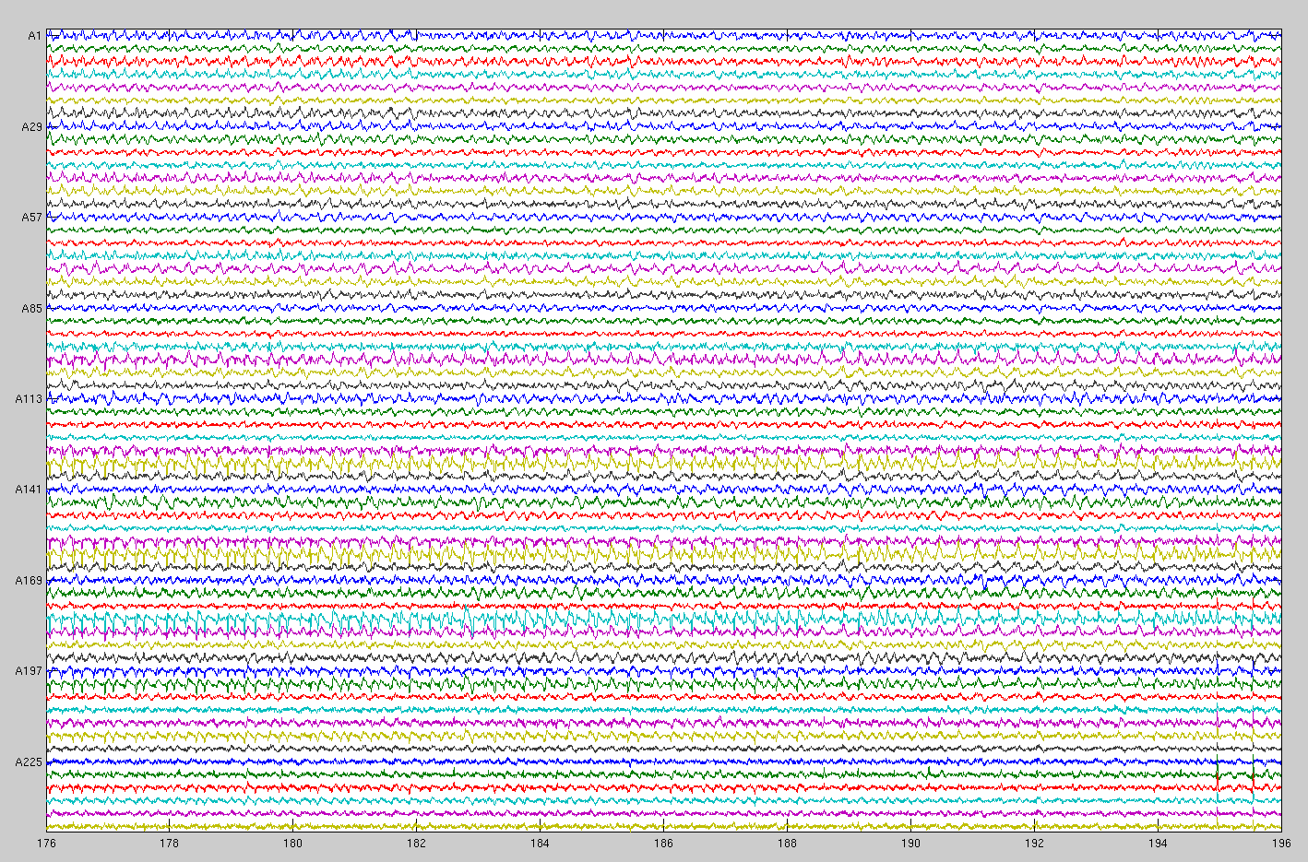
After cleaning

Slide 15

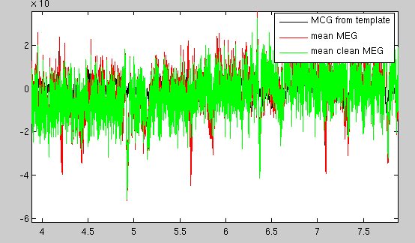
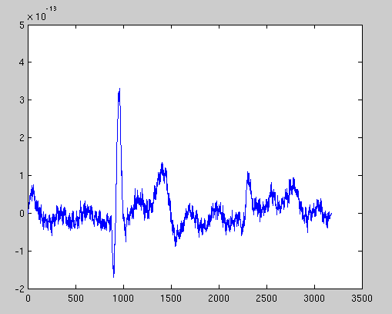
The period is too long
[clean,~,templateHB]=correctHB;
You suspect it because you got a warning of 'too long period'
The heartbeat was skipped many times
The templateHB is too long

Slide 16
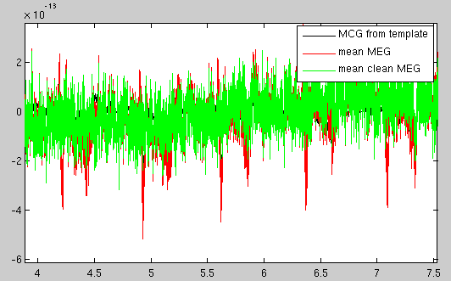
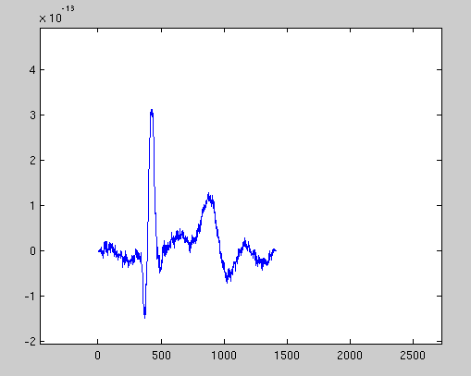
The period is too long
What can be done?
cfg=[];
cfg.maxPeriod=1;
[clean,~,templateHB]=correctHB([],[],[],[],cfg);

Slide 17
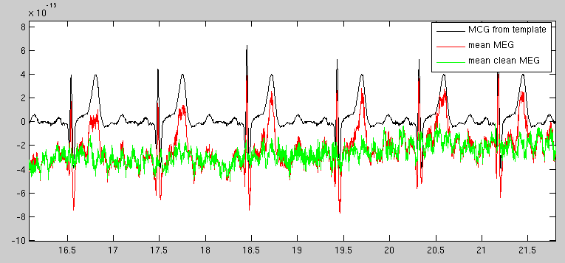
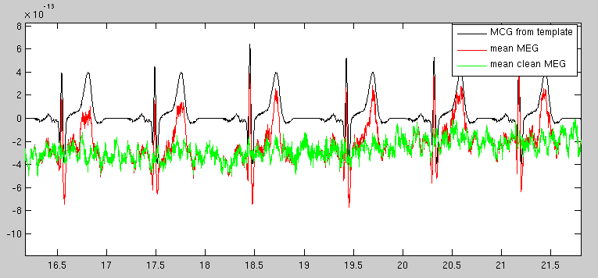
The template is too long
Here the template has a bump in the end
What can be done?
cfg=[];
cfg.afterHBs=0.45;

Slide 18
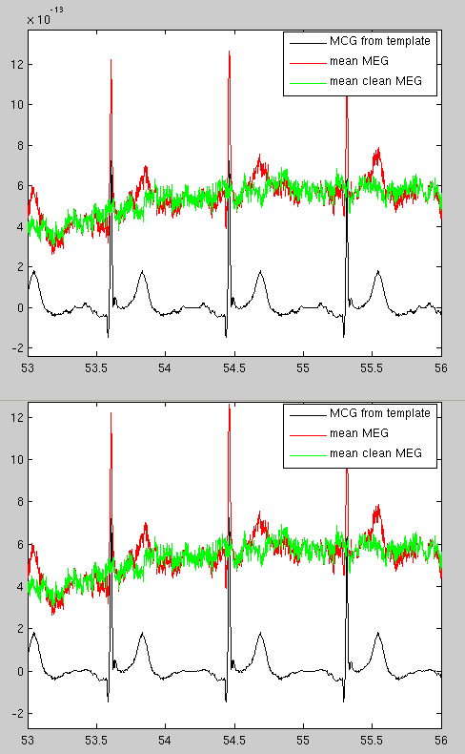
The templates chains strangely
What can be done?
cfg=[];
cfg.repressTime=100;

Slide 19
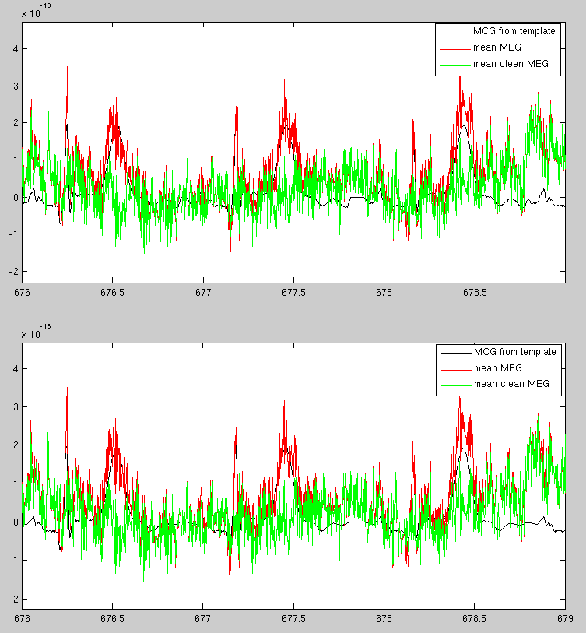
The template chains strangely
Another example (HB shakes bed / sensor)
cfg=[];
cfg.repressTime=100;

Slide 20
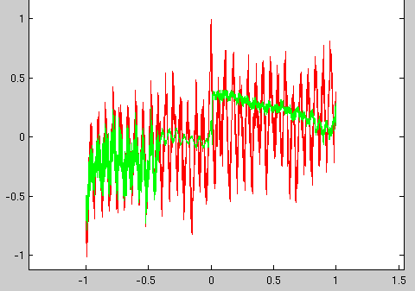
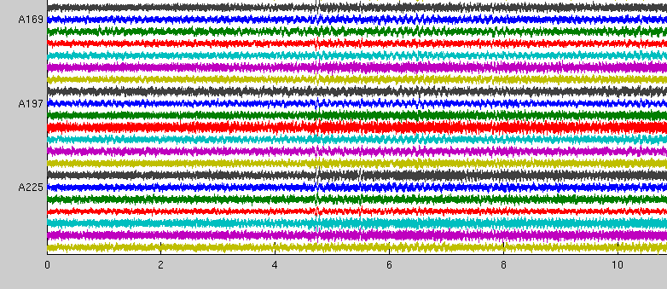
No detectable artifact
Sanity check failed
The averaged HB looks like alpha
Hard to see HB in raw data
Don't clean HB

Slide 21
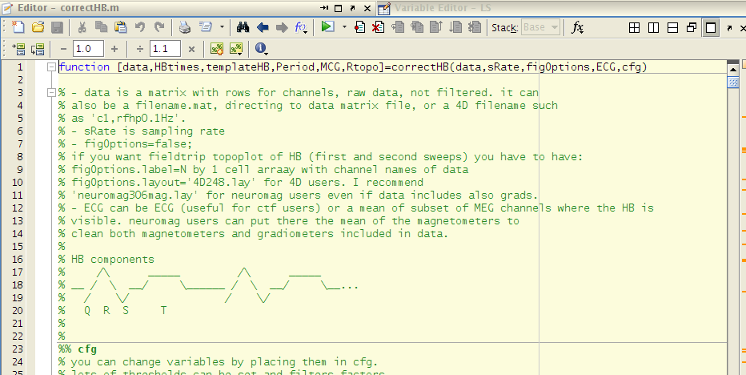
Monitor the process
When the cleaning fails you can ask for more figures for better understanding of the failure.
We will use it here to explain the cleaning process
clean=correctHB([],[],1);

Slide 22
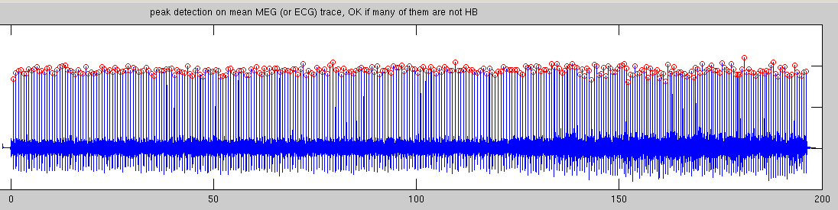
Monitor the process
Peak detection on the mean MEG channel, 7-90Hz bp-filtered
(zero padding for sliding window)

Slide 23
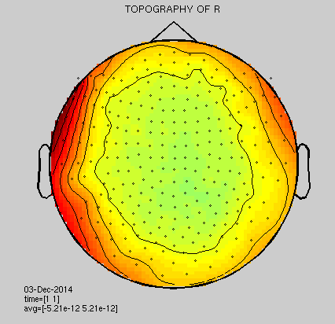
Monitor the process
Topography of R of averaged HB
(4D data)

Slide 24
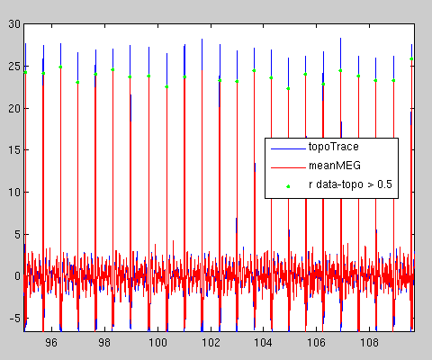
Monitor the process
Choosing good heartbeats for second averaging – only those with a topography similar (r > 0.5) to the average topography

Slide 25
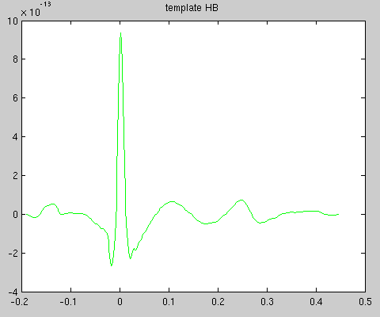
Monitor the process
Averaging the good HBs to make a template

Slide 26
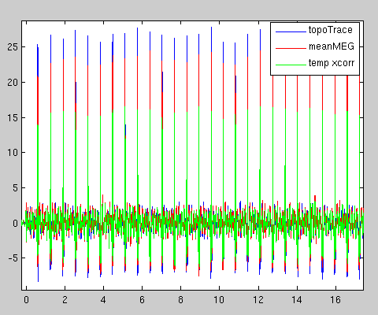
Monitor the process
Computing cross-correlation between the template and the average MEG channel

Slide 27
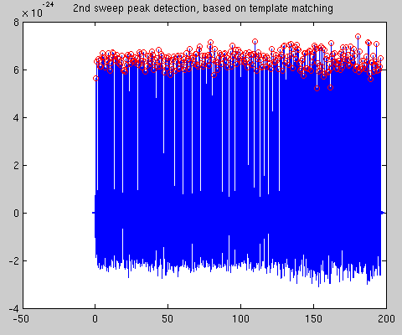
Monitor the process
2nd sweep peak detection on xcorr trace

Slide 28
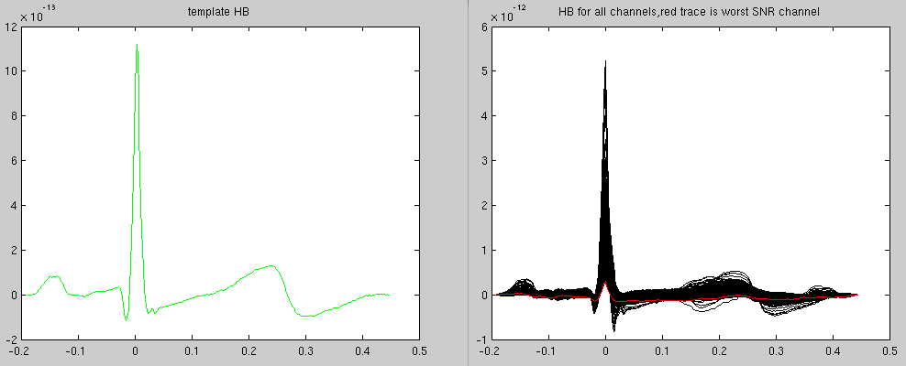
Monitor the process
Computing a template HB for every channel (unfiltered)

Slide 29
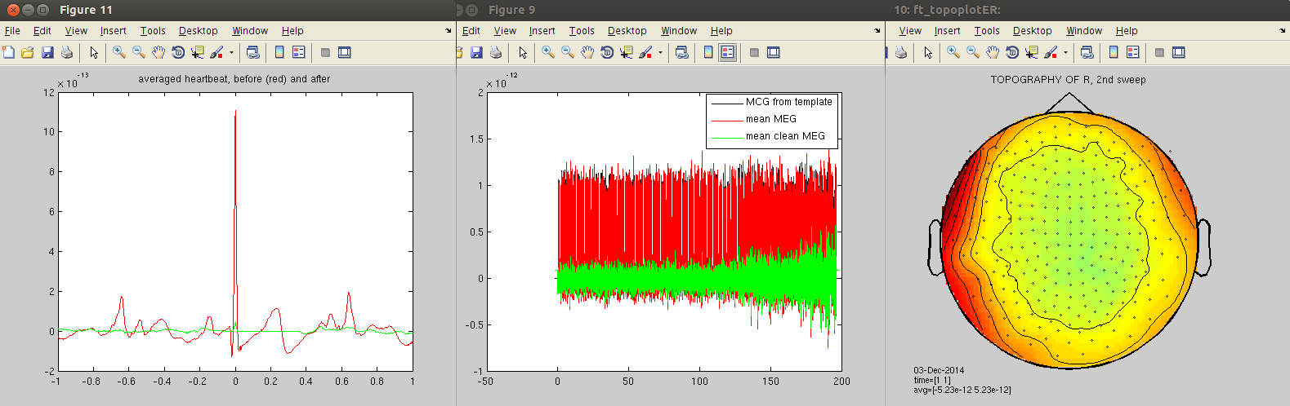
Monitor the process
Next step (yields no figure): adjusting peak amplitude for each HB
Then, for each channel, the adjusted templates are concatenated to ECG like trace, which is then subtracted from the MEG channel.
The new R topography is displayed, and the regular two figures (avg HB and mean MEG before and after)

