Slide 1
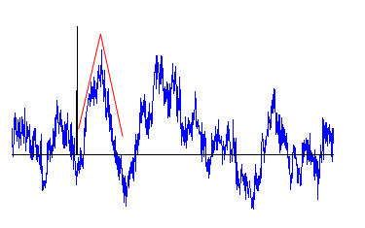
Find transient events in MEG trace
Dr. Yuval Harpaz, Bar Ilan University

Slide 2
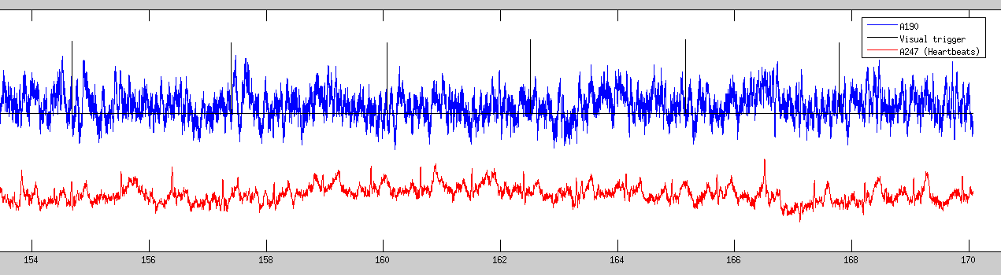
Observing events online

Slide 3
Validating the observation offline
Create a template from averaged trials
Fit the template to the raw data
Find distribution of positive and negative peaks along trial timeline

Slide 4
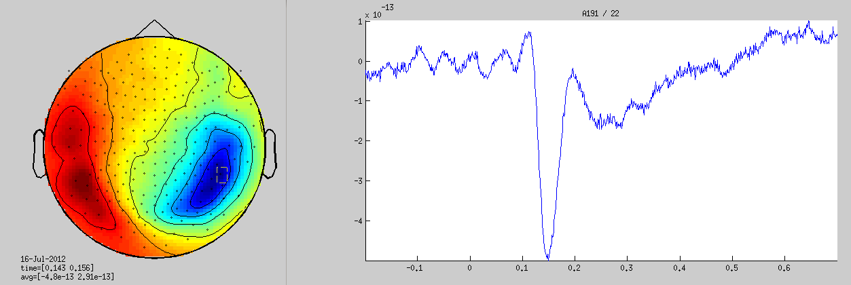
Creating a template from averaged trials
Clean the heartbeat artifact (more important for next step)
Reject bad trials
Average remaining trials
Select channel and time

Slide 5
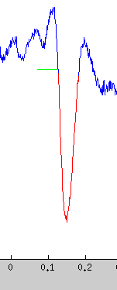
Creating a template from averaged trials
Simplest method: take the averaged trace. Consider padding with zeros to detect onset of activity. More on that later.
Less simple options:
  Select trials with visible peaks, choose peak time for each trial, align and average.
  Instead of averaging run component analysis and take first one or two components
  Make a linear / polynomial fit
  Run again: after fitting a template find exact latency in every trial by fitting the template to the unaveraged data (next step), align and create a new template

Slide 6
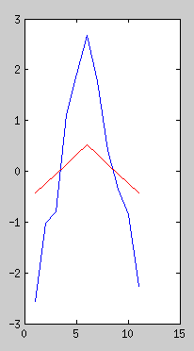
Multiply data by template simulation data
The template is baseline corrected and normalized
tempBlc = temp-mean(temp);
tmplt=tempBlc./sqrt(sum(tempBlc.*tempBlc));
sum (tmplt x tmplt) = 1
A data slice (same length as template) is baseline corrected (the mean of the whole length is removed).
Abeles & Goldstein, 1977
Data and template
before multiplication

Slide 7
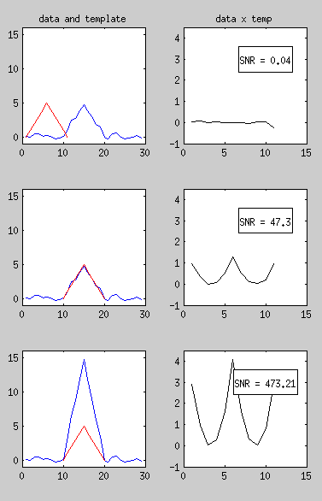
Multiply data by template simulation data
Multiply Data by temp in a “sliding window”. Each
multiplication yields one SNR value for the peak time-point.
Signal = (sum(data.*temp))^2;
Greater amplitude yields greater signal.
Negative and positive data (or templates) are the same.
Total = sum(data.*data);
Error = Total – Signal;
SNR=Signal/Error of course.
Greater amplitude of data yields greater SNR.

Slide 8
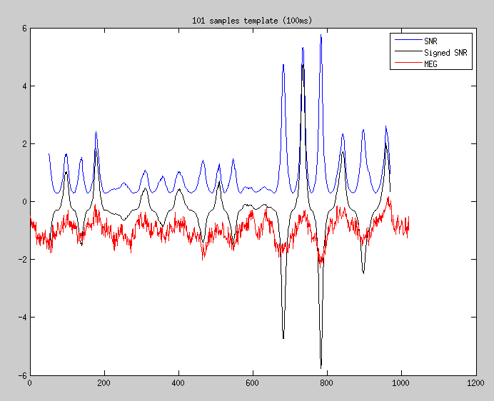
Multiply data by template real data
The SNR detects positive and negative peaks.
Signed SNR keeps the neg / pos information.
proj = sum(data.*tmplt);
sign=proj/abs(proj);

Slide 9
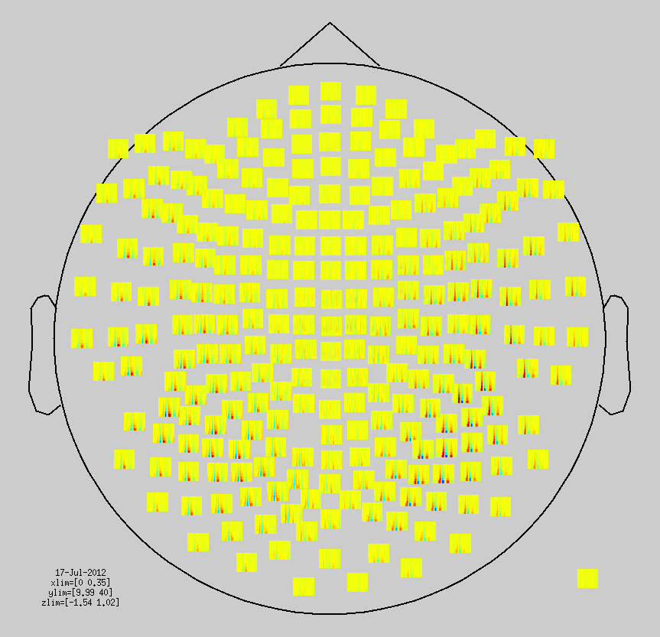
Time – Freq like analysis
No Freq domain here !!!
Shape templates of different widths were multiplied by the data.
10Hz means 100ms triangle was used.
Results here show average SNR over trials
symmetric templates, no padding with zeros
^

Slide 10
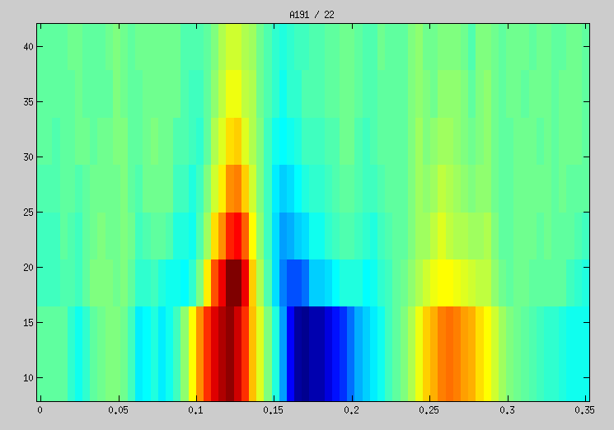
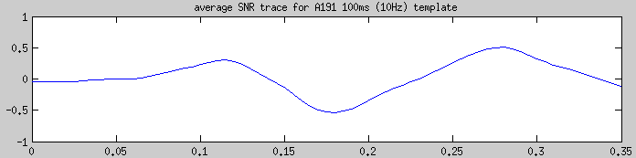
Time – Freq like analysis

Slide 11
Time – Freq like analysis
cfg = [];
cfg.keeptrials = 'yes';
cfg.output = 'pow';
cfg.channel = 'MEG';
cfg.method = 'mtmconvol';
cfg.foi = [10 15 20 25 30]; % freq of interest
cfg.t_ftimwin = 1./cfg.foi;
cfg.toi = -0.2:0.001:0.5;
cfg.tapsmofrq = 1;
cfg.trials='all';
cfg.tail=[]; % pad the template with zeros, 'beg' 'end' 'both' or [] for no padding
[TF,wlt] = freqanalysis_triang_temp(cfg, datacln);

Slide 12
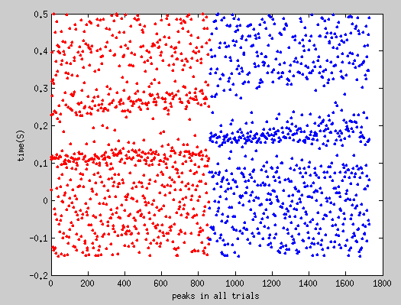
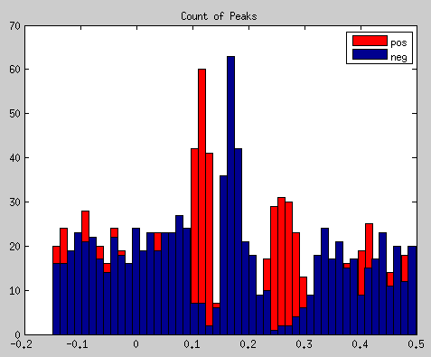
Single trial analysis
Find peaks on SNR curve of every trial
Plot the distribution of negative and positive peaks

Slide 13
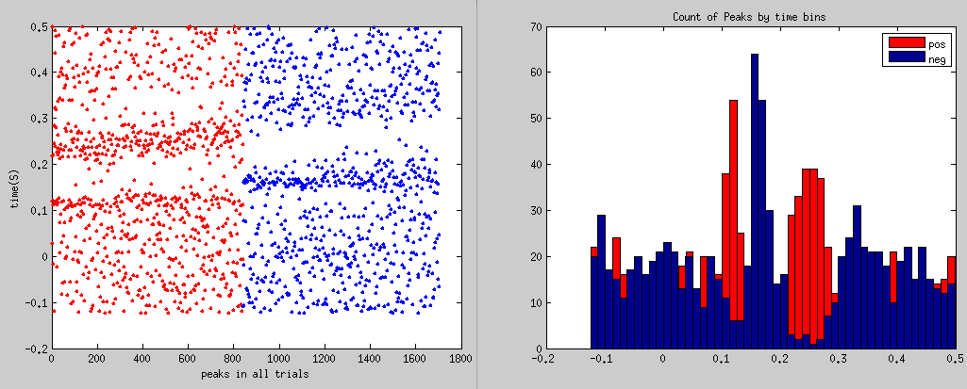
Single trial analysis
Now with padded template, 50ms wide triangle (half cycle of 10Hz)
Less peaks are detected for 110ms, more for 250ms.

Slide 14
Single trial analysis
peaks=peaksInTrials1freq(TF,wlt);
[~,chani]=ismember('A191',peaks.label);
post=[];negt=[];
for ti=1:length(peaks.chan{1,chani}.trial)
try
post=[post,peaks.chan{1,chani}.trial{1,ti}.time(1,peaks.chan{1,chani}.trial{1,ti}.SNR>0)];
end
try
negt=[negt,peaks.chan{1,chani}.trial{1,ti}.time(1,peaks.chan{1,chani}.trial{1,ti}.SNR<0)];
end
end
figure;hist(post,50);
h1 = findobj(gca,'Type','patch');
set(h1,'FaceColor','r')
hold on;
hist(negt,50);
legend ('pos','neg')
title('Count of Peaks by time bins')
figure;
plot(post,'r.')
hold on
plot(length(post)+1:length(post)+length(negt),negt,'.')
xlabel ('peaks in all trials')
ylabel('time(S)')

Slide 15
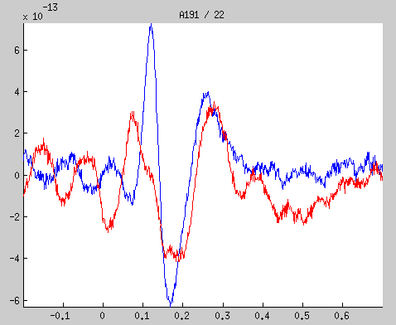
Alpha and M100
Trials with M100 are compared to no M100 trials.
see what happens before the the trial begins?

Slide 16
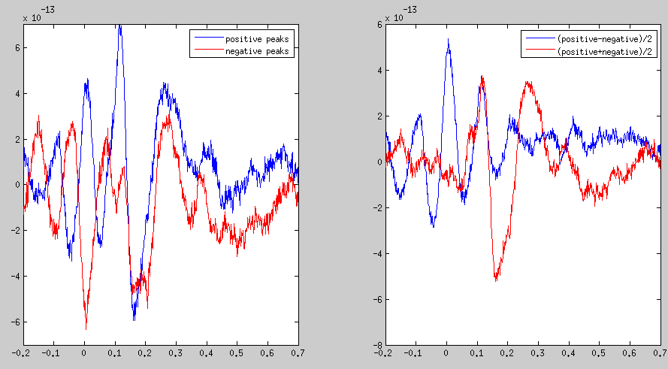
Alpha and M100
Here I found trials with neg and pos peaks at ~ time 0. NOTE:
- No M100 for positive peak at 0s. (left Fig)
- Amplitude of alpha and M100 is the same (right Fig)

Slide 17
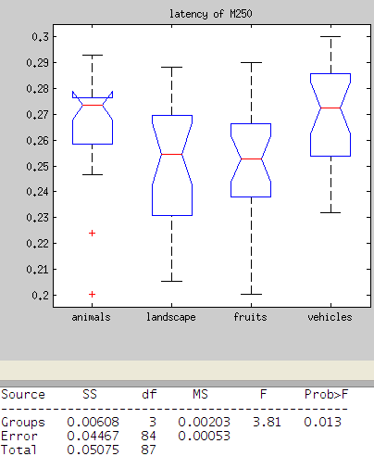
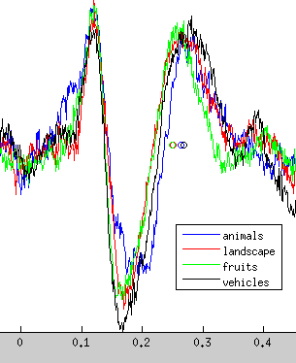
Compare conditions statistics for one subject
Latency of M250

Slide 18
What's next?
Use / shape template to allow asymmetric patterns
Correct alpha
Create envelop a la Hilbert without filtering
Take a break
thanks go to Professor Abeles for support and script

