Slide 1
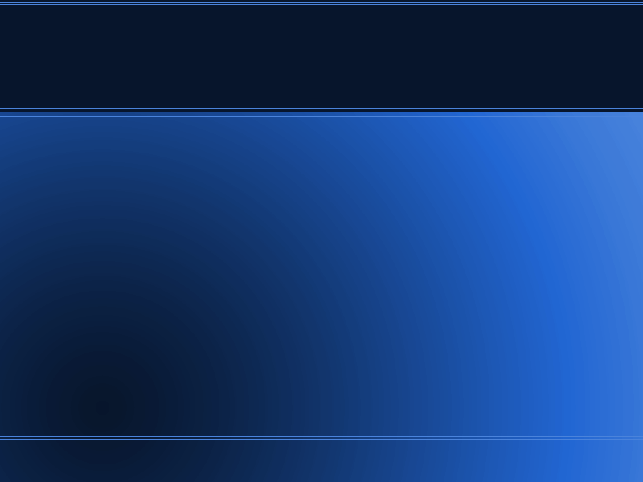
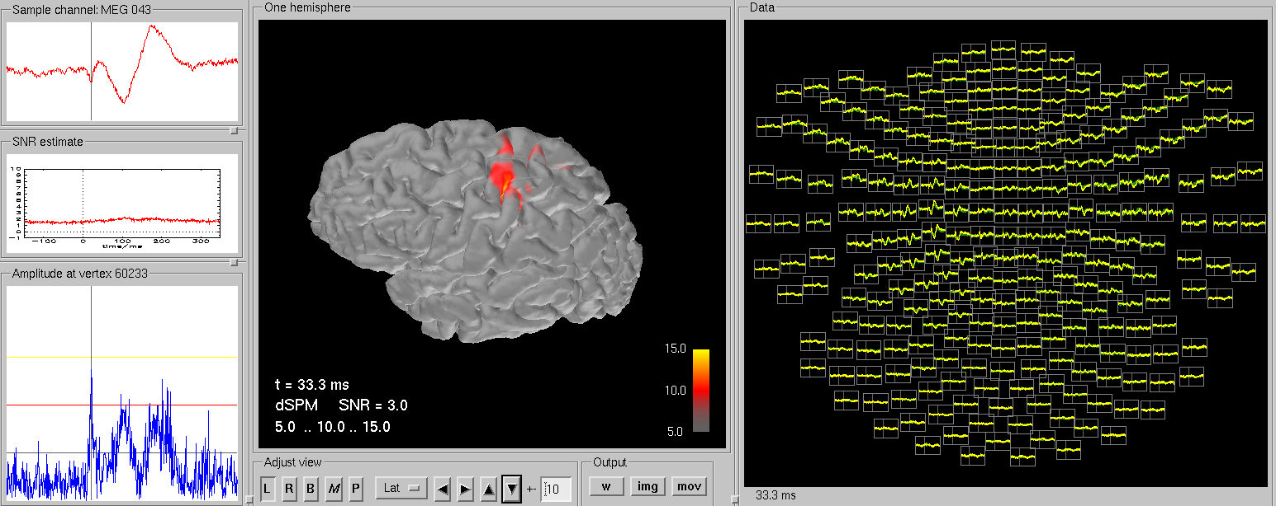
MNE, MEG a la Harvard
Dr. Yuval Harpaz

Slide 2
What is MNE?
Comparison to beamforming (BF)
Both find inverse solution.
BF – is applied to single points (can be many).
MNE – requires whole head.
BF – is usually applied by “voxel”, volume.
MNE – relies on surfaces.
BF biased to deep, MNE biased to superficial sources
BF written in C, MNE written in Python
BF deals well with artifacts, MNE requires clean data
SAM BF is developed in NIMH, lots of BF in Europe, MNE in Harvard, mainly Electa systems.

Slide 3
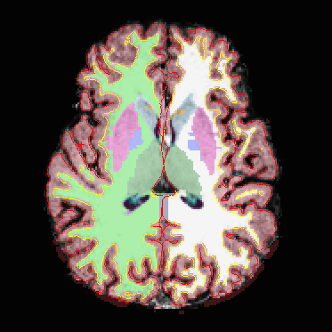
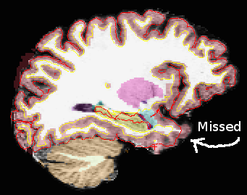
FreeSurfer
MNE requires cortex surface (individual MRI).
You do it with FreeSurfer, 12h.
To view results use tkmedit
May require manual
labour
recon-all -all -s Maor -i 20110815151552288.dicom
tkmedit Maor brainmask.mgz -aux T1.mgz -surfs -aseg

Slide 4
MNE commands make BEM model and stuff
export SUBJECT=maor1
mne_watershed_bem --atlas
mne_setup_mri --overwrite

Slide 5
Make MNE read 4D data export to .fif
You need bti2fiff.py
You can find it in work-drafts/docs and also at
https://github.com/dengemann/mne-python/blob/bti_bin/bin/mne_bti2fiff.py
Thank you Denis
mne_bti2fiff.py -p c,rfhp0.1Hz -o maor_raw.fif

Slide 6
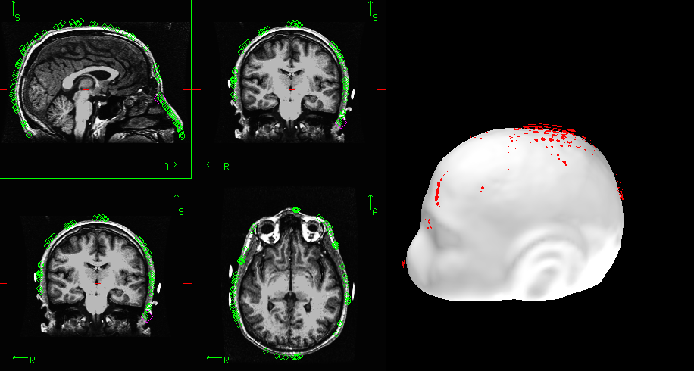
MNE pipeline
You can use python or command lines. Sometimes you need GUI too.
1. coregistration of MRI to headshape
in a terminal:
You have to mark fiducial on the
scalp (white), then nudge or use
automatic alignment. Here the
nose is off by a few degrees.
Save default (maor_raw-trans.fif)
Export SUBJECT=Maor

Slide 7
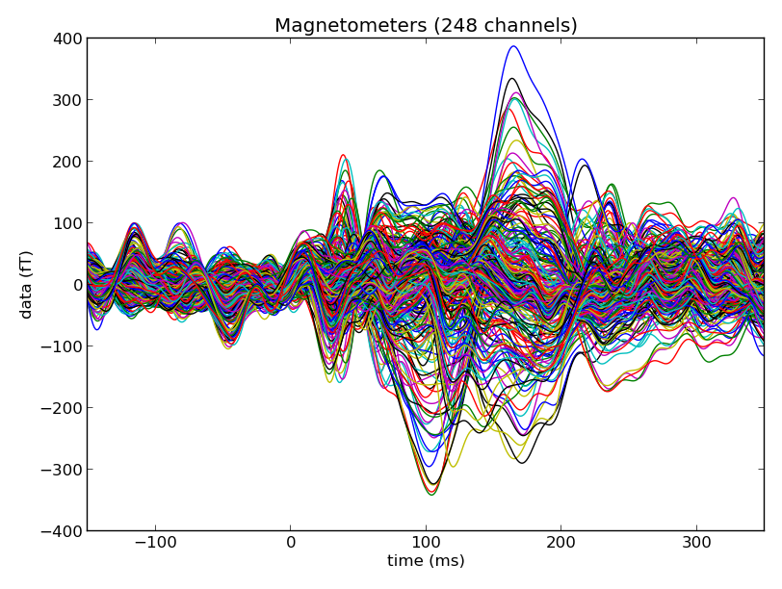
MNE pipeline
2. processing MEG with python
use ipython terminal
import mne
import numpy
# read the data
raw = mne.fiff.Raw('maor_raw.fif',preload=True)
# bandpass filter
picks = mne.fiff.pick_types(raw.info, meg=True)
raw.band_pass_filter(picks, 1.0, 50.0, filter_length=2048)
raw.save('maorf_raw.fif')
# averaging
import mne
raw = mne.fiff.Raw('maorf_raw.fif')
events = mne.find_events(raw, stim_channel='STI 014')
event_id = 102 # the event number in events
tmin = -0.15 # start of each epoch (200ms before the trigger)
tmax = 0.35 # end of each epoch (500ms after the trigget)
picks = mne.fiff.pick_types(raw.info, meg=True, eeg=False, eog=False)
baseline = (None, 0)
reject = dict(mag=4e-12)
epochs = mne.Epochs(raw, events, event_id, tmin, tmax, proj=True,picks=picks, baseline=baseline, preload=True,reject=reject)
epochs_data = epochs.get_data()
evoked = epochs.average()
# plot
from mne.viz import plot_evoked
plot_evoked(evoked)
# save
evoked.save('maorf_evoked.fif')

Slide 8
MNE pipeline
3. calculate noise covariance, forward and inverse solution
Whitening – unit independent. Allows eeg + meg model
Inverse solution is depends on noise cov only
cov = mne.compute_covariance(epochs, tmin=None, tmax=0)
cov.save('maorf_raw-cov.fif')
mne_setup_source_space --ico -6 --overwrite
mne_setup_forward_model --homog --surf --ico 4 --overwrite
MEG_FN='maorf_raw.fif'
mne_do_forward_solution --spacing oct-6 mindist --overwrite --meas $MEG_FN --megonly --noisecov
mne_do_inverse_operator --fwd maorf_raw-oct-6-fwd.fif --deep --loose 0.2 --meg

Slide 9
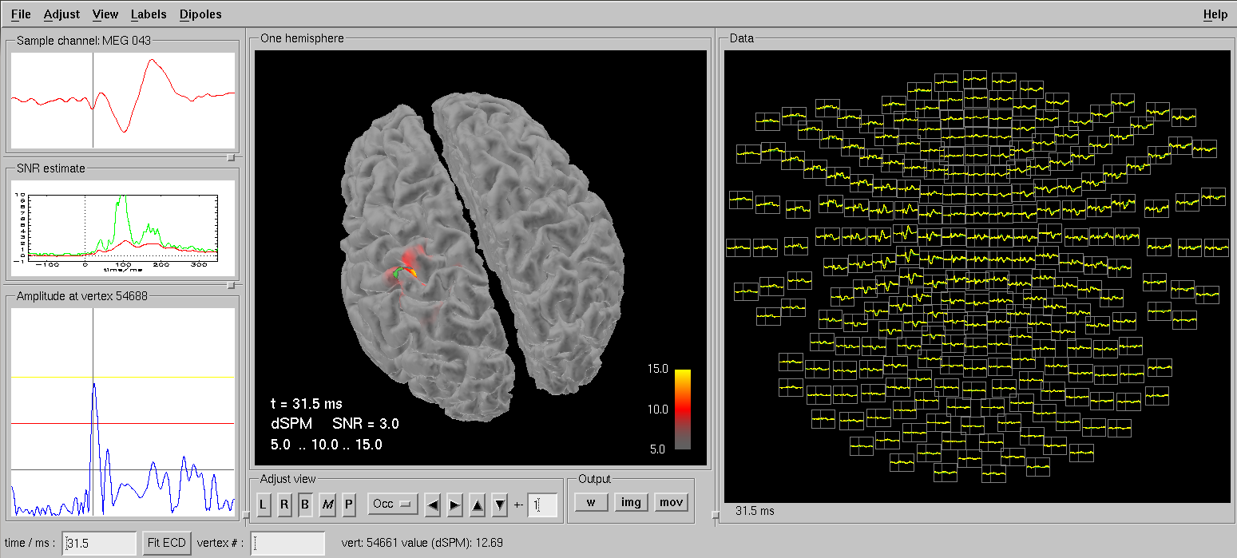
mne_analyze
We used it for corregistration, now for visualizing sources

Slide 10
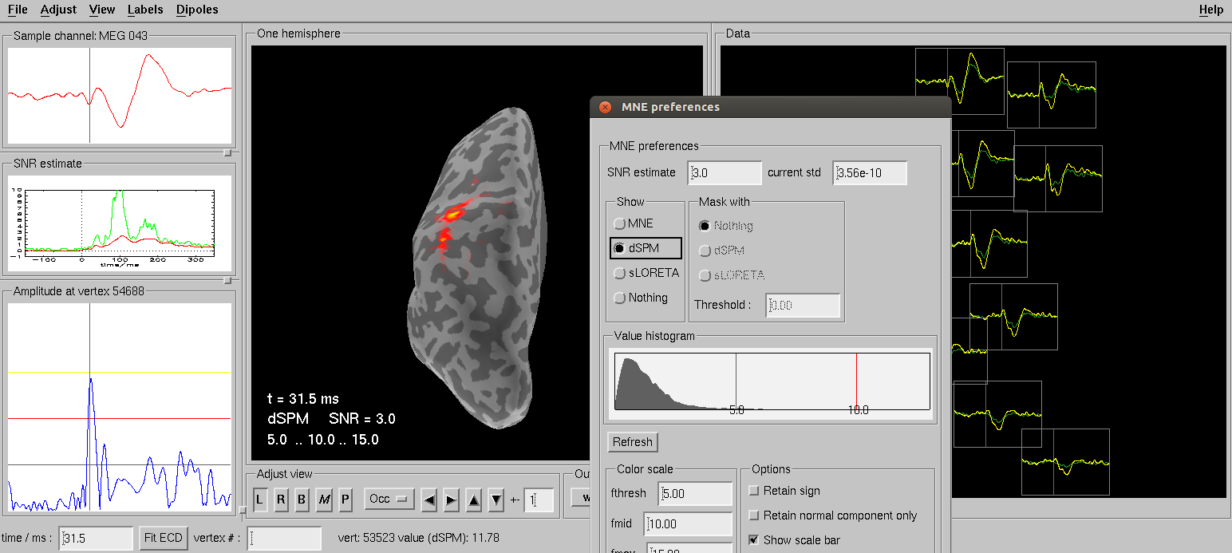
mne_analyze
SLORETA, inflated brain, all sorts

Slide 11
Did I thank Denis?
Not enough
Thank you Denis.

