Slide 1

MEG data processing
Tutorial - from cleaning to averaging the data

Slide 2
Why clean the data?
Not always cleaning is necessary. When using SAM beamforming for source localization artifacts are generally ignored by the beamformer.
For sensor level analysis (no beamformer) the following issues should be addressed:
  Muscle hi frequency noise
  Blinks (equal to up-down eye movement)
  Left-right eye movement
  Heart artifact
  50Hz and its harmonics (100, 150...)
  Building / sensor vibrations
  Jump artifact (large step like)
  Bad channels

Slide 3
How to view the raw data in matlab
It is impossible to view all 248 channels at once
To find bad channels, use the script-
WAIT A MINUTE WHERE ARE THE SCRIPTS?
Sorry, here. There is a site called github where free code can be placed. It is intended for users of software called git. The advantage of the software is that with it you can download a whole pack once, and next time you want to update you only download the changes. You don't have to. You can copy scripts from the site. However this is how you do it:
Install git. For linux (ubuntu) open a terminal and then:
  sudo apt-get install git-core
you can install git on windows, I did but better get linux.

Slide 4
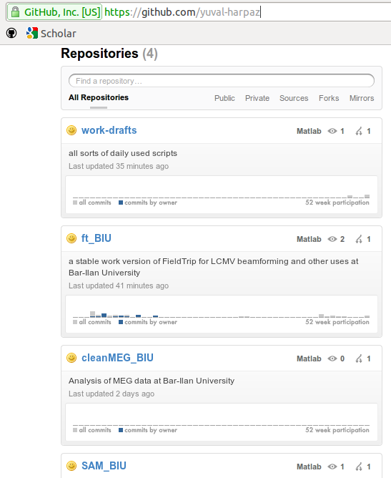
Github
Go to
github.com/yuval-harpaz

Slide 5
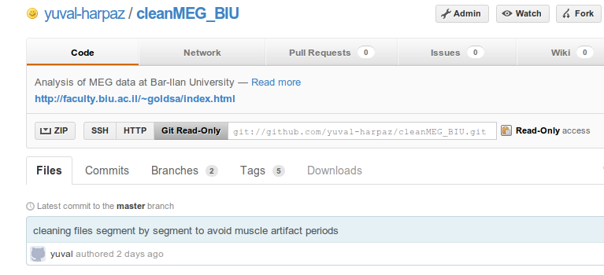
Github
Go to
github.com/yuval-harpaz
Click on one of the repositories, say cleanMEG_BIU
Click Git Read-Only
Copy the line git://...
in a terminal write: git clone git://...(paste here what you copied)
this should copy
the files. Add the
inner directory to
the path of matlab.

Slide 6
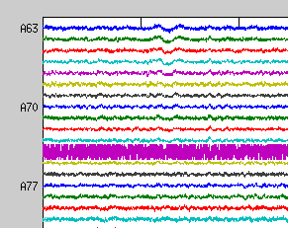
Overview
Where were we? Ok, so now you have the code. Let's take a look at the enemy.
Bad Channels
First we want to look at all the channels to see if we have bad channels.
cd with matlab to where the data is and use findBadChans('c,rfhp0.1Hz'). The data filename is c,rfhp0.1Hz in this example. This opens 4 plots to display all the channels for the first 10s of the data. The blue channels are nubered. Here is an example of bad A74.
It is possible to display any part of the data.
This is useful for finding bad timewindows.
tracePlot_BIU(20,80,'c,rfhp0.1Hz') will display
every 4th channel (to squeeze it to one fig) between
20 and 80s from the beginning of the file.

Slide 7
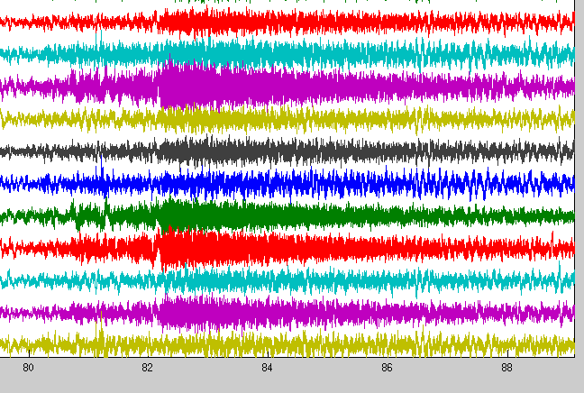
Overview
Muscle
this is a typical example of muscle artifact. Note that rarely there is a tiny twitch which starts and ends in a matter of a few ms, and it is usually measured only by few channels.

Slide 8
Overview
Blinks
UNDER CONSTRUCTION
Ok, no time. I will make such examples for every artifact type.
Let's deal with the artifacts now

Slide 9
cleanMEG
There is a complex function called createCleanFile. It cleans 50Hz line frequency (lf), heartbeat (hb) artifact, building vibrations – this is achieved by external channels (xc) connected to accelerometers, and frequency by frequency (byFFT method, never mind details now).
Cleaning HB is important for frequency analysis because it creates a lot of 10Hz and other brain like waves. Averaging reduces it but for some subjects even the averaged data will stay dirty with HB uncleaned. The trouble is it is sometimes tricky.
LF is important mainly if you are interested in gamma activity.
XC cleans 24Hz and other frequencies – 12Hz for example.
ByFFT seem to clean the data best, even too much. It erases some of the brain activity.
Generally I recommend using xc,hb,lf.

Slide 10
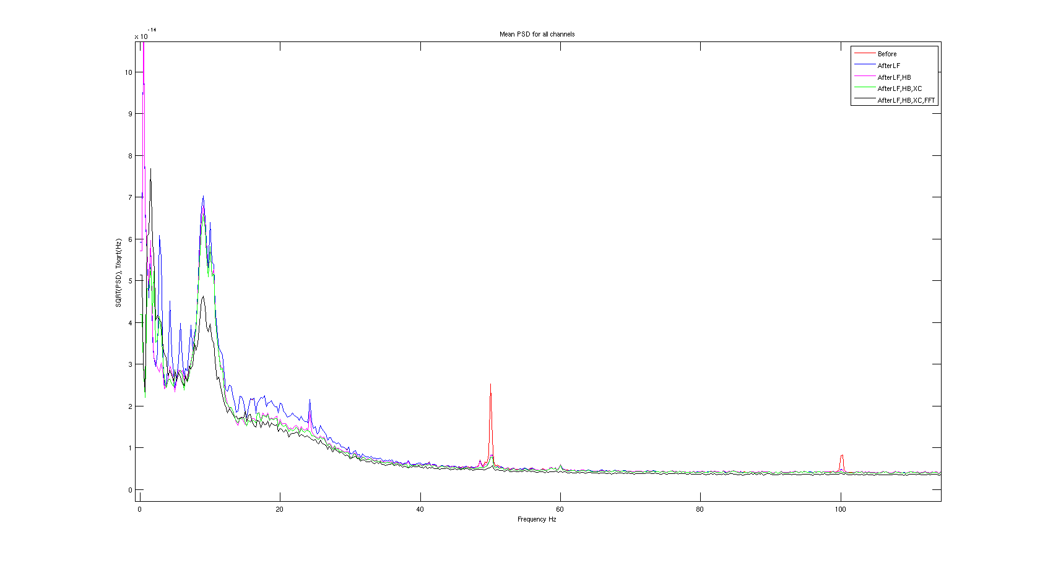
cleanMEG

Slide 11
Check examples in repos
To use createCleanFile check the example in the repository cleanMEG_BIU.
There is another example there showing you how to look for muscle artifact and then clean only good periods.

Slide 12
Pipeline of processing
Lets say you have 100 trials to average.
  Clean the data with createCleanFile
  Read the data with fieldtrip (ft_BIU repo)
  Reject muscle artifact trials
  Run ICA to reject blinks
  Reject visual to reject any remaining bad trials

