Slide 1
RAG-Based Insurance Case Study
Presented by:
Adi Fermon
Yuval Miller
Idan Adar

Slide 2
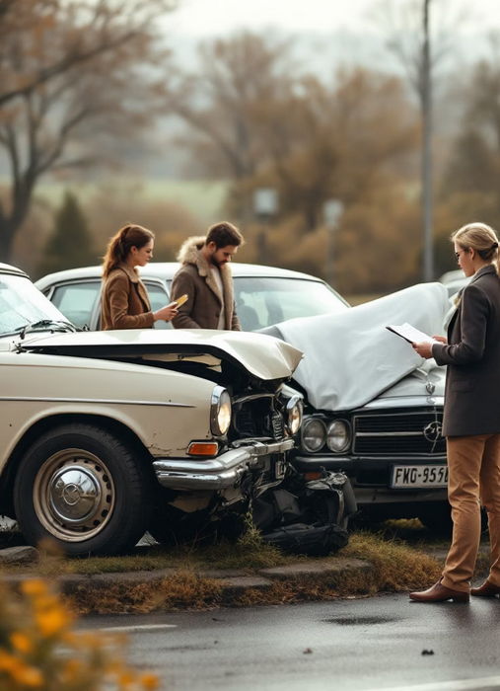
Team Intro
Notes:
We’re Adi, Yuval, and Idan — proudly known as “The Best Team!”
Whether it's coding late into the night, troubleshooting bugs, or generating documents, we’ve had each other's backs the whole way.
We don’t just run code — we run teamwork like pros.
From day one of the course, we’ve been working side-by-side (virtually, of course) in the Zoom group, and building our brains together on Discord. Three devs, one brain, and way too many coffee refills choosing between map_reduce or refine is not just a comparison for us, it’s the .

Slide 3
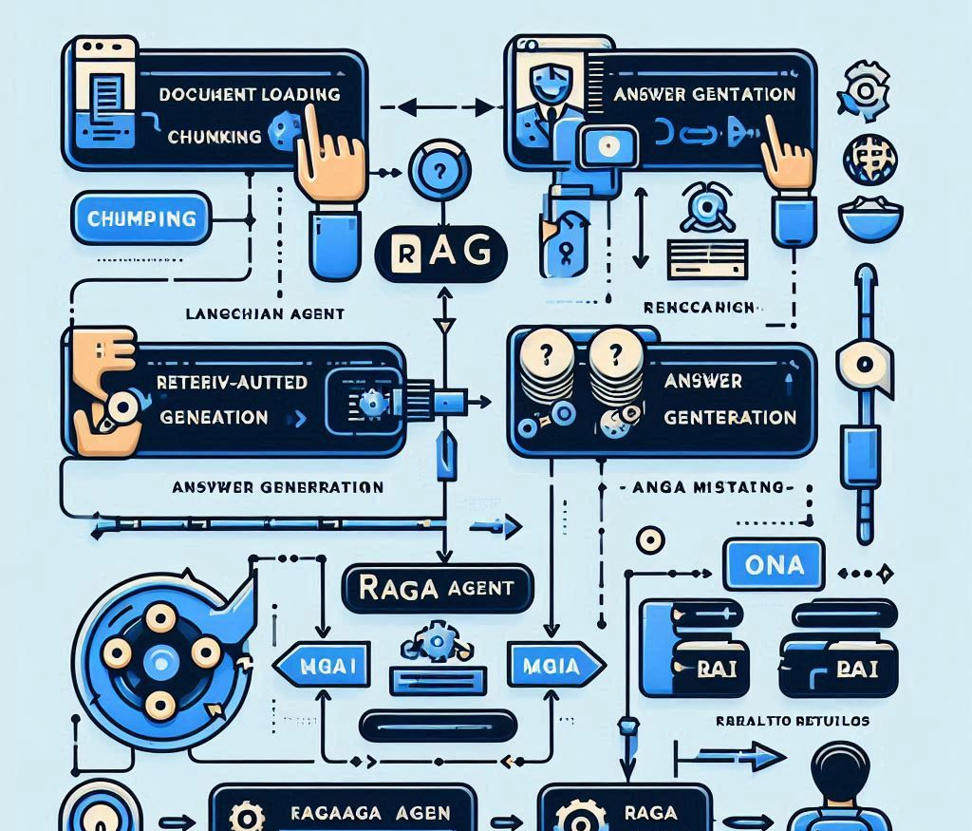
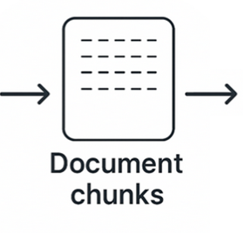
Our RAG Project
In our project, we apply Retrieval-Augmented Generation (RAG) techniques to a real-world insurance case study, involving a car accident.
The goal: summarize and answer questions based on the data
Main technologies used: LangChain, OpenAI, ChromaDB, RAGAS, and Gradio.

Slide 4
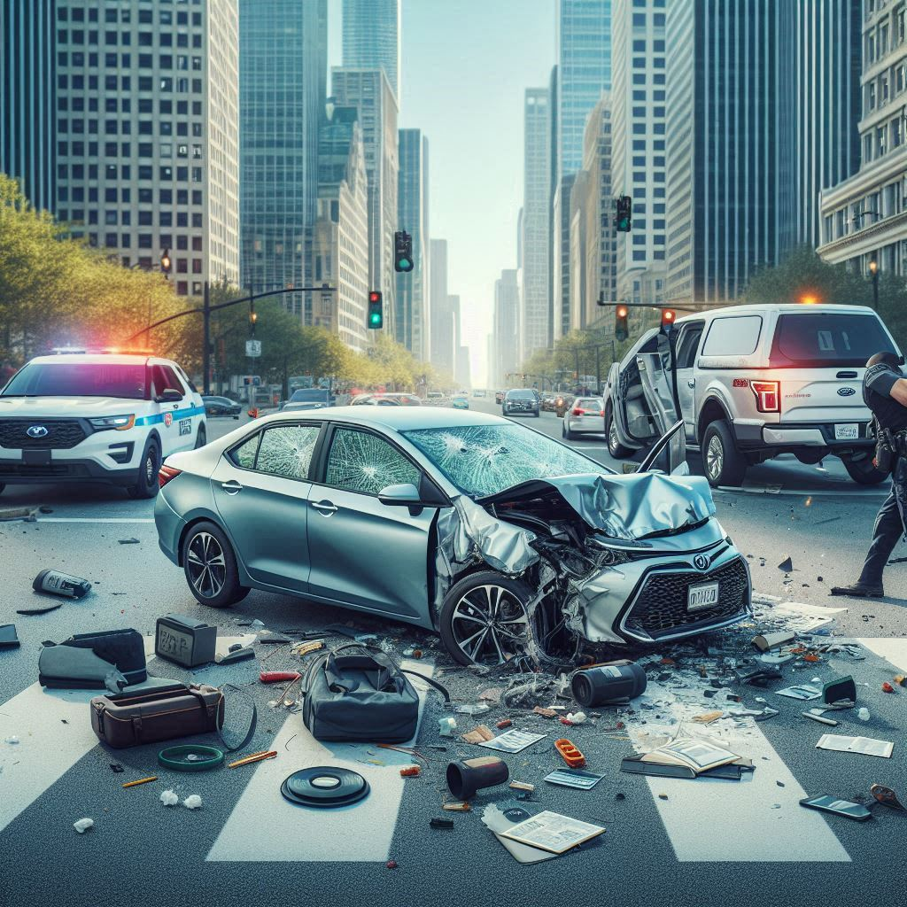
Our Insurance Case
Realistic simulation of a car accident and insurance claim
Two people and coverage, our case: Ms. Ross (full coverage) vs Mr. Vega (liability only)
Accident date, place and time.
Focuses on: claims, injuries, damages, ethics, and financial outcomes

Slide 5
Summary Highlights
Summary
On May 12, 2025, a traffic collision occurred at Lincoln and Maple Street in Chicago, involving Emily Ross and Daniel Vega. Daniel failed to stop at a red light, causing the crash. Emily was momentarily unconscious and later diagnosed with a rotator cuff injury and mild concussion. The city implemented safety measures at the intersection. Emily was satisfied with her insurance experience, while Daniel took steps to improve his driving skills and coverage. By September 1, 2025, Daniel's claim was recognized by Midwest Mutual's subrogation department as an "EXEMPLARY RESOLUTION – COOPERATIVE THIRD PARTY.“ Main Parties:
Emily Ross: 34-year-old office manager, driving a 2020 Toyota Corolla.
Daniel Vega: 29-year-old delivery driver, operating a 2018 Ford F-150.
Critical Details
Location: Intersection of Lincoln and Maple Street, Chicago, Illinois.
Conditions: Clear skies and no wind at the time of the incident.
Impact Description: The F-150 struck the Corolla, causing the latter to lift slightly before crashing back down. Airbags deployed, and glass shattered during the collision.
Outcomes
Emily experienced a brief loss of consciousness and was later diagnosed with a rotator cuff injury and mild concussion. Daniel's liability-only insurance left him without coverage for his own damages, while Emily's insurer handled her claims and pursued reimbursement through subrogation. The city implemented changes to enhance safety at the intersection following the incident. Daniel's case was later recognized for its exemplary resolution, contributing to the training and efficiency analysis within Midwest Mutual 1.

Slide 6
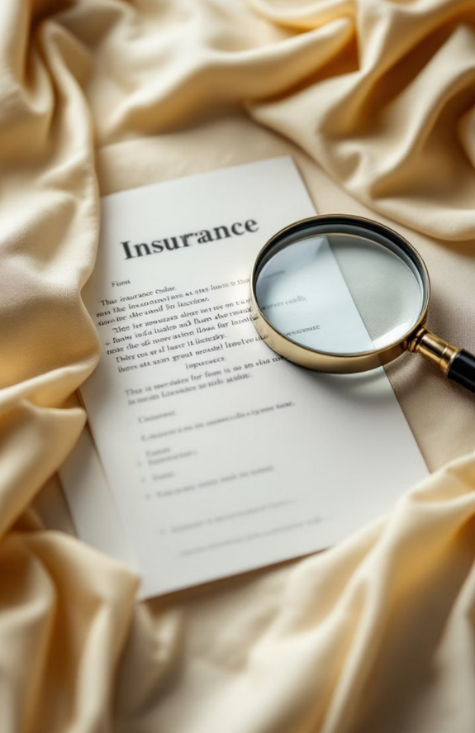
Our Dataset
For this project, we generated our own custom dataset centered on our insurance case.
Aimed to simulate a realistic, structured textbook report that includes all the essential components.
In addition to the main document, we crafted a set of focused questions, each paired with a precise ground truth answer.
Notes:
the essential components. accident details, involved parties, insurance policies, damages, claims process, and final resolution.
The ground truths were also developed collaboratively with ChatGPT, ensuring clarity and relevance. This dual structure — document + Q&A pairs — allowed us to evaluate our RAG agents effectively using RAGAS, while maintaining full control over the content and its quality.

Slide 7
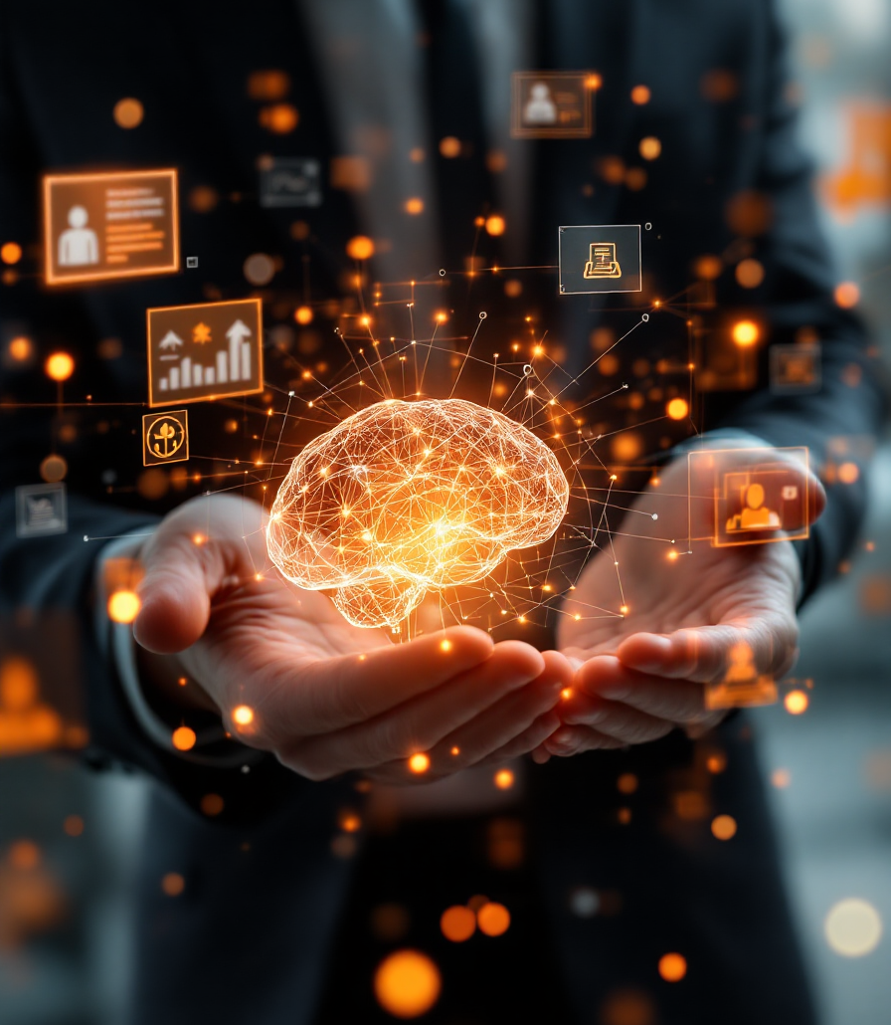
Our Ground Truth
We’ve generated focused developed collaboratively with ChatGPT, ensuring clarity and relevance.
This dual structure — document + Q&A pairs — allowed us to evaluate our RAG agents effectively using RAGAS
The ground truth allows us to maintain full control over the content and its quality.
Notes:
Yuval: the essential components. accident details, involved parties, insurance policies, damages, claims process, and final resolution.
Elaborate on using different models and methods to get a few summaries and then running them with our code to find the best.

Slide 8
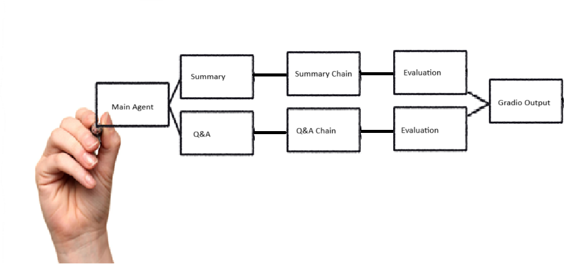
Workflow
Notes:
Adi

Slide 9
Business Problems
Lack of centralized knowledge from case history.
Extract key information from long accident reports.
Notes:
הבעיה העסקית שאנו מתמקדים בה היא פיזור המידע מחקירות תאונות מרובות. קיים ידע רב במסמכים ארוכים שאינו מרוכז או נגיש בקלות, ושיתוף וסיכום אוטומטי יכולים לשפר משמעותית את קבלת ההחלטות.
בעזרת הפרויקט ניתן לענות על שאלות בצורה יותר מהירה באופן המזכיר צ'אט-בוט ובכך לחסוך זמן רב.

Slide 10
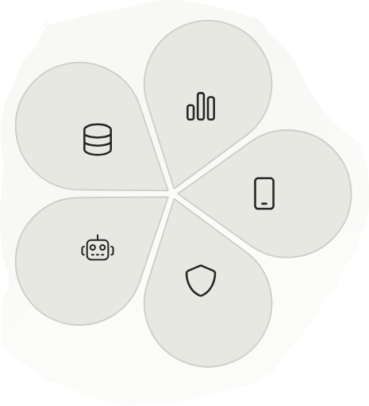
Examples & Results
Notes:
Open gradio and show

Slide 11
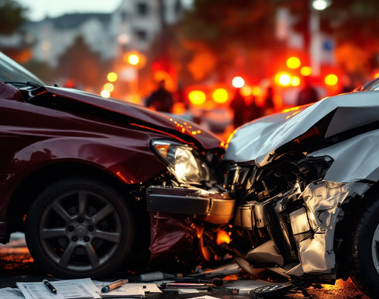
Conclusion

