Slide 1
College Management Database
Replacing array / file storage with a PostgreSQL database (JDBC)
Database Systems 10127
Original program from: Object-Oriented Programming (10118)
Yuval Dror, 213144058 • Doran Kordova, 213377708
Notes:
Introduce the team and the project: we took our Object-Oriented College program and replaced its in-memory arrays and .bin file with a real PostgreSQL database accessed through JDBC. Replace the bracketed names with the real team members.

Slide 2
What the project does
2
The starting point
Our OOP "College" program manages Lecturers (Doctors / Professors), Committees and study Departments.
It stored everything in Java ArrayLists and saved them to a binary file (collegeData.bin) using serialization.
What we changed
We designed a relational database and moved all the data into PostgreSQL.
The Java program now uses JDBC for every database access - no arrays, no file.
It supports insert, update, delete and search directly on the database, plus 13 SQL queries and 2 triggers.
Notes:
Explain the before/after. Before: data lived in memory and was serialized to a .bin file. After: data lives in PostgreSQL; the program talks to it with JDBC PreparedStatements and supports insert/update/delete/search.

Slide 3
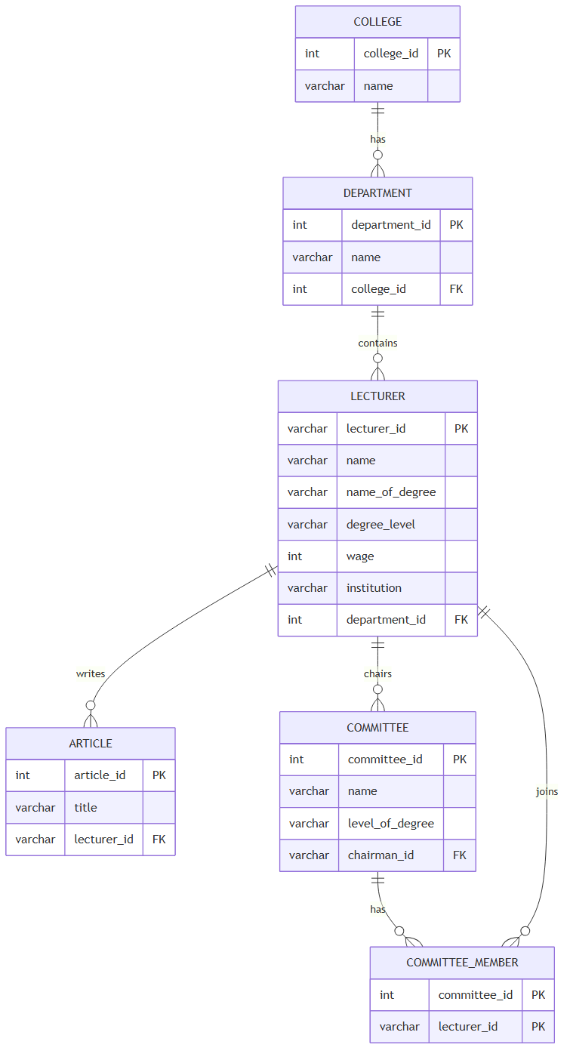
ERD - 6 entities
3
Six entities
college, department, lecturer, committee, article, committee_member.
Two key relationships
Lecturer ↔ Committee is many-to-many - resolved with the COMMITTEE_MEMBER junction table.
A lecturer chairs a committee (chairman_id) and writes articles (1-to-many).
Inheritance
The Doctor / Professor hierarchy became one LECTURER table (with a degree_level column) plus a separate ARTICLE table.
Notes:
Walk through the entities and the two interesting relationships: (1) a lecturer can be in many committees and a committee has many lecturers - a many-to-many that we resolved with the COMMITTEE_MEMBER junction table; (2) the Doctor/Professor inheritance became a single LECTURER table (with a degree_level column) plus a separate ARTICLE table. You can replace this drawing with the PNG exported from college_erd.mmd via mermaid.live if you prefer.

Slide 4
The tables (normalized to 3NF)
4
Table | Primary key | Foreign keys / constraints
college | college_id | name UNIQUE
department | department_id | college_id -> college
lecturer | lecturer_id | department_id -> department; CHECK(degree_level); CHECK(wage >= 0)
committee | committee_id | chairman_id -> lecturer
article | article_id | lecturer_id -> lecturer (ON DELETE CASCADE)
committee_member | (committee_id, lecturer_id) | both columns are FKs - junction for the N:N
3NF: no repeating groups, no partial dependencies, no transitive dependencies (e.g. college_id is NOT stored in lecturer - it is reached through the department).
Notes:
Show the six tables and their keys. Stress that the schema is in 3NF: we removed repeating arrays (articles), used single-column keys, and avoided transitive dependencies - for example we do NOT keep college_id in lecturer, because department already determines the college.

Slide 5
Queries, triggers & demo
5
13 SQL queries (requirement: at least 10)
e.g. average salary per department, committee sizes, article counts per lecturer, lecturers in no committee, highest-paid lecturer per department.
2 triggers (bonus)
1) A committee chairman must be a Doctor or Professor.
2) A committee member's degree must match the committee's level.
We moved these business rules from Java into the database, so they always hold no matter which client writes the data.
Live demo
Show all lecturers -> add one -> search -> update wage -> try an illegal insert and watch the trigger block it.
Notes:
Mention the 13 queries and the two triggers, and explain WHY you chose the triggers (they enforce the same rules the original Java enforced, but now at the database level). Then run the live demo: option 9 (list), 1 (add), 15 (search), 16 (update wage), and finally option 3 adding a degree-1 lecturer to a Doctor committee so the trigger rejects it.

