Slide 1


Automatic Classification of Figurative and Literal Usage in Hebrew Idioms
A study on distinguishing figurative from literal usage in morphologically rich languages
Igor Nazarenko, Yuval Amit
Reichman University | Hebrew NLP Research Group
NLP Final Project, 2025
Achieved 95% accuracy with AlephBERTGimmel
Hebrew NLP Research

Slide 2




Hebrew Idiom Classification Research
Problem Statement & Motivation
Idiomatic expressions in Hebrew often diverge from their literal meaning, introducing semantic ambiguity
for NLP systems
Existing NLP systems struggle to classify literal vs figurative usage, especially in morphologically rich, low-resource languages like Hebrew
Accurate idiom classification is essential for: Machine translation
Sentiment analysis Dialogue systems
Figurative vs. Literal Example:
לשבור את הראש
Literal: Actually breaking one's head Figurative: Working hard to solve a problem
Hebrew presents unique challenges due to its complex morphology and relatively limited NLP resources
Hebrew NLP Research

Slide 3








Hebrew Idiom Classification Research
Research Objectives & Contributions
Develop automatic classification methods for Hebrew idioms (figurative/literal)
Compare adaptation strategies: Full fine-tuning
Frozen feature extraction Zero-shot evaluation
Empirical Insights:
Hebrew-specific models outperform multilingual ones
Fine-tuning essential for idiom understanding
Domain-specific pre-training improves performance
Transferable methodologies for low- resource languages
Assess impact of language-specific pre-training on classification accuracy
Released a new, balanced dataset: 41 idioms, 1,230 sentences (615 literal, 615 figurative)
Reichman University | NLP Final Project 2025
Hebrew NLP Research
Bar-Ilan University | NLP Final Project 2024
Hebrew NLP Research

Slide 4




Hebrew Idiom Classification Research
Background & Related Work
Figurative language processing challenges:
Non-compositional semantics Context-dependent interpretations
Ambiguity between literal and figurative senses
Previous approaches:
Compositionality scores
Statistical methods (word embeddings) Transformer-based idiom detection
Evolution of Approaches
Statistical methods & lexical resources
Hebrew NLP landscape:
Limited resources compared to English Recent progress with AlephBERT and BEREL models
2010s
2018 Contextual embeddings (BERT)
2020 AlephBERT for Hebrew
Task-specific adaptation & fine- tuning
Research gap: No comprehensive dataset or comparative study for Hebrew idiom usage classification
2022+
Reichman University | NLP Final Project 2025
Hebrew NLP Research

Slide 5








Dataset Construction
Hebrew Idiom Classification Research
Collection Scope: 41 Hebrew idiomatic expressions with dual-usage potential
Dataset Balance
Sentence Generation: For each idiom: 15 literal + 15 figurative sentences
Initially created with ChatGPT4o
Manually refined for fluency & accuracy Diverse contexts (workplace, family, daily life)
1,230
Total Sentences
615 Literal 615 Figurative
Perfect 50/50 balance
Data Splitting: Stratified GroupShuffleSplit to prevent idiom leakage
~70% training (810 sentences)
~15% validation (210 sentences)
~15% test (210 sentences)
Quality Assurance
Linguistic clarity & correctness
Accurate class labels
Appropriate context diversity
Reichman University | NLP Final Project 2025
Hebrew NLP Research

Slide 6






Hebrew Idiom Classification Research
Model Architectures
Hebrew-Specific Models
AlephBERTGimmel
Hebrew-only
Latest Hebrew language model with enhanced vocabulary coverage; trained on large, high-quality Hebrew corpus
Adaptation Strategies Tested
Full Fine-tuning: All model parameters updated
AlephBERT
Hebrew-only
First Hebrew BERT model; trained on Hebrew Wikipedia & news articles; earlier, smaller version
Frozen Extraction:
Fixed encoder, trainable classification head
DictaBERT
Hebrew Legal
Zero-shot: No task-specific training
Domain-specific model pretrained on Hebrew legal and formal texts; specialized vocabulary
Multilingual Models
Implementation Details
XLM-RoBERTa
Multilingual
Hugging Face Transformers library
Advanced cross-lingual model covering 100 languages; strong transfer learning capabilities
PyTorch framework
Consistent classification head architecture
mBERT
Multilingual
Multilingual BERT supporting 104 languages; Wikipedia-based training; benchmark model
Reichman University | NLP Final Project 2025
Hebrew NLP Research

Slide 7










Hebrew Idiom Classification Research
Methodology & Experimental Setup
Binary classification task: literal (0) vs. figurative (1) usage in Hebrew idioms
Preprocessing: HuggingFace datasets/transformers; tokenization with 64-token maximum length
Adaptation strategies:
Fine-tuning
Full model parameter updates during training
Evaluation Metrics:
Accuracy Precision
F1 ROC AUC
Recall
Frozen encoder
Fixed encoder weights, only classification head trained
Brier Score
Hyperparameter Optimization:
Optuna framework
RTX 4080 GPU (VastAI)
Zero-shot
Random classifier head, no task-specific training
All experiments used fixed seed=42 for reproducibility
Reichman University | NLP Final Project 2025
Hebrew NLP Research

Slide 8





Hebrew Idiom Classification Research
Results Overview
AlephBERTGimmel (Hebrew-specific) achieved best performance with 95% accuracy on test set
Model Performance Comparison
AlephBERTGimmel
95%
Hebrew-specific models consistently outperformed multilingual models by 2-4% in accuracy
AlephBERT
94%
DictaBERT
94%
Fine-tuning is essential for strong results Frozen models: 7-10% lower accuracy Zero-shot: near random (50% accuracy)
XLM-RoBERTa
92%
mBERT
90%
Zero-Shot Results
Near random accuracy (~50%)
XLM-RoBERTa defaulted to one-class prediction
DictaBERT maintained high accuracy (94%) even when encoder was frozen, showing domain-specific benefits
Reichman University | NLP Final Project 2025
Hebrew NLP Research

Slide 9


Hebrew Idiom Classification Research
Detailed Results & Analysis
Model Accuracy Precision Recall F1-Score Literal Fig. Literal Fig. Literal Fig.
AlephBERTGimmel | 0.95 | 0.97 | 0.94 | 0.93 | 0.97 | 0.95 | 0.95
AlephBERT | 0.94 | 0.97 | 0.92 | 0.91 | 0.97 | 0.94 | 0.94
DictaBERT | 0.94 | 0.95 | 0.93 | 0.93 | 0.94 | 0.94 | 0.94
XLM-RoBERTa | 0.92 | 0.89 | 0.95 | 0.95 | 0.89 | 0.92 | 0.92
mBERT | 0.90 | 0.94 | 0.88 | 0.87 | 0.94 | 0.90 | 0.91
Fine-tuning vs. Frozen Performance
XLM-RoBERTa: -7% accuracy when frozen
Statistical Significance
Hebrew-specific vs. multilingual model differences: p < 0.01
AlephBERTGimmel: -12% accuracy when frozen
Well-calibrated predictions: Brier score < 0.1 for all models
DictaBERT: Maintained 94% accuracy even when frozen
Zero-shot: near-random accuracy (~50%)
Key Insights
Hebrew-specific models consistently outperform multilingual ones
Full fine-tuning essential for strong performance in idiomaticity tasks
Reichman University | NLP Final Project 2025
Hebrew NLP Research

Slide 10






Hebrew Idiom Classification Research
Error Analysis & Model Behavior
Most errors involve confusing figurative expressions as literal ones, particularly when contextual cues are weak or ambiguous
DictaBERT error distribution (210 test samples): Literal→Figurative: 7 cases (3.3%)
Figurative→Literal: 5 cases (2.4%)
Typical error patterns identified:
Ambiguous contexts with dual interpretations
Token-level overfitting: focus on idiom itself without context Shallow pragmatic reasoning limiting disambiguation
Model Behavior Insights:
Hebrew-specific models show better contextual understanding
Multilingual models struggle with Hebrew morphology
Most errors occur near decision boundaries in embedding space
Attention analysis reveals models sometimes ignore idiom or focus solely on idiom tokens while missing relevant contextual keywords
Reichman University | NLP Final Project 2025
Hebrew NLP Research

Slide 11
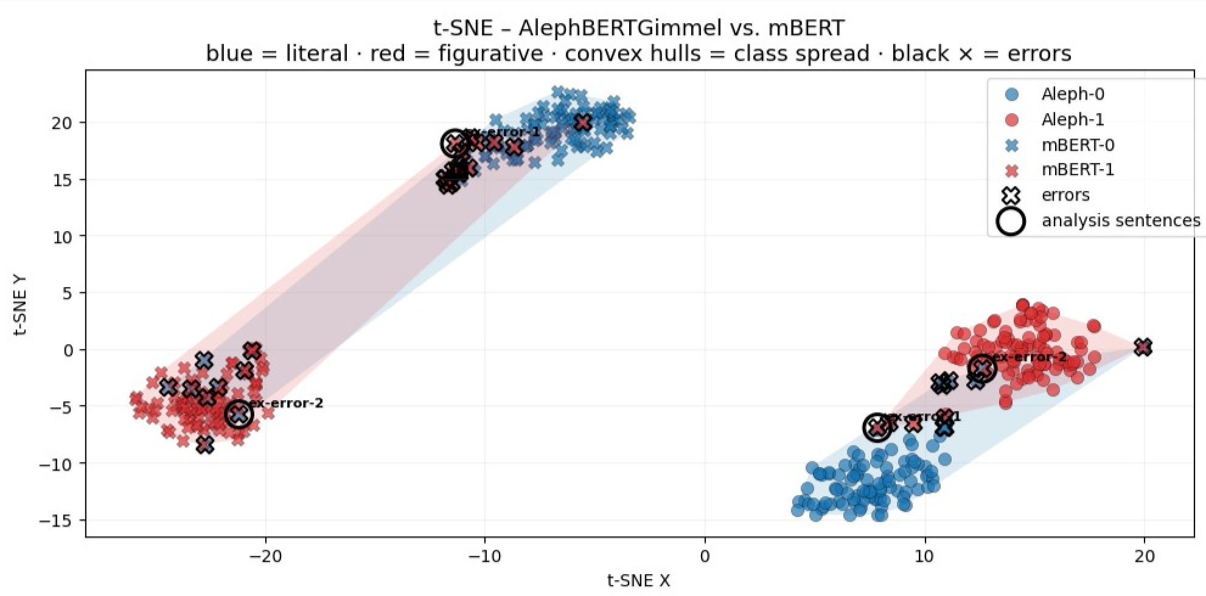
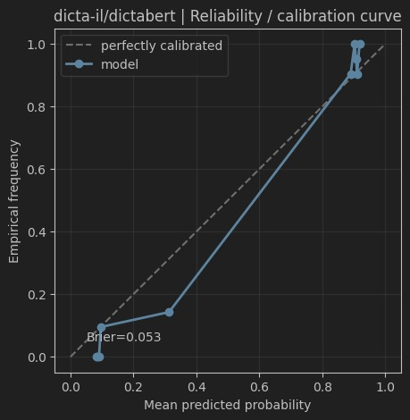
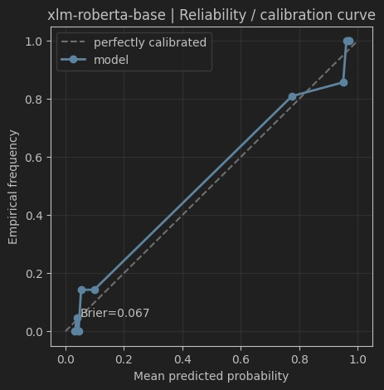

Hebrew Idiom Classification Research
Advanced Analysis: Visualizations
t-SNE Visualization
Embedding space visualization shows clear separation between literal and figurative classes
Calibration Curve
Model confidence assessment for dictaBERT vs. XLM-RoBERTa
Attention Analysis
Token attention patterns in correct and incorrect predictions
Key Insights
False Positive (predicted figurative, some literal sentence expression)
Model Embedding Clusters
AlephBERTGimmel forms more compact and separable clusters between literal and figurative classes
Hebrew-specific models show clearer decision boundaries in t-SNE Misclassifications occur near cluster boundaries
Attention Patterns
Models focus heavily on idiom tokens
Errors occur when models ignore critical contextual words Successful classification balances token and context attention
True Positive (predicted figurative, some figurative sentence expression)
Reichman University | NLP Final Project 2025
Hebrew NLP Research

Slide 12


Hebrew Idiom Classification Research
Conclusions & Impact
Key contributions and implications for Hebrew NLP research
Key Contributions
First comprehensive study on automatic idiom usage classification in Hebrew
Released balanced, annotated dataset of 41 Hebrew idioms with 1,230 sentences (615 literal, 615 figurative)
Developed reproducible methodology for classifying idiomaticity in morphologically rich languages
Achieved 95% accuracy with AlephBERTGimmel, establishing a strong baseline for future research
Visual analysis of embedding clusters confirms clearer class separation with language-specific models.
Research Impact
Language-specific models (AlephBERTGimmel) consistently outperform multilingual models on Hebrew idiom classification
DictaBERT demonstrates strong performance even with frozen parameters, highlighting the importance of domain-specific pretraining
Established evaluation framework and metrics for figurative language understanding in Hebrew
Laid groundwork for improved machine translation, sentiment analysis, and dialogue systems for Hebrew
Our analysis reveals that misclassifications often occur near semantic boundaries and are driven by ambiguous context or token overfocus, highlighting remaining interpretability challenges.
Our findings demonstrate that full fine-tuning is essential for idiom classification, with near-random accuracy (50%) in zero-shot settings, highlighting the challenge of transferring idiomatic knowledge without task-specific adaptation.
This research addresses a critical gap in NLP for morphologically rich, low-resource languages, providing empirical evidence that language-specific pretraining substantial benefits for nuanced linguistic tasks like idiom classification.
Methodological Insight Broader Impact
Hebrew NLP Research
Reichman University | NLP Final Project 2025

Slide 13











Hebrew Idiom Classification Research
Limitations & Future Directions
Current Limitations
Ambiguous contexts where both literal and figurative interpretations are plausible
Dataset constraints: 41 idioms, 1,230 sentences, potentially unrepresentative of natural text
Computational resources limited full exploration (batch sizes, training duration, ensembles)
Model weaknesses: shallow contextual reasoning, token-level overfitting, bias toward figurative readings
Technical Improvements
Use k-fold cross-validation and model ensembling to improve generalization and mitigate individual model weaknesses
Span-level token representations for improved context handling
Future Research Directions
Expand dataset with idioms from diverse, natural sources
Integrate external lexical resources:
Idiom dictionaries
Wiktionary & Hebrew WordNet
Evaluate on downstream applications:
Machine translation
Sentiment analysis & Question answering
Experiment with prompt-based methods and instruction-tuned models
Joint idiom detection & classification in natural text (without marked spans)
Reichman University | NLP Final Project 2025
Hebrew NLP Research

