Slide 1

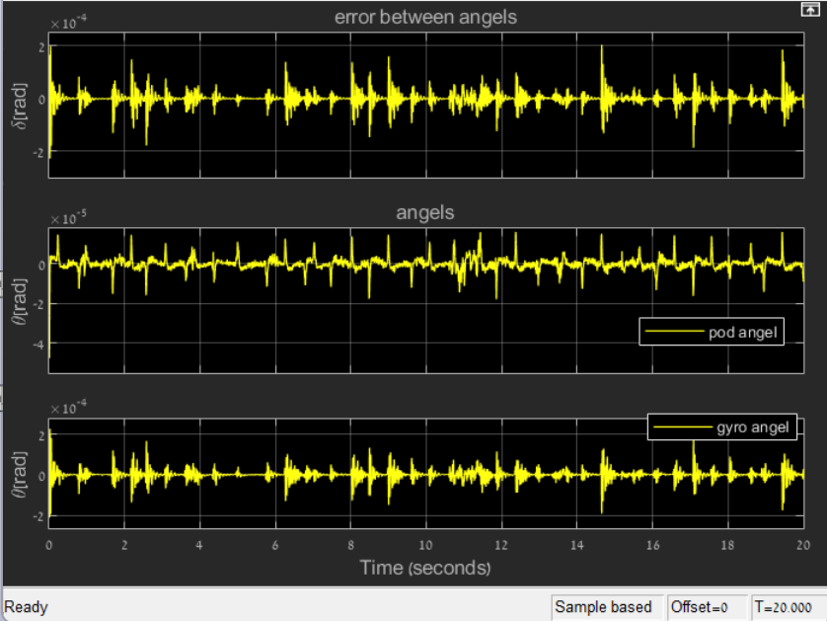
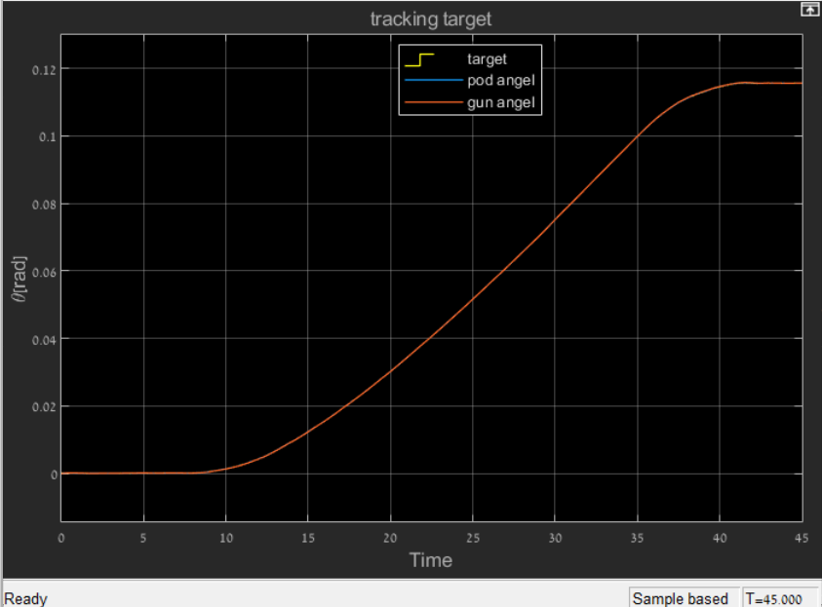
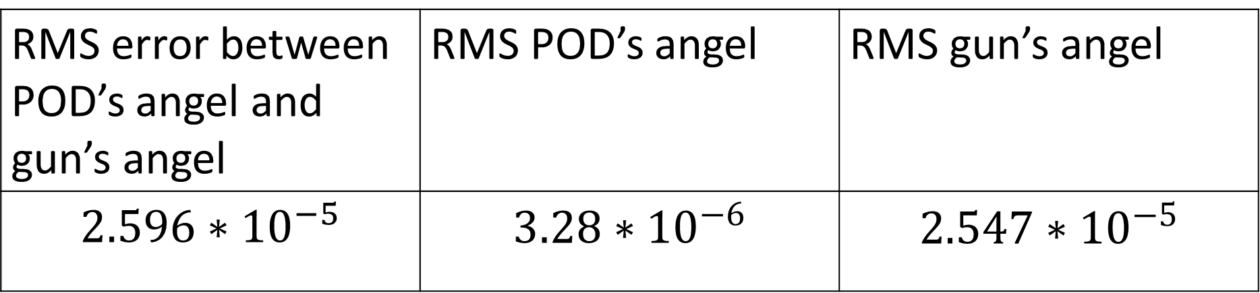
Development of a simulation of a servo control system for inertial stabilization of a
weapon system enslaved to an observation system
Project Number: 22-1-1-2480
Names: Yuval Dekel & Itamar Horovitz
Advisor: Dr. Gavriel Davidov
Introduction The project is a milestone in the development of mobile autonomous systems consisting of a weapon and observation system. The project reproduces mechanical transmissions from measurements and models the systems to maintain a basis that simulates the mechanical system. Based on the modeling of the mechanical system, control systems and systems for treating non-linear phenomena are implemented with known requirements. The various elements have been slaved so that the weapon system follows the optics system, and this is so the system can track a mobile target. Motivation By realizing the goals of the project, a platform is obtained which is a design basis for a mechanical system. Proper planning of this basis is a platform for the development of similar systems with different physical parameters. The platform maintains a programming indicator for system design with desired data, parameter calibration, and checking the possibility of meeting stability conditions. All this before production, based on computing while lacking in hardware resources and saving time resources by working on simulation as an alternative to field experiments. | Methods/Implementation The project was implemented based on MATLAB and SIMULINK software. In the SIMULINK software, the molecules were built, were connected and the control systems were built while paying attention to the system requirements. The unbalanced and ground disturbance elements were placed directly on the platforms and added to the existing systems. The FEEDFORWARD techniques were used to adapt the system response to the requirements. At the end of the design, the controller was built in the SIMULINK software and connected to the model in such a way that the weapon system was slaved to the optics system. Based on SIMULINK with the help of command buttons in MATLAB syntax and switch components, a control panel was built for each axis. Results & Conclusions The following plot depicts the angels of tracking the target trajectory of our system, the route of the target and the error between the angels. | Level of stabilization accuracy underground distribution It can be seen from the plot that our system tracks the route of the target, and all the RMS values in the table are smaller than 0.5[mrad]. In addition, we can conclude that even with a complex system, tracking the route of the target can be achieved with a PID controller, while maintaining the requirements. Bibliography [1] PID explanation: https://ctms.engin.umich.edu/CTMS/index.php?example=Introduction&section=ControlPID [2] feedforward explanation: https://www.researchgate.net/profile/Mohamed_Mourad_Lafifi/post/Is_there_a_measure_based_on_the_eigenvalues_of_a_closed-loop_discrete-time_system_to_evaluate_how_fast_the_system_is_going_to_be_damped/attachment/59d641d179197b807799db5e/AS%3A436557925621762%401481094928368/download/Chapter+9+Reference+Feedforward+Control.pdf [3] Feedforward explanation https://www.mathworks.com/videos/control-systems-in-practice-part-3-what-is-feedforward-control-1535712796292.html
RMS error between POD’s angel and gun’s angel | RMS POD’s angel | RMS gun’s angel
$$2.596∗{10}^{−5}$$ | $$3.28∗{10}^{−6}$$ | $$2.547∗{10}^{−5}$$

