Slide 1
Active Noise Reduction System In a Vehicle
FxLMS-Based Multi-Channel ANC for the Car Cabin — from SISO to Full MIMO
Project No. 25-1-1-3214
Ariel Turnowski (206483513) · Yuval Horowitz (206587719)
Supervisor: Dr. Lior Arbel
The Iby and Aladar Fleischman Faculty of Engineering, Tel Aviv University

Slide 2
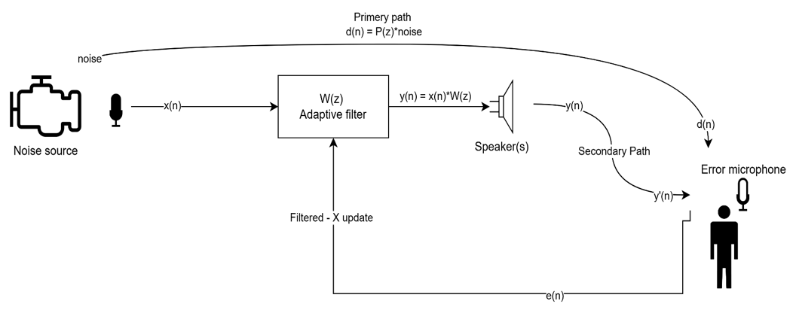
Topic
What is Active Noise Control?
A microphone captures noise early; a filter computes an inverted copy; a loudspeaker radiates it so the two cancel at the ear.
Targets the low-frequency cabin noise (engine, road, wind) that passive insulation cannot economically absorb.
We build and evaluate the full system in simulation, driven by real Los-Angeles driving recordings.
Headline result: a full MIMO controller reaches +14.3 dB on idle, +12.6 dB on cruising, +9.9 dB on acceleration.

Slide 3
Topic
Background — the Cancellation Principle
Two coherent sound waves of equal magnitude and opposite phase sum to silence at the point where they meet.
Cancellation is local: it only holds where the anti-noise is phase-matched to the disturbance.
The reference signal is filtered and continuously adapted so the residual error at the ear is driven toward zero.
Two acoustic paths matter:
Primary path P(z): noise source → error microphone.
Secondary path S(z): loudspeaker → error microphone (the part that makes naive LMS unstable).

Slide 4
Motivation & Goals
Engineering Motivation
Sits at the intersection of Digital Signal Processing, acoustics and machine learning.
Improves passenger comfort and reduces driver fatigue on long drives.
Low-frequency noise (50–300 Hz) is exactly where adding mass / insulation gives the least return.
Unlike headphones or cockpit headsets, a car needs a broad zone of quiet that tolerates natural head movement — which demands a multi-channel adaptive system.

Slide 5
Motivation & Goals
Project Goals & Targets
Goal | Target
Noise reduction at driver ear | ≥ 10 dB (stretch 10–20 dB)
Frequency range | 20 – 1000 Hz
Convergence time | < 2 seconds
Stability | across idle / cruising / acceleration
Configurations | SISO → SIMO → full MIMO (multi-speaker / mic)
Evaluated on real recordings, not synthetic noise — the harder and more honest test.

Slide 6
Methods
Methods — System Architecture
Acoustic simulation: pyroomacoustics shoebox cabin (4.5 × 1.85 × 1.2 m), image-source reflections, frequency-dependent absorption.
Controller: Filtered-x Normalised LMS (FxNLMS) adaptive filter — the de-facto ANC standard.
Scaled across five configurations of growing channel count, SISO through full 4×4×4 MIMO.
Two ML research threads explored in parallel (step-size selection and an end-to-end neural controller).
Everything wrapped in an interactive Streamlit playground for live experimentation.

Slide 7
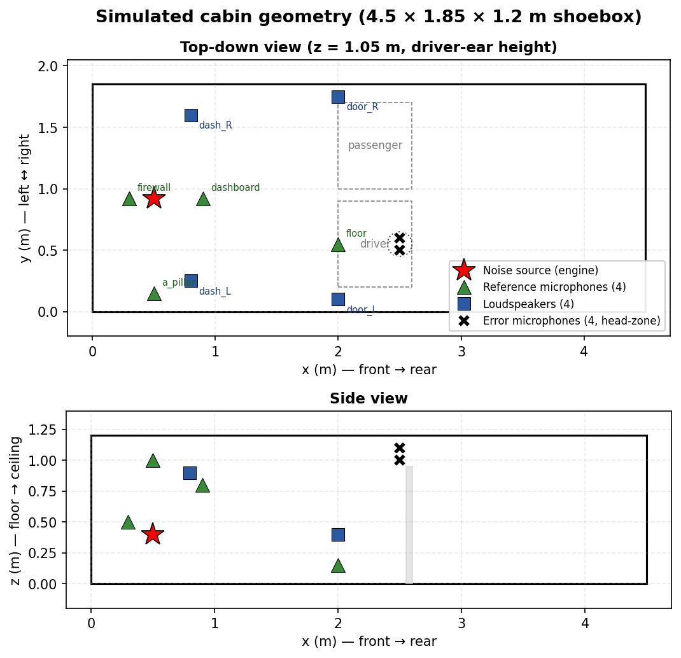
Methods
Simulation Environment & Cabin Geometry
Shoebox cabin at 16 kHz, reflections to order 3, per-surface absorption (carpet, headliner, glass, dashboard).
Noise source in the engine bay; 4 candidate reference mics (firewall, floor, A-pillar, dashboard).
4 loudspeakers in door / dashboard positions.
4 error mics in a 2×2 head-zone grid (±5 cm) around the driver ear.

Slide 8
Methods
Excitation — Real Driving Scenarios
Scenario | Recording | Character
Idle | la_idle.wav | Stationary engine, low-frequency harmonics
Cruising | la_medium_cruise.wav | Steady tyre / wind, broadband
Acceleration | la_varying.wav | Non-stationary spectrum, transients
Real Los-Angeles downtown driving — the acceleration clip is the regime where FxLMS is most challenged.

Slide 9
Methods
FxLMS → FxNLMS — the Core Algorithm
FxLMS filters the reference through an estimate of the secondary path before the weight update — this is what keeps it stable.
Update rule (normalised form):
w(n+1) = w(n) + μ · e(n) · x′(n) / (δ + ‖x′(n)‖²)
w — filter weights; μ — step size; e(n) — error at the mic.
x′(n) — reference filtered through the secondary-path estimate; δ — regularisation.
FxLMS adapts ~16,000 times per second (one update per sample at 16 kHz).
Parameter | Value
Filter length | 512 taps (256 for MIMO)
Step size μ | 0.003 (0.001 for MIMO)
Regularisation δ | 1e-4
Sample rate | 16 kHz

Slide 10
Methods
From SISO to MIMO — the Taxonomy
SISO (1×1×1): one ref, one speaker, one error mic — small zone of quiet, baseline.
Pseudo-SIMO (1×4×1): four speakers driven by ONE shared filter — cheap, but limited.
Stage 1 — true SIMO (1×4×1): four independent filters.
Stage 2 — SIMO + multi-error (1×4×4): four head-zone error mics → uniform quiet zone.
Stage 3 — full MIMO (4×4×4): four reference mics exploit different noise paths → biggest gain.
More channels = more degrees of freedom = better cancellation (at higher compute cost).

Slide 11
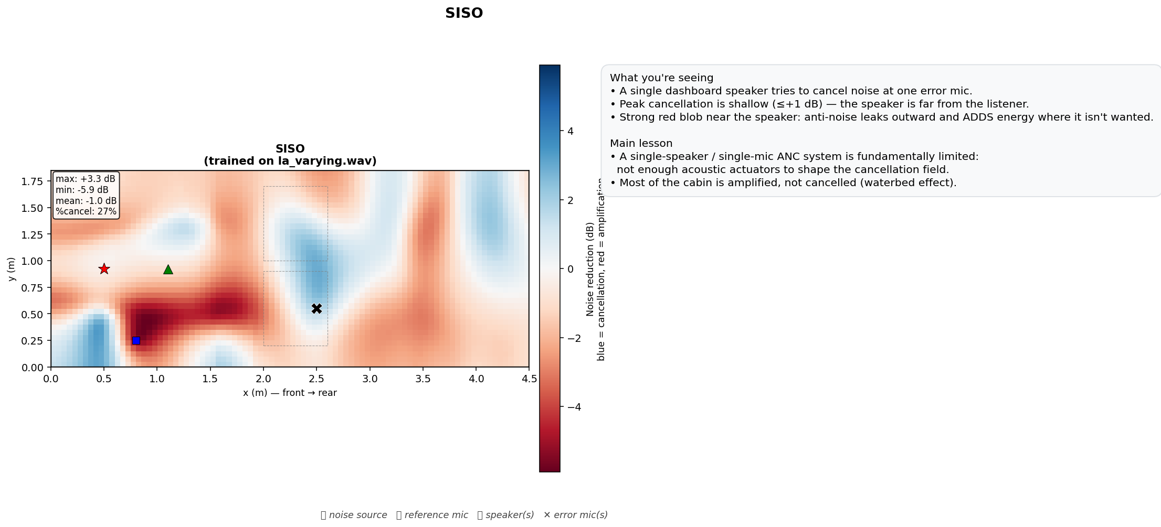
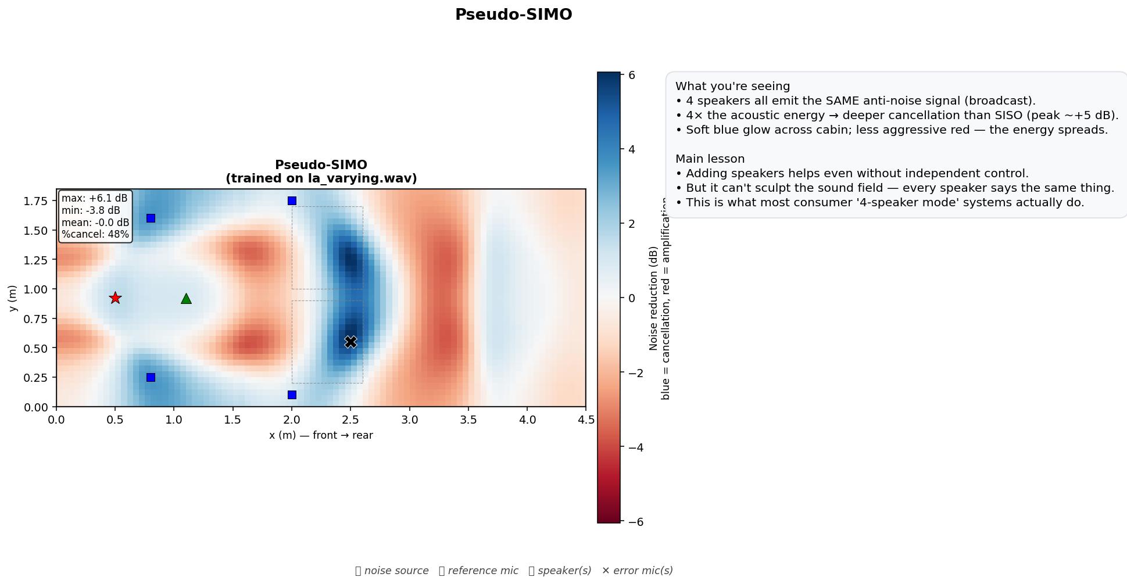
Methods
Implementation — SISO vs Pseudo-SIMO
SISO — sharp, tiny quiet point
Pseudo-SIMO — wider, shared filter

Slide 12
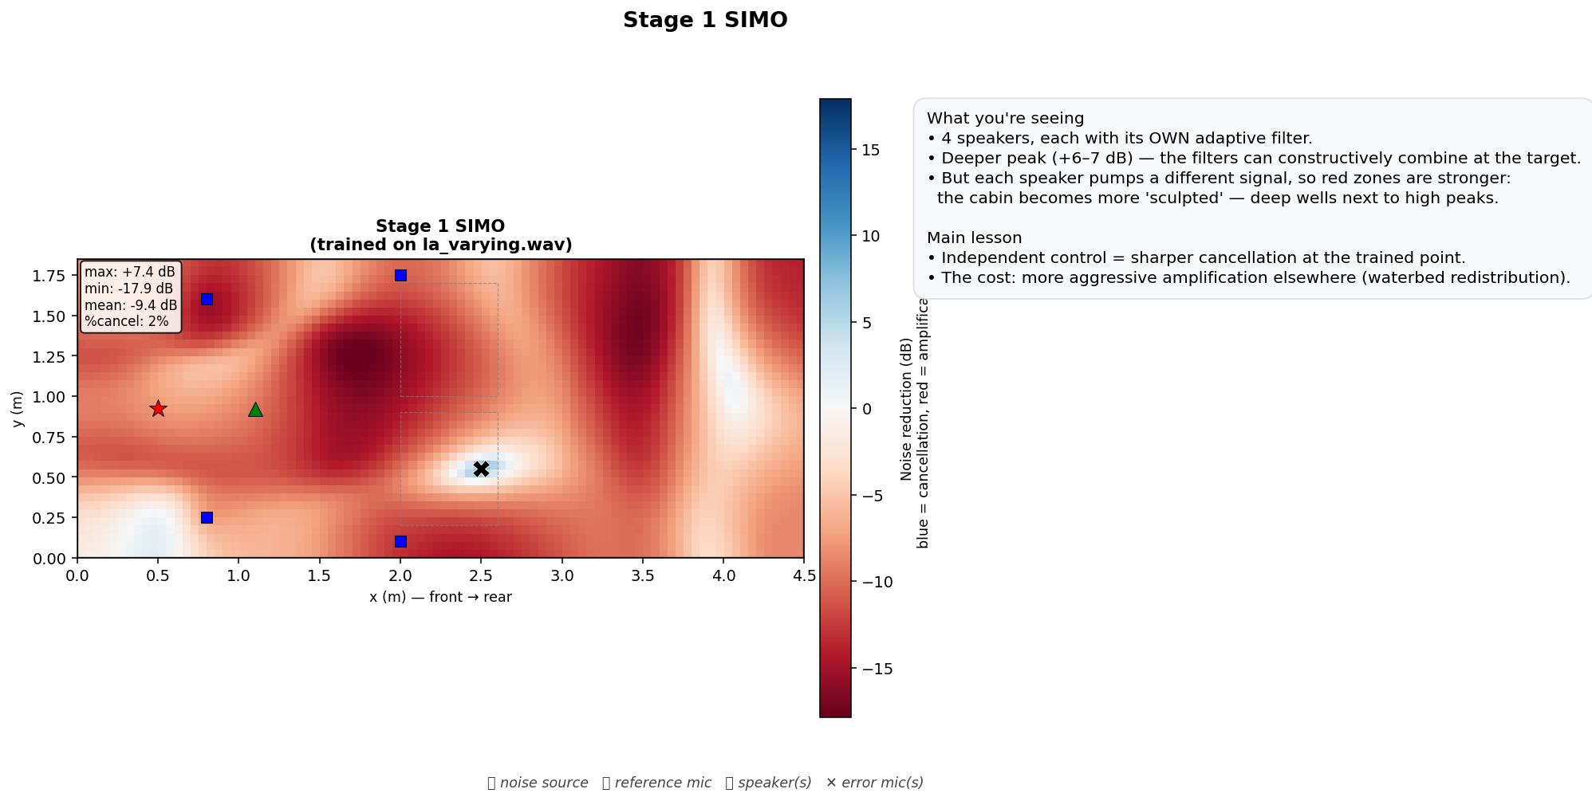
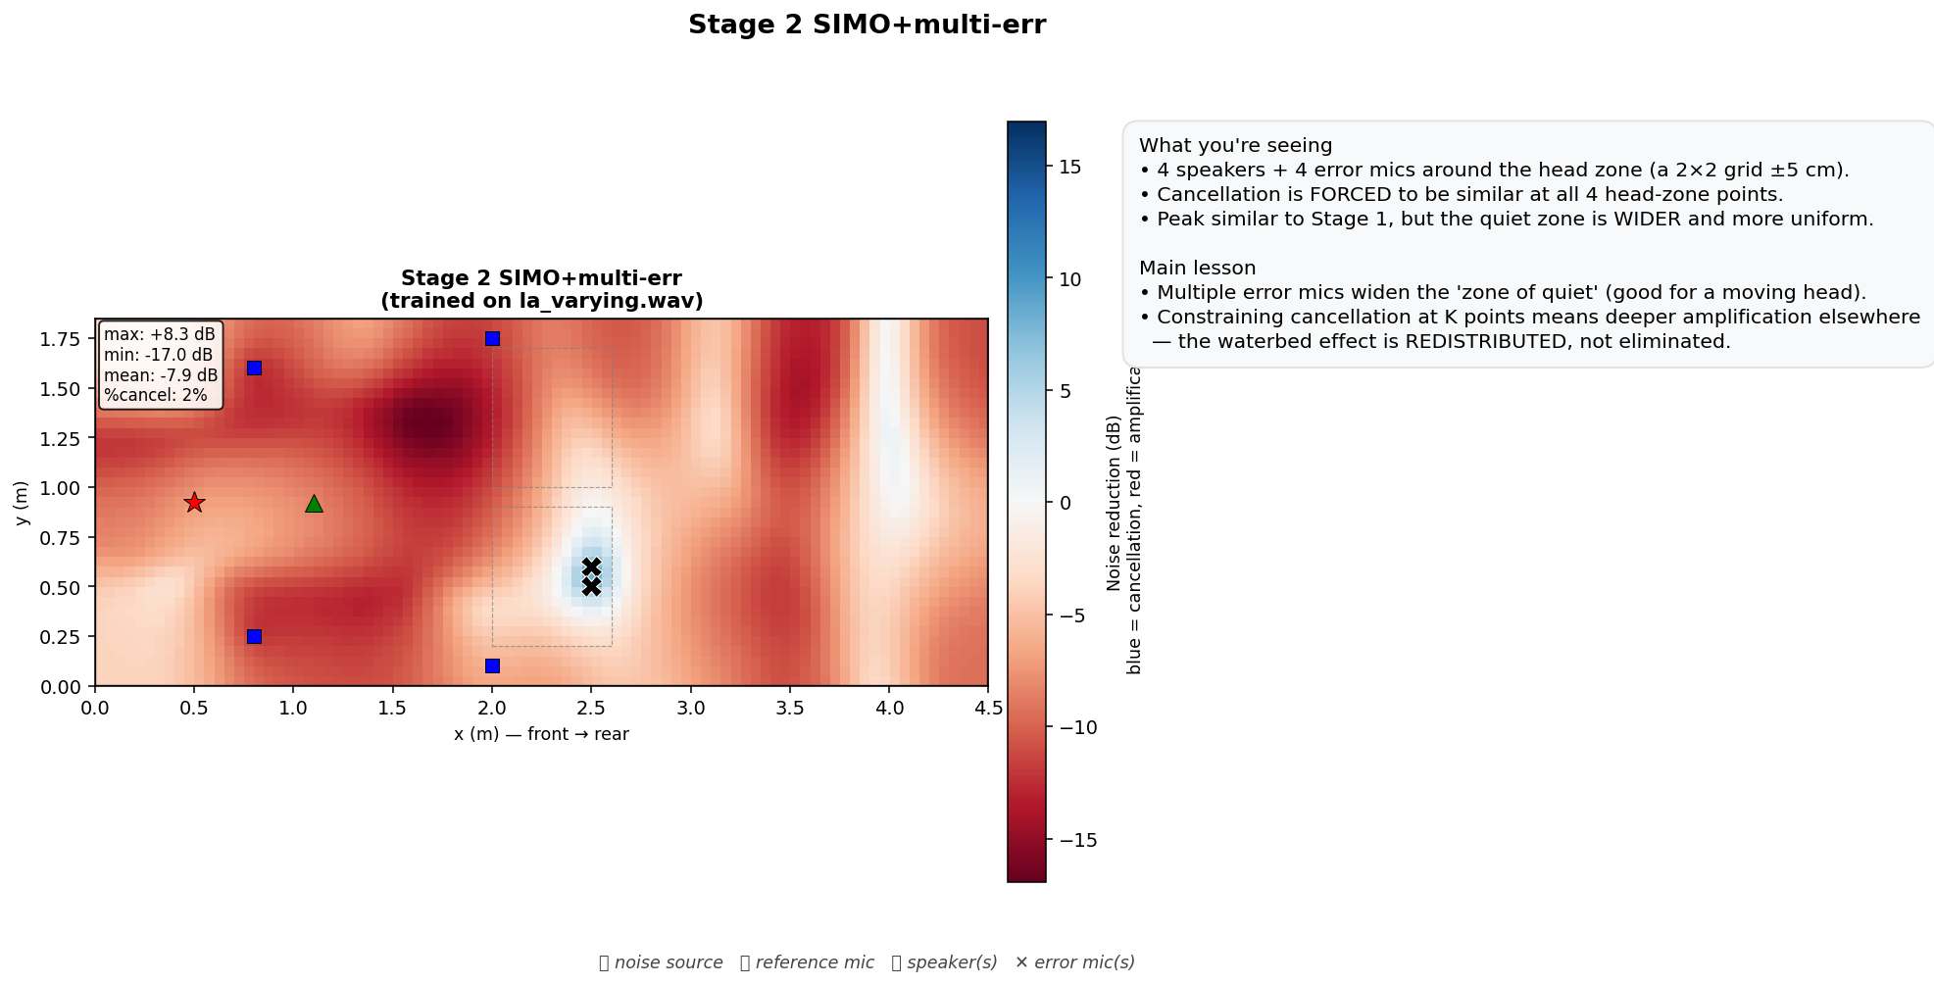
Methods
Implementation — Stage 1 SIMO vs Stage 2 Multi-Error
Stage 1 — independent filters
Stage 2 — uniform head-zone quiet

Slide 13
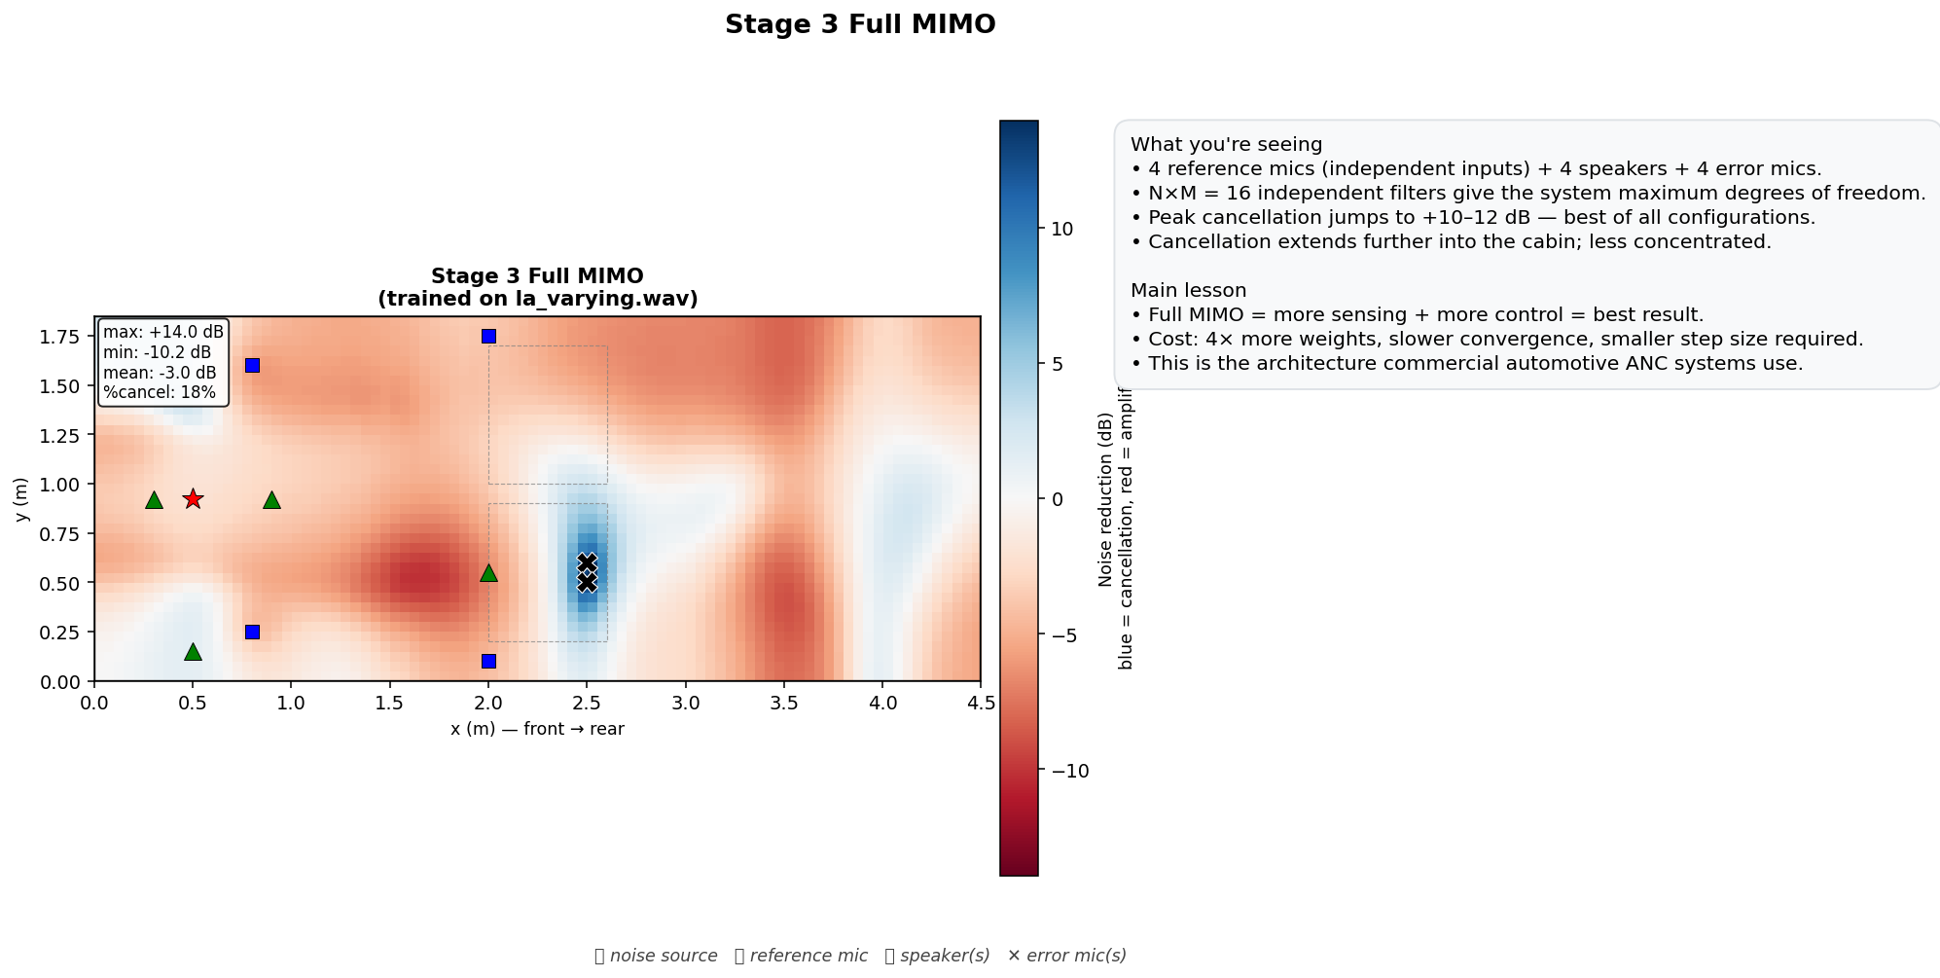
Methods
Implementation — Stage 3 Full MIMO (4×4×4)
Four reference mics feed a 4×4×256 = 4,096-weight controller.
Each reference captures a different noise path — engine via firewall, road via floor, wind via A-pillar.
Step size reduced to 0.001 to stay stable with 4× more weights.
Best result of all configurations — but ~13× real-time compute.

Slide 14
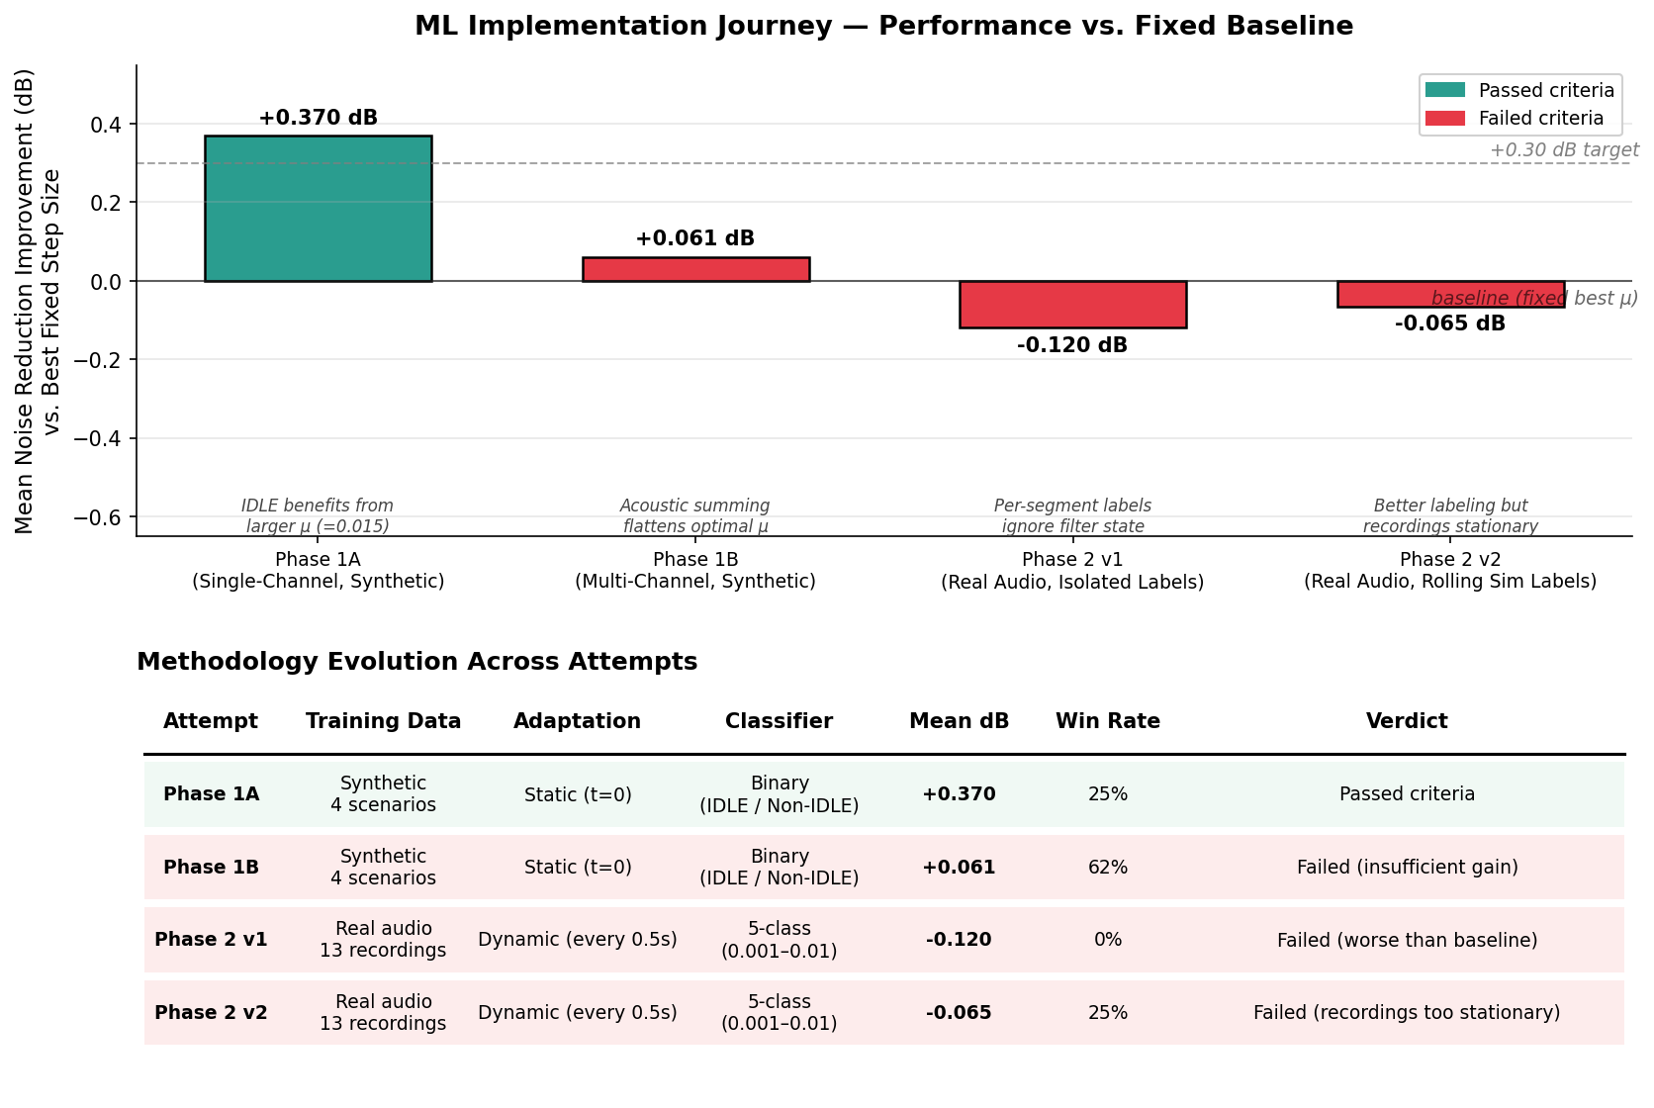
Methods
ML Thread A — Adaptive Step-Size Selection
Idea: a small classifier picks the FxLMS step size from short-term audio features.
Four attempts: synthetic-static (+0.37 dB), multi-channel (+0.06 dB), dynamic per-segment (−0.12 dB), rolling-sim labels (−0.07 dB).
Finding: FxLMS already adapts 16,000×/s — little headroom left for a 0.5-s-granularity classifier.
ML only helps when the optimum changes faster than the filter can self-tune.

Slide 15
Methods
ML Thread B — End-to-End Neural Control (TCN)
Idea: replace FxLMS with a Temporal Convolutional Network that learns anti-noise directly from the reference.
Causal dilated convolutions; secondary path placed INSIDE the training loss (the neural filtered-x idea).
Variants: baseline +2.2 dB; RIR-pre-filtered ≈ +8.9 dB (controlled); others inconsistent or amplified the noise.
Failure modes: amplitude overshoot, weak phase alignment, poor generalisation to unseen cabins.
Lesson: a black box lacks the microsecond phase/amplitude precision that FxLMS enforces structurally → we chose physics-structured MIMO.

Slide 16
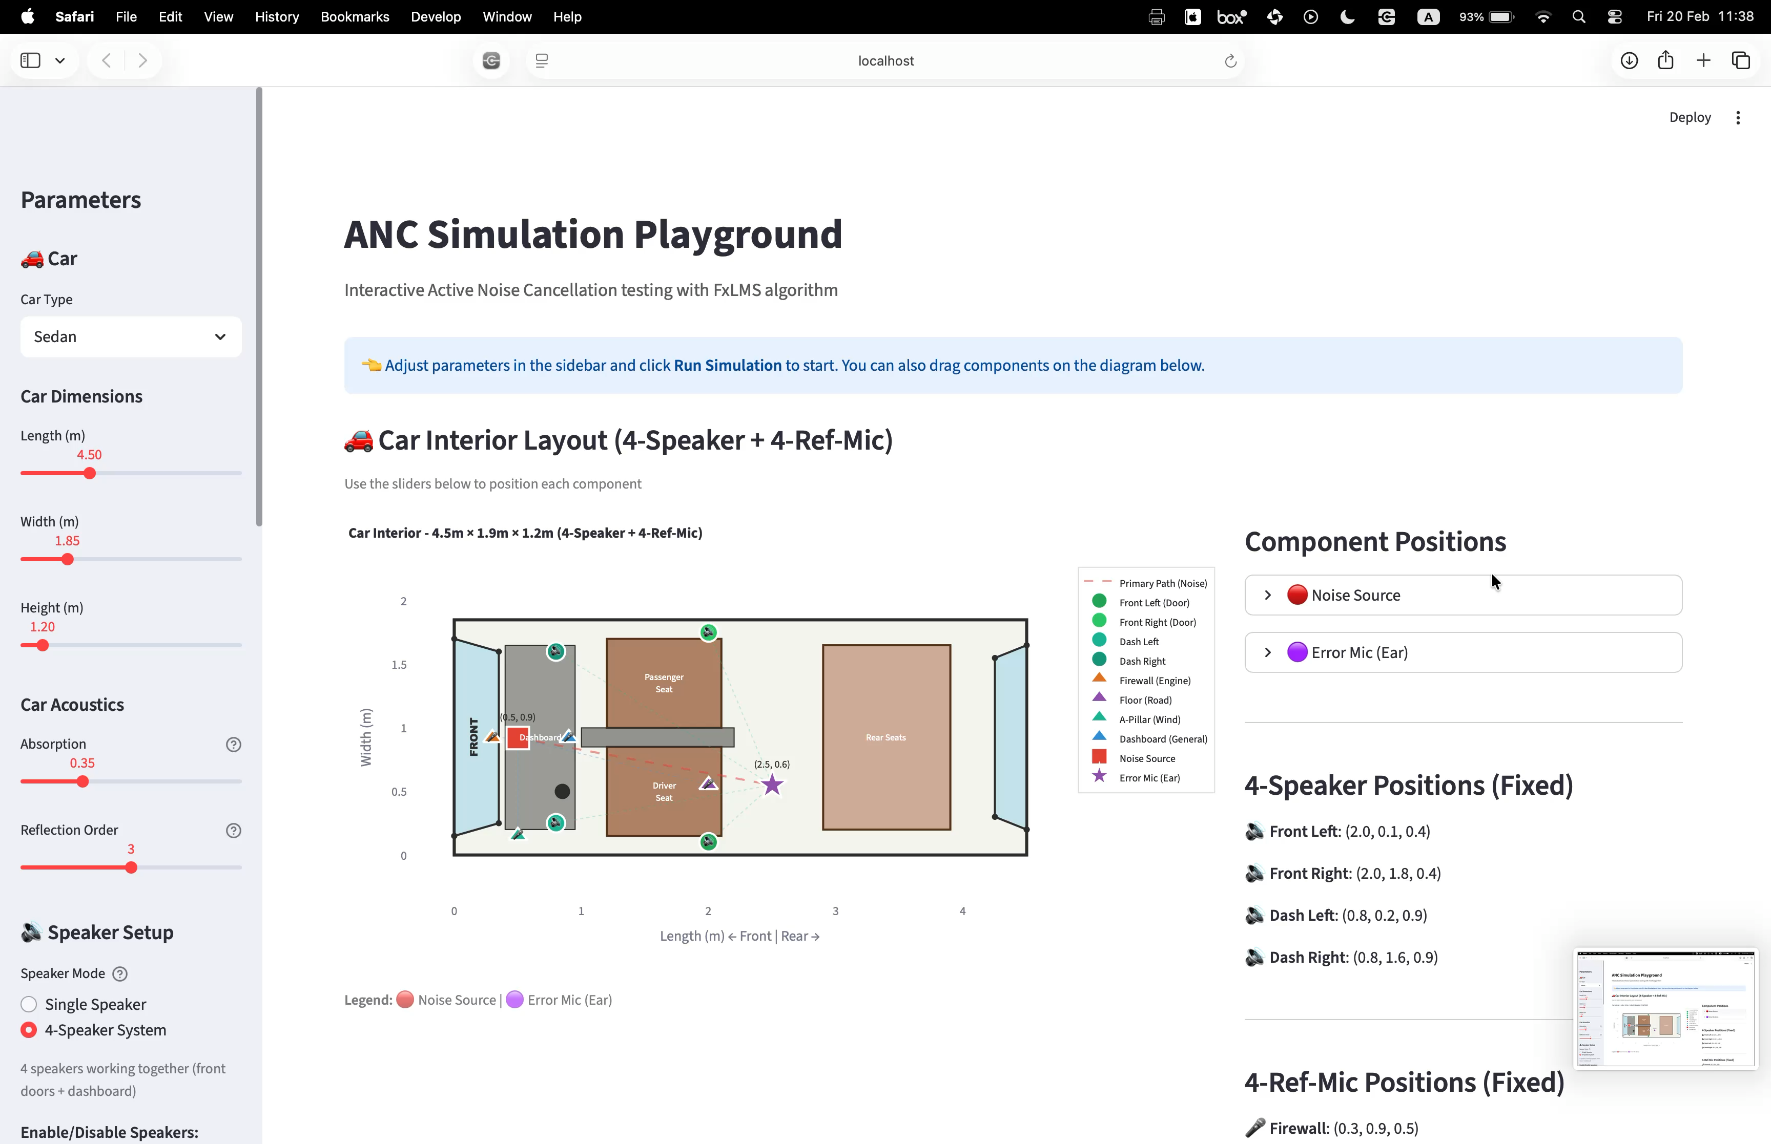

Demonstration
Demonstration
Interactive Streamlit playground: switch algorithm, scenario and transducer positions live.
Listen to the before / after on the right (embedded audio).
Live app: streamlit run playground/app.py
Original noise ▶
With ANC ▶

Slide 17
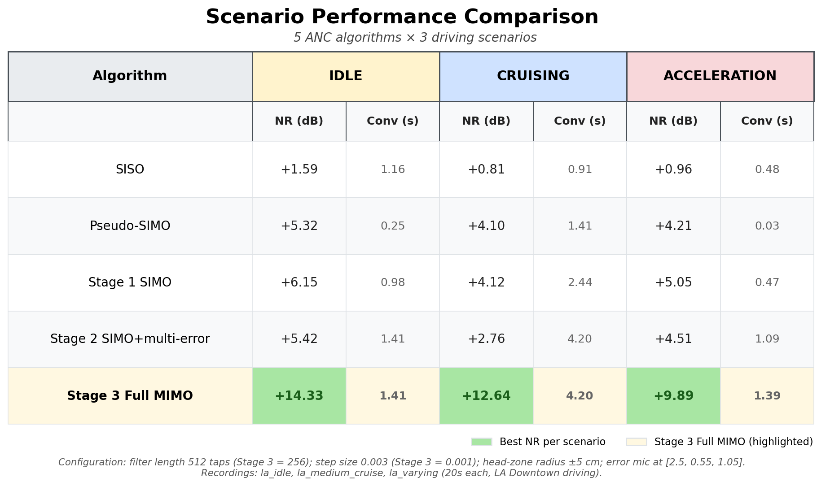
Results
Results — Scenario Performance
Five algorithms × three scenarios. Stage 3 Full MIMO wins every scenario: +14.3 / +12.6 / +9.9 dB.

Slide 18
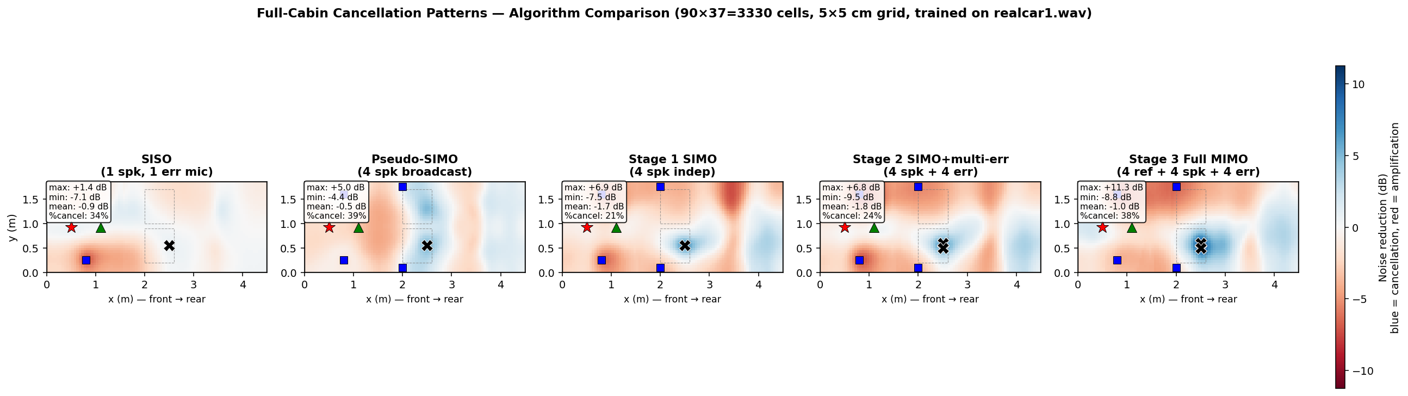
Results
Results — Spatial Field & the Waterbed Effect
Deep quiet zone at the ear, but energy is pushed up elsewhere — ANC redistributes, it does not delete.

Slide 19
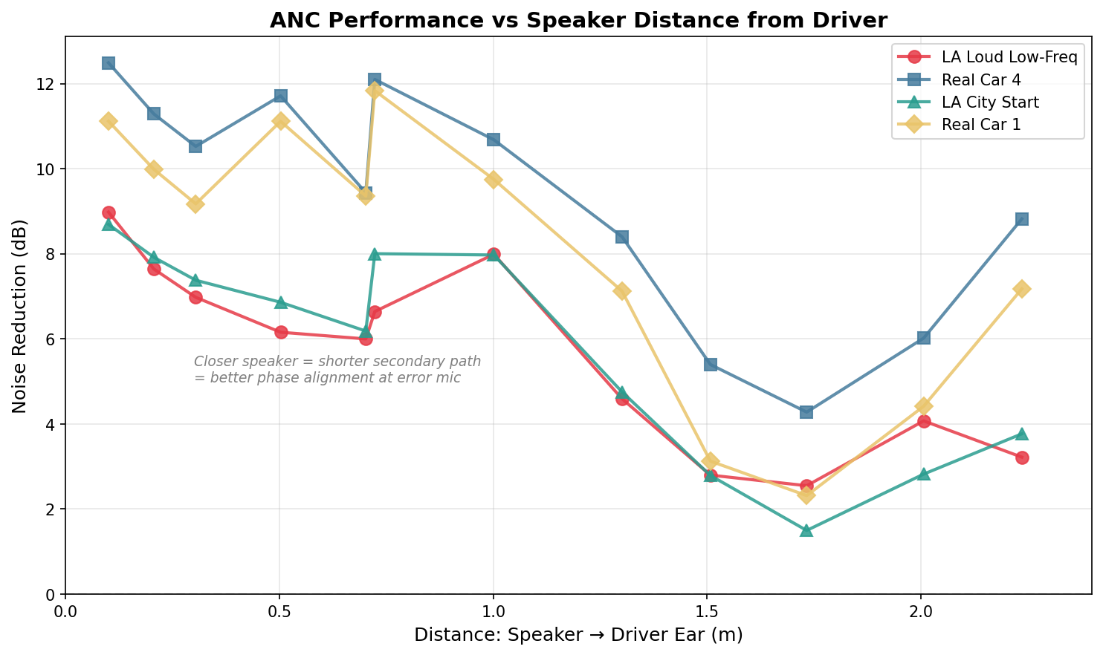
Results
Results — the Zone of Quiet
SISO quiet zone collapses within ~5 cm of the error mic.
Multi-error Stages 2 & 3 hold >10 dB across a 10 cm head-zone radius.
This is the practically useful regime: the listener can move their head without losing cancellation.

Slide 20
Results
Conclusions
All three goals met: Stage 3 reaches +14.3 dB (idle) / +9.9 dB (acceleration), converging in ~1.4 s.
More channels genuinely help — multi-reference MIMO is the biggest single jump in performance.
Transducer placement matters as much as the algorithm: position optimisation alone adds 6–8 dB.
Both ML directions lost to a well-tuned FxLMS — physics structure beat the black box here.

Slide 21
Future Work
Suggestions for Future Work
Online secondary-path identification — track drift with temperature, seats and occupants (recovers lost dB).
Vectorised / GPU MIMO — bring Stage 3 from ~13× real-time into real-time on a DSP.
Long-form non-stationary audio — where adaptive step-size selection should finally pay off.
Improved neural ANC — cascaded magnitude/phase TCN with RIR pre-filtering.
Real-cabin measurements & a hardware port to validate the simulator.

Slide 22
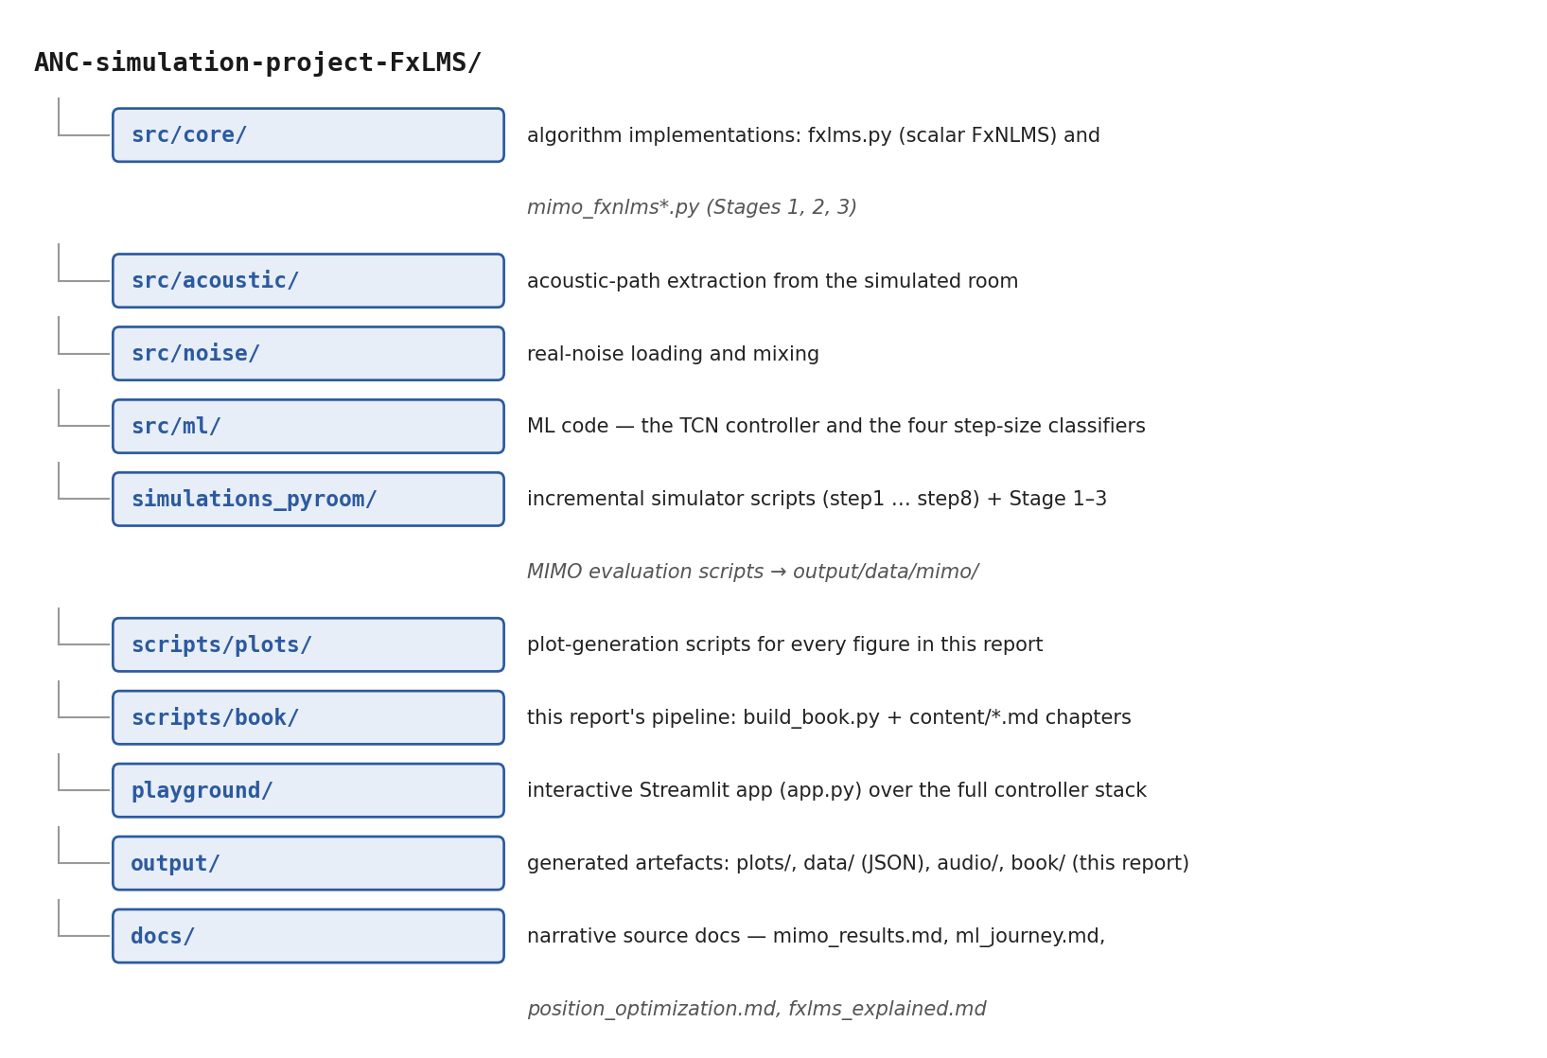
Documentation
Project Documentation
Public GitHub repository with all code, simulations, plots and this presentation.
Project Book documents theory, simulation, results.
Interactive playground: streamlit run playground/app.py
Reproducible: every figure has a generator script.

Slide 23
Documentation
Thank You
Active Noise Reduction System In a Vehicle — Project 25-1-1-3214
Ariel Turnowski · Yuval Horowitz
Supervisor: Dr. Lior Arbel
Questions?

