Slide 1


Yuval Solaz , Dr. Itzik Klein , Guy Ohayon
Data mining & analytics department
Unclassified

Slide 2
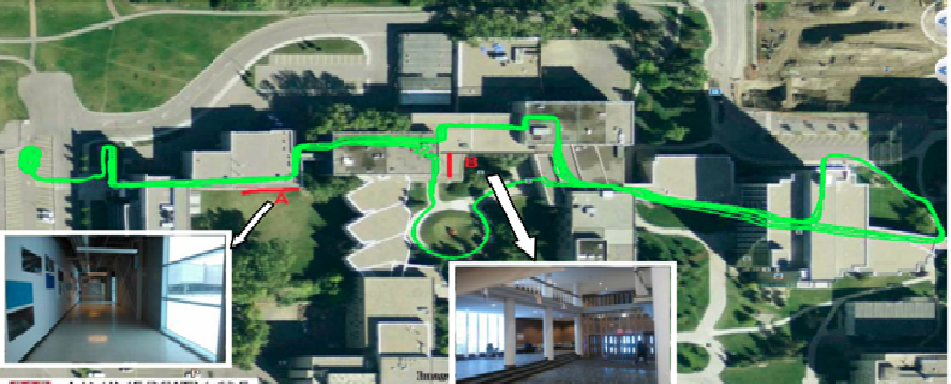
Motivation:
Improve indoor pedestrian dead reckoning
Basic PDR process
  detect the pedestrian’s travelling steps – step detection.
  Estimate step length.
  Estimate user heading.
Unclassified

Slide 3
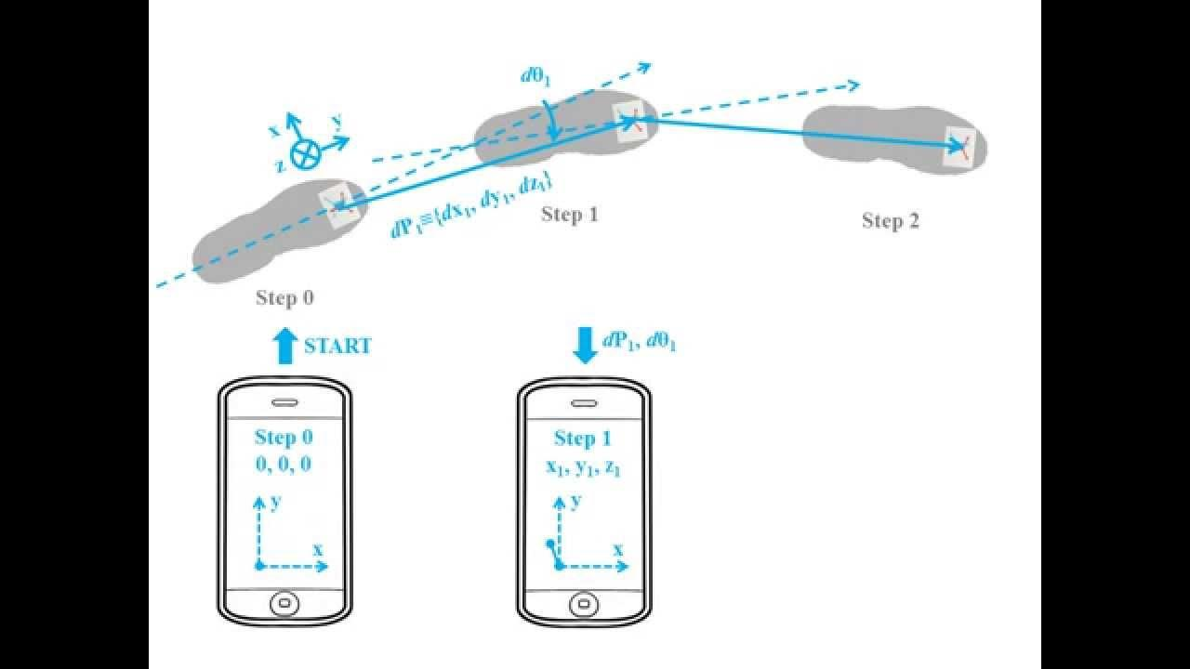
Estimate step length
  Step length estimation is sensitive to the Smartphone mode
Unclassified

Slide 4

Smartphone mode classification
Modes - pocket, swing, talk, texting
Unclassified

Slide 5
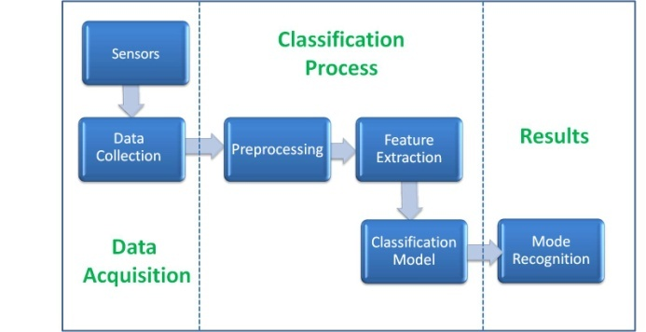
Classification workflow
pip install sklearn
pip install xgboost
Unclassified

Slide 6
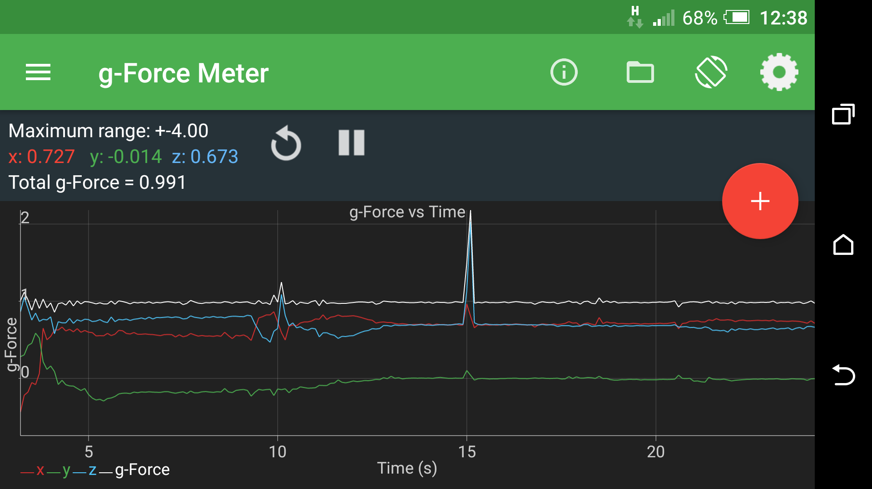
Dataset
Data recording :
Android recording application (sample rate ~ 50 Hz).
Record accelerometer - x,y,z [g] , gyroscope - wx wy wz [red/sec].
One label (texting , pocket , etc ) for each recording session.
magnetometer, barometer , ambient light for future use.
Unclassified

Slide 7
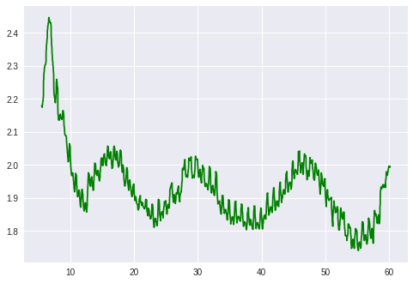
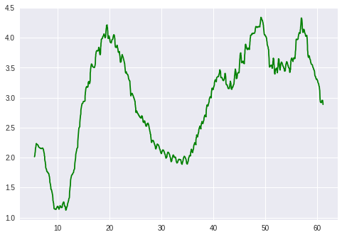
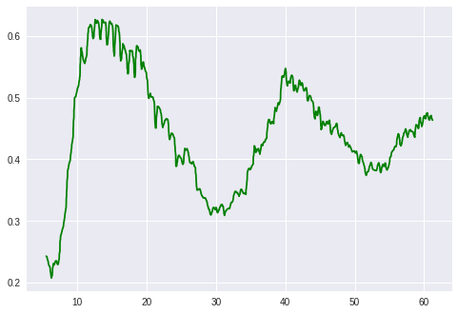
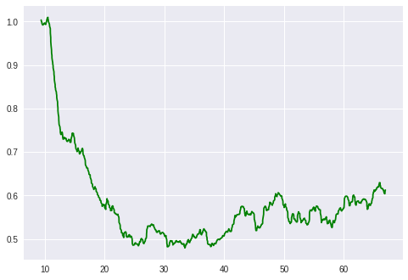
Gyroscope signal examples
Swing
Angular Rate [rad/sec]
Pocket
Talking
Angular Rate [rad/sec]
Texting
Time [sec]
Time [sec]
Unclassified

Slide 8
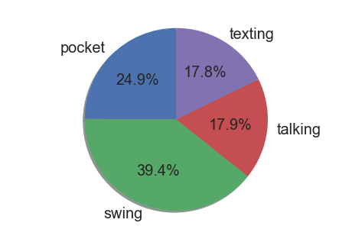
Dataset mode distribution
Unclassified

Slide 9
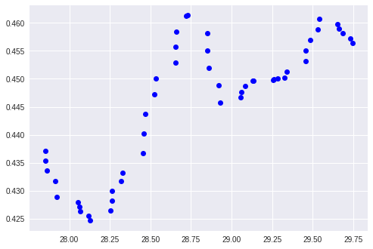
Basic model
All features based on
sliding window of 120 samples (~2 seconds )
Features: mean , median , max , min , std
Angular Rate [rad/sec]
Time [sec]
Works on the accelerometer and
gyro magnitude not on the vector components
Unclassified

Slide 10
Basic model evaluation
Split the data files to train and test files
Test results :
KNN - K-Nearest Neighbors : 70.0%
SVM - Support Vector Machine : 78.0%
RF - Random forest : 83.5%
Unclassified

Slide 11
Improved model
  Preprocessing
    Remove outliers
  Advanced features
    Peaks count
    Median Crossing count
    Amplitude ( max - min )
    Sensors correlation features
  Improved classifiers
    xgboost
    Hyper parameters tuning
Unclassified

Slide 12
Final results
Best Accuracy 87.7%
RF - Random forest : 87.7%
GBM – Gradient boosting : 87.5
SVM - Support Vector Machine : 85.1%
KNN - K-Nearest Neighbors : 84.2%
Unclassified

Slide 13
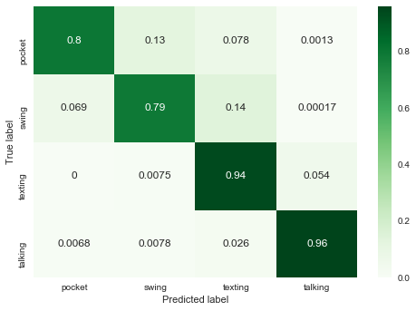
Results
Random Forest Confusion Matrix
Unclassified

Slide 14
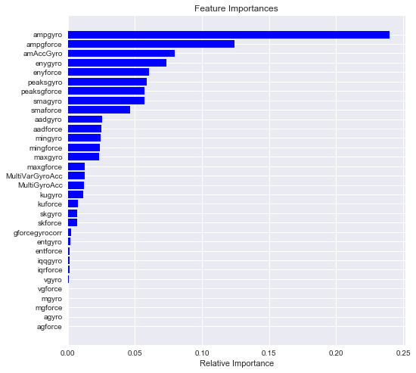
Random Forest Feature Importance
Unclassified

Slide 15
What’s next ?
1D CNN
RNN , LSTM
Frequency domain features
Unclassified

Slide 16
Thanks
Unclassified

