Slide 1


Lending Club Case Study
Group Members :
1. Pradeep Singh
2. Yuvan Raj Kumar

Slide 2
Abstract
Lending Club is largest online loan marketplace, facilitating personal loans, business loans and financing medical procedures. Borrowers can easily access lower interest rate loans through a fast online interface.
Like most other lending companies, lending loans to ‘risky’ applicants is the largest source of financial loss . The financial loss is the amount of money lost by the lender when the borrower refuses to pay or runs away with the money owed
The objective of analysis is to use the information about past loan application and find whether they “defaulted” or not.

Slide 3
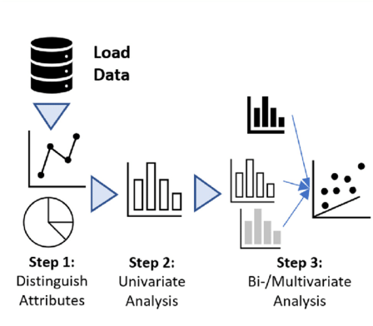



Steps involved in analyzing
Step 4:
Recommendation

Slide 4
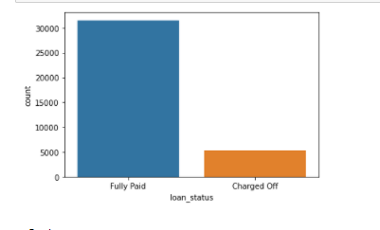
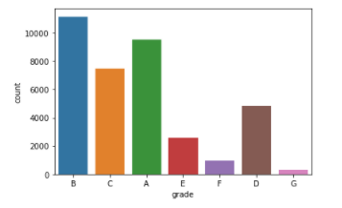
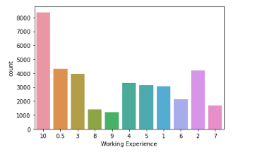
Analysis
1.Loan Status
2.Grades
3.Working Experience

Slide 5
Observations
1.It is observed that the loan amount varies from 0 to 30,000
2.Most of the loans are fully paid
3.Most of the loans are grade A & B
4.Human having more than 10 years experience apply loan in majority
5.Funded amount by investor is right skewed, hence most of the loan amount is greater than 6.5Lakhs
7.From the above plot it is visible that only 2 Humans are getting higher salary greater than 3L
8.70% of people get sure loan from investers

Slide 6
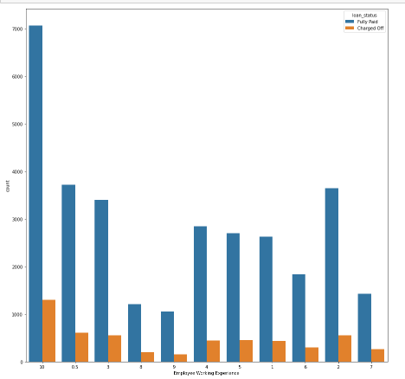
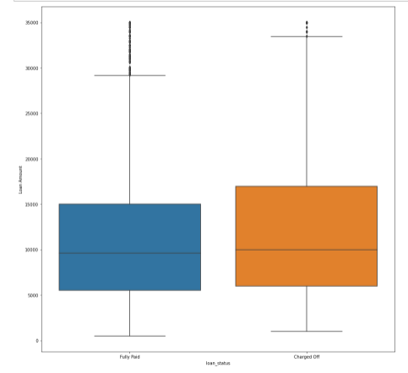
Analysis
Employee Experience vs Loan Status
Loan Amount vs Loan Status

Slide 7
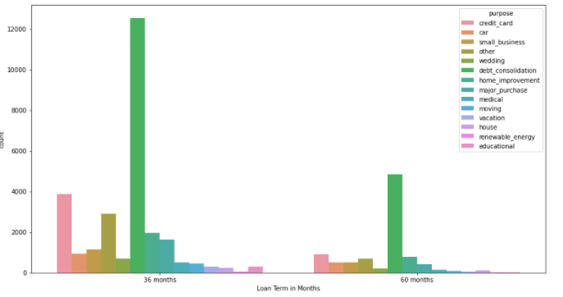
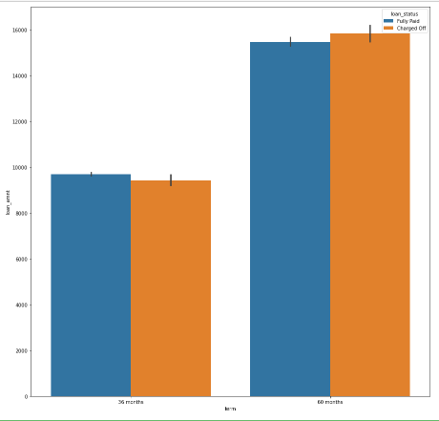
Term vs Purpose
Term vs Loan Amount

Slide 8
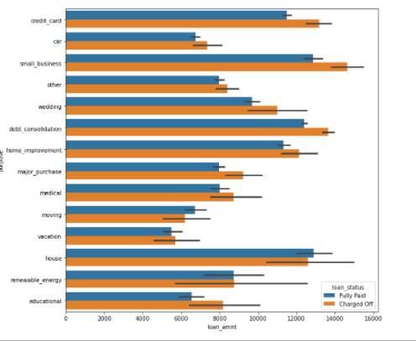
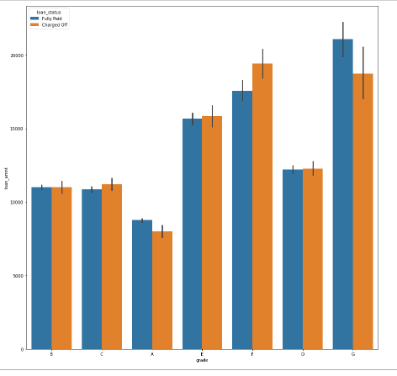
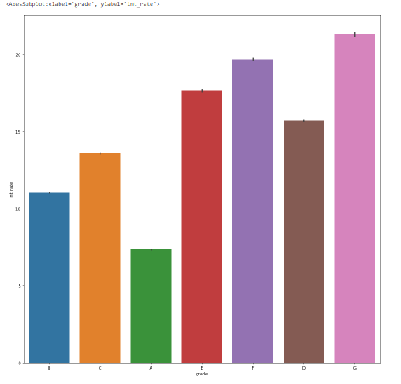
Loan Amount vs Purpose
Grade vs Loan Amount
Grade vs Instalment Rate

Slide 9
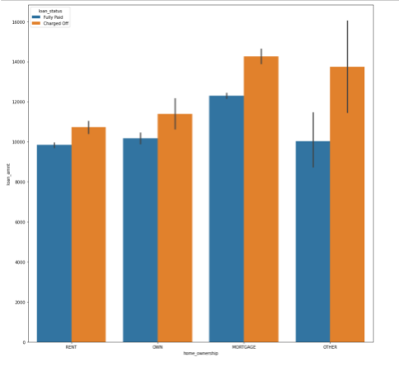
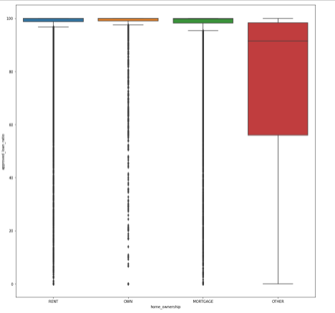
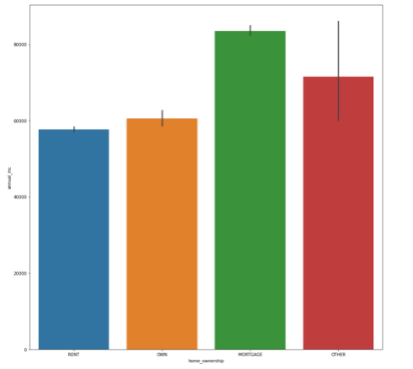
House Owner Ship vs Loan Amount
House Owner Ship vs Approved loan
House Owner Ship vs Annual Income

Slide 10
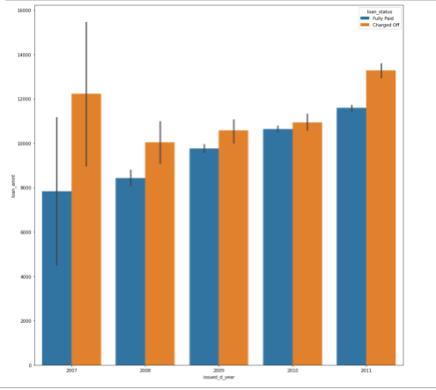
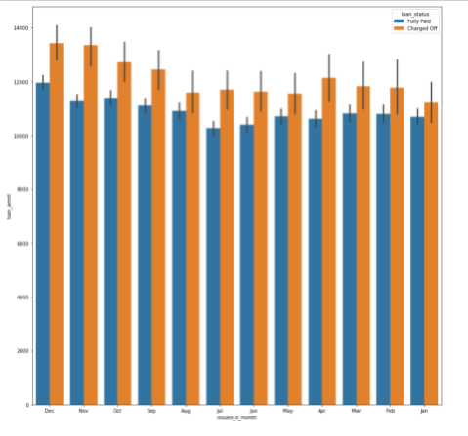
Loan Amount vs Loan Issued Month
Loan Amount vs Loan Issued year

Slide 11
Observations
1.Human's having experience of 10 paid their loan successfully when compared with others, where as 8,9 are not paying their loan well
2.From the above plot it is observed that mean, 25% and 75% Loan amount of Fully paid and charged off is similar
3.Major human takes loan for the dept consolidation and taken loan is fully paid
4.Human choosing 36 Months tenure have high chance of paying correctly
5.People having Good annual income paying better Instalments
6.Maximum status of the loan were Fully paid
7.People having Home ownership as 'MORTAGE' have income of about 60K
8.F grade Loan applier having loan amount of 15k-20k
9.G grade Loan applier having interest rate above 20%
10.Its seems that the default rate is high in 60 months tenure
11.The Lower grade are higher chance of default than the Higher grade one
12.The lower grade (E-G) are getting loans for higher interest rate which might cause default
13.Human who took loan for small business seems to be default more
14.Human's in mortage home ownership has high default rate

