Slide 1
Product Inventory Management System
TEAM 7

Slide 2
Group Members
Siddesh
Iliyas
Darshan
Barath
Yuvan

Slide 3
Table of Contents
Introduction
Objective
Key Features
Technologies Used
Components Details
Work Flow
ER Diagram
Future Enhancements
Thank You

Slide 4
Introduction
“Product Inventory Management System” is a Single Page Application (SPA) designed to enhance inventory management for businesses by simplifying the process of managing products and stock. This system enables businesses to efficiently add, update, delete, list, and search for product records.
Users can also categorize products, update stock quantities, and view detailed product information such as descriptions, prices, and manufacturers

Slide 5
Objective
To provide a user-friendly inventory management system
To manage product information
To improve efficiency and reduce manual errors
To enable seamless product transactions

Slide 6
Key Features
Product Management (CRUD Operations)
Spring boot for the backend
JUnit Testing – Write test cases to verify backend services
Using REST API – Enable seamless communication between frontend and backend for efficient data exchange.
Responsive UI with HTML and CSS

Slide 7
Technology Stack
Front End:
Angular: A TypeScript-based framework for building SPAs.
HTML/CSS: For structuring and styling the UI.
Back End:
Spring Boot: A Java-based framework for building RESTful APIs.
Spring Data JPA: For database interactions.
Spring Security: For user authentication and authorization.
MySQL: For database storage (or H2 for development).
Tools:
Visual Studio Code: For Angular development.
STS: For Spring Boot development.
Postman: For API testing.

Slide 8
Components Details
Frontend:Angular
Components:
LoginComponent: Handles user login.
RegisterComponent: Handles user registration.
ProductListComponent: Displays the list of products.
AddProductComponent: Form for adding new products.
EditProductComponent: Form for editing existing products.
ViewProductComponent: Form for viewing edited products
Services:
ProductService: Handles HTTP requests for product-related operations.
AuthService: Handles user authentication (login/registration).
Routing:
Angular's RouterModule is used for navigation between pages (e.g., /products, /add-product, /login).

Slide 9
Components Details
Backend - Spring Boot(monolithic)
The backend is designed as a monolithic application with modular services:
User Service: Handles user authentication and management.
Product Service: Handles product management (add, update, delete, view).
RESTful APIs
Spring Data JPA

Slide 10
Work Flow-STAGE 1
1. User Registration & Authentication
User visits Welcome Page
Choose Sign In or Register
New User → Register & Submit Details
Existing User → Sign In & Validate Credentials
If authentication fails → Show error & retry
If successful → Redirect to Product Dashboard

Slide 11
Work Flow - STAGE 2
2. Product Management
Dashboard displays product list
User actions: View, Edit, Delete, Add Product
View → Show product details
Edit → Modify details & save changes
Delete → Confirm & remove product
Add → Enter details & save product

Slide 12
Work Flow - STAGE 3
Adding product information and storing it in the list of products
Logout & Session Handling
User selects Logout
Redirect to Welcome Page
End

Slide 13
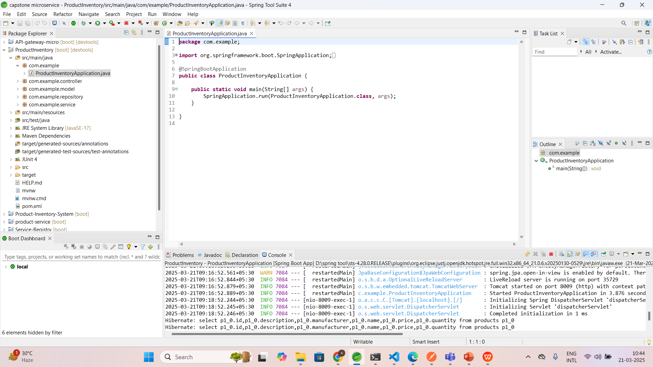
Project Implementation

Slide 14
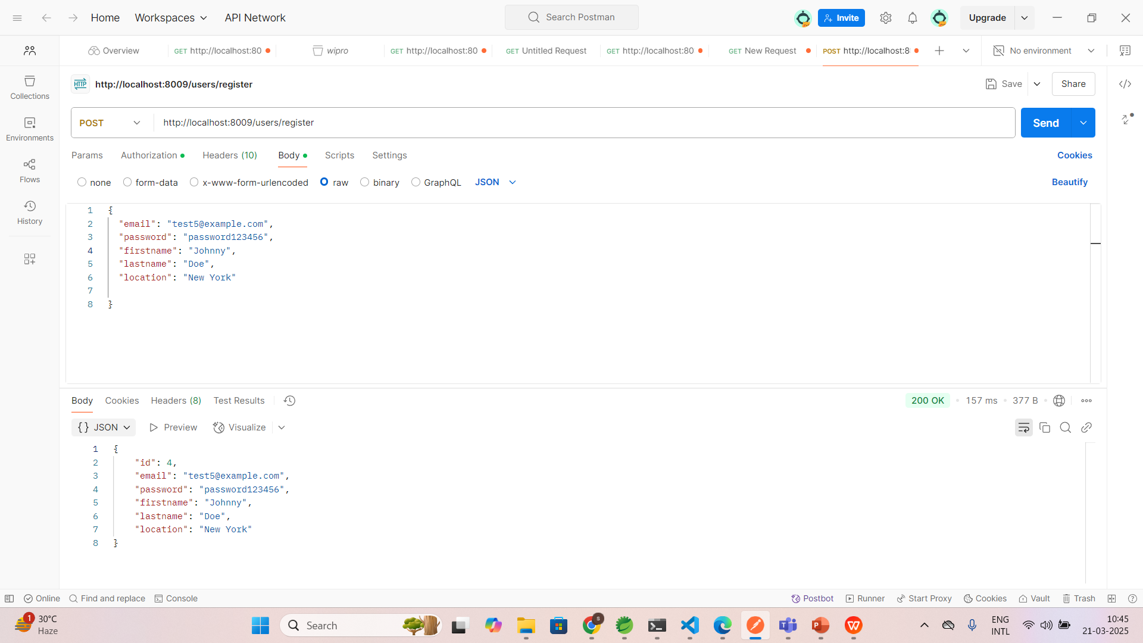
Project Implementation

Slide 15
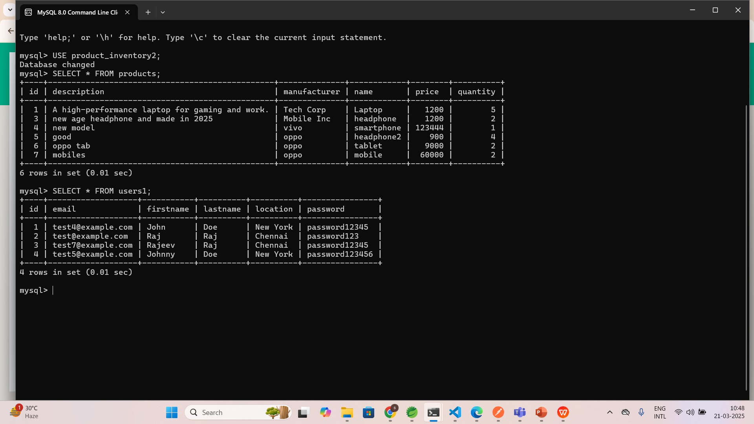
Project Implementation

Slide 16
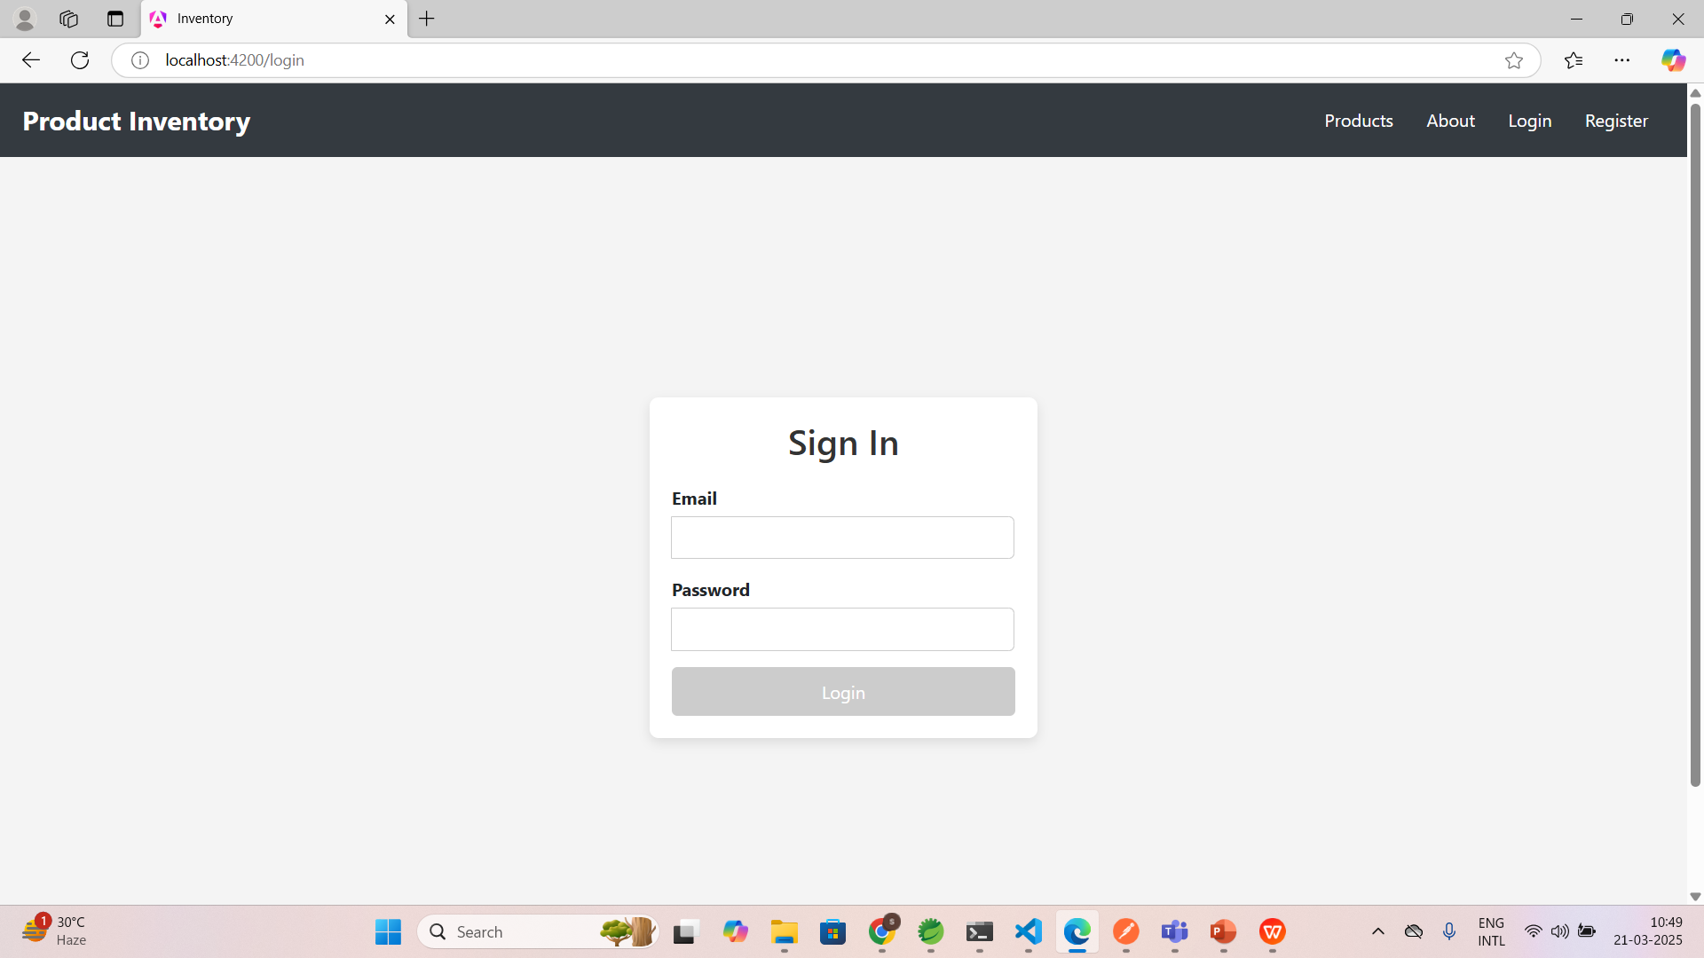
Project Implementation

Slide 17
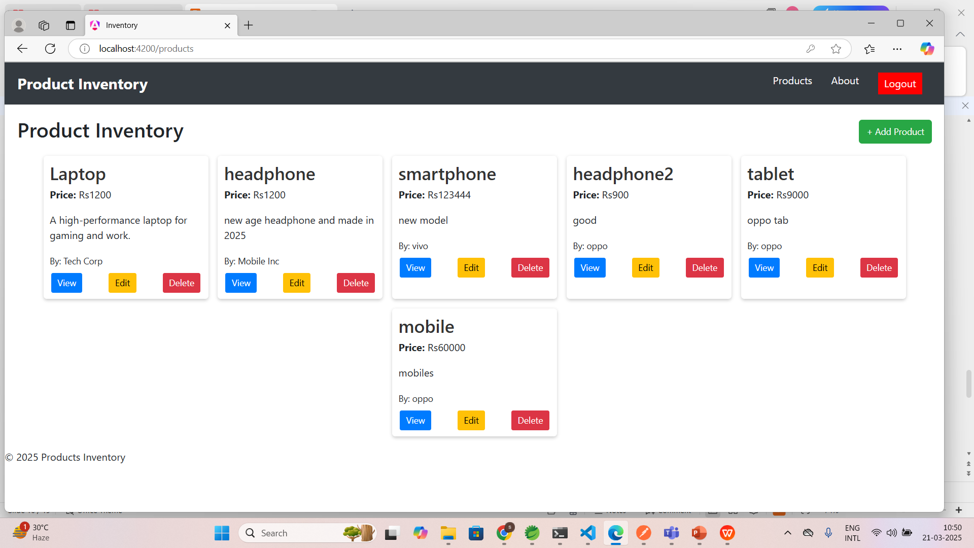
Project implementation

Slide 18
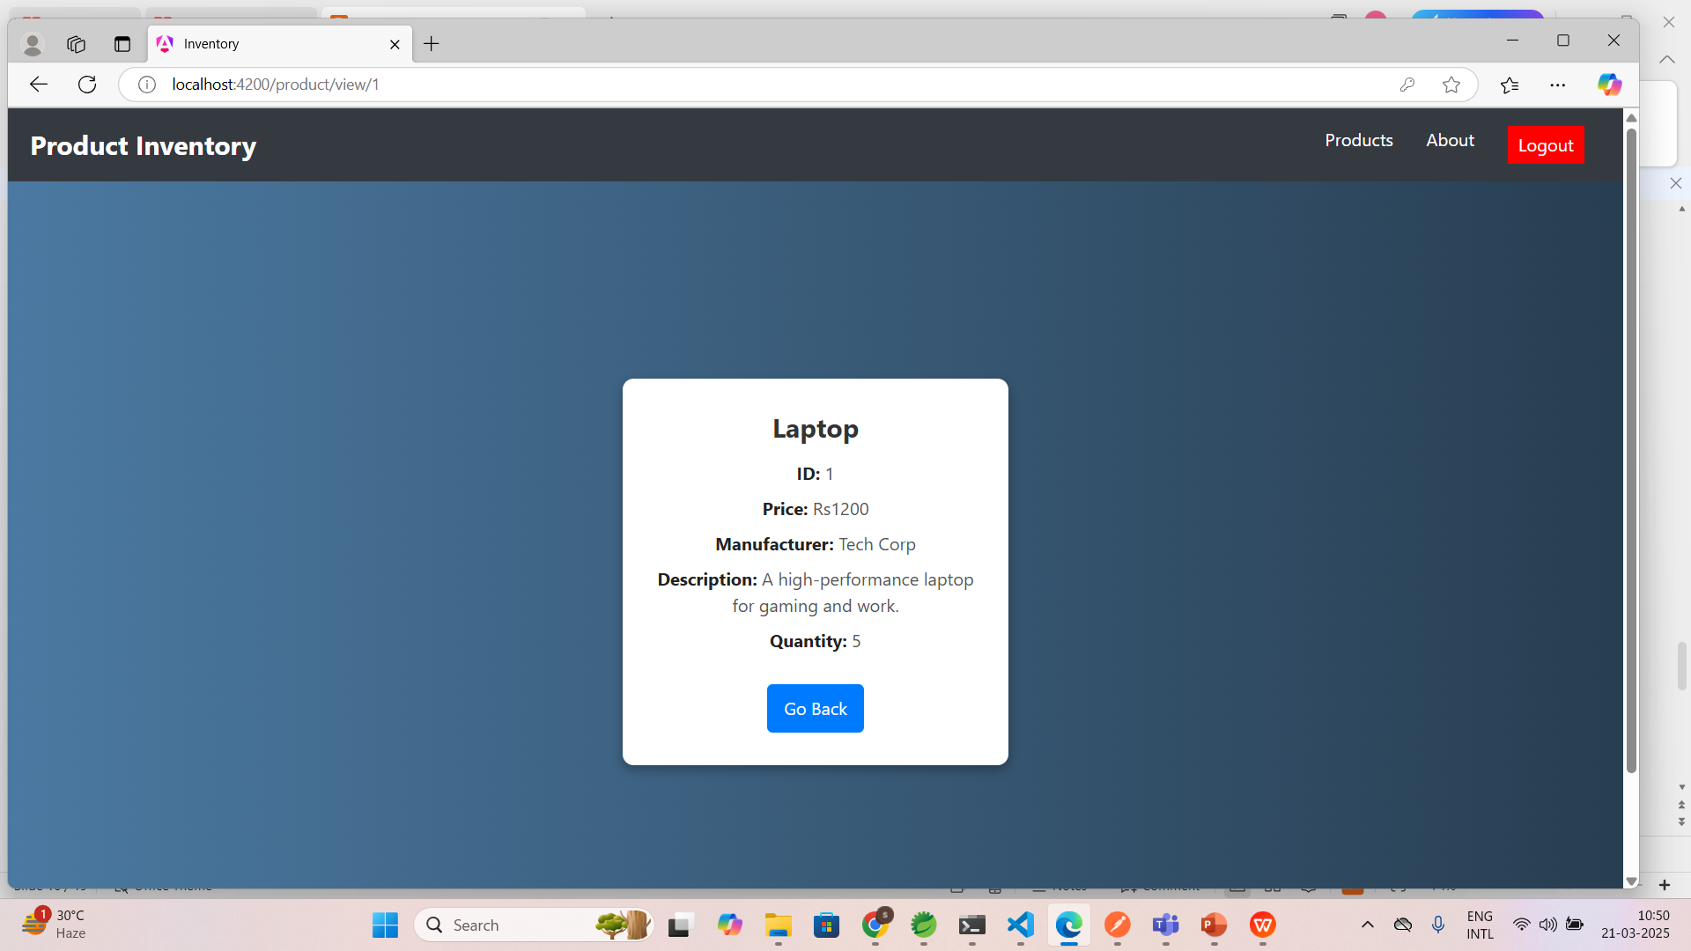
Project Implementation

Slide 19
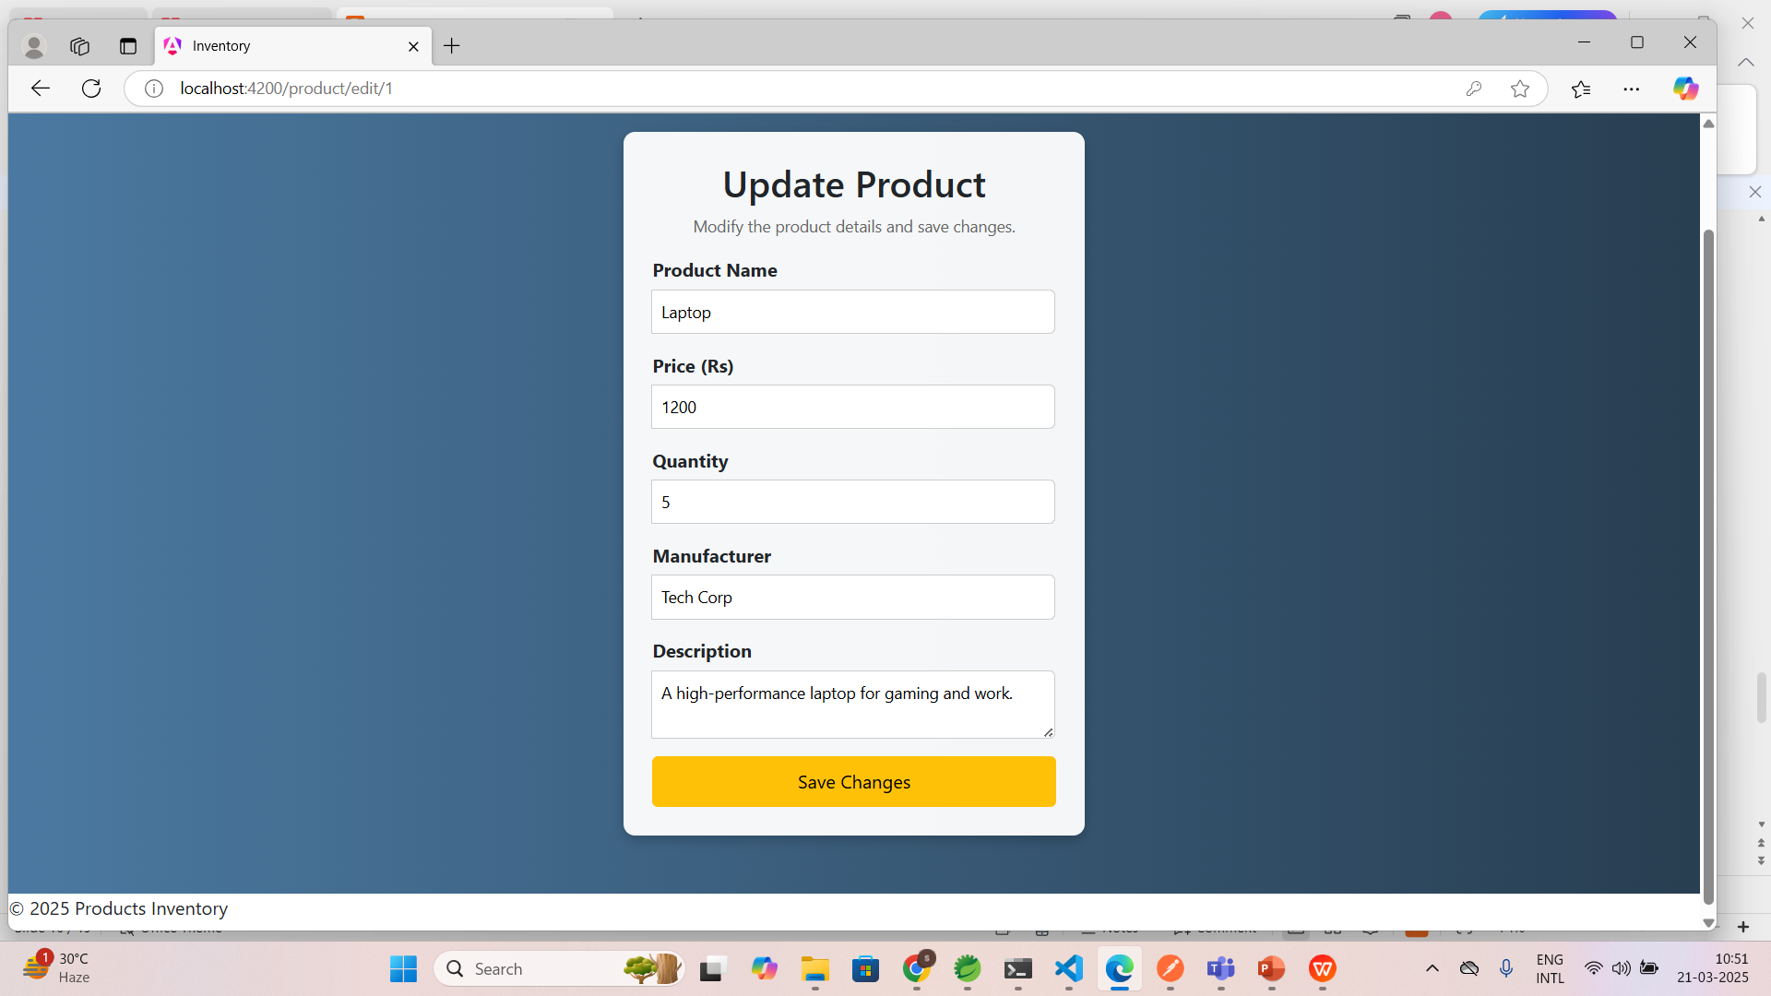
Project Implementation

Slide 20
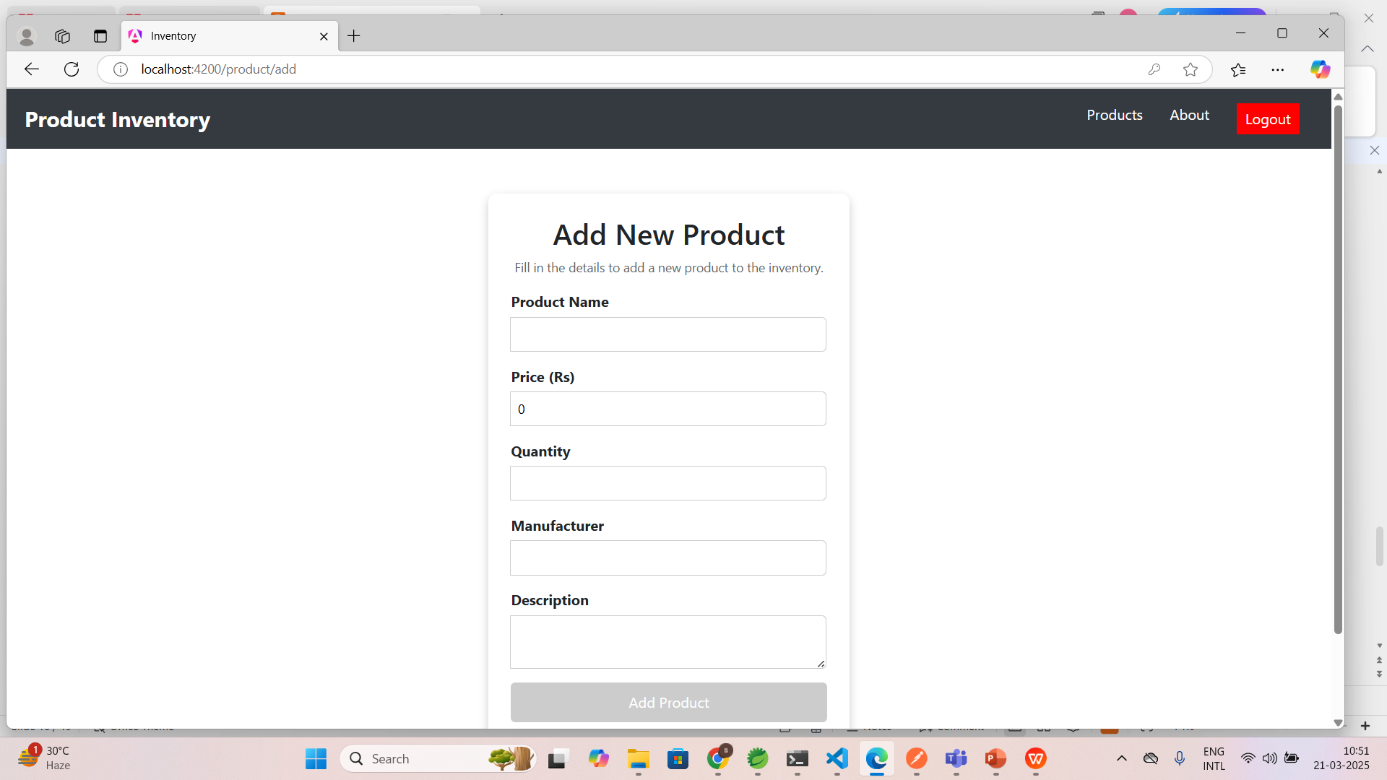
Project Implementation

Slide 21
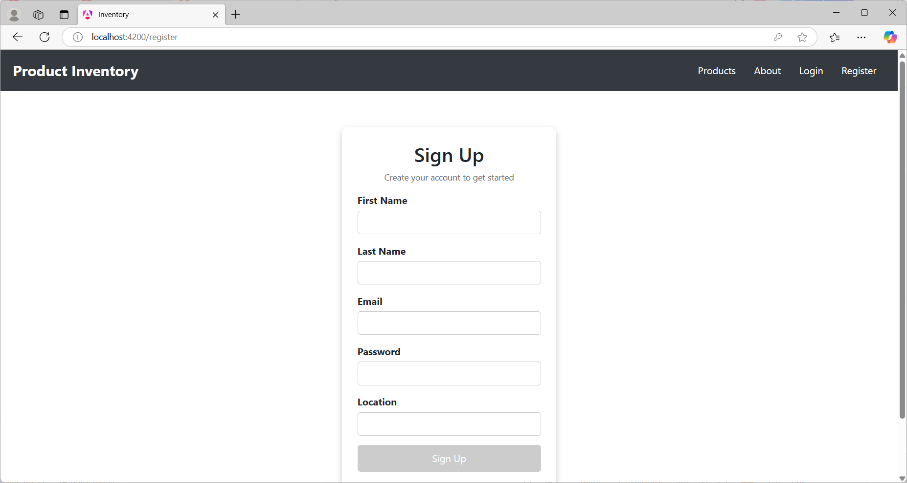
Project Implementation

Slide 22
Future Enhancements
AI-based demand forecasting
Security development
Multi-user access with different roles
Cloud-based data storage

Slide 23
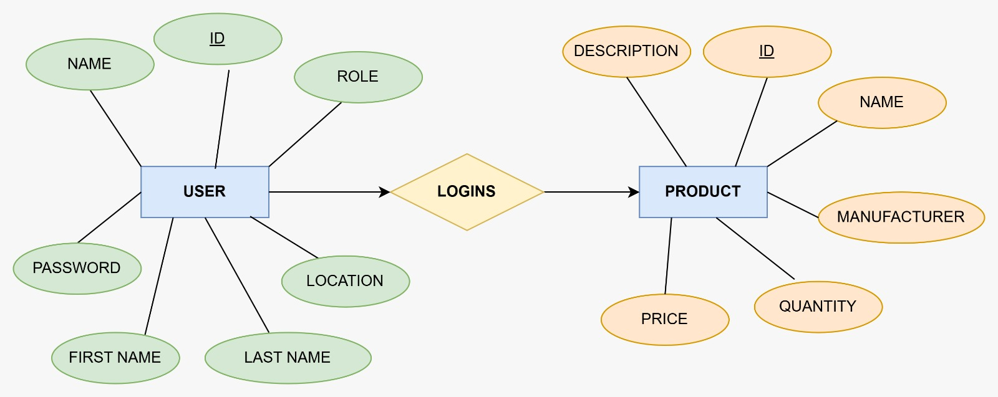
ER Diagram

Slide 24
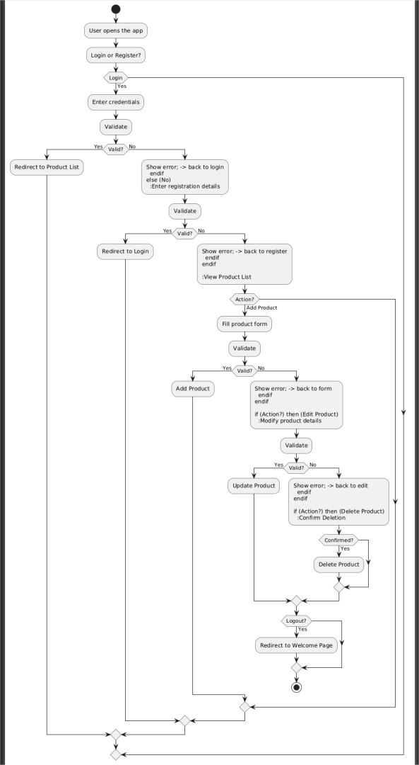
Activity Diagram

Slide 25
Thank You

