Slide 1
Enhanced Driver Safety System: Raspberry Pi-based Drowsiness Detection With Multi-modal Alerts And Speed Control
TEAM MEMBERS
K.SMS VINAY KUMAR ( 20761A05G1 )
U.ARJUN ( 21765A0519 )
K. RENUKA ( 20761A05F9 )
Guided By:
Dr. B.SIVARAMAKRISHNA

Slide 2
INTRODUCTION
In recent years, the escalating prevalence of road accidents attributed to driver drowsiness has prompted a critical need for advanced safety systems. According to Road Transport and Highways India, a staggering 22.8% of accidents stem from driver fatigue, resulting in significant societal and economic repercussions
In response to this pressing concern, our research endeavors to introduce a technologically advanced cognitive detection system for driver drowsiness, harnessing the capabilities of OpenCV and Python.
The primary objective is to offer a comprehensive solution that not only identifies signs of driver drowsiness with precision but also employs a multi-modal alert system to ensure timely and effective responses. The alert mechanisms include controlled shocks or subtle jerks and a distinctive red-light warning projected onto the driver’s face, serving as stimuli to mitigate drowsiness.

Slide 3
LITERATURE SURVEY
S.NO | AUTHOR NAME | PAPER TITLE | PUBLICATION | METHODOLOGY
1 | Saravanaraj Sathasivam Abd Kadir Mahamad Sharifah Saon Azmi Sidek Mohamad Md Som Hussein Ali Ameen | Drowsiness Detection System Using Eye Aspect Ratio Technique | 2020 IEEE Student Conference on Research and Development (SCOReD) | Here they used OpenCV and Dlib prediction techniques to detect the eye aspect ratio of the both left and right eye of the driver. When the eyes are closed the eye ratio is nearer to zero then it gives an alert
2. | Pooja D.C. Sara Aziz Shakuntala Koujalagi Shilpa B. H. Mr. Vasanth Kumar N.T | Driver Drowsiness Detection Using OpenCV and Raspberry Pi | International Journal for Research in Applied Science & Engineering Technology (IJRASET) ISSN: 2321-9653; IC Value: 45.98; SJ Impact Factor: 7.538 Volume 10 Issue VII July 2022 | Here in this publication they used the EAR tool for detecting the rate of eye closure for every 0.5 seconds whenever a certain threshold exceeds it raises an alarm to the Rasperry Pi board.

Slide 4
LITERATURE SURVEY
S.NO | AUTHOR NAME | PAPER TITLE | PUBLICATION | METHODOLOGY
3. | Rohith Chinthalachervu Immaneni Teja M. Ajay Kumar N. Sai Harshith T. Santosh Kumar | Driver Drowsiness Detection and Monitoring System using Machine Learning | International Conference on Electronic Circuits and Signaling Technologies Journal of Physics: Conference Series 2325 (2022) 012057 IOP Publishing doi:10.1088/1742-6596/2325/1/012057 | In this, they have used Eye Detection, Mouth Detection, and Head Bending to calculate the EAR, MOR, NLR and compare them to threshold values, and identify whether the driver is drowsy or not.
4. | Kavyashree Subramonian G. Sumathi | Drowsiness Detection System with Speed Limit Recommendation using Sentiment Analysis | International Journal of Recent Technology and Engineering (IJRTE) ISSN: 2277-3878 (Online), Volume-10 Issue-1, May 2021 | Here in this publication the drowsiness recognition is based on the facial expressions of the driver based on this it classifies whether the driver is sleepy or awake and it also recommends the safe speed limit based on driver’s emotional state.

Slide 5
EXISTING SYSTEM
Relies on sensor-based and computer vision algorithms for driver drowsiness detection.
Common techniques include eye-tracking, head movement analysis, and facial expression recognition.
Some systems integrate vehicle-based sensors to detect erratic driving behavior.
Lacks the precision and sophistication to promptly detect and mitigate drowsiness in real-time.
Often results in delayed or insufficient responses to potentially dangerous situations on the road real time.

Slide 6
PROPOSED SYSTEM
Utilizes OpenCV and Python for cognitive detection of driver drowsiness.
Analyzes facial cues, eye movements, head position, and physiological signals in real-time.
Aims for precise detection of subtle signs of drowsiness with high accuracy and reliability.
Implements a multi-modal alert system with controlled shocks and visual cues to prompt driver alertness.
Enhances alertness with a red-light warning projected onto the driver's face.
Prioritizes gradual deceleration over abrupt braking for smoother and safer responses, minimizing collision risks.

Slide 7
ABSTRACT
This research project focuses on the development of a sophisticated cognitive detection system for driver drowsiness utilizing OpenCV and Python, presenting an advanced solution to enhance driver safety. In response to the alarming statistic from Road Transport and Highways India, revealing that 22.8% of accidents result from driver drowsiness, this initiative aims to mitigate the detrimental consequences of such incidents, which lead to loss of lives, vehicle damage, road infrastructure destruction, and financial burdens on individuals. The proposed solution involves a precise driver drowsiness detection system and a multi-modal alert system. Upon detecting signs of drowsiness, the system employs nuanced alert mechanisms, such as controlled subtle jerks, to prompt the driver to regain alertness. Notably, instead of abrupt braking, our system adopts a gradual deceleration strategy to ensure a smoother and safer response, minimizing the risk of sudden movements and potential collisions with the windshield. Furthermore, integrating cruise control mechanisms contributes to reducing the overall fatality rate. This comprehensive solution not only addresses the critical issue of driver drowsiness but also strives to enhance overall road safety by leveraging advanced technology and strategic alerting methodologies

Slide 8
ALGORITHM
Capture Driver's Face: Use a camera to take pictures of the driver's face at regular intervals.
Analyse Facial Features: Look for signs of drowsiness in the facial features, like closed eyes, nodding head, or yawning.
Detect Drowsiness: Use software to determine if the driver is showing signs of drowsiness based on the analysed facial features.
Set Alert Threshold: Decide on a threshold level for drowsiness detection. If the level is reached, trigger an alert.
Activate Alert Mechanisms: When drowsiness is detected, activate alert mechanisms like sound, vibration, or visual alerts.
Alert Persistence: Keep the alert active until the driver shows signs of alertness again.
Monitor Alert Deactivation: Continuously monitor the driver for signs of alertness to deactivate the alert when appropriate.
Repeat Process: Continuously capture and analyse the driver's face to detect drowsiness and ensure prompt alerting.

Slide 9
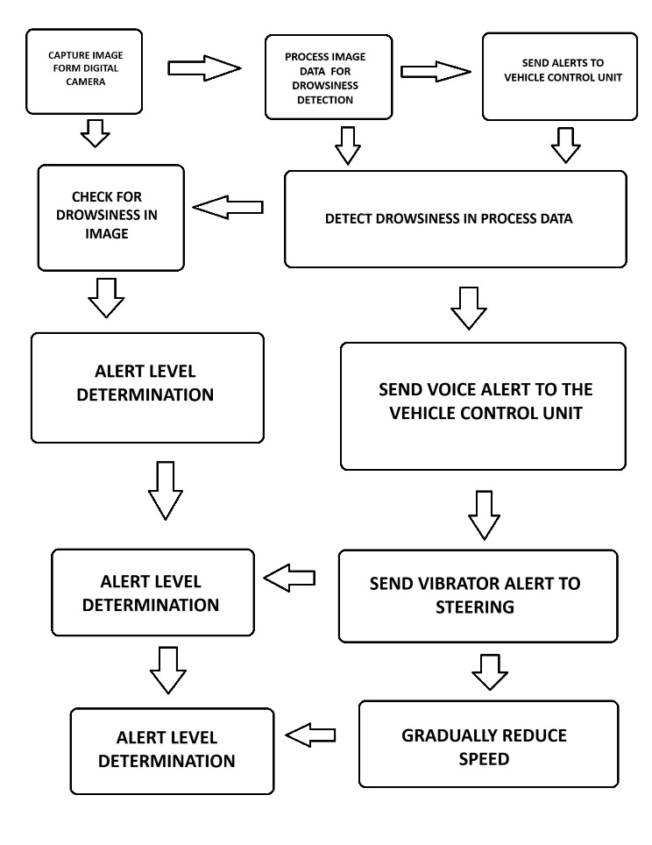
FLOW CHART

Slide 10
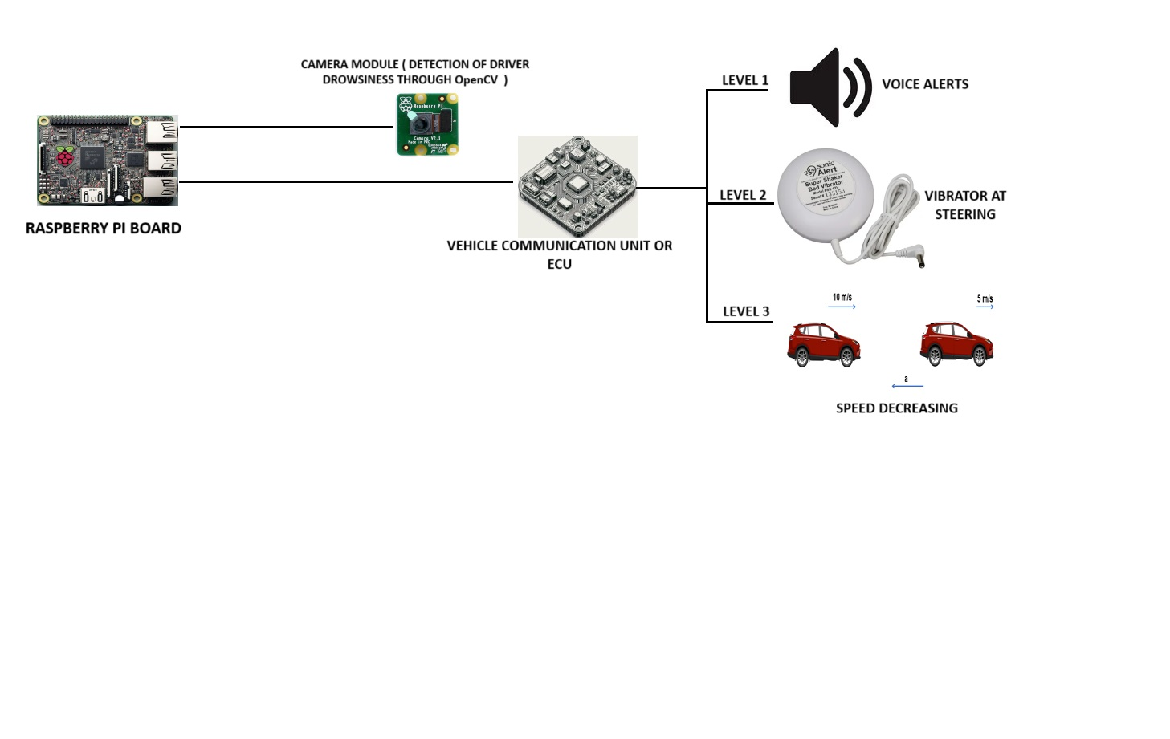
ALERTING MECHANISMS
ALERTING MECHANISMS AT DIFFERENT LEVELS

Slide 11
LEVEL 1: VOICE ALERT SYSTEM
This alerting mechanism issues voice alerts to the driver when minor signs of drowsiness are detected. The voice alert, "PLEASE FOCUS ON DRIVING," serves as an immediate reminder to the driver to pay attention and regain focus on the road ahead. This initial alert is designed to catch the driver's attention without causing undue distraction, providing an early warning to mitigate the onset of drowsiness.

Slide 12
LEVEL 2: Steering Wheel Vibrator System
When drowsiness is detected to a greater extent beyond the initial warning level, the Steering Wheel Vibrator System is activated. This mechanism utilizes vibrators integrated into the steering wheel to provide tactile feedback directly to the driver. The vibrations serve as a physical reminder, alerting the driver to the increased severity of drowsiness and prompting immediate corrective action. By engaging multiple senses, this alerting mechanism enhances the effectiveness of the warning and encourages the driver to respond promptly.

Slide 13
LEVEL 3: Speed Reduction System
If drowsiness persists despite the initial voice alert and tactile feedback, the Speed Reduction System is activated as the final alerting mechanism. This system automatically reduces the vehicle's speed by increments of 5 km/h to ensure safety and prevent potential accidents caused by impaired driving. The gradual speed reduction provides a proactive intervention, allowing the driver additional time to react and regain control of the vehicle while minimizing the risk of collision or injury.

Slide 14
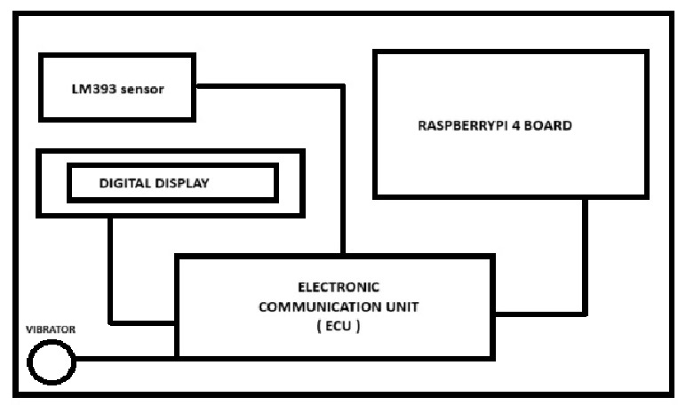
ARCHITECTURE DIAGRAM

Slide 15
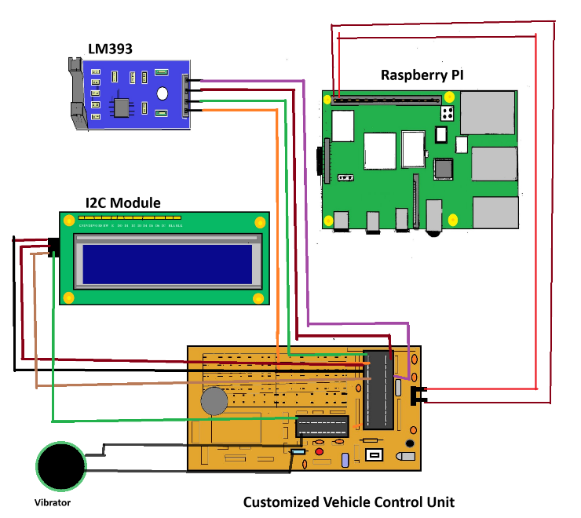
CIRCUIT DIAGRAM

Slide 16
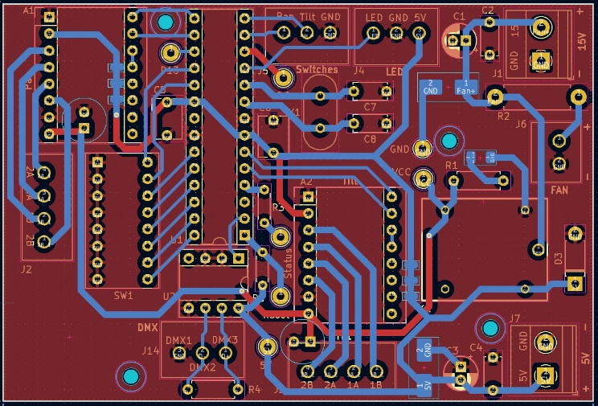
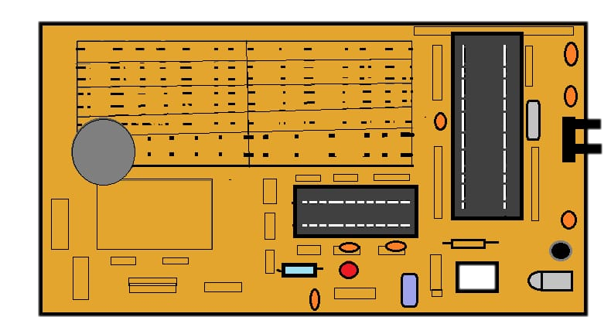
CUSTOMISED VEHICLE CONTROL UNIT
DESIGN OF PCB FOR VEHICLE CONTROL UNIT

Slide 17
CONCLUSION
The project offers a comprehensive and effective solution to address the pervasive issue of driver drowsiness by integrating sophisticated cognitive detection systems powered by OpenCV and Python. By leveraging statistical data illustrating the significant impact of drowsy driving on road accidents, the initiative underscores the urgent need for robust mitigation strategies. The multi-modal alert system, encompassing controlled shocks, subtle jerks, and red-light warnings projected onto the driver's face, demonstrates tangible results in enhancing road safety by effectively counteracting drowsiness and improving driver responsiveness. Moreover, the strategic adoption of gradual deceleration over abrupt braking minimizes the risk of collisions. At the same time, the integration of cruise control mechanisms further augments the system's capability to maintain safe driving conditions, ultimately reducing the overall fatality rate on roads. The successful implementation of advanced technology and strategic alerting methodologies underscores the project's significance in mitigating the risks associated with drowsy driving and enhancing overall road safety.

