Slide 1
Yuvan Raja K -2021506127
Final Project
3/21/2024 Annual Review

Slide 2
PROJECT TITLE
Bitcoin-Price-Prediction-Using-RNN
3/21/2024 Annual Review

Slide 3


AGENDA
The aim of this project is to develop a machine learning model capable of predicting the price of Bitcoin using Recurrent Neural Networks (RNN).
Bitcoin, as a highly volatile and widely traded cryptocurrency, presents a challenging yet fascinating domain for time-series prediction tasks.
By employing deep learning techniques like RNN and LSTM, we can leverage the sequential nature of Bitcoin price data to make accurate predictions.
3/21/2024 Annual Review

Slide 4

PROBLEM STATEMENT
Cryptocurrencies, particularly Bitcoin, have witnessed significant fluctuations in their prices, making them an intriguing yet volatile asset class for investors and traders.
Predicting the future price movements of Bitcoin is a challenging task due to the complex and non-linear nature of cryptocurrency markets.
Traditional financial models often struggle to capture the dynamics of these markets effectively.
3/21/2024 Annual Review

Slide 5

PROJECT OVERVIEW
The cryptocurrency market, led by Bitcoin, has gained significant attention in recent years due to its volatile nature and potential for substantial returns.
However, the inherent unpredictability of cryptocurrency prices presents a challenge for investors and traders. This project aims to develop a machine learning model based on Recurrent Neural Networks (RNNs) to predict the future price movements of Bitcoin.
By leveraging historical price data and sophisticated deep learning techniques, the model seeks to provide valuable insights for decision-making in the cryptocurrency market.
3/21/2024 Annual Review

Slide 6

WHO ARE THE END USERS?
The end users of the "Bitcoin Price Prediction Using RNN" project can include various stakeholders within the cryptocurrency market ecosystem:
Investors and Traders
Financial Analysts
Cryptocurrency Exchangers
Regulators and Policy Makers
Blockchain Developers
Educators and Researchers
Overall, the end users of the project span a wide range of stakeholders within the cryptocurrency ecosystem, including investors, traders, analysts, exchanges, regulators, developers, educators, and researchers, all of whom can benefit from the insights and applications enabled by the predictive model.
3/21/2024 Annual Review

Slide 7

YOUR SOLUTION AND ITS VALUE PROPOSITION
The solution proposed in the project offers several key value propositions for its end users:
Accurate Price Predictions: By leveraging historical price data and advanced deep learning techniques, the predictive model aims to generate accurate forecasts of Bitcoin prices.
Enhanced Decision-making: The predictive model empowers users to make data-driven decisions based on forecasted Bitcoin prices.
Risk Management: The ability to forecast future price movements of Bitcoin enables users to better assess and manage risk in their investment strategies.
4.Market Analysis and Insights: Financial analysts, researchers, and policymakers can leverage the insights provided by the predictive model to conduct comprehensive market analysis, identify trends, and gain deeper insights into the behavior of the cryptocurrency market.
5. Education and Research: The project contributes to the advancement of knowledge in cryptocurrency analytics and machine learning by providing a framework for studying price prediction models.
3/21/2024 Annual Review

Slide 8

THE WOW IN YOUR SOLUTION
1. High Accuracy: The predictive model harnesses the sequential nature of cryptocurrency price data and learns complex patterns and dependencies over time.
2. Real-time Insights: The model is deployed in a production environment, enabling it to provide real-time or near-real-time predictions of Bitcoin prices.
3. Dynamic Adaptability: The model is designed to adapt to changing market conditions and evolving price trends. Through continuous monitoring and updates, it remains robust and effective in forecasting Bitcoin prices across different time frames, market cycles, and macroeconomic scenarios.
4. Risk Mitigation: By incorporating the model's predictions into their decision-making processes, users can effectively manage risk in their investment strategies.
5. Innovation and Advancement: The project represents a pioneering effort in the intersection of cryptocurrency analytics and machine learning.
3/21/2024 Annual Review
8

Slide 9

MODELLING
Data Preparation
Model Architecture Selection
Model Development
Model Training
Hyperparameter Tuning
Model Evaluation
Deployment
3/21/2024 Annual Review
9

Slide 10
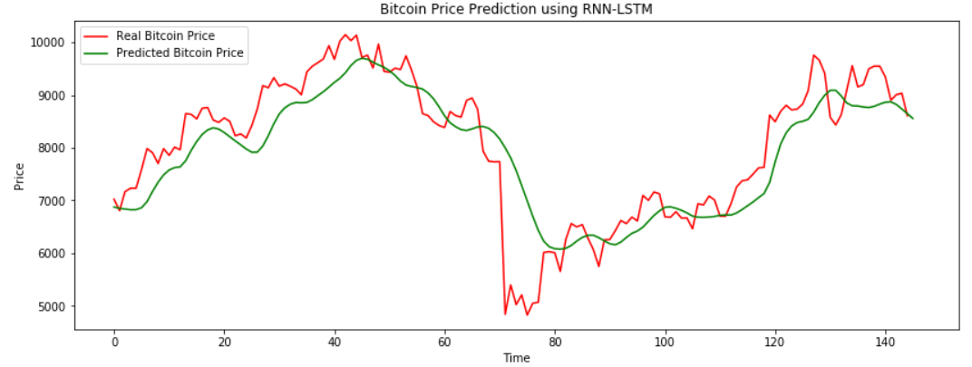
RESULTS
https://colab.research.google.com/drive/1MAcgSNEOWpkr3FcAoH1D2mD_LhVKrNmu?usp=sharing
3/21/2024 Annual Review
10

