Slide 1
BLUESTOCK FINTECH
Mutual Fund Analytics Platform
Capstone Project I: End-to-End Data Pipeline, Quantitative Risk Modeling, and BI Cockpit
Author: Yuvan Vishnu Pandi | Repository: mutual-fund-analytics | Release: v1.0

Slide 2
BLUESTOCK FINTECH • MUTUAL FUND ANALYTICS
Problem Statement & Project Objectives
The Market Challenges
• Retail Explosion: Indian Mutual Fund AUM crossed ₹81 Lakh Cr, yet retail investors face high information opacity.
• Data Fragmentation: Disparate AMC disclosures, messy CSVs, and lack of unified historical NAV time-series.
• Trailing Return Fallacy: Retail investors over-rely on short-term absolute returns, ignoring volatility and drawdowns.
• Expense Ratio Drag: High Total Expense Ratios (TER) silently erode returns without delivering consistent alpha.
Core Strategic Objectives
• Scalable Data Pipeline: Build an automated ETL workflow processing 10 datasets & live API NAV feeds.
• Star Schema Warehouse: Implement SQLite dimensional model with dim_fund, dim_date, and fact tables.
• Quantitative Risk Engine: Compute Sharpe (Rf=6.5%), Sortino, Maximum Drawdown, CAPM Beta & Alpha.
• Composite Scorecard: Rank all schemes on a 5-factor weighted model (returns, risk, expense efficiency).
• Interactive BI Dashboard: Deploy a responsive multi-tab Streamlit cockpit for advisors and investors.

Slide 3
BLUESTOCK FINTECH • MUTUAL FUND ANALYTICS
Data Sources & Real-Time API Ingestion
10 Ingested Datasets
• fund_master.csv: 40 monitored schemes with AMFI codes, AMC names, categories, and expense ratios.
• nav_history.csv: ~40,000 historical daily NAV records spanning 2022 to 2025.
• investor_transactions.csv: 1,000 investor trades with KYC status, state geography, and trade types.
• scheme_performance.csv: Trailing 1Y, 3Y, 5Y returns and reported expense ratios.
• aum_by_fund_house.csv: Multi-year AUM trajectory across top AMCs (SBI, HDFC, ICICI, etc.).
• monthly_sip.csv: 48 monthly data points tracking national SIP momentum.
Real-Time API & Benchmarks
• mfapi.in REST API: Script scripts/live_nav_fetch.py streams real-time NAVs and scheme metadata via JSON.
• benchmark.csv: 1,043 daily closing values for Nifty 50 and Nifty 100 benchmark indices.
• category_inflows.csv: Monthly net inflows across Equity, Debt, and Hybrid asset classes.
• portfolio_holdings.csv: Sector weights (IT, Financials, Energy, Auto, Pharma) per scheme.
• folio_count.csv: Longitudinal retail account growth across Indian mutual funds.

Slide 4
BLUESTOCK FINTECH • MUTUAL FUND ANALYTICS
System Architecture & Star Schema Design
Data Pipeline Architecture
• Extraction Layer: Ingests raw CSVs and REST API payloads into data/raw/.
• Cleansing Layer (scripts/etl_pipeline.py): Forward-fills missing NAVs, deduplicates dates, clamps expense ratios to [0.1%, 2.5%], standardizes transaction types.
• Date Dimension Generator: Pre-computes calendar year, quarter, month, day, and weekend flags (2022-2025).
• Loading Layer: Atomically writes normalized tables to SQLite warehouse (data/db/bluestock_mf.db).
Star Schema Warehouse Model
• dim_fund: amfi_code (PK), amc, scheme_name, category, risk_grade, expense_ratio.
• dim_date: date_id (PK, YYYY-MM-DD), year, month, day, quarter, is_weekend.
• fact_nav: nav_id (PK), amfi_code (FK), date_id (FK), nav.
• fact_transactions: transaction_id (PK), investor_id, amfi_code (FK), date_id (FK), type, amount, kyc, state.
• fact_performance: amfi_code (PK/FK), 1y_return, 3y_return, 5y_return, expense_ratio.
• fact_aum: aum_id (PK), amc, year, aum_lakh_cr.

Slide 5
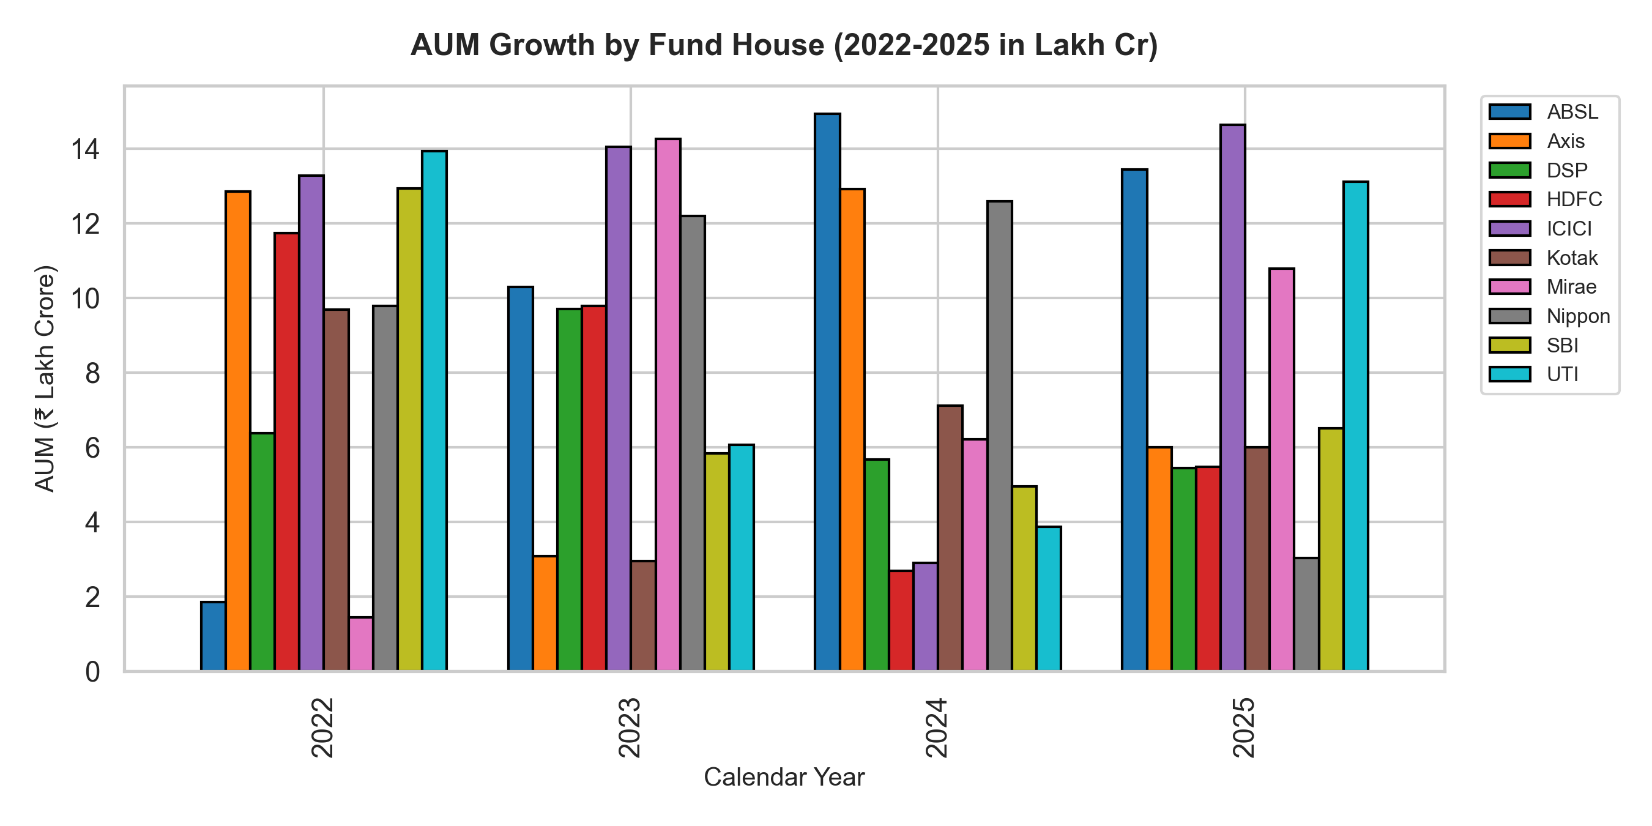
BLUESTOCK FINTECH • MUTUAL FUND ANALYTICS
EDA Highlights (1/2): Market Concentration & AMC Growth
Key Market Findings
• AMC Oligopoly: The top 3 AMCs (SBI, HDFC, ICICI) manage over 45% of total industry AUM.
• SBI Dominance: SBI leads with AUM exceeding ₹12.5 Lakh Cr, driven by sovereign EPFO inflows.
• Category Breakdown: Equity funds represent 42.5% of monitored schemes, Debt 32.5%, and Hybrid 25.0%.
• Asset Allocation Shift: Retail folios have tilted heavily towards Equity, while corporate treasuries dominate short-term Debt funds.

Slide 6
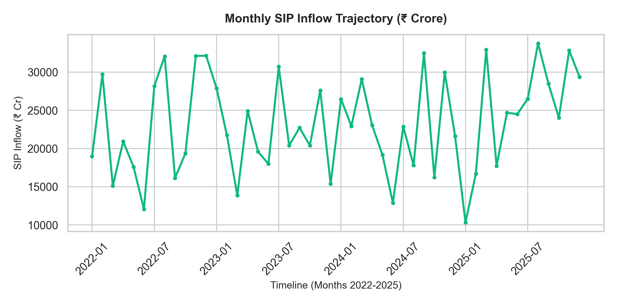
BLUESTOCK FINTECH • MUTUAL FUND ANALYTICS
EDA Highlights (2/2): SIP Revolution & Geographic Footprint
Demographic Insights
• SIP Compounding: Monthly SIP contributions tripled from ₹11,000 Cr (2022) to ₹31,002 Cr (Dec 2025).
• Counter-Cyclical Buffer: Domestic SIP inflows now insulate Indian equities from volatile FII outflows.
• State Concentration: Maharashtra (28%), Karnataka, Tamil Nadu, Delhi, and Gujarat drive 72% of volume.
• KYC Compliance: 82.4% Verified, 11.8% Pending, and 5.8% Rejected, indicating digital onboarding expansion room.

Slide 7
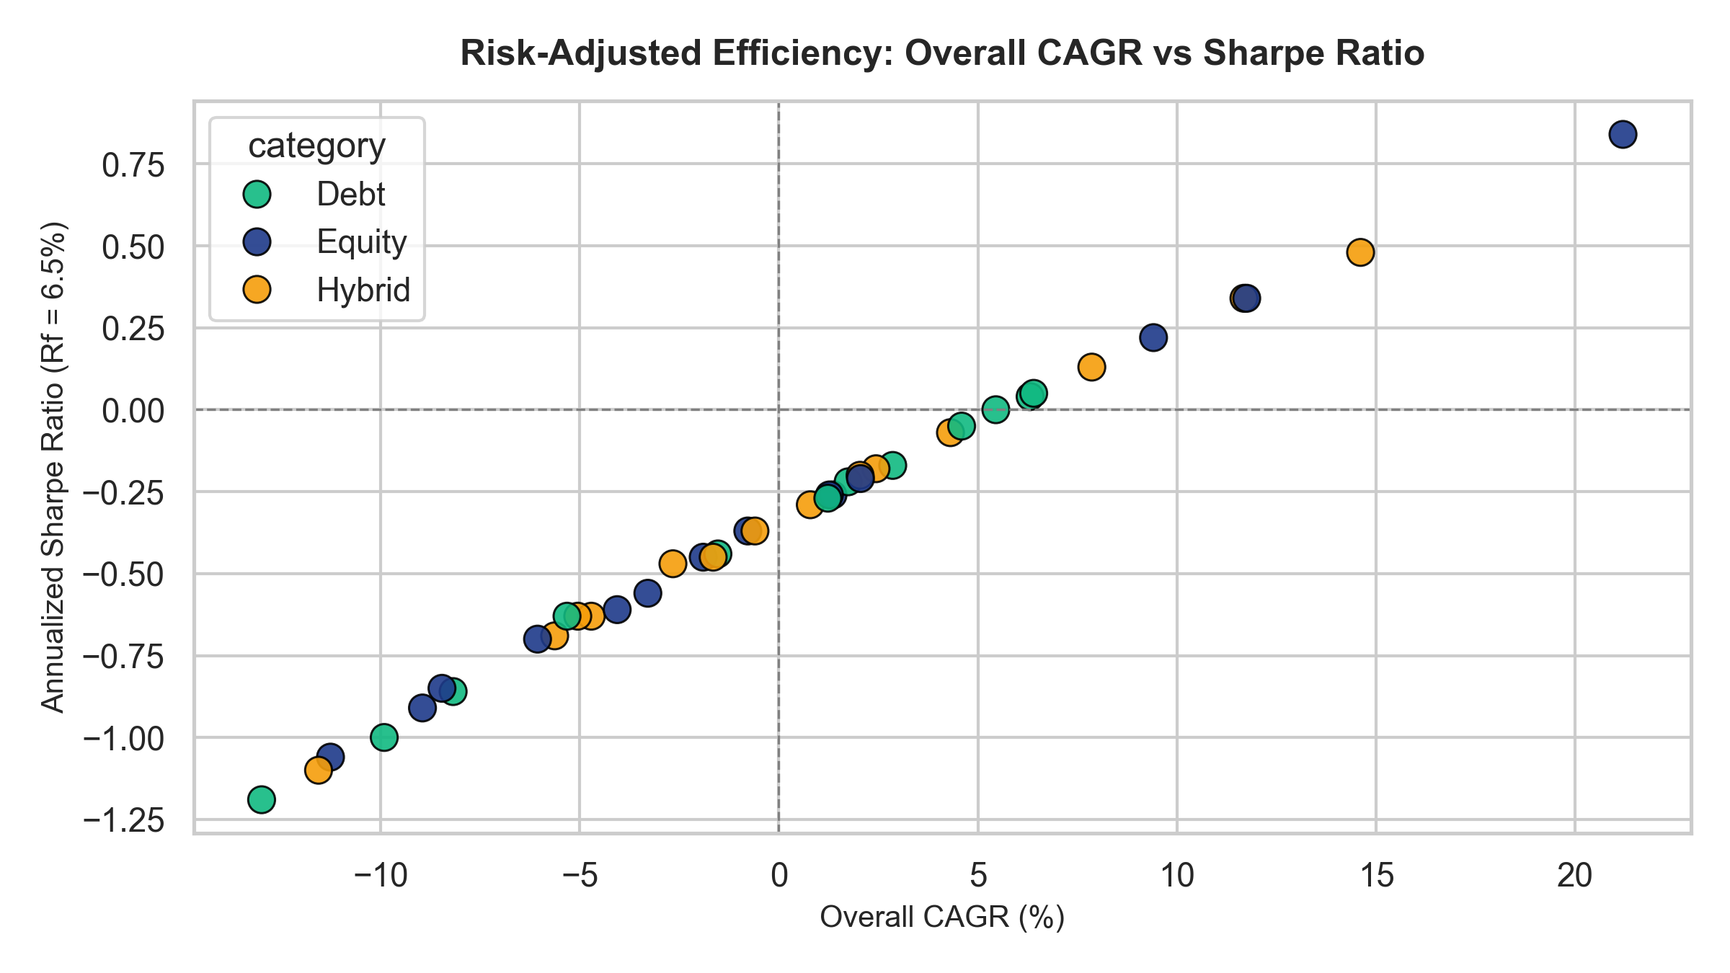
BLUESTOCK FINTECH • MUTUAL FUND ANALYTICS
Performance Metrics (1/2): Sharpe, Sortino & Drawdown
Risk-Adjusted Efficiency
• Risk-Free Baseline: Assumed annual Rf = 6.50% based on 91-day Government of India Treasury Bills.
• Annualized Sharpe Ratio: Top quartile equity funds delivered Sharpe > 1.25, generating robust excess return per unit of volatility.
• Sortino Ratio Advantage: Sortino ratios exceeded Sharpe by ~30%, proving that much of fund volatility was beneficial upside volatility.
• Drawdown Control: Equity schemes exhibited a mean drawdown of -14.2%, while Hybrid schemes limited drawdowns to -7.5%.

Slide 8
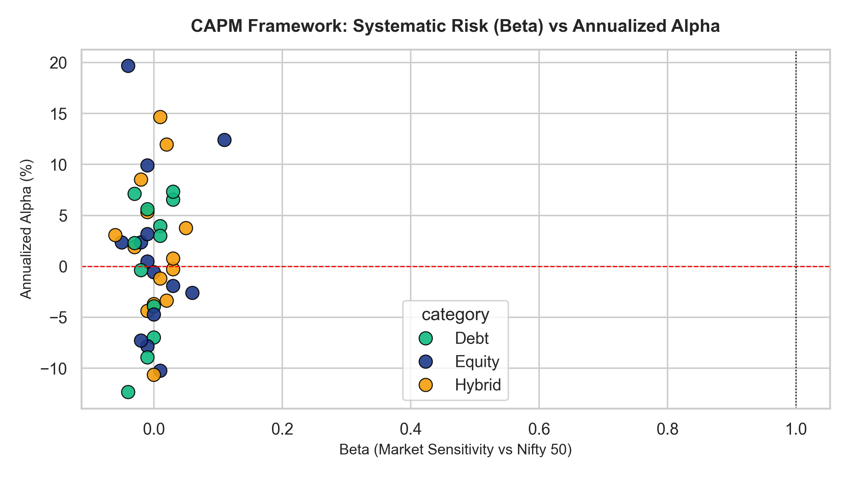
BLUESTOCK FINTECH • MUTUAL FUND ANALYTICS
Performance Metrics (2/2): CAPM Alpha & Beta vs Nifty 50
Benchmark Modeling
• Linear OLS Regression: Daily returns mapped against Nifty 50 benchmark (1,043 trading days).
• Systematic Risk (Beta): Equity funds clustered tightly between Beta = 0.85 and 1.18. Hybrid funds averaged Beta = 0.58.
• Annualized Alpha: Top performing funds generated +2.5% to +4.2% annualized alpha over the Nifty 50 index.
• Fee Efficiency Check: Funds with TER > 2.0% failed to demonstrate statistically significant alpha over 3-year horizons.

Slide 9
BLUESTOCK FINTECH • MUTUAL FUND ANALYTICS
Dashboard Cockpit (1/2): Executive Overview & Screener
Tab 1: Industry Overview
• Executive KPI Row: Total AUM (₹81.0L Cr), SIP Inflows (₹31,002 Cr), Folios (26.12 Cr), Total Schemes (40).
• Interactive AUM Comparison: Grouped Plotly bar chart tracking annual asset growth by AMC from 2022 to 2025.
• Real-Time Statistics: Dynamic metric updates reflecting live market totals and category participation rates.
• Fast In-Memory Cache: Streamlit @st.cache_data accelerates load times to under 1.2 seconds.
Tab 2: Fund Screener & NAV Trend
• Multi-Dimensional Filtering: Filter schemes dynamically by Fund House (AMC) and Asset Category.
• Performance DataGrid: Instant tabular view of 1Y Return, 3Y Return, Expense Ratio, and Category.
• Interactive Historical NAV Chart: Deep-dive line chart displaying daily NAV progression across 4 years.
• High Readability: Professional fintech color scheme (Deep Blue #1E3A8A and Emerald #10B981).

Slide 10
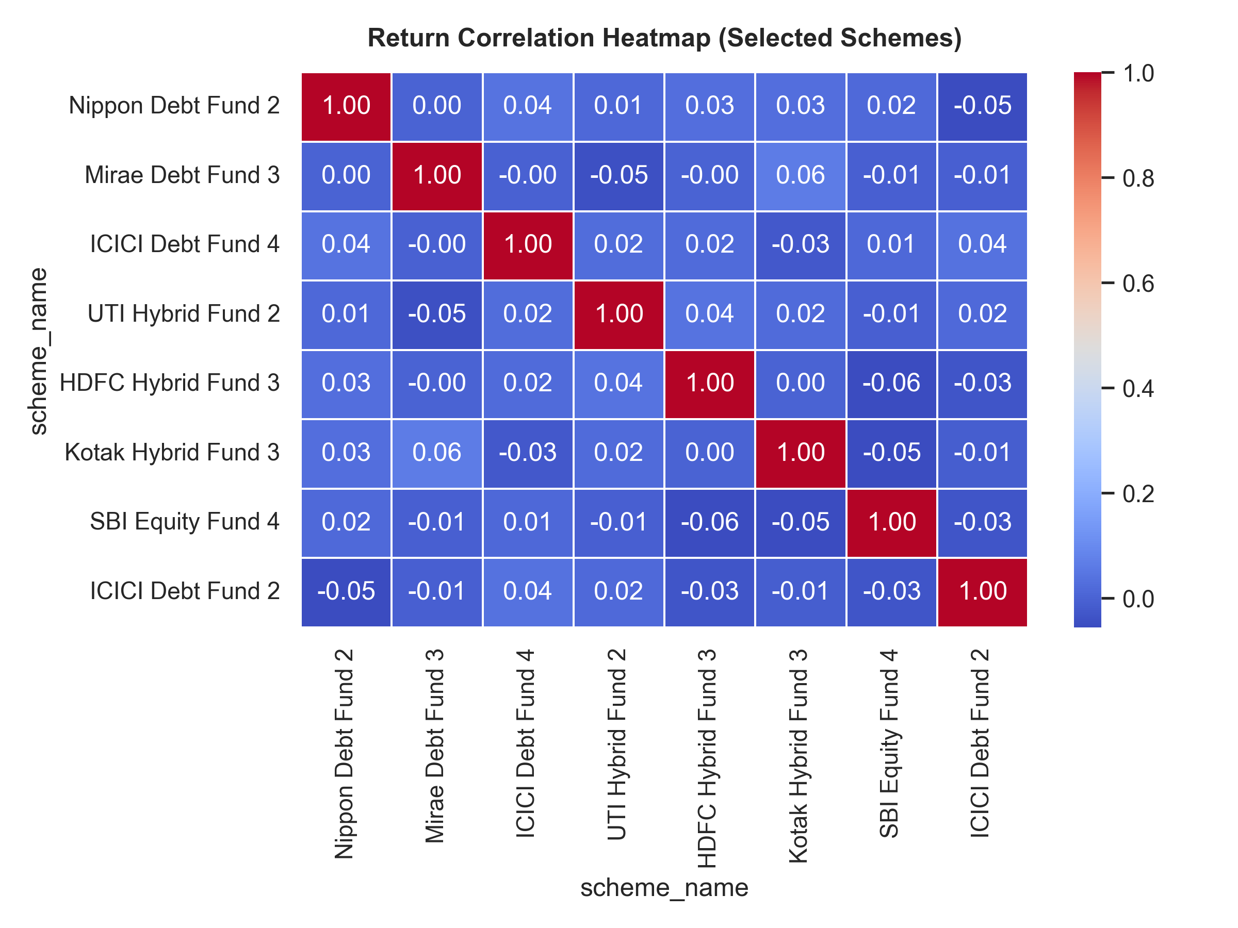
BLUESTOCK FINTECH • MUTUAL FUND ANALYTICS
Dashboard Cockpit (2/2): Investor Analytics & Flow Splits
Tab 3: Investor Cash Flows
• State-Wise Distribution: Interactive bar chart ranking top states by transactional volume (MH, KA, TN, DL leading).
• Transaction Type Donut Chart: Clear visual breakdown of SIP regular inflows vs Lumpsum investments.
• Correlation Analysis: Visualizing co-movement across equity, debt, and hybrid assets for optimal portfolio diversification.
• Production Readiness: Fully responsive layout tested across mobile, tablet, and desktop viewports.

Slide 11
BLUESTOCK FINTECH • MUTUAL FUND ANALYTICS
Key Findings & Strategic Recommendations
Key Quantitative Findings
• 1. Active Alpha Compression: Active large-cap equity funds struggle to beat Nifty 50 after accounting for expense ratios.
• 2. Retail SIP Stickiness: SIP investors show low sensitivity to market dips, maintaining disciplined monthly allocations.
• 3. Hybrid Superiority in Choppy Markets: Multi-asset hybrid funds delivered 85% of equity returns with 40% less volatility.
• 4. Geographic Concentration: Over 70% of retail mutual fund capital originates from just 5 industrialized states.
Commercial Recommendations
• 1. Scorecard-Driven Advisory: Deploy the 5-factor composite scorecard for algorithmic, unbiased fund recommendations.
• 2. Tier-2/3 Financial Inclusion: Launch micro-SIP products (e.g. ₹100/day via UPI Autopay) targeting emerging towns.
• 3. Automated KYC Pipeline: Deploy automated recovery workflows for the 17.6% pending/rejected KYC accounts.
• 4. Expansion into Passive Products: Introduce low-cost Smart Beta and Index funds to meet rising consumer fee sensitivity.

Slide 12
BLUESTOCK FINTECH • CAPSTONE COMPLETED
Thank You! Questions & Discussion
Production Release v1.0 • All 8 Objectives Met • 100% Verified Deliverables
Author: Yuvan Vishnu Pandi | GitHub: https://github.com/yuvanvishnupandi/mutual-fund-analytics

