Slide 1


Quantify
Translate and summarize to 100+ languages
#Include.io
Yuvaraj Tankala
Subrahmanyam Konakanchi
HackOFiesta-Flagship Hackathon of India
01

Slide 2

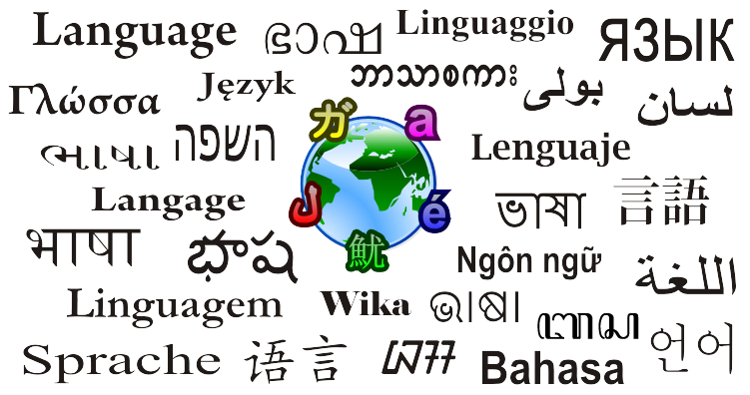
PROBLEM STATEMENT
1.Today Mainstream education is available only in English in most countries. We believe that language should not be a barrier to learn.
2.Media is an expensive segment and affording to scale globally with a studio setup would cost millions of dollars
3.engage with your target audience from across the world. Whether it's on Instagram, TikTok, Facebook or your own vlog, grow your audience without any hassle.

Slide 3

PROPOSED SOLUTION
Quantify is a one-stop destination for the content creators such as bloggers, activists, reporters, youtubers and many more . As, content creators should be able to communicate with people around the globe, there's always a language barrier. We at Quantify help to translate and summarize the videos and text files to 100+ languages by leveraging bleeding edge technologies like AI and NLP.
Today we have manual translation agencies translating it by taking over 15 days and would cost 50,000 INR or more.
Using Quantify:
-You can translate and summarize your content to the language of your choice.
- Accelerate content reach to 8 billion people with just 1-click.
- Save more than 50,000 INR

Slide 4

UNIQUE SELLING POINTS
1.
Interact and Engage With Your Customers across the World
2.
Engage with your Audience on Social Media Channels worldwide
- Save more than 50,000 INR
- Accelerate content reach to 8 billion people with just 1-click.
- Save more than 50,000 INR

Slide 5

YOUR TECH STACK
Backend: Django
Architecture: MVT
Web Page : HTML, CSS, Javascript
Others : Tensorflow,TF-IDF,Wiki,Fuzzy Match
1.
2.
3.

Slide 6
THANK YOU
Feel free to add more slides!

