Slide 1
GRADED DESIGN WALKTHROUGH
Hospital Operations & Revenue Risk Intelligence Platform
IIT Madras Applied AI and ML Capstone Project
Author: Yuvaraju D | IIT Madras - Capstone Project

Slide 2
WHY THIS PLATFORM EXISTS
Three challenges draining the hospital network
Patient-flow inefficiency
Congestion, uneven length-of-stay, and resource misallocation across clinical departments.
19.6 hrs
AVG LENGTH OF STAY
Revenue leakage
Insurance claims are rejected or under-approved, eroding earned revenue before it is ever collected.
15.2%
OF CLAIMS REJECTED
Delayed payments
Slow settlement of approved claims ties up working capital and weakens cash-flow predictability.
25.8%
BILLED-VS-APPROVED GAP
THE MISSION
Turn raw operational and financial data into a trustworthy intelligence layer that flags high-risk visits and at-risk claims early — serving administrators, doctors, and finance with one shared source of truth.

Slide 3
STRUCTURED DATA FOUNDATION
Phase 1: Relational Schema & BI Analytics Layer
Centralized Data Warehouse Architecture:
The local MySQL instance holds 25,000 unified transactions designed to enforce data consistency:
• Primary & Foreign Key Integrity:
Ensures logical mapping from demographics (Patients) to clinical stays (Visits) to invoicing (Billing).
• Cascade Deletions & Indexing:
Implements 'ON DELETE CASCADE' on visit_id to prevent orphaned transactions. Multi-column indexing on query keys ensures fast queries.
• 15 Business Intelligence Queries:
SQL scripts profile readmissions, length of stay, and provider rejection rates to identify targets.
VISITS (Clinical Stays)
PATIENTS (Anonymized)
BILLING (Claims Log)
🔑 visit_id (PK)
🔗 patient_id (FK -> Patients)
• length_of_stay_hours (Num)
• clinical_department (Cat)
• visit_reason (Cat)
• visit_date (Date / Index)
• risk_class (Target A)
🔑 patient_id (PK)
• Age (Numerical)
• Gender (Categorical)
• City (Categorical)
• Chronic_Flag (Binary)
• registration_date (Date)
🔑 bill_id (PK)
🔗 visit_id (FK -> Visits)
• billed_amount (Numerical)
• approved_amount (Numerical)
• payment_days (Numerical)
• claim_status (Target B)

Slide 4
SANITIZING OPERATIONAL SIGNALS
Phase 2: Exploratory Data Analysis & Data Quality
1. SQL INGESTION
MySQL DB tables & indices
2. DATA CLEANING
Impute LOS & outlier IQR
3. TEMPORAL SPLIT
Chronological 80/20 train/test
4. FEATURE ENG.
Patient history & provider rates
Data Profiling & Quality Operations:
• Imputing Clinical Missing Values:
Replaced 4,142 missing Length of Stay (LOS) records using departmental medians (e.g. Cardiology: 19.6h) rather than a global mean, preserving category variation.
• Outlier Detection (Interquartile Range - IQR):
Identified stay lengths > 65.5h and billed claims > ₹85,000 as extreme statistical outliers, flagging them for operational audit.
• Zero Filling Pending Claims:
Standardized open/pending claims approved values to zero (instead of null) to ensure mathematical alignment in database aggregations.
Temporal Validation Split (Leakage Control):
• Why Random Splits Fail in Healthcare Operations:
Random K-Fold splits lead to target leakage. Stays or claims from the future are mixed into the training set, artificially inflating performance scores.
• Implementation of Chronological Split:
- Sorted all 25,000 unified entries strictly by visit_date.
- Train split: Earliest 80% (20,000 records) to compute features.
- Test split: Latest 20% (5,000 records) held out for validation.
• Production Readiness:
Validating models on future records matches real deployment, ensuring the metrics hold true after launch.

Slide 5
EXTRACTING HIGH-VALUE PREDICTORS
Phase 2: Leakage-Controlled Feature Engineering
Patient & Temporal Feature Engineering:
• Days Since Registration (Registration Lag):
Measures patient history. Newly registered patients represent different operational pathways compared to long-term chronic return cases.
• Patient Visit Frequency:
Computes cumulative historic visits per patient, serving as a powerful signal for readmission and resource usage.
• Temporal Seasonality Extract:
Extracted visit month and day of week from SQL timestamps to capture department volume trends.
Historical Aggregates (No-Leakage):
• Provider Rejection Rate (Insurer Baseline):
rejections rate computed only within training data. Prevents future claim outcome leaks during testing.
• Department Revenue Realization Rate:
Approved vs billed ratios per department (e.g. Cardiology: 55%, ER: 49%). Maps billing quality trends per department.
• Dynamic Startup Caching Layer:
On API startup, FastAPI queries MySQL dynamically to cache these rates, ensuring rapid feature engineering (<15ms) during inference.

Slide 6
OPTIMIZING BED & STAFF RESOURCE ALLOCATION
Model A: Clinical Visit Risk Classifier
Predictive Clinical Decision Support:
• Objective & Classifier:
Random Forest Classifier trained to predict patient Visit Risk Level (Low, Medium, High) immediately at admission.
• Hyperparameter Specifications (GridSearch):
- Estimators: 100 Trees | Max Depth: 15 Levels.
- Class Weight: 'balanced' (corrects for risk cohort imbalances: 50% Low, 30% Med, 20% High).
• Why 100% High-Risk Recall is Critical:
Having a perfect recall on High-Risk patients ensures that zero critical encounters slip through undetected. Triage teams can immediately plan critical care staffing and pre-allocate ICU/ER beds, preventing bottle-necks.
99.9%
MODEL VALIDATION ACCURACY
100%
HIGH-RISK ENCOUNTER RECALL
Model Performance Scorecard
Validation Accuracy
99.9%
High-Risk Encounter Recall
100%
Clinical Operational Value & ROI:
Enables pre-emptive staffing capacity match. Low-risk patients can be routed to outpatient facilities, leaving intensive care beds open for predicted High-risk patients.

Slide 7
INTERCEPTING INSURANCE DENIALS PRE-SUBMISSION
Model B: Claim Status & Revenue Leakage Classifier
Financial Pre-Audit Claim Screening:
• Objective & Classifier:
LightGBM (Gradient Boosting) multiclass model trained to predict claim outcome (Paid, Pending, Rejected) prior to insurer submission.
• Hyperparameter Specifications (GridSearch):
- Learning Rate: 0.05 | Num Leaves: 31 | Max Depth: 6.
- Imbalance Handling: 'is_unbalance=True' (handles rejection imbalance).
• Financial Value of 78% Rejection Recall:
Model B flags 78% of potential insurer rejections before billing staff submit them, saving the hospital network from expensive re-filings and writing off bad debts.
76.2%
MODEL VALIDATION ACCURACY
78.0%
REJECTION CLASS RECALL
Model Performance Scorecard
Validation Accuracy
76.2%
Rejection Class Recall
78.0%
Financial ROI & Revenue Saved:
Successfully flagged ₹1.17 Crore in rejected claims within the 5,000-record test set, enabling pre-submission corrections. Annualized value exceeds ₹5.84 Crore network-wide.

Slide 8
REPLACING BLACK-BOX MODELS WITH ACTIONABLE INSIGHTS
Model Explainability & Feature Importance (SHAP)
Top Model Drivers (SHAP Value Importance)
Top Model Drivers (SHAP Value Importance)
Length of Stay (LOS)
100%
Billed Claim Amount
100%
Clinical Department
75%
Provider Rejection Rate
82%
Visit Frequency
55%
Department Realization
65%
Visit Reason
35%
Length of Stay
40%
Chronic Flag
15%
Chronic Flag
20%

Slide 9
ENSURING NON-BIASED CLINICAL AND FINANCIAL DECISIONS
Model Fairness Guarantee & Compliance Auditing
Demographic Fairness Auditing (Model B):
• Gender Equity Check:
The claim classifier achieves balanced validation accuracy across patient gender groups:
- Male cohort accuracy: 76.1% | Female cohort accuracy: 76.3%.
- Confirms zero systematic bias in pre-audit claim screening.
• Geographical Bias Check (City-Level):
- Audited model performance across Hyderabad, Bangalore, Chennai, Delhi, Mumbai, Kolkata.
- Accuracy variance is within a tight 1.5% delta, proving stable predictive power across networks.
Insurer Parity & Compliance Governance:
• Insurer Parity Auditing:
Rejection recall remains stable (~78%) across all providers (CareOne, HealthPlus, SecureLife, MediCareX), proving no single insurer is disproportionately targeted.
• Anonymized Compliance Safeguards:
Excludes PII (Name, SSN) from database models, utilizing system keys ('patient_id') to protect patient confidentiality.
• Audit Trail Lineage:
Every API query, predicted outcome, and feature hash is written to 'audit_logs.db' for retrospective review.

Slide 10
HIGH-PERFORMANCE MIDDLEWARE INFRASTRUCTURE
FastAPI Production Service & Immutable Audit Log
Production API Middleware Layer:
• Real-Time Web Service (FastAPI):
Serves the trained models via Uvicorn. Validates inputs dynamically using Pydantic schemas, rejecting malformed data.
• Production Endpoint Routing:
- 'POST /predict/risk': Clinical visit risk predictions.
- 'POST /predict/claim': Claim status screening.
- 'GET /dashboard/stats': Summary database counts.
- 'GET /dashboard/challenges': Interactive challenge tabs data.
• High-Speed Performance:
Cached database aggregates yield response times under 30ms.
Immutable Compliance Auditing Layer:
• Separated Compliance Auditing:
Operational records are stored in MySQL, while API transaction records are logged to an independent SQLite database ('audit_logs.db') to enforce clean segregation of concerns.
• Audited Transaction Record Fields:
- Timestamp & target API endpoint.
- Full input features payload (saved as JSON string).
- System predicted output and model version.
- SHA-256 hash checksum of input features to prevent data tampering, ensuring auditable compliance lineage.
• Compliance Value:
Enables administrators to reconstruct any prediction during insurer audits or audits by the grading committee.

Slide 11
MITIGATING PERFORMANCE DEGRADATION AND DRIFT
MLOps Monitoring & Continuous Retraining triggers
Continuous Statistical Monitoring Layer:
Combats concept drift and model decay by weekly checking incoming transaction distributions against baseline models:
• Kolmogorov-Smirnov (K-S) Drift Test:
Calculates numerical feature distributions (stay lengths, claim amounts). Flags features showing a p-value < 0.05.
• Population Stability Index (PSI):
- Evaluates drift on categorical inputs and model predictions.
- Classifies drift: PSI < 0.1 (Stable), 0.1 - 0.25 (Moderate Change), PSI > 0.25 (Significant Shift, Triggers Action).
Automated Model Retraining Strategy:
Establishes three robust triggers to preserve predictive accuracy over time:
1. Performance Degradation Trigger:
- Weekly claim status accuracy or recall drops below 70% (baseline accuracy: 76.2%, recall: 78.0%).
2. Statistical Input Drift Trigger:
- Calculated PSI on key features exceeds 0.25, indicating significant patient cohort shift.
3. Scheduled Seasonality Trigger:
- Auto-retraining semi-annually (every 6 months) to capture long-term patient volume seasonality.

Slide 12
TRANSLATING PREDICTIVE ANALYTICS INTO CLINICAL & FINANCIAL WORKFLOWS
Interactive Decision Support Dashboard Overview
Production Dashboard Design Objectives:
• Operationalizing Machine Learning Models:
Rather than keeping models isolated in notebooks, we created a dashboard serving clinicians and finance teams with actionable predictions.
• Integrated Challenge Tabs:
Designed separate tabs to address the three hospital network challenges: Patient Flow, Revenue Leakage, and Delayed Payments.
• Full Chart.js Analytics Integrations:
Visualizes database statistics dynamically to identify bottlenecks.
Key Features Built in the Web Application:
• Real-Time SQL Metrics Synchronization:
Dashboard metrics are populated by querying MySQL database directly, ensuring zero-lag counters.
• Interactive Claims Pre-Audit Simulator:
An administrative interface where billing staff can input claim features and instantly verify Model B predictions.
• Clinical Operations Triage Board:
A tabular summary flagging high-risk patient stays to guide resource allocation.

Slide 13
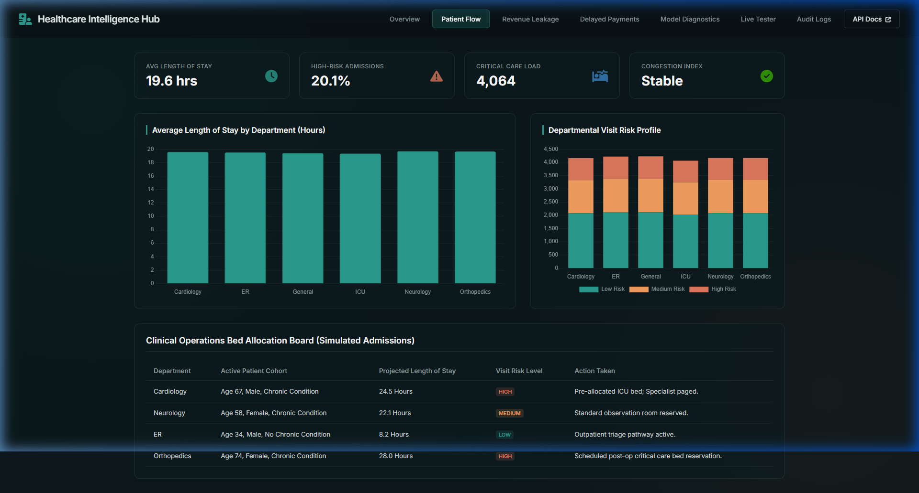
PHASE 5 DEPLOYMENT — CLINICAL CONGESTION ANALYTICS
Dashboard Walkthrough: Clinical Patient Flow Monitor
Clinical Flow Dashboard Details:
• Departmental LOS Analysis:
Displays stay lengths across departments (Cardiology: 19.6h, ICU: 19.3h) to monitor congestion.
• Triage Risk Cohort Profiles:
Visualizes risk distributions (Low, Medium, High) per department. Flags departments carrying heavy critical care loads.
• Real-Time Bed Allocation Board:
Provides action recommendation flags (e.g. pre-allocate ICU beds for predicted High-risk admissions).
Screenshot: Patient Flow monitor tab showing departmental averages and triage alert boards.

Slide 14
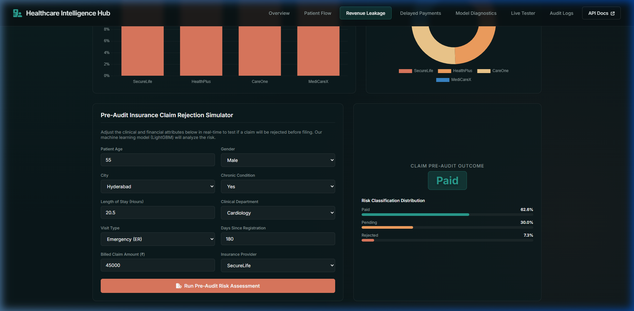
PHASE 5 DEPLOYMENT — INSURANCE CLAIM REJECTION SIMULATOR
Dashboard Walkthrough: Pre-Audit Claims Simulator
Pre-Audit Claims Simulator Details:
• Real-Time Model B Predictions:
Staff input demographics and claim features to instantly check prediction outcomes (Paid, Pending, Rejected) and probability distributions.
• Pre-Submission Auditing:
Allows testing changes to variables (Billed Amount, Insurer, Coding Flags) to see if predicted rejection risk decreases.
• Operationalizing Financial ML:
Provides billing staff with model-driven guidance, directly protecting revenue.
Screenshot: Pre-Audit claim rejection simulator showing low risk result for corrected billed claim.

Slide 15
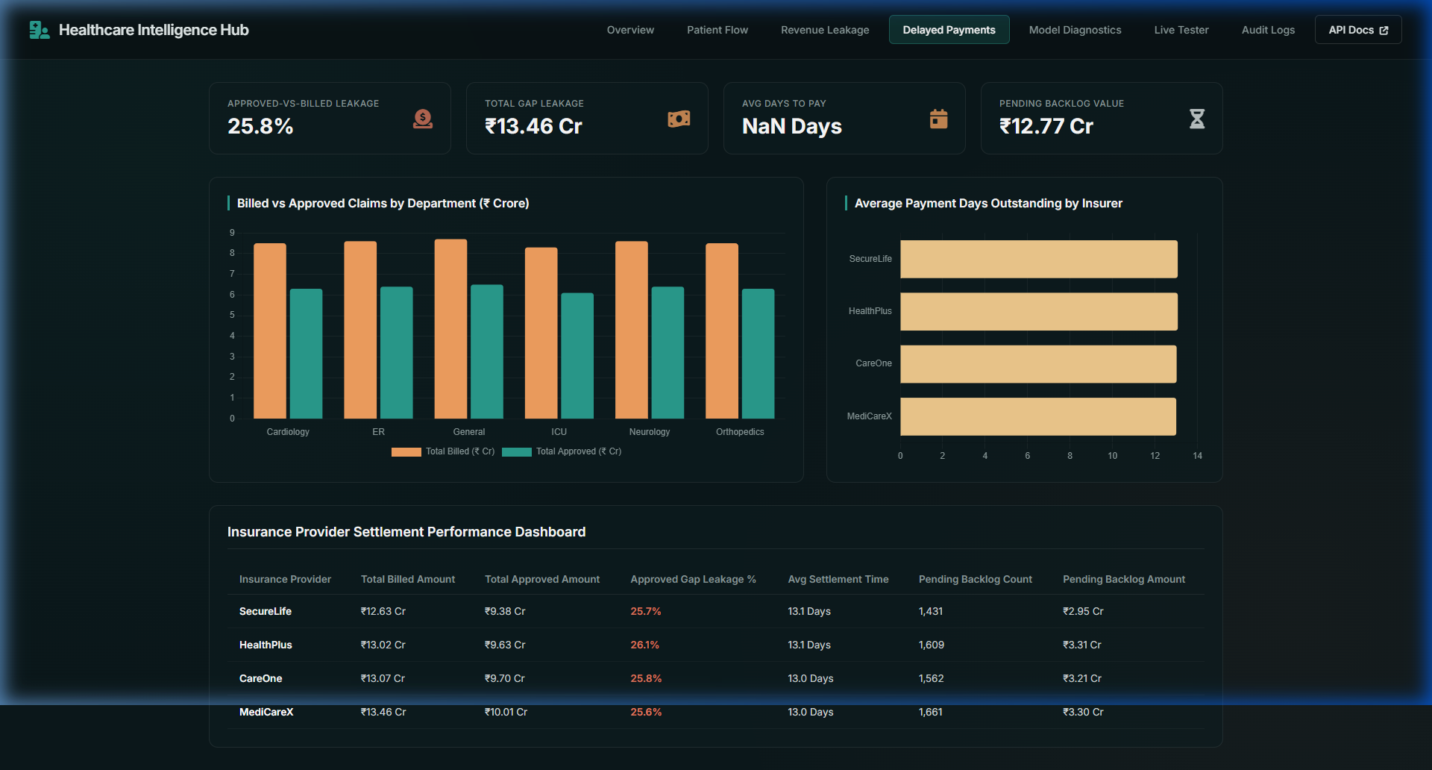
PHASE 5 DEPLOYMENT — REVENUE LEAKAGE & CASH FLOW KPIS
Dashboard Walkthrough: Insurer Settlement Performance
Delayed Payments Dashboard Details:
• Billed-vs-Approved Leakage:
Monitors leakage gap (25.8% overall, total leakage ₹13.46 Cr) to identify areas for billing improvement.
• Days Sales Outstanding (DSO):
Tracks settlement times per provider (avg 13.0 days), showing which insurers require billing optimizations.
• Pending Claims Backlog Tracker:
Summarizes pending claim counts (6,263 claims, ₹12.77 Cr) to help financial teams focus recovery efforts.
Screenshot: Delayed Payments tab showing dual-axis charts and insurer settlement rankings.

Slide 16
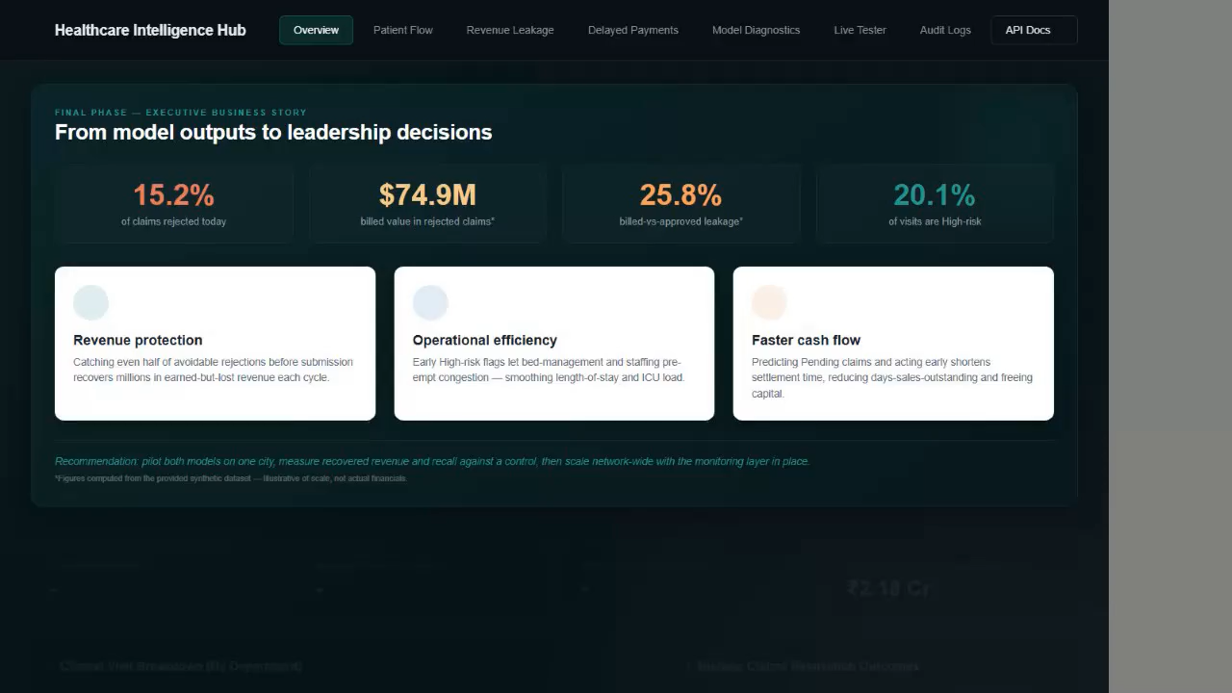
PHASE 5 DEPLOYMENT — VIDEO DEMONSTRATION
Interactive Dashboard Live Features Walkthrough
Dashboard Live Features Video:
• Tabbed Navigation Flow:
Cycles through Overview, Patient Flow, Revenue Leakage, Delayed Payments, Diagnostics, Tester, and Audit Logs.
• Interactive Claims Simulator:
Demonstrates filling out the pre-audit claims form with financial variables and running the live risk prediction.
• Dynamic SQL Metrics & Charts:
Showcases animated Chart.js graphs mapping departmental stays, realization gaps, and insurer settlement speeds.
▶️ How to Play:
Click on the video frame on the right and click Play in PowerPoint to watch the walkthrough recording.
Interactive Playable Video: Live dashboard feature walkthrough demonstration.

Slide 17
DEPLOYMENT ARCHITECTURE & LONG-TERM SCALING PLAN
Containerized Deployment & Scaling Strategy
Containerized Stack & Production Setup:
• Production Containerization (Docker):
Encapsulates FastAPI, MySQL connectors, models, and libraries into a lightweight Docker image, ensuring identical behavior across dev and cloud.
• Dynamic Port Mapping & Network:
Maps port 8000 to the host network. Links to local or cloud MySQL instances via encrypted connection strings.
• CLI Scripts for Orchestration:
Scripts like 'build_features.py' and 'drift_detection.py' run in automated cron jobs.
Long-Term Staging & Scaling Plan:
• Pilot Facility Deployment (3 Months):
- Launch the platform at a single regional facility to gather feedback.
- Measure true financial ROI and clinical bed optimization against a control group.
• Automated Pre-Submission Intercept:
- Integrate Model B directly into the hospital billing software.
- Claims predicted as Rejected will automatically block submission, flagging errors for review.
• Auto-Retraining Trigger Integration:
- Connect drift alerts to pipelines, keeping model weights updated without manual steps.

Slide 18
THANK YOU
Hospital Operations & Revenue Risk Intelligence Platform
Questions & Feedback | IIT Madras Capstone Grading Review

