Slide 1
DBA & ASML Applications
Sap BTP CF – Architecture Diagrams

Slide 2
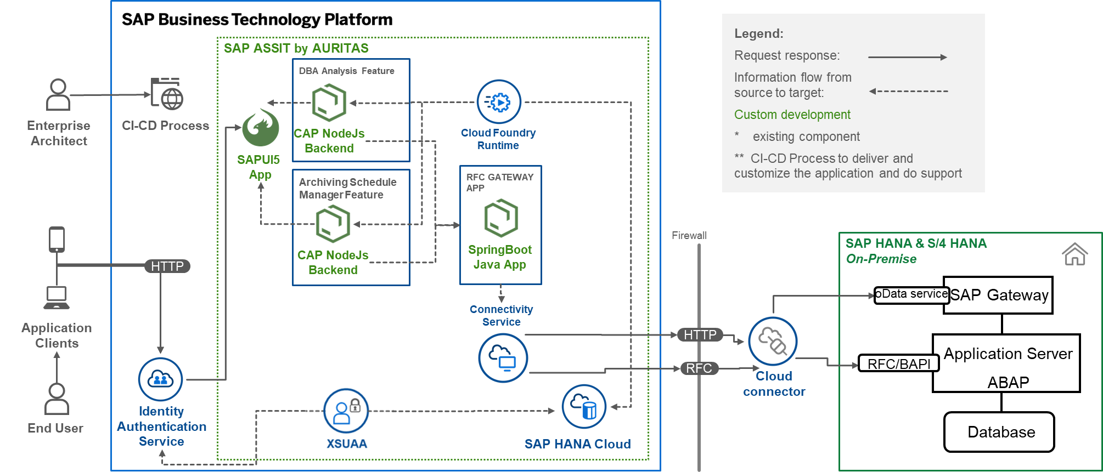
Overall Architecture Diagram
To create architecture diagram as bellow please refer to the most recent version of the SAP Business Technology Platform Solution Diagrams & Icons here https://wiki.scn.sap.com/wiki/pages/viewpage.action?pageId=477829554
This architecture shows how all steps work in the customer subaccount when deployed.
Some servicers are mandatory and could have cost related (contact your SAP Sales Contact to request an estimate on the cost).
Pre-requisites (services):
Hana Cloud
Cloud Foundry Runtime 1GB
Application logging (standard plan)
Connectivity
Destination
Xsuaa

Slide 3
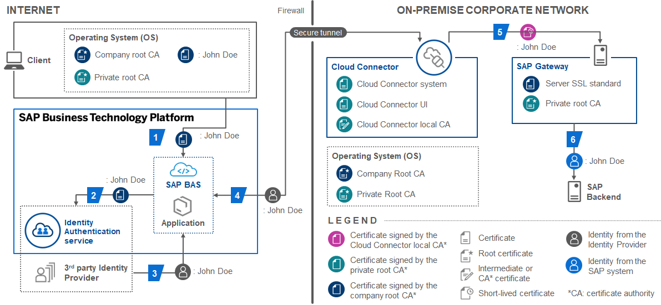
Development Security Diagram

Slide 4
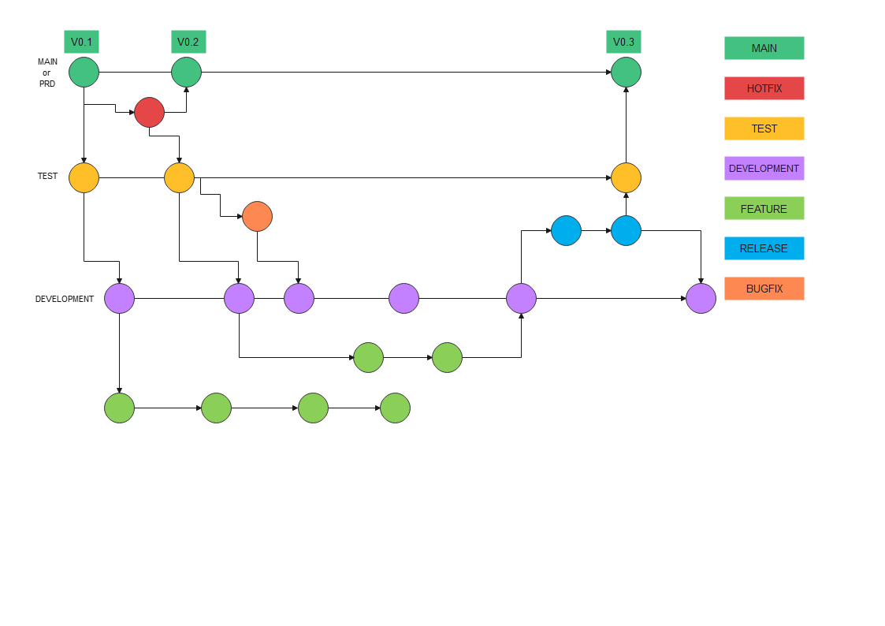
Git Strategy
For our project we have chosen to follow the git flow strategy and with it we have 3 environments, dev, test and prd.
More information can be found here: https://www.atlassian.com/git/tutorials/comparing-workflows/gitflow-workflow

Slide 5
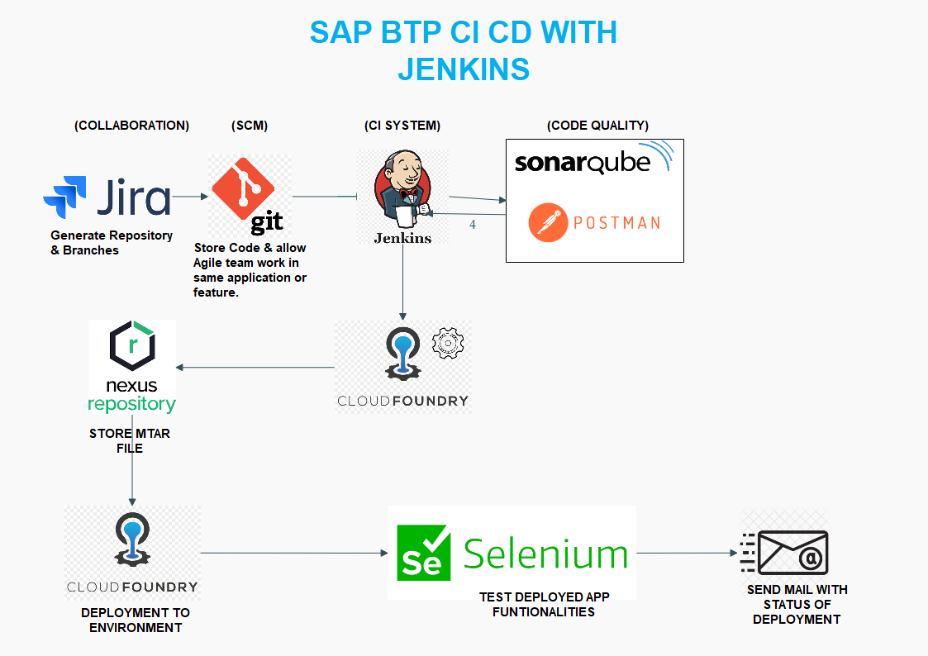
Jenkins
Application CI/CD Process
For this project we are using our Jira board integrated with GitHub and a webhook is configured to jenkins that will start the pipeline when a pull request is approved. The build, unit tests, integration tests and deployment are done in this section. We will send mail with success and failure of the process.
BUILD

Slide 6
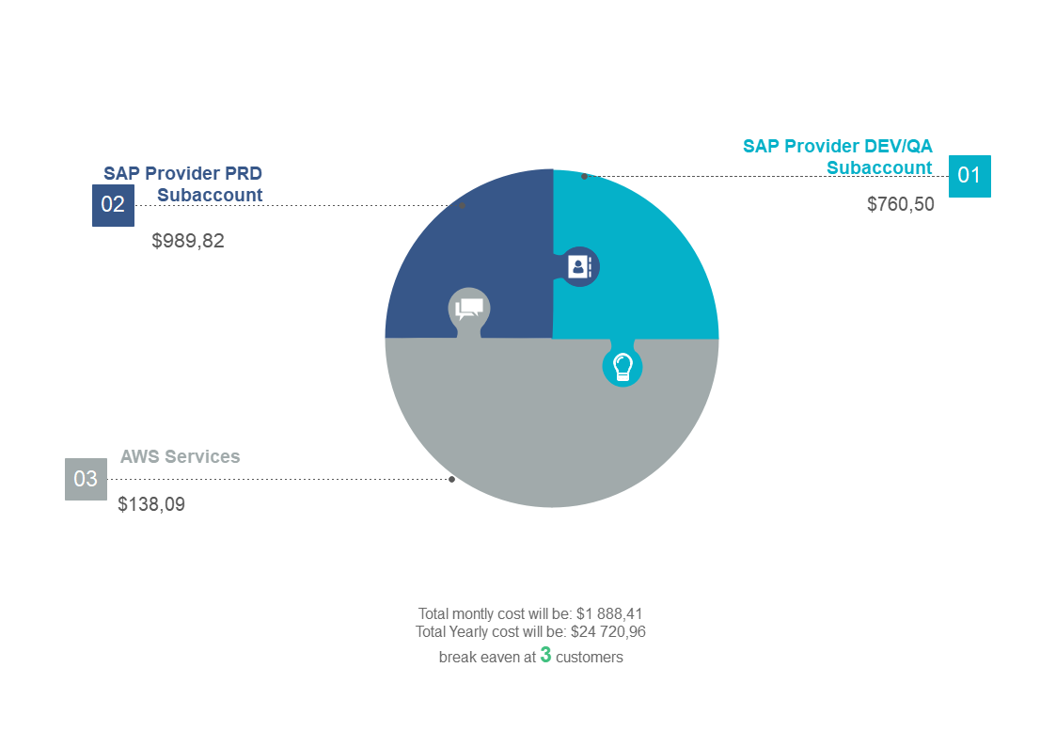
Application costs
Here you can see the costs of the application, here we still need to add development team cost, marketing cost, consultant cost and some others.
What is here are the techinical resource cost and some estimation only taking that in mind.

