Slide 1





NEXT GEN EMPLOYABILITY PROGRAM
Creating a future-ready workforce
Team Members: 06
College Name
Student Name : YUVARAJ K
Arunai Engineering Collage
Student ID : au510421104120

Slide 2


CAPSTONE PROJECT SHOWCASE
Next Gen Employability Program
Project Title
"RESUME GENERATOR: EMPOWERING YOUR PROFESSIONAL JOURNEY"
Abstract | Problem Statement | Project Overview | Proposed Solution |
Technology Used | Modelling & Results | Conclusion

Slide 3
Next Gen Employability Program
Abstract
The purpose of our project is to develop a web application that facilitates the creation of professional portfolios for individuals. The application consists of two main pages: a Welcome Page and a Portfolio Page.
The Welcome Page serves as the entry point for users and features a prominent "Create Resume" button. Upon clicking this button, users are directed to the Portfolio Page.
The Portfolio Page provides users with a comprehensive form to input various details including personal information, educational background, work experience, projects, skills, and a summary. Additionally, users can upload a photo to include in their portfolio.
Upon filling out the form and clicking the "Generate Resume" button, the application processes the provided information and generates a professional A4-sized resume document. This document includes all the details provided by the user in a structured and visually appealing format.
Overall, our project aims to streamline the process of creating portfolios by offering a user-friendly web interface with intuitive controls and professional output.
Source :

Slide 4
Next Gen Employability Program
Problem Statement
Problem Statement: In today's competitive job market, individuals often struggle to create professional portfolios that effectively showcase their skills, experiences, and achievements. Existing methods for creating portfolios, such as manually formatting documents or using generic templates, can be time-consuming, cumbersome, and may not produce optimal results.
Therefore, our project aims to address this challenge by developing a web application that simplifies and streamlines the process of creating professional portfolios. This application will provide users with a user-friendly interface to input their personal information, educational background, work experience, projects, skills, and a summary.
Additionally, the application will offer features such as photo upload functionality and automated resume generation. By leveraging modern web technologies and design principles, our solution will empower individuals to effortlessly create polished and visually appealing portfolios that effectively highlight their qualifications and accomplishments.
Through this project, we seek to provide a solution that caters to the needs of job seekers, students, freelancers, and professionals across various industries, ultimately helping them stand out in the competitive job market and achieve their career goals.
Source :

Slide 5
Next Gen Employability Program
Project Overview
Our project is a user-friendly web application designed to simplify the creation of professional portfolios. It comprises a Welcome Page with a prominent "Create Resume" button, directing users to a Portfolio Page.
On the Portfolio Page, users fill out a comprehensive form with personal details, educational background, work experience, projects, skills, and a summary. They can upload a professional photo. After completing the form, users can click "Generate Resume" to produce a polished A4-sized resume document.
This document incorporates all entered information in a structured and visually appealing format. Our application aims to streamline the portfolio creation process, helping individuals effectively showcase their qualifications and stand out in the job market.
Source :

Slide 6
Next Gen Employability Program
Proposed Solution
.
Our proposed solution is to develop a comprehensive web application that simplifies the process of creating professional portfolios. The application will provide users with an intuitive interface and robust features to effectively showcase their skills, experiences, and achievements. Here are the key components of our solution:
1. User-Friendly Interface:
- The application will feature a clean and intuitive user interface designed to be accessible to users of all levels of technical proficiency.
- Clear navigation and organized layout will guide users through the portfolio creation process seamlessly.
2. Welcome Page:
- Upon accessing the application, users will be greeted with a Welcome Page that introduces the purpose of the application and encourages them to begin creating their portfolio.
- The Welcome Page will prominently feature a "Create Resume" button, serving as the entry point for users to initiate the portfolio creation process.
Source :

Slide 7
Next Gen Employability Program
3. Portfolio Page:​
- After clicking the "Create Resume" button, users will be directed to the Portfolio Page where they can input their personal information, educational background, work experience, projects, skills, and a summary.​
- The Portfolio Page will feature a comprehensive form with fields for users to fill out, accompanied by clear instructions and prompts to guide them through the process.​
- Additionally, users will have the option to upload a professional photo to include in their portfolio, enhancing its visual appeal and personalization.​
4. Automated Resume Generation:
- Once users have filled out the form with their information, they can click the "Generate Resume" button.
- The application will then process the provided information and automatically generate a professional A4-sized resume document.
- The generated resume will be formatted in a visually appealing and structured manner, incorporating all the details provided by the user in the Portfolio Page.
​
Source :

Slide 8
Next Gen Employability Program
5. Customization Options:
- Our solution will offer customization options to allow users to tailor their portfolios according to their preferences and specific needs.
- Users may have the ability to choose from different layout templates, color schemes, and font styles to customize the appearance of their portfolio.
6. Accessibility and Compatibility:​
- The web application will be designed to be accessible across various devices and screen sizes, ensuring a consistent and user-friendly experience for all users.​
- Compatibility with different web browsers will be ensured to maximize accessibility and reach.​
​
7. Security and Privacy:​
- Our solution will prioritize the security and privacy of users' personal information.​
- Secure data encryption and protection measures will be implemented to safeguard users' sensitive data.​
Overall, our proposed solution aims to provide individuals with a convenient, efficient, and professional platform for creating and showcasing their portfolios, empowering them to stand out in the competitive job market and achieve their career aspirations.​
Source :

Slide 9
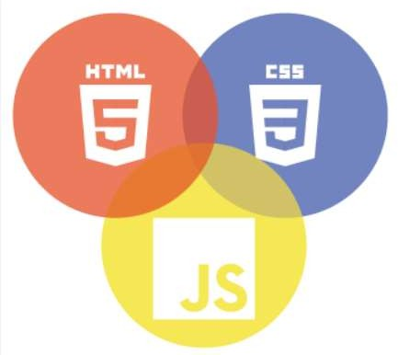

Next Gen Employability Program
Technology Used
Front-end
Back-end
Source :

Slide 10
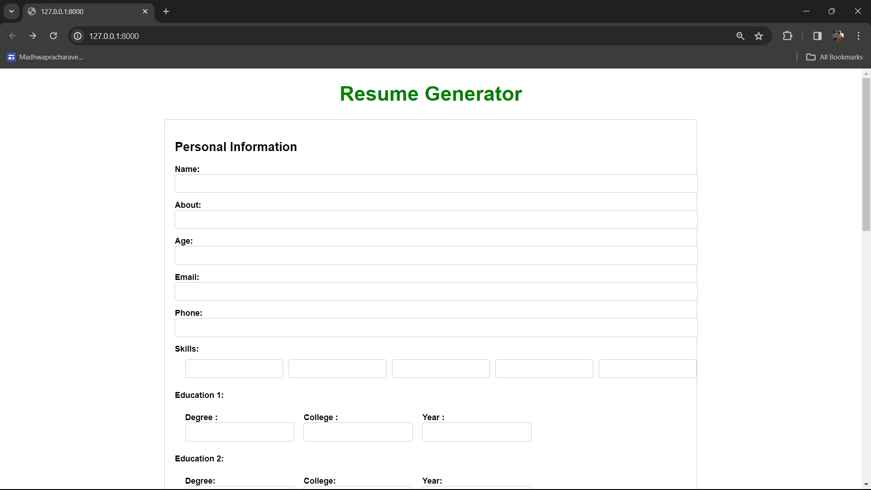
Homepage
Next Gen Employability Program

Slide 11
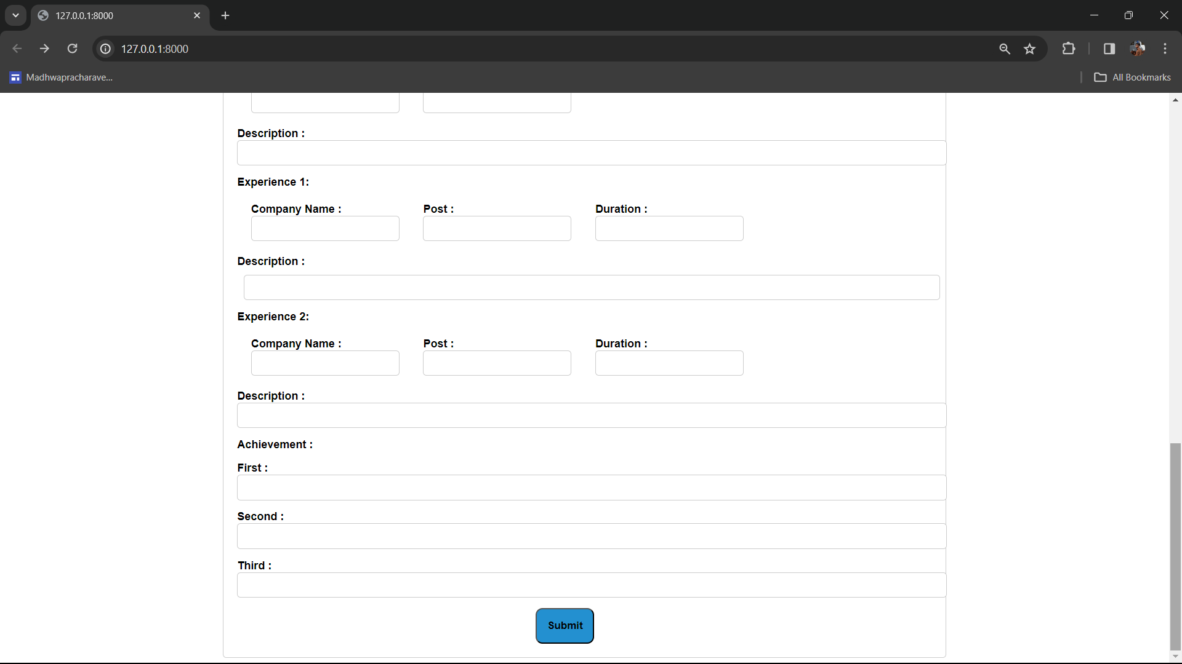
Homepage
Next Gen Employability Program

Slide 12
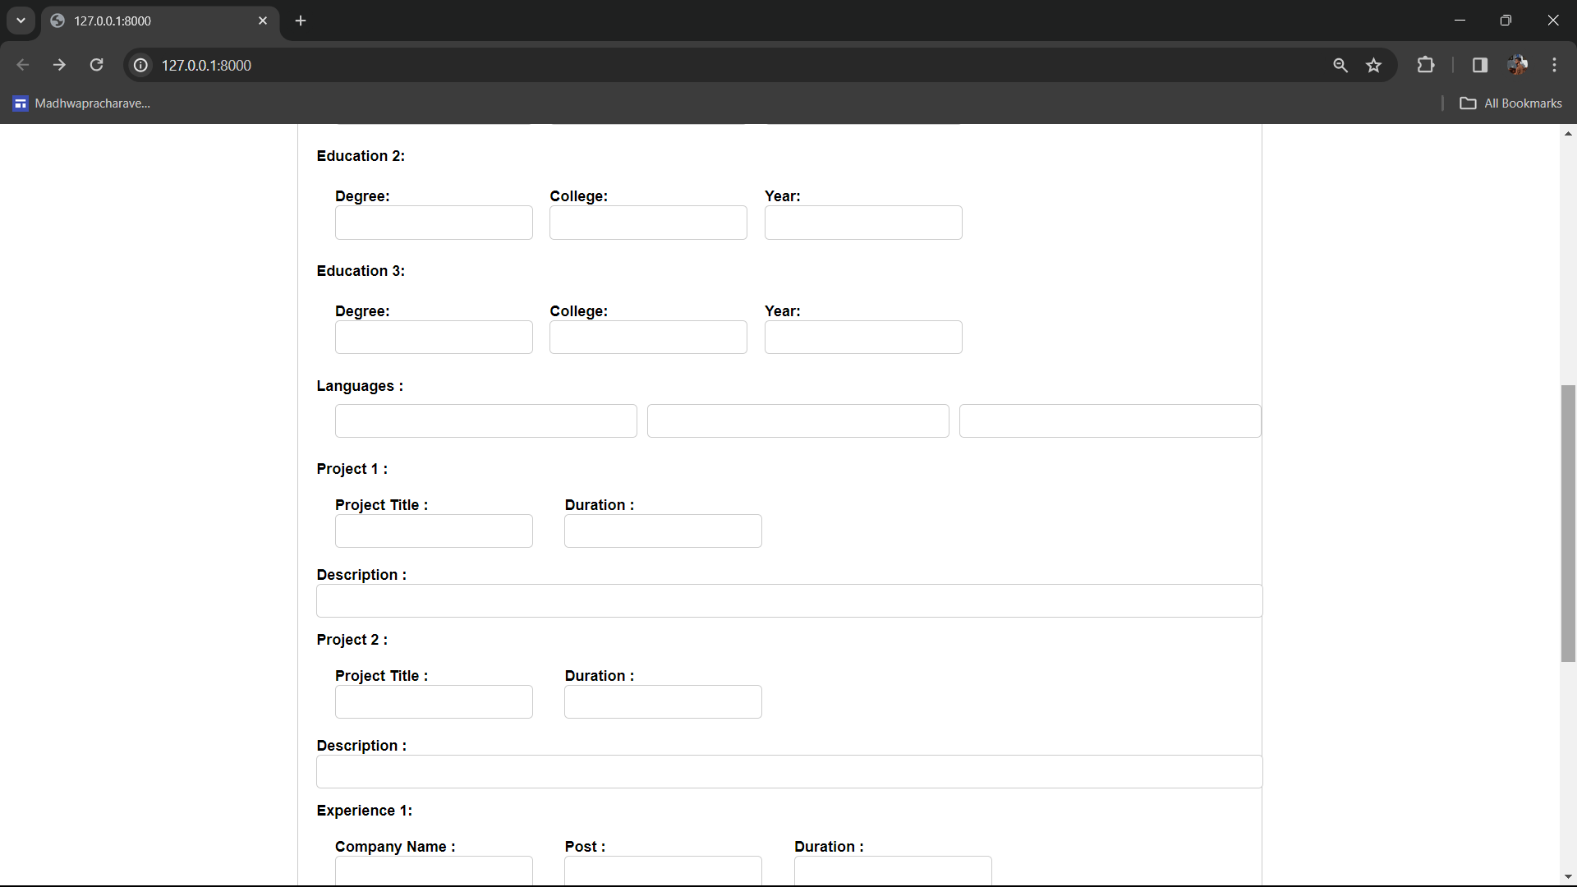
Homepage
Next Gen Employability Program

Slide 13
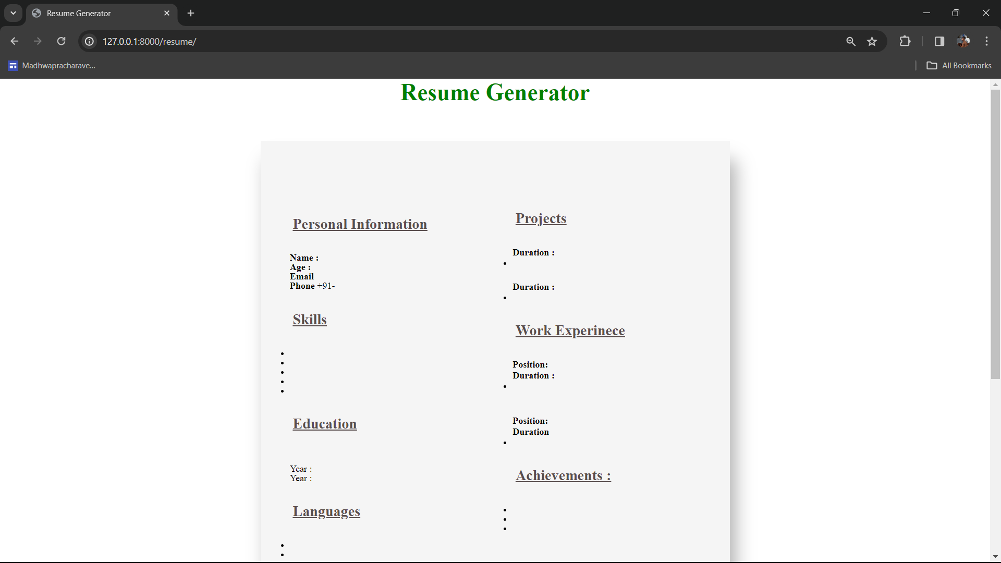
Next Gen Employability Program
Results
Source :

Slide 14
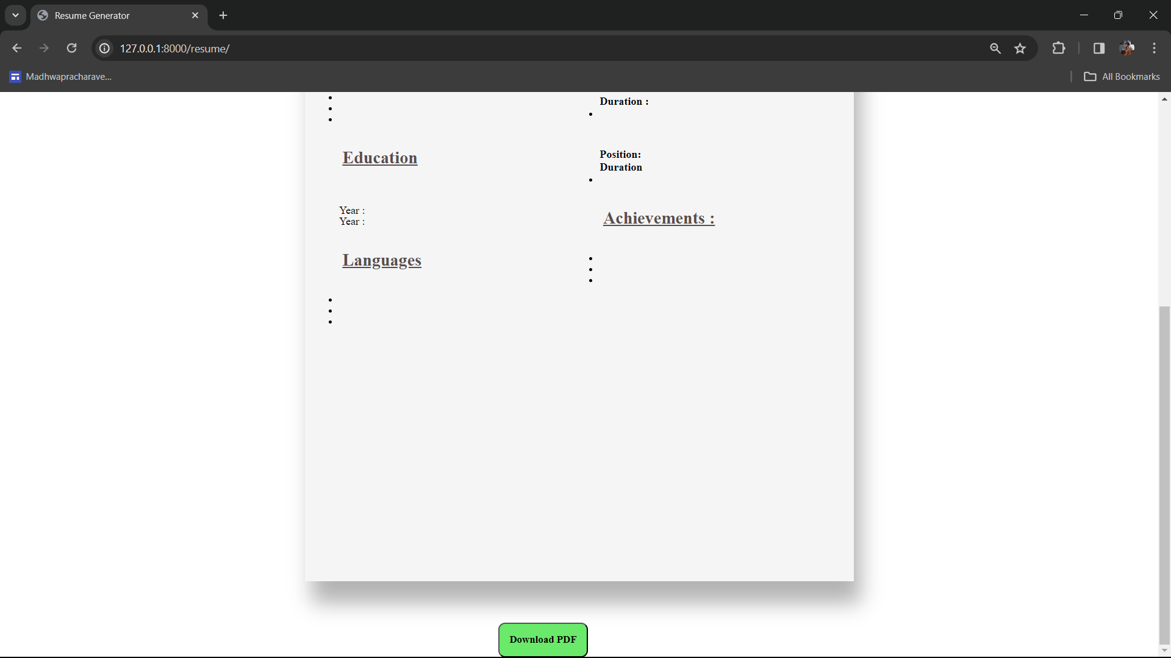
Next Gen Employability Program
Results
Source :

Slide 15
Next Gen Employability Program
Future Enhancements:
1. Template Customization: Allow users to choose from various pre-designed templates and customize colors, fonts, and layouts to match their preferences and branding.
2. Integration with Social Media: Enable easy sharing of portfolios on platforms like LinkedIn, Twitter, and Facebook to enhance visibility and networking.
3. Collaborative Editing: Implement features for multiple users to work on portfolios simultaneously, beneficial for team projects.
4. Interactive Elements: Incorporate sliders, charts, and graphs to visually represent skills and achievements, making portfolios more engaging.
5. Feedback System: Introduce a feedback mechanism for users to request and receive critiques on their portfolios, aiding improvement.
6. Export Options: Offer export formats beyond PDF, such as HTML or dedicated portfolio websites for dynamic online showcases.
7. Integration with Portfolio Tools: Explore partnerships with tools like Behance or Adobe Portfolio for additional resources and features.
8. Analytics: Provide analytics to track portfolio engagement, including views, time spent, and section interactions.

Slide 16
Next Gen Employability Program
Conclusion
Conclusion: In conclusion, our project aims to address the challenges individuals face in creating professional portfolios by developing a user-friendly web application. Through intuitive interfaces, comprehensive form inputs, and automated resume generation, we empower users to effortlessly showcase their skills and experiences. The proposed future enhancements further expand the functionality and versatility of the application, offering users customization options, collaborative tools, and analytics insights. These enhancements align with our goal of providing a comprehensive solution that meets the evolving needs of users in the competitive job market. By continuously refining and expanding our platform, we aim to support individuals in their career endeavors, helping them stand out and succeed in their professional journeys. Our commitment to innovation and user satisfaction drives us to deliver a portfolio-building experience that is efficient, effective, and empowering for all users.
Source :

Slide 17
Thank You!
Next Gen Employability Program

