Slide 1

iPhone-user Journey Map
G.yuvaraj,S.prasanthi,G.anjali devi,K.sree chandana
B.sidhartha,G.mahidhar

Slide 2
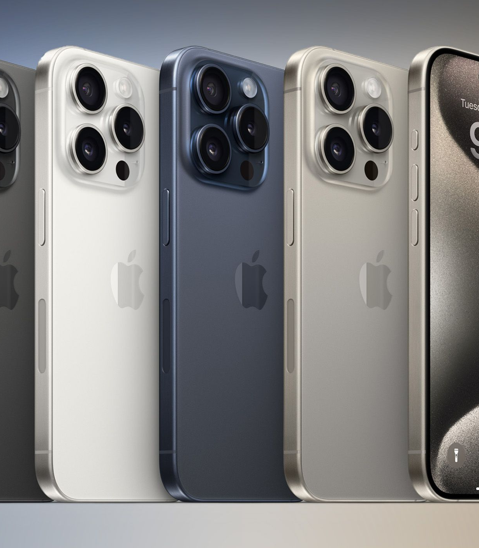
History
Launched on JAN 9 2007 by Steeve jobs
FEATURES
User experience (IOS)
Security and Privacy
DIY repairs
High performing chipsets
Camera quality
Water and dust resistance

Slide 3

Benifits of iphone
Seemless Ecosystem
Software Optimisation
Privacy and Security
Integration with Apple
Longevity and Resale Value
Customer Support

Slide 4

Problems faced by user
1. Battery Life
Problem: Battery degrades overtime, requiring frequent charging.
2. Storage Limitations
Problem: Fixed storage capacity without external memory options.
3.Price
Problem: iPhones are expensive , limiting accessability
4.Compatability with non apple devices
problem: limited integration with non apple Eco systems
5.Over Heating
Problem: Overheating during intensive use (e.g., gaming, heavy multitasking).

Slide 5
Solutions
1. Battery-life :
Introduce AI powered energy optimization that adjusts settings and app usage dynamically based on user habits maximising battery longivitiy
2. Storage Limitation:
Push cloud integration further , offering seemless automatic background syncing with advanced compression for photos and videos
3. Price
Develop a modular iPhone that allows user to upgrade specific components rather than buying a new device
4. Compatability with Non Apple Devices :
Expand cross platform support and introduce universal adapters allowing iPhone user to connect easily to non apple device
5. Overheating :
Innovate with liquod cooling technology to manage heat more effectively

