Slide 1

ChefMate: Restaurant Clustering & Cooking Guide Application
YUVARAJ.R
ChefMate

Slide 2
ChefMate
A intelligent application that clusters and recommends restaurants based on user input, such as cuisine and integrates a chef-like ‘chatbot assistant’ for guiding users in preparing recipes.

Slide 3
Problem Statement
In a fast-paced world, finding the right restaurant based on individual preferences (such as cuisine type or specific dishes) can be overwhelming. Traditional recommendation systems often lack personalized suggestions, making it difficult for users to explore diverse dining options. Additionally, many users are interested in preparing meals at home but struggle with finding reliable, step-by-step cooking guidance.

Slide 4
Business Use Cases
Personalized restaurant recommendations based on user preferences.
Dynamic display of restaurant data with maps and ratings, enhancing user experience.
Assisting users with cooking instructions, improving home cooking engagement.
Potential integration with food delivery platforms for enhanced customer engagement.

Slide 5
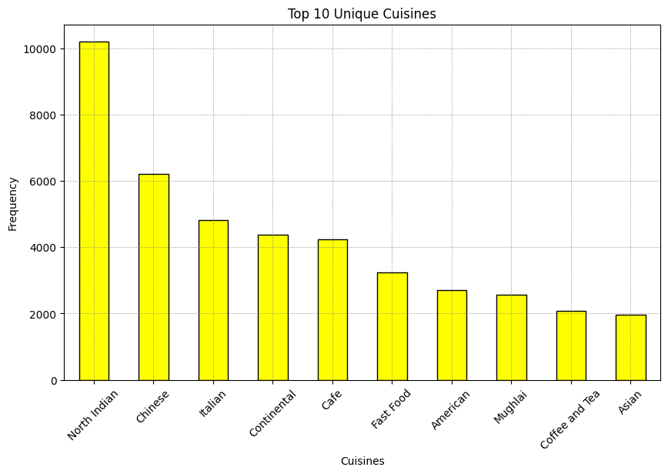
Top 10 Cuisines in Our Dataset

Slide 6
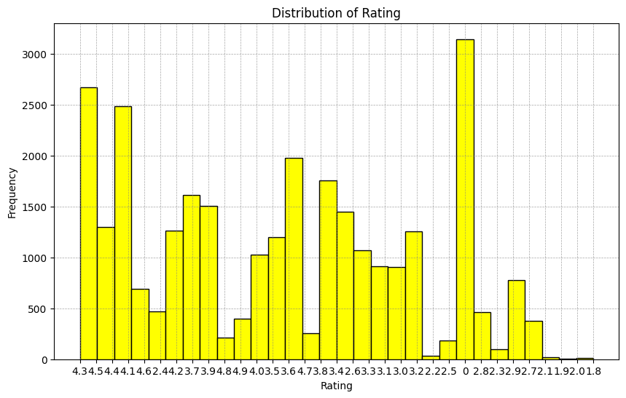
Distribution of Rating

Slide 7
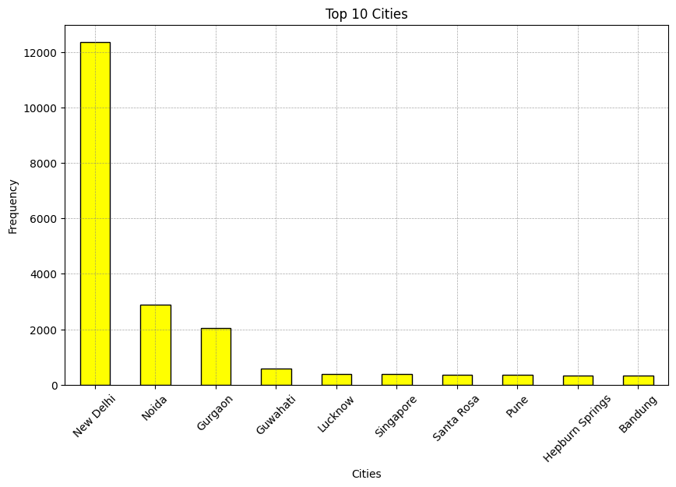
Top 10 Cities

Slide 8
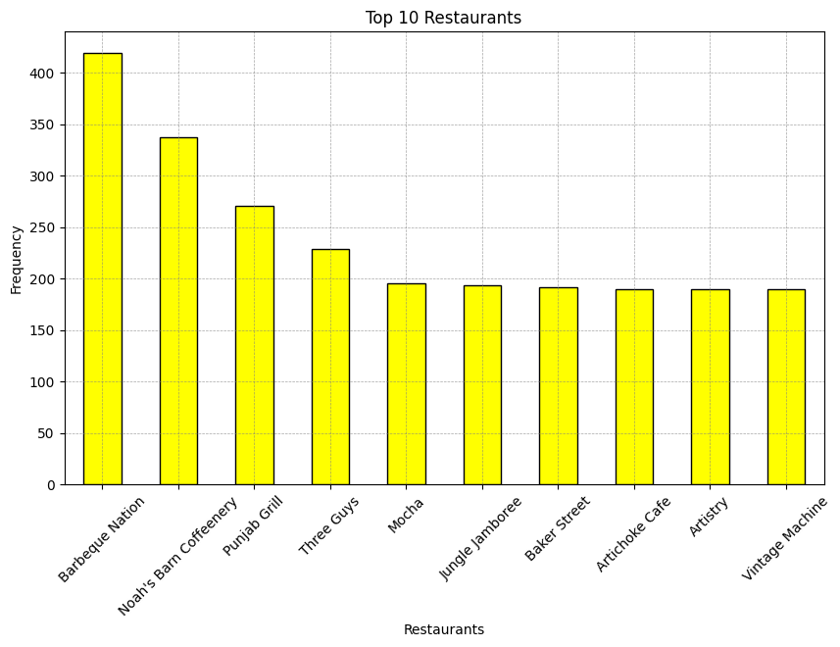
Top 10 Restaurants

Slide 9
Conclusion
The "ChefMate: Restaurant Clustering & Cooking Guide Application" successfully combines personalized restaurant recommendations with a chatbot for home cooking assistance. By utilizing machine learning and AI, the application enhances user experience through tailored suggestions and interactive guidance. The integration of AWS services and Streamlit ensures seamless performance and scalability. This project addresses key challenges in dining and cooking, offering a comprehensive solution for users. Future enhancements can expand its reach with food delivery integrations and more advanced features.

