Slide 1
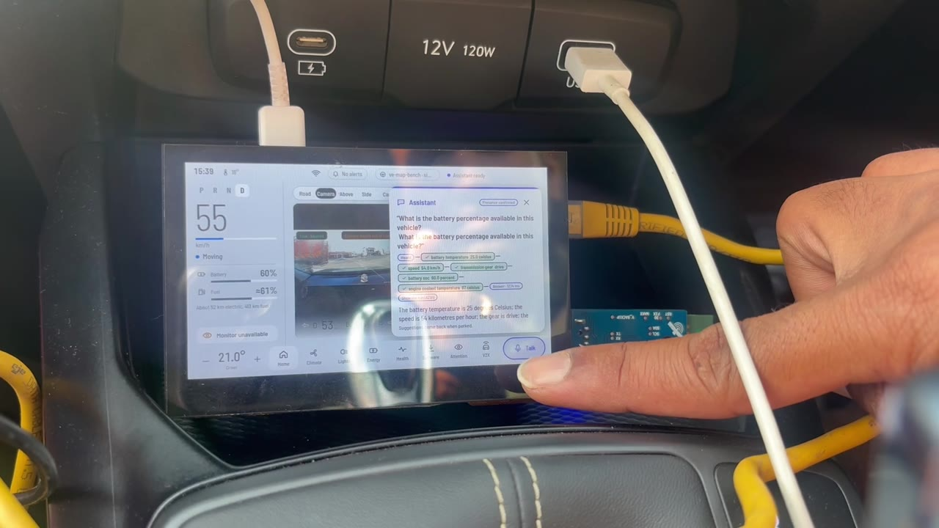
Ve-AP: a governed AI agent in a real car
Bounded authority and measured refusal for in-vehicle agents
Capstone project 2026 · Yuvaraja
No cloud · Jetson + Raspberry Pi 5 · tested in a car, 19 Oct 2026
Notes:
Ve-AP is an AI agent that answers questions about a car while it is driven. It runs on two small boards in the car, with no cloud. Its point is not the answers: it is that every call to the vehicle passes a gate that can refuse, and every refusal is recorded.

Slide 2



Agents are arriving in cars. Three questions stay open
What may it do, and who decides?
0
A tool list says what an agent can call, not what it is allowed to call here, now, with this evidence.
How do we know a refusal works?
times a failure ceiling fired in 19 runs of an earlier evaluation
A safety rule that has never refused anything has never been shown to work.
Not because it was rarely needed: the tests never created the event. A predicate with eight conditions has eight ways to repeat that mistake.
How does it reach hardware without protocols?
If a model can emit a CAN ID, every guard above it can be bypassed by one string.
Notes:
Vendor architectures show where an agent sits. They do not say what it may do, how we know its refusals work, or how it reaches hardware without speaking protocols. The author's earlier evaluation had a failure ceiling that fired zero times in nineteen runs: the zero meant 'never tested', not 'never needed'.

Slide 3
One predicate guards every vehicle call
Allow(q) = Auth ∧ Schema ∧ Fresh ∧ Pre
∧ Risk ≤ Permit ∧ Consent ∧ Budget ∧ Before
Auth
Schema
Fresh
Pre
in this agent's manifest?
arguments well formed?
evidence young enough?
preconditions hold now?
NOT_IN_MANIFEST
SCHEMA_INVALID
STALE_EVIDENCE
PRECONDITION_UNMET
Risk ≤ Permit
Consent
Budget
Before
class within the permit?
data use consented?
calls and cost left?
inside the deadline?
RISK_EXCEEDS_PERMIT
REDACTION_UNAVAILABLE
BUDGET_EXHAUSTED
DEADLINE_EXCEEDED
Each conjunct must deny on its own, name itself, and leave evidence. All 8 are made to deny, with their own code, on every run.
Notes:
The thesis: every action passes one predicate of eight conditions. Each can refuse on its own and names itself. The first one to refuse names the decision, and the decision is journalled before anything reaches a device.

Slide 4
L4 is the only way down
L9 Cloud / depot — optional, off
Invariants — each has a test that runs every time
L8 Experience — cabin display, voice, console
I1
No model or agent touches a vehicle interface
L7 Orchestration — fast route, planner, budgets
I2
Only L3 adapters speak a protocol
L6 Specialised agent — read-only vehicle agent
I3
No CAN, service or UDS IDs in any capability
L5 Shared intelligence — knowledge, driver state
L4 Capability gateway — Allow(q) · MCP · journal
I4
High-rate data never crosses L4
L3 Vehicle services — SOVD north face over MHS
I5
Deterministic controllers stay authoritative
L2 Signals and transport — KUKSA · CAN
I6
Only admitted paths actuate; only providers publish
L1 Runtime — Jetson + Pi, containers, models
I7
Isolation is a missing import, not a filter
L0 Physical — ECUs, sensors, deterministic controllers
Notes:
Ten layers. Models and agents live above L4, protocols below it. Nothing crosses except bounded semantic operations: never a CAN ID or a diagnostic service number. These are invariants with tests, and a hook stops the coding agent from breaking them.

Slide 5
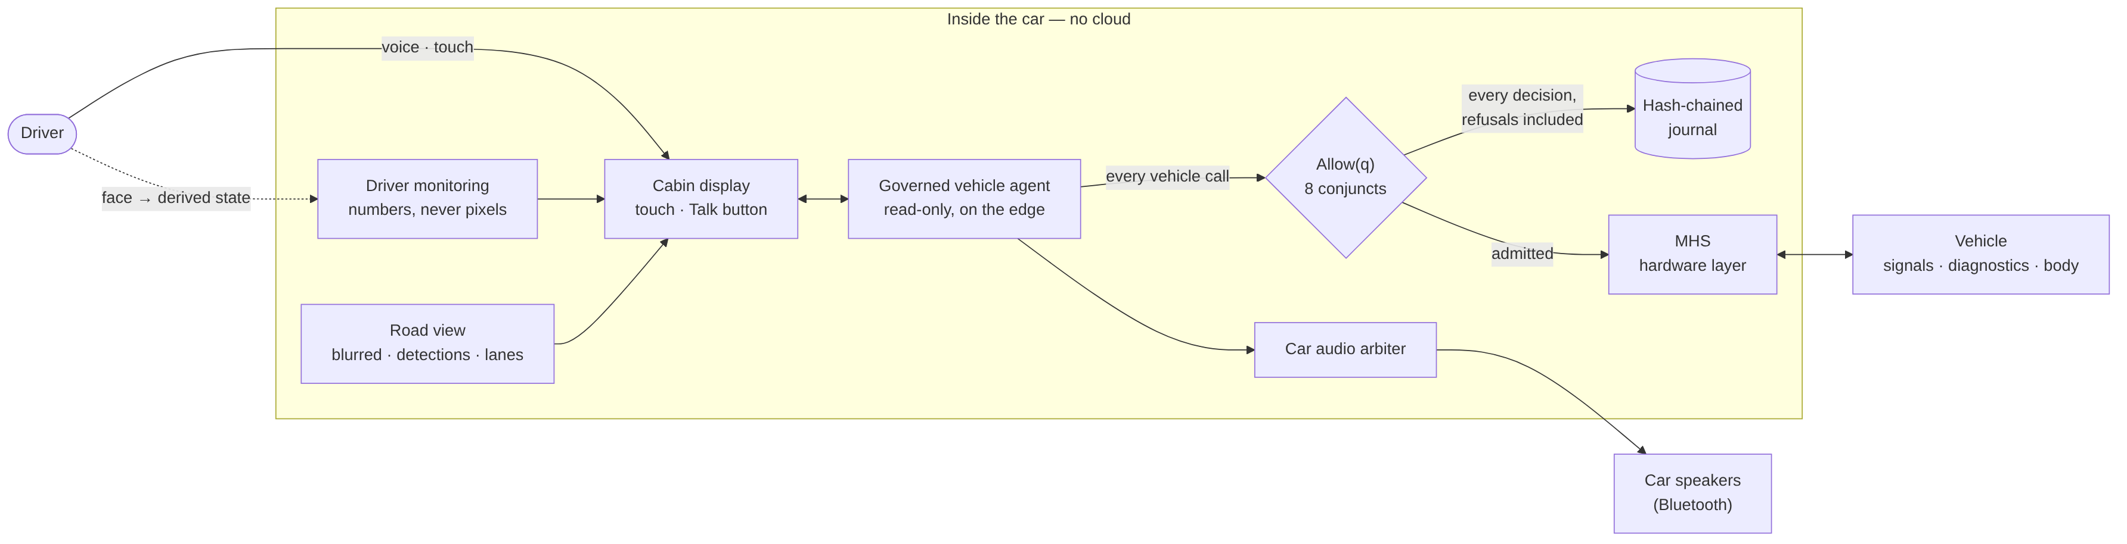



The system on one page
Every vehicle call goes through Allow(q)
Every decision, refusals included, is journalled
No cloud: two boards in the car
Notes:
The agent has no route to the vehicle except through the gate. Below the gate is MHS, the hardware layer. Driver monitoring and the road view feed the cabin display with derived data only.

Slide 6
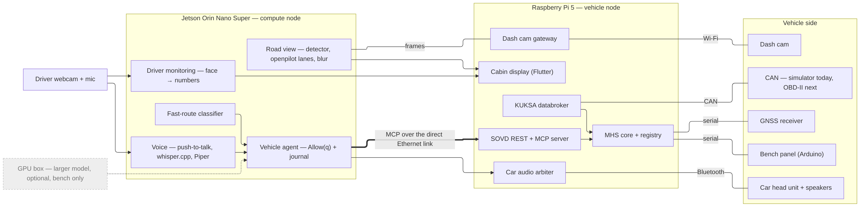
Two boards in the car, no cloud
Jetson Orin Nano Super
Raspberry Pi 5
In the car
Vehicle agent, Allow(q) and journal · fast-route classifier · voice · driver monitoring · road view
MHS · SOVD + MCP server · KUKSA · CAN · cabin display · car audio · dash cam gateway
Dash cam · driver webcam + mic · GNSS · bench panel · the car's own speakers over Bluetooth
Notes:
The Jetson runs the agent and perception; the Pi runs the hardware layer, the diagnostic server and the cabin display. They talk over a direct Ethernet cable. The workstation model is optional, and it was not in the car.

Slide 7
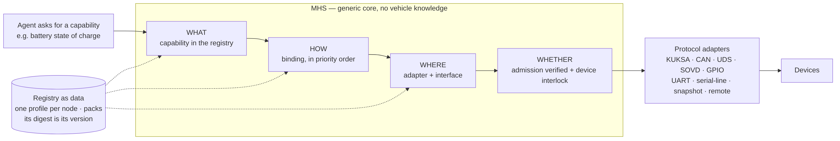




MHS: every hardware fact is checked data
Registry as data
Pinned by digest
Honest fallback
Generic core
Interfaces, capabilities, bindings, interlocks, lenses, controllers. Generated, checked, never hand-edited.
Nodes import each other pinned by digest. A mismatch answers REGISTRY_CHANGED, not a guess.
A read falls back only to the same quantity, as fresh or fresher. Writes never fall back.
The core knows no vehicle, board or pin. A test fails if one appears in its logic.
Notes:
MHS is the hardware layer. Every hardware fact is data in a registry that is checked when it compiles. MHS separates what, how, where and whether, so the agent never names a pin, a CAN ID or a diagnostic service. A new sensor is a registry entry, not new agent code.

Slide 8
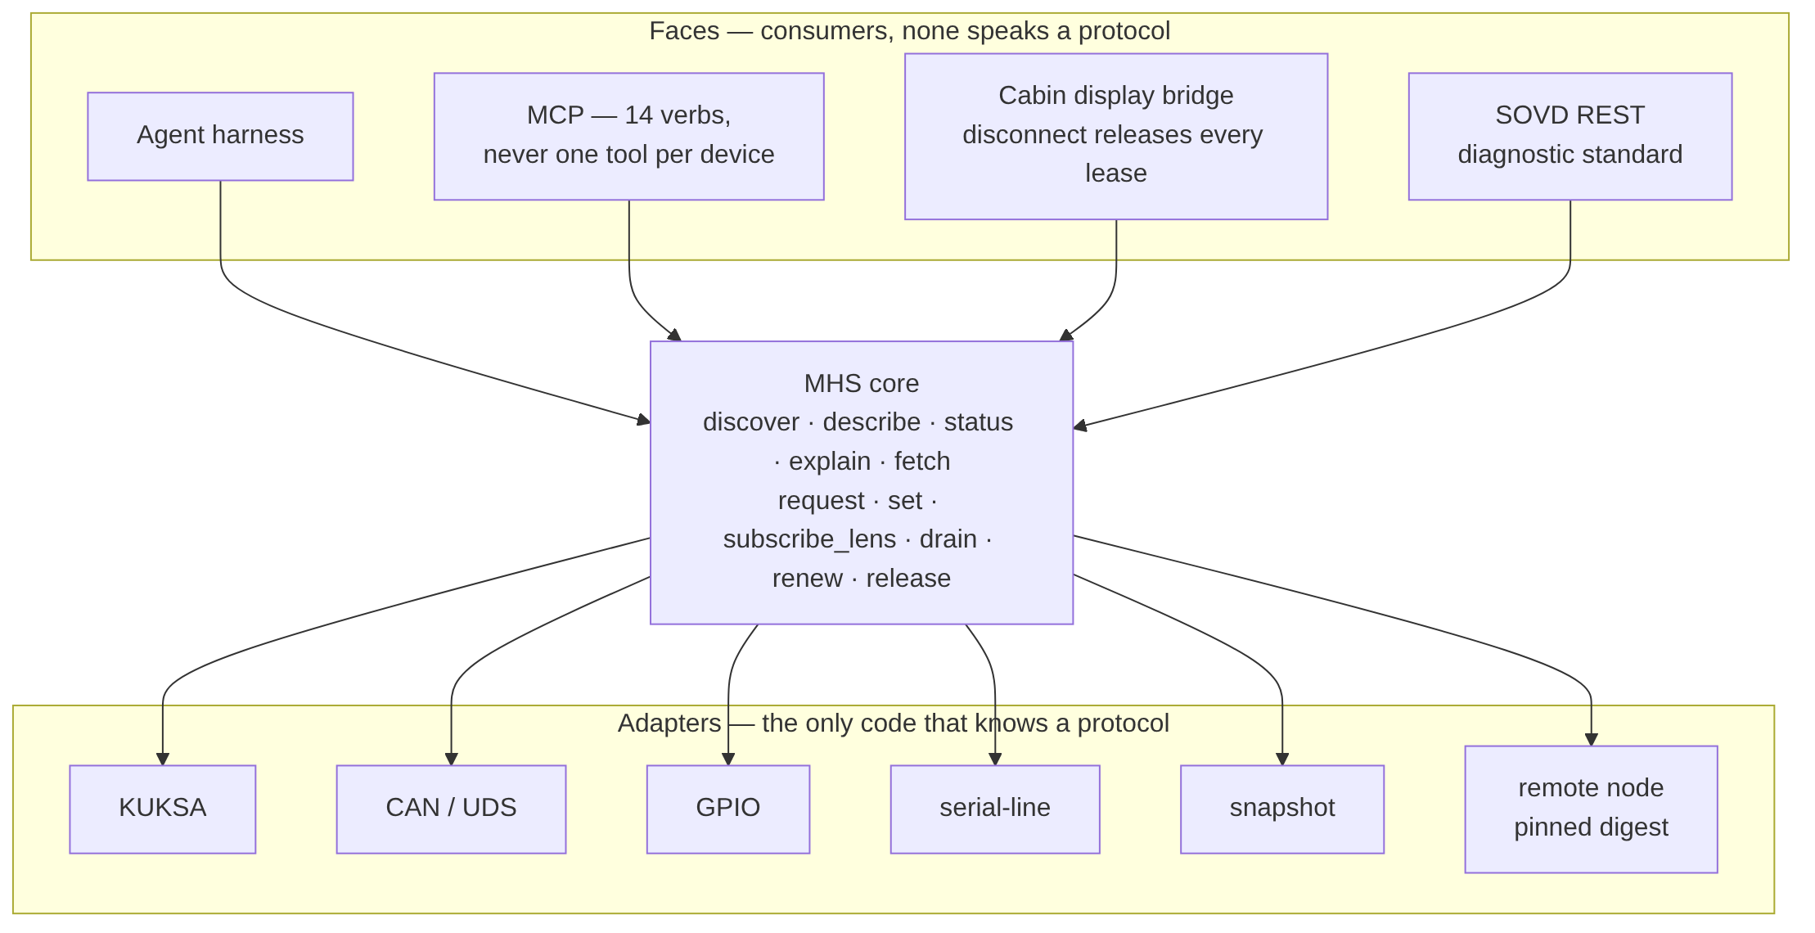
MHS decides no authority: two locks, one core
Gate
MHS
Interlock
Adapter
Read-back
mints an admission for this exact request
verifies it, and cannot mint one
the device policy may still refuse
the only code that speaks the protocol
the write is verified, then journalled
Agent harness, MCP, cabin display and the SOVD diagnostic API are faces of one core. None speaks a protocol.
Live data leaves only through budgeted lenses. Anything held is a lease that expires to a safe state.
Faults are named: REGISTRY_CHANGED, INTERLOCK_REJECTED, LEASE_EXPIRED, CONTROLLER_HALTED.
481 MHS tests passed (19 Oct 2026).
Notes:
Two locks. The gate mints an admission for one exact request; MHS verifies it and cannot mint one. The device interlock can still refuse an admitted write. And every face, from MCP to the cabin display, is a consumer of one core.

Slide 9
Alerts never wait for a model
Path A · deterministic, no model
Refused by name (C3)
Declared rules: coolant hot, door open while moving, belt unfastened
Alert on screen and sound
send_can_frame
write_ecu_memory
install_ota_bundle
stream_forward_camera_raw
get_cabin_frame
identify_driver
identify_speaker
read_emotion
Path B · the governed agent
detect_stress
detect_smoking
Through Allow(q), like every other call
May explain an alert. Never clear or suppress one
store_audio
In no manifest, ever. The names exist only so a request for them is refused with NOT_IN_MANIFEST, before any model runs.
Notes:
Two paths: safety alerts are rules with no model, so a model failure can never silence a warning. And the dangerous capabilities are not missing features: they are named, and refused by name, which makes the refusal testable.

Slide 10
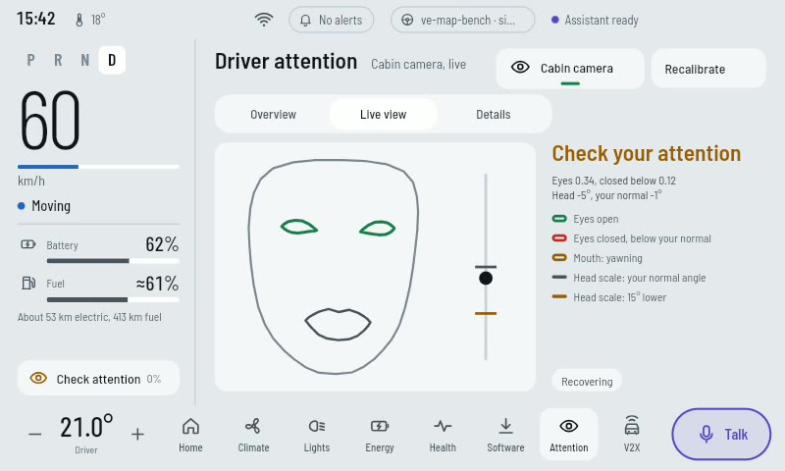
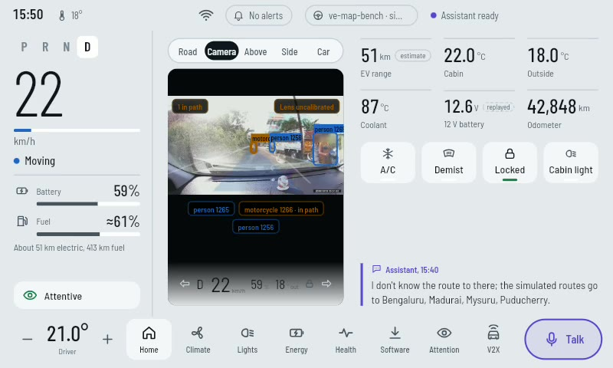




Privacy by construction, not by redaction
The driver's face, drawn from numbers
The dash cam, blurred before it leaves the computer
Driver camera
Dash cam
Microphone
Location
numbers out, never a frame
blurred, or no picture at all
only while Talk is held
only with consent
Notes:
Nothing is redacted afterwards because the sensitive data never leaves its box. The driver monitor emits numbers, and the screen draws the face as lines. The road picture is blurred on the Jetson, and if blurring is unavailable no picture is sent at all.

Slide 11





What is new
Allow(q), executed
MHS hardware layer
Refusal by name
8 conjuncts, each made to deny on every run
hardware as checked data; cannot mint authority
safety-critical names exist only to be refused
8/8
481 tests
built
Derived-state sensing
Privacy-first road view
Two paths
the driver camera emits numbers, never frames
no blur means no picture
alerts need no model; the agent never clears one
in the car
in the car
built
Model as last resort
Car audio arbiter
Gated AI-SDLC
~130 ms classifier (warm); 19.7 s → 0.86 s
a critical alert pre-empts an answer; repeats are rate-limited
hooks stop the coding agent breaking an invariant
12/12
shown in car
212 commits
Notes:
Nine ideas a reviewer can check. Each card carries its evidence: a test count, an eval, or the fact that it was shown in the car.

Slide 12
Seventeen inventions, each with its real status
Built
14 derived-state-only sensing
Partial
1 authority-routed inference · 4 offline manifest · 6 evidence receipt · 8 A2UI in the car · 11 motion-state legality · 12 a generated tool is a proposal · 13 the plan is not the authority · 15 grammar-bounded calls · 17 presence = push-to-talk
Proof of concept
2 the Speak predicate
Design only
3 refusal counterfactual · 5 joules per answer · 7 negative-answer accountability · 9 shadow verdict gate · 10 conflict arbitration · 16 signed model slots
Notes:
The architecture argues for seventeen inventions. This build proves one fully, nine partly, one in a proof of concept, and six remain design. Saying so is part of the method.

Slide 13
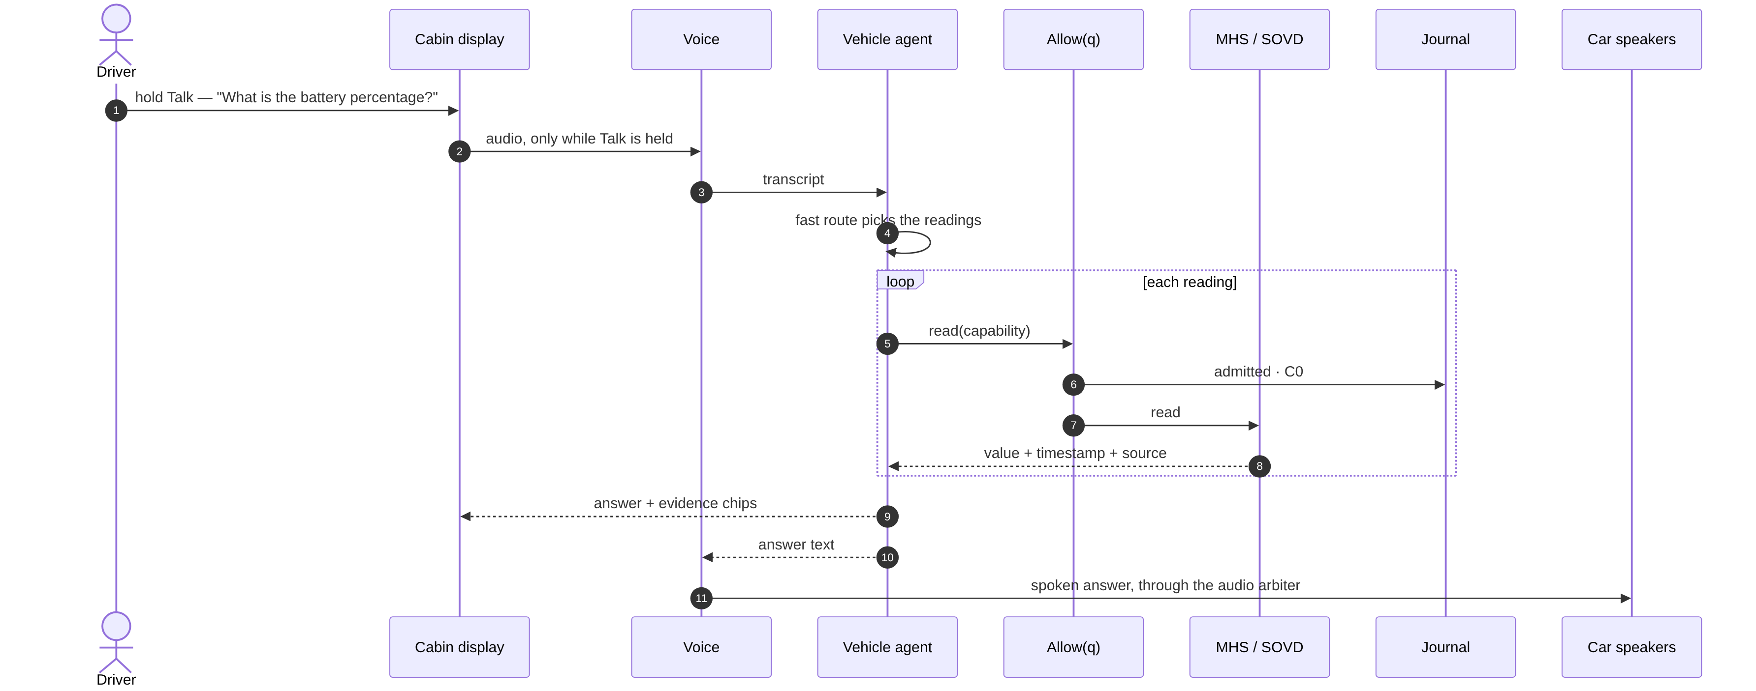
Ask the car: every reading passes the gate
The fast route picks the readings. Each passes Allow(q) and is journalled. The answer shows its evidence and is spoken through the car's speakers.
Notes:
A push-to-talk question. Audio is captured only while Talk is held. The fast route picks the readings, every reading passes the gate, and the answer comes back with its evidence, spoken through the car's own audio.

Slide 14
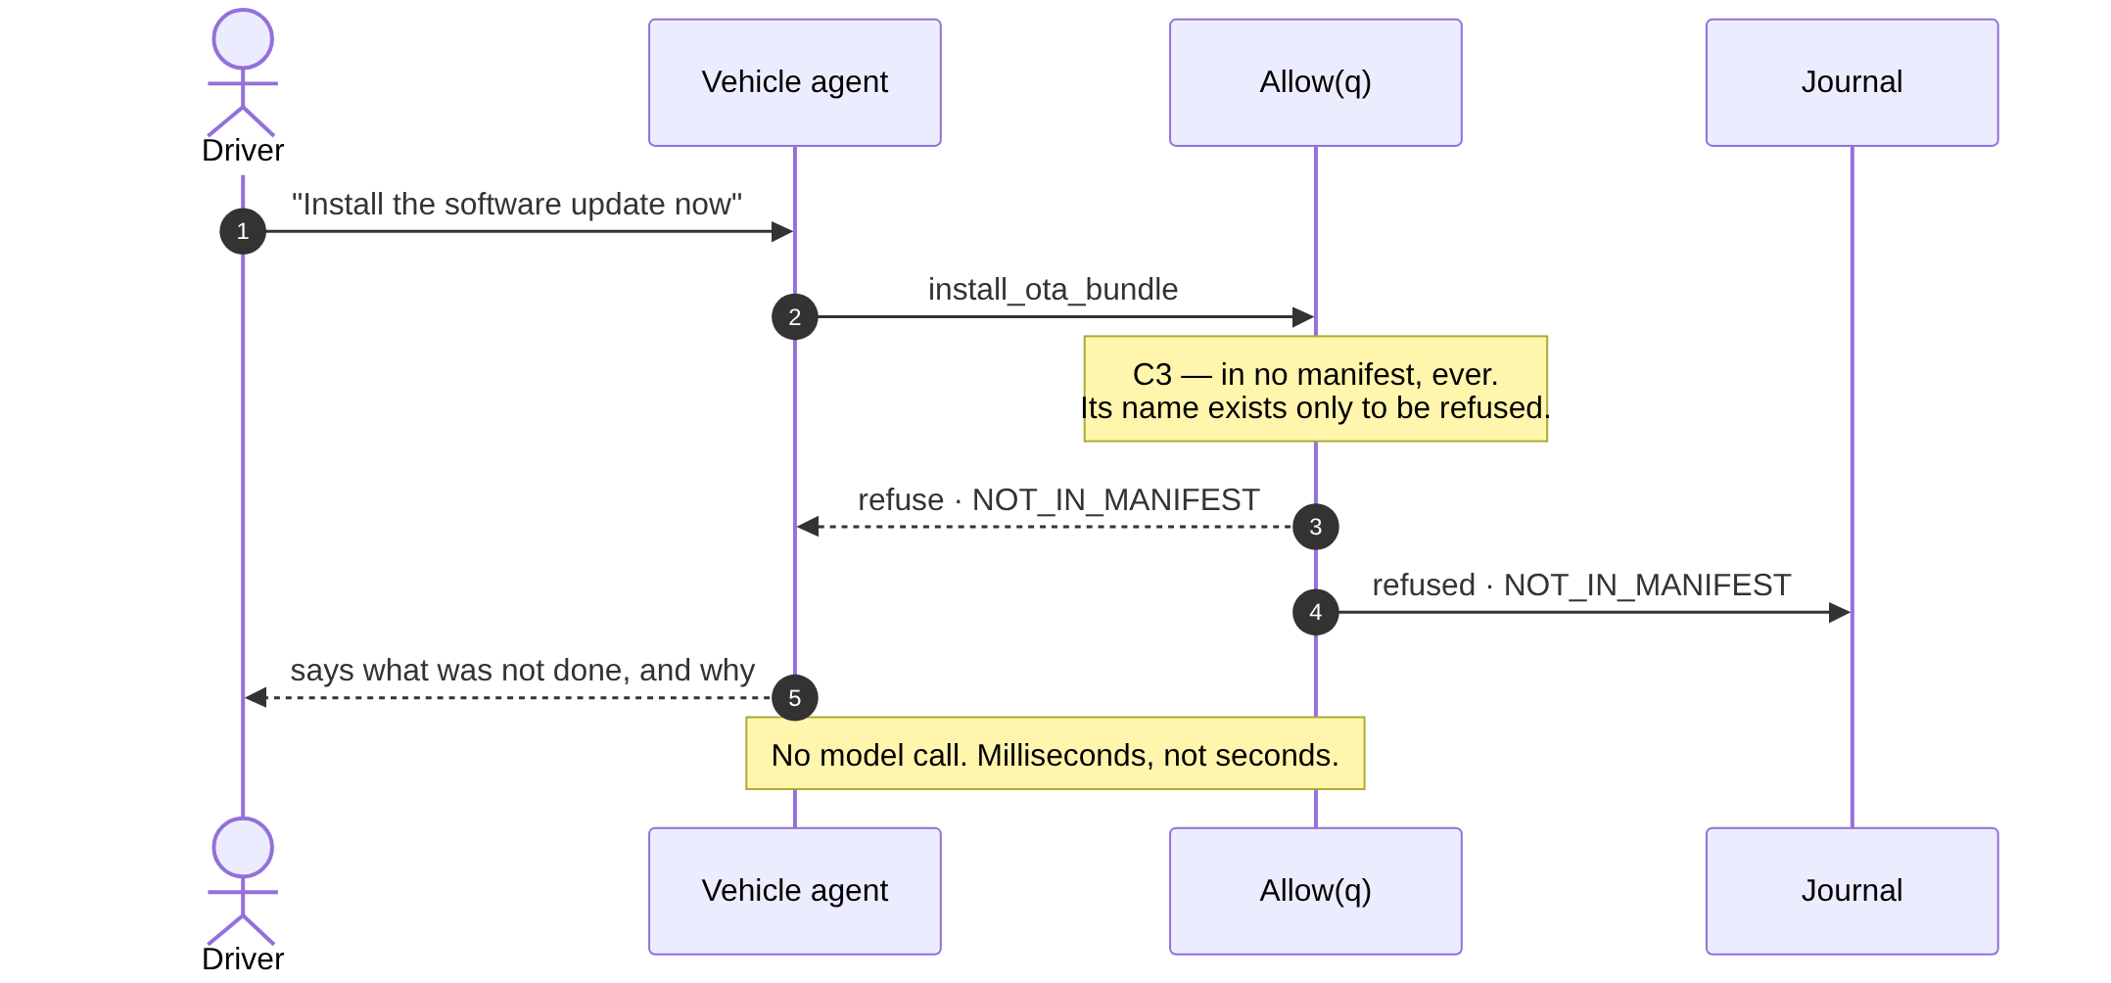
Refusals are fast, named and journalled
Stale data is refused too
A reading older than its bound is refused STALE_EVIDENCE.
The agent says: "I could not read the coolant temperature — the reading is too old."
Commands are refused before any model runs: milliseconds, not seconds.
An old number is never shown as current.
Notes:
Refusals are first-class. A C3 request is refused by name, before any model runs. A stale reading is refused rather than shown as current. Both are journal lines.

Slide 15
The model is the last resort
No model
19.7 → 0.86 s
1
commands and C3 refused; template answers
median answer time, before and after the fast route
Small classifier, ~130 ms warm
2
picks the one reading a question needs
12 / 12
Larger model
eval questions answered with the workstation model off (19 Oct)
3
plans in a strict schema; every step re-enters the gate
0.4 s
If the larger model is unreachable: a model-free answer, or an honest "I can't answer that now".
median live answer, the same day
Notes:
The model is the last resort. Most questions need one reading, which a small classifier picks in about 130 milliseconds and a template answers. That took the median answer from almost twenty seconds to under one, and every answer still works when the big model is unreachable.

Slide 16
A test that has never failed proves nothing
Requirement
Test names its reason code
Must fail for the stated reason
Minimal code
Pass
Reachability
Mutation gate
Commit
Tiers — a tier that cannot run skips with its reason
Reachability
T1
pure logic, any machine
Each conjunct is made to deny alone, with its own code and no other. 8/8.
T2
compute host
Mutation gates
T3
CAN + ECU simulator
Break a rule on purpose: cabin, registry, audio, dev gates. A test must go red.
T4
governed: guard + journal
T5
two or more nodes
Traceability
shadow, recorded corpus
Intent → requirement → plan → test → reason code. A gap breaks the build.
T6
Notes:
Every behaviour starts as a test that fails for the stated reason. Then reachability proves each conjunct can deny, mutation gates prove each rule is really tested, and traceability links every requirement to its test.

Slide 17
Results: 19 October 2026
18 / 18
8 / 8
1,950
I1–I7
check-all sections pass, 0 fail
conjuncts deny with their own code
journal decisions, chain intact
every invariant held
Notes:
The offline check-all passed every one of its eighteen sections on the nineteenth of October. Every conjunct denied, the journal chain was intact over 1,950 decisions, and the invariants held.

Slide 18
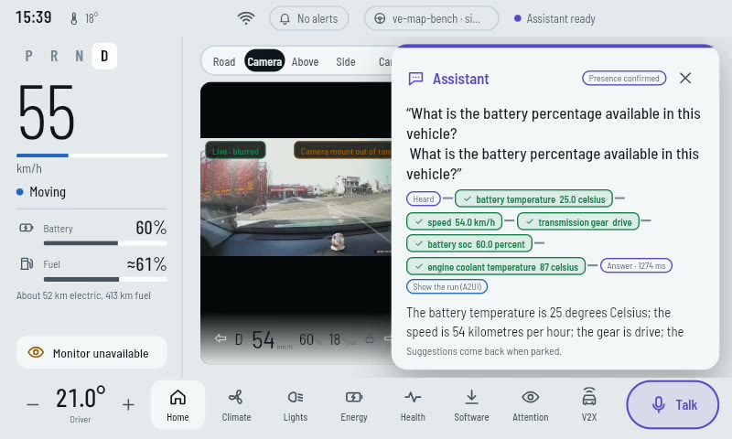
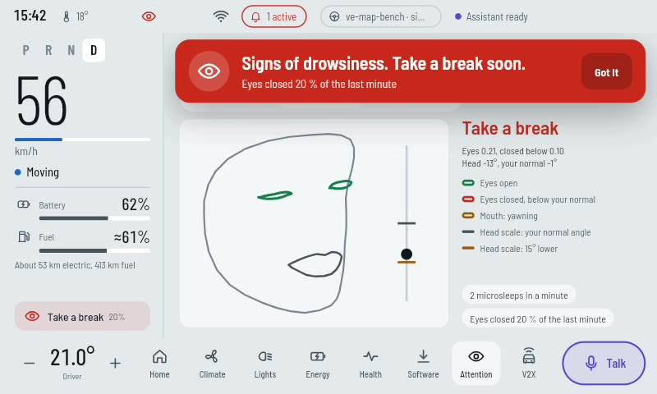
In the car: what was real, what was simulated
Spoken question, answer with its evidence
"Signs of drowsiness. Take a break soon."
Blurred dash cam, detections, in path
Real
Simulated
Dash cam and road view · driver webcam and monitoring · microphone, speech, spoken answers · Bluetooth to the car's speakers · both boards on their own battery
The vehicle signals the agent read: speed, battery %, coolant, fault codes, from a CAN simulator. The screen marks them estimate / replayed. The car's OBD-II port is the next stage.
Notes:
On the nineteenth of October the rig went into a car. Cameras, microphone, speech and the car's own speakers were real. The vehicle signals came from a simulator, and the screen says so. Reading the car's own bus is the next stage.

Slide 19
What the drive measured
 | Drive 1 | Drive 2 | Drive 3 · camera straightened
Duration | 5 min 41 s | 29 min 5 s | 6 min 53 s
Pictures processed | 3,253 | 17,386 | 4,116
Rate (blur on) | 9.8 fps | 9.98 fps | 9.97 fps
Camera mount | found at 42 s, lost at 64 s | out of range: "straighten the camera" | found after 74 s
Lane probability, left near | 0.01 | 0.14 | 0.35
Lead car seen | 0 % | 1 % | 13 %
Boxes flagged in path | 0 | 601 | 149
It refused to calibrate a crooked camera and said why. Once the camera was straightened, the mount was found in 74 s.
Not done on the day: OBD-II in the car, lens calibration, a GNSS fix. Each is said, not hidden.
Notes:
The road view held about ten frames a second for forty-two minutes with blurring on. On the long drive it refused to calibrate a crooked camera and told us to straighten it; once straightened, it found the mount in seventy-four seconds. The lens was never calibrated, and the roads had no lane markings, so lane confidence stayed low.

Slide 20
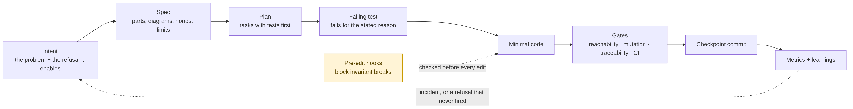
Built with an AI coding agent, inside gates
212
54
424
7 weeks
commits, 204 co-authored with the AI agent
intents · 47 specs · 10 plans
requirements traced to a test and a code (19 Oct)
3 Sep → 19 Oct 2026
Pre-edit hooks stop the coding agent before it writes:
a gate importing CAN or MCP · a camera frame escaping · a C3 capability · a flash path · an unsigned model slot · a push to main · a cloud SDK, or actuation outside an admitted path · protocol IDs in a capability. Each gate is probed both ways in CI.
Notes:
The coding agent worked inside gates it could not edit around. Memory lived in files: status, plan, learnings. Every incident opened an intent. The human chose, approved, wired, drove and pushed; the agent wrote tests first and reported failures with their output.

Slide 21
Honest limits, and what comes next
Limits
Next
A simulated vehicle bus; OBD-II not yet in a car
Live permit is C0 (read-only); C2 proven in a proof of concept
Journal tamper-evident, not anchored or signed
Driver monitoring not validated on drowsy drivers
One car, one session, one operator
No ISO 26262 or ISO/SAE 21434 claim
OBD-II in the car: listen-only, then reads
Calibrate the lens; drive a marked road
C2 on the live path with a real writ issuer
Anchor the journal; sign the receipts
Wire the verdict-sequence shadow gate
Release MHS on its own, with its paper
Overclaiming is worth less than not claiming. Every limit above is also written in the documents.
Notes:
Overclaiming is worth less than not claiming. These are the limits, and the next steps that close them, starting with connecting to the car's own bus.

Slide 22
Thank you
Documents, diagrams, slides and film: the ve-ap-capstone repository on GitHub
CC BY-NC-ND 4.0 · source code private
Notes:
Thank you. Everything in this talk, including the film and every diagram, is in the public repository.

