Slide 1
FOUNDATION OF ARTIFICIAL INTELLIGENCE
AI RESCUE
MISSION
Find the Best Path Using Heuristic Search
A playable Human Rover vs. Autonomous A* Cyber-Drone experience with a step-by-step search laboratory.
Mukhesh Kumaar R S
Yuvaraja A
Rajalakshmi Engineering College
Department of Computer Science and Engineering
TEAM MEMBERS
240701340
240701809
AI RESCUE MISSION / CSE / 2026

Slide 2
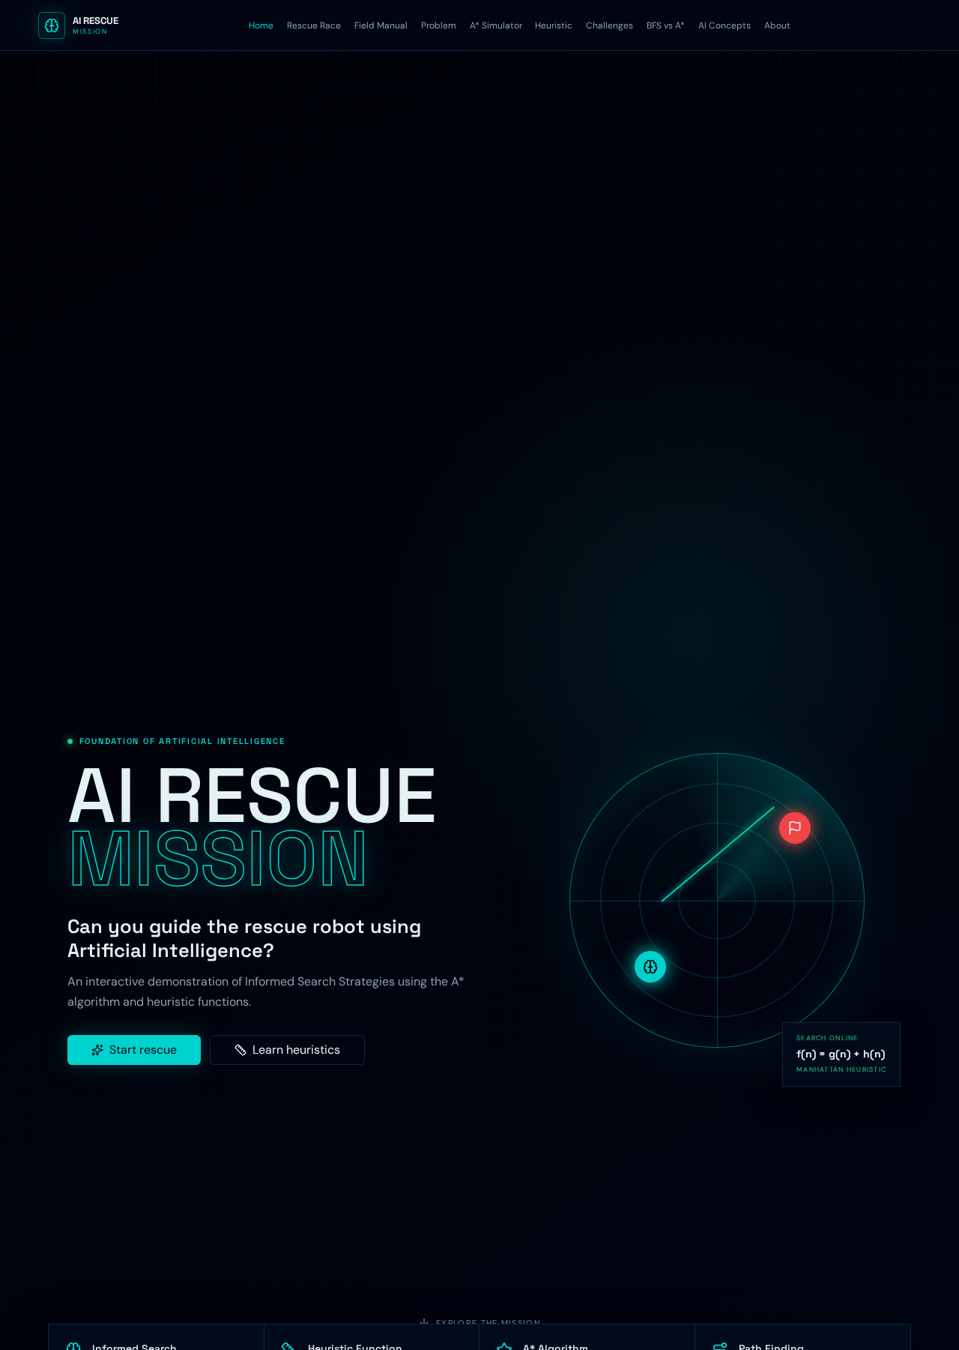
PROJECT OVERVIEW
02
Abstract
AI Rescue Mission transforms heuristic search into an observable, playable rescue problem.
A responsive educational web app for learning informed and uninformed search on disaster grids.
The player drives a Human Rescue Rover while an Autonomous Cyber-Drone follows a path computed by authentic A* search.
A laboratory visualizes open, explored, and final-path states with live g(n), h(n), and f(n) values.
BFS runs on the same map as a baseline, enabling a fair comparison of path optimality and exploration effort.
All logic executes locally in TypeScript: no database, external AI API, machine learning, or fabricated results.
KEY IDEA
Turn search decisions into visible evidence.
AI RESCUE MISSION / CSE / 2026

Slide 3
WHY THIS PROJECT
03
Problem Statement & Objectives
Shortest-path algorithms are often taught as equations and pseudocode. Students struggle to see how each search decision changes the route.
?
Learning gap
→
Proposed solution
✓
Expected value
Static diagrams hide the open list, explored states, parent links, and tie-breaking decisions that shape a search.
An interactive rescue game plus an event-by-event simulator using one shared, real search engine.
Learners connect path cost, heuristic estimates, algorithm behavior, and game performance through direct interaction.
PROJECT OBJECTIVES
Implement correct A* and BFS on four-direction unit-cost grids.
Visualize every search event and calculated score.
Compare algorithms on identical obstacle maps.
Make AI concepts engaging through race mechanics and responsive controls.
f(n) = g(n) + h(n)
g(n) actual cost already travelled
h(n) Manhattan estimate to the goal
f(n) total priority used by A*
AI RESCUE MISSION / CSE / 2026

Slide 4
FOUNDATIONS INFORMING THE DESIGN / 1 OF 2
04
Literature Survey
S.No. | Author / Source | Study / Topic | Key Findings
1 | Hart, Nilsson & Raphael (1968) | A Formal Basis for the Heuristic Determination of Minimum Cost Paths | Introduced the A* search algorithm for finding minimum-cost paths using heuristic information.
2 | Russell & Norvig (2021) | Artificial Intelligence: A Modern Approach | Explains informed search, heuristic functions, A* search, and optimal solution finding.
3 | Amit Patel (2014) | Introduction to the A* Algorithm | Demonstrates A*, Breadth-First Search, and heuristic-based pathfinding using interactive visualizations.
AI RESCUE MISSION / CSE / 2026

Slide 5
FOUNDATIONS INFORMING THE DESIGN / 2 OF 2
05
Literature Survey & Research Gap
S.No. | Author / Source | Study / Topic | Key Findings
4 | Amit Patel (2022) | Implementation of A* | Explains the practical implementation of A*, path costs, priority queues, and heuristic calculations.
5 | Amit Patel (2014) | Flow Field Pathfinding for Tower Defense | Explores pathfinding approaches and explains how search algorithms guide movement toward a destination.
RESEARCH GAP
Understanding heuristic search can be difficult through theory alone. This project addresses the learning challenge by providing an interactive grid-based rescue simulation that visualizes A* search, Manhattan distance, explored nodes, and the final path.
AI RESCUE MISSION / CSE / 2026

Slide 6
CLIENT-SIDE DATA FLOW
06
System Architecture
01
02
03
04
05
USER INPUT
REACT INTERFACE
SEARCH ENGINE
STATE & TRACE
VISUAL OUTPUT
Keyboard · WASD
Touch D-pad · Grid editor
Race · Simulator
Field Manual
A* + Manhattan
BFS baseline
Path · Scores · Events
Timer · Battery
Grid animation
Analysis · Comparison
IMPLEMENTATION BOUNDARY
Browser-only execution
React 19 · TypeScript · TanStack Start · Tailwind CSS · Web Audio API
No backend · No database · No external AI API
AI RESCUE MISSION / CSE / 2026

Slide 7
AUTHENTIC SEARCH UNDER THE HOOD
07
Algorithms: A* and BFS
A* — informed search
BFS — uninformed baseline
f(n) = g(n) + h(n)
FIFO queue · h(n) = 0
Open list ordered by lowest f; ties use lower h, then insertion order.
Manhattan h(n) = |x − goalX| + |y − goalY|.
Parent links reconstruct the final path.
Closed set prevents repeated expansion.
With unit costs and admissible Manhattan distance, the returned route is optimal.
Expands states in increasing depth order.
Uses the same four directions, obstacles, start, and goal.
Also finds a shortest path on unit-cost grids.
Typically explores more states because it has no goal estimate.
Provides a fair benchmark for evaluating heuristic guidance.
Both algorithms generate real event streams: step, node, g, h, f, parent, status, and open-list size.
AI RESCUE MISSION / CSE / 2026

Slide 8
WHAT THE SYSTEM CONTAINS
08
Major Modules
01 Rescue Race
02 Search Engine
Campaign sectors, custom maps, countdown, keyboard/touch controls, battery, timer, and AI drone.
Reusable A*, BFS, Manhattan, Euclidean, Chebyshev, parent tracking, and event tracing.
03 A* Simulator
04 Comparison Lab
Editable 10×10–15×15 grid, step/run controls, animation speeds, inspector, and trace table.
Runs BFS and A* on the exact same map and reports cost, steps, and explored nodes.
05 Challenges
06 Field Manual
Five deterministic educational maps plus five progressive race sectors.
Problem formulation, heuristic laboratory, AI concepts, pseudocode, applications, and outcomes.
AI RESCUE MISSION / CSE / 2026

Slide 9
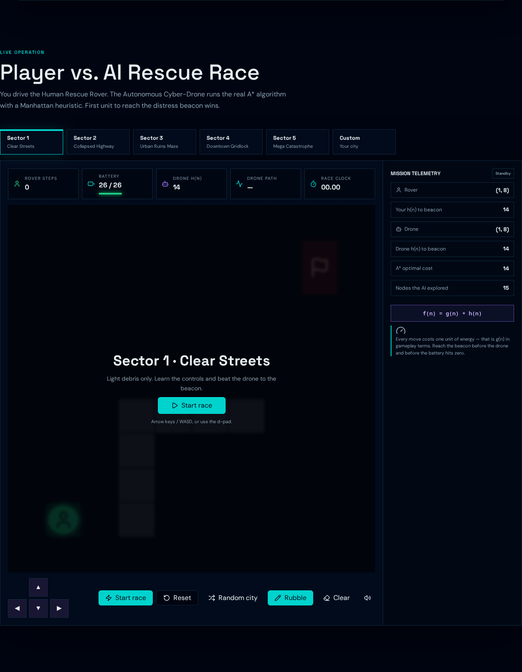
PLAYABLE EXPERIENCE
09
Output: Player vs. AI Rescue Race
GAME FEATURES
Five campaign sectors with progressive layouts.
Human Rover: Arrow keys, WASD, or touch D-pad.
Cyber-Drone follows the real A* optimal path.
Ready–Set–GO countdown, battery cost, and stopwatch.
Custom obstacle editing and solvable Random City maps.
Post-race efficiency analysis and AI radar reveal.
Every rover move costs one unit of g(n).
AI RESCUE MISSION / CSE / 2026

Slide 10
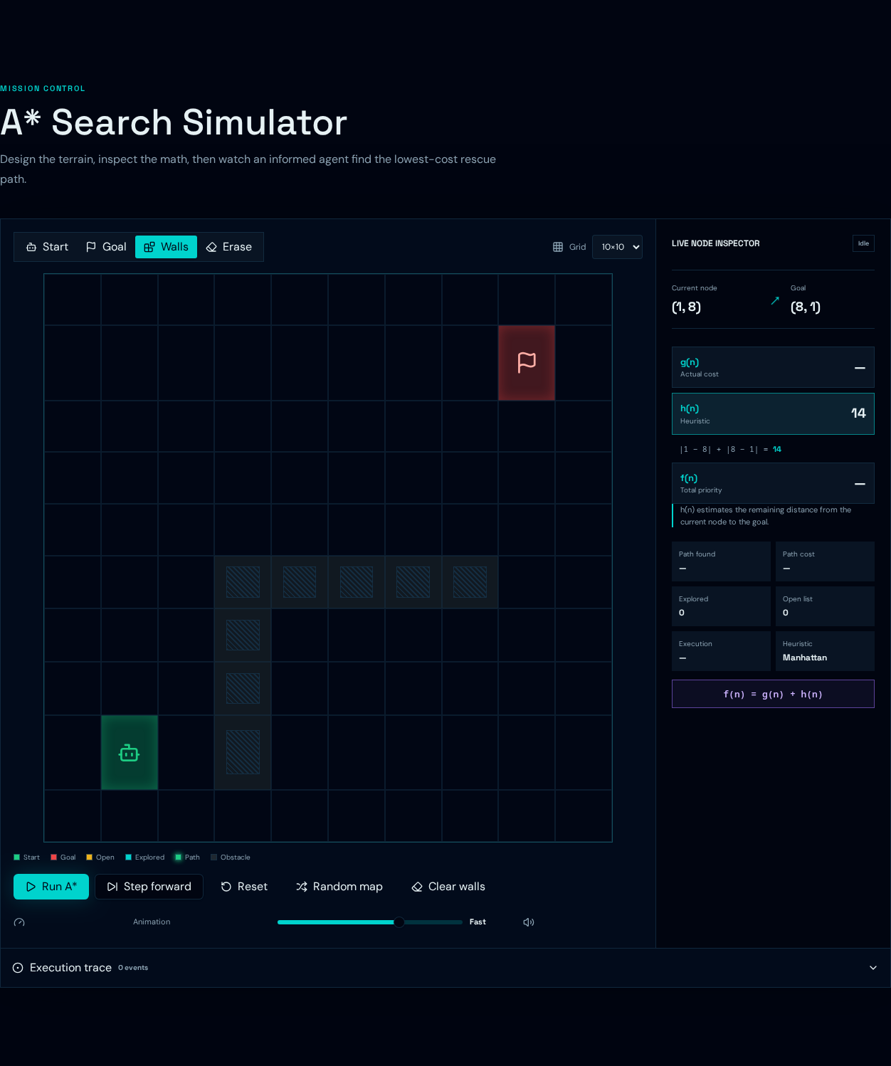
INSPECT EVERY DECISION
10
Output: A* Search Simulator
Editable grid
Place start, goal, walls, or erase cells; select grid sizes from 10×10 to 15×15.
Live analyzer
Hover a node to inspect coordinates and its real g(n), h(n), and f(n) values.
Execution trace
Replay or step through open-list additions, explored nodes, parents, and final path.
Manhattan: |Δx| + |Δy|
AI RESCUE MISSION / CSE / 2026

Slide 11
MEASURED ON FIVE PREDEFINED CHALLENGES
11
Results & Performance
15
73.85%
Easy
88
average reduction in explored nodes
36
Blocked
82
23
Easy Rescue
Maze
113
Same optimal cost: 14 moves
A*: 15 explored · BFS: 88 explored
44
Multiple
121
Correctness signal
29
Across all five measured maps, A* and BFS returned equal shortest-path costs.
Expert
162
A* explored
BFS explored
Measured costs: 14 · 15 · 22 · 17 · 28
AI RESCUE MISSION / CSE / 2026

Slide 12
WHAT STUDENTS CAN DEMONSTRATE
12
Learning Outcomes
✓
FORMULATE
✓
CALCULATE
✓
TRACE
Model a rescue task using state, initial state, goal, actions, cost, and constraints.
Compute Manhattan, Euclidean, and Chebyshev estimates for selected coordinates.
Explain how open and closed sets evolve during A* search.
✓
COMPARE
✓
EVALUATE
✓
APPLY
Contrast uninformed BFS expansion with goal-directed A* expansion.
Use explored-node counts and path cost to judge search efficiency.
Relate heuristic search to robotics, navigation, games, logistics, and route planning.
The central takeaway: an admissible heuristic changes the order of exploration—not the correctness of the optimal answer.
AI RESCUE MISSION / CSE / 2026

Slide 13
SOURCE BIBLIOGRAPHY / 1 OF 2
13
References
[1]
Hart, P. E., Nilsson, N. J., & Raphael, B. (1968). A Formal Basis for the Heuristic Determination of Minimum Cost Paths. IEEE Transactions on Systems Science and Cybernetics, 4(2), 100–107.
[2]
Russell, S. J., & Norvig, P. (2021). Artificial Intelligence: A Modern Approach (4th ed.). Pearson.
[3]
Patel, A. (2014). Introduction to the A* Algorithm. Red Blob Games.
https://www.redblobgames.com/pathfinding/a-star/introduction.html
AI RESCUE MISSION / CSE / 2026

Slide 14
SOURCE BIBLIOGRAPHY / 2 OF 2
14
References & Implementation
[4]
Patel, A. Implementation of A*. Red Blob Games.
https://www.redblobgames.com/pathfinding/a-star/implementation.html
[5]
Patel, A. Flow Field Pathfinding for Tower Defense. Red Blob Games.
https://www.redblobgames.com/pathfinding/tower-defense/
PROJECT IMPLEMENTATION
JavaScript-based A* Search Algorithm using Manhattan Distance as the heuristic function.
AI RESCUE MISSION / CSE / 2026

Slide 15
PROJECT SUMMARY
15
Conclusion & Future Scope
AI Rescue Mission makes search intelligence visible.
FUTURE SCOPE
Authentic A* and BFS share the same grid rules and produce traceable results.
The race turns path cost and heuristic guidance into meaningful gameplay.
The simulator connects formal equations to every generated and explored state.
The browser-only design is portable, private, and suitable for classroom demonstration.
Weighted terrain and diagonal movement
Dynamic obstacle re-planning
Additional heuristics and Dijkstra mode
Accessible difficulty presets
Optional export of trace data for lab records
THANK YOU
Questions & demonstration
Mukhesh Kumaar R S · Yuvaraja A
AI RESCUE MISSION / CSE / 2026

