Slide 1
by Yuvarajan S
STOCK MARKET INVESTMENT

Slide 2
Abstract
This Stock Market Investment Platforms is an intuitive web application designed to simplify investment portfolio management. The platform offers a suite of comprehensive tools that cater to both novice and experienced investors. Key features include real-time market data, advanced portfolio tracking, in-depth market analysis, and a wealth of educational resources.
By integrating these tools into a single user-friendly interface, the application enhances the investment experience, making it more accessible and efficient.
Users can monitor market trends, analyze their investment performance, and gain valuable insights, all in one place. This project seeks to demystify the complexities of stock market investment, empowering users to make informed financial decisions.

Slide 3
System Analysis
Existing System
In the current stock market applications, there are several platforms provides the users basic functionalities such as stock tracking, news fees and portfolio management. However, many existing systems have limitations also.
While offering basic stock market tracking and portfolio management, fall short in areas like personalization, real-time updates, educational support, security and real-time alerts.

Slide 4
Proposed System
It’s offers significant improvements by addressing theses shortcomings with features such as real-time integration, advanced customization, enhanced security, and beginner friendly educational resources, positioning it as a superior alternative for investors of all levels.
Use reacts component based architecture for responsive design. So that accessible for both novice and experienced investors.

Slide 5
Advantages
Allow users to create and manage their investment portfolios.
Provide real-time stock market data for users to track stock performance
Enhance user engagement with educational resources and news
Provide a seamless and intuitive user interface for portfolio and market management.

Slide 6
System Requirements
Software Requirements
Operating system : Windows/Linux/Mac OS X
Front End : React JS, HTML,CSS and Java script
Backend : Java, Spring Boot
Hardware Requirements
Processor : i3 – 11th gen
RAM : 4GB – minimum
Hard Disk : 40GB
Input Devices : Keyboard, Mouse.

Slide 7
Module 1: User Authentication and Registration
Implement user authentication and registration functionality to enhance security and user experience.
It includes User registration and login mechanisms.

Slide 8
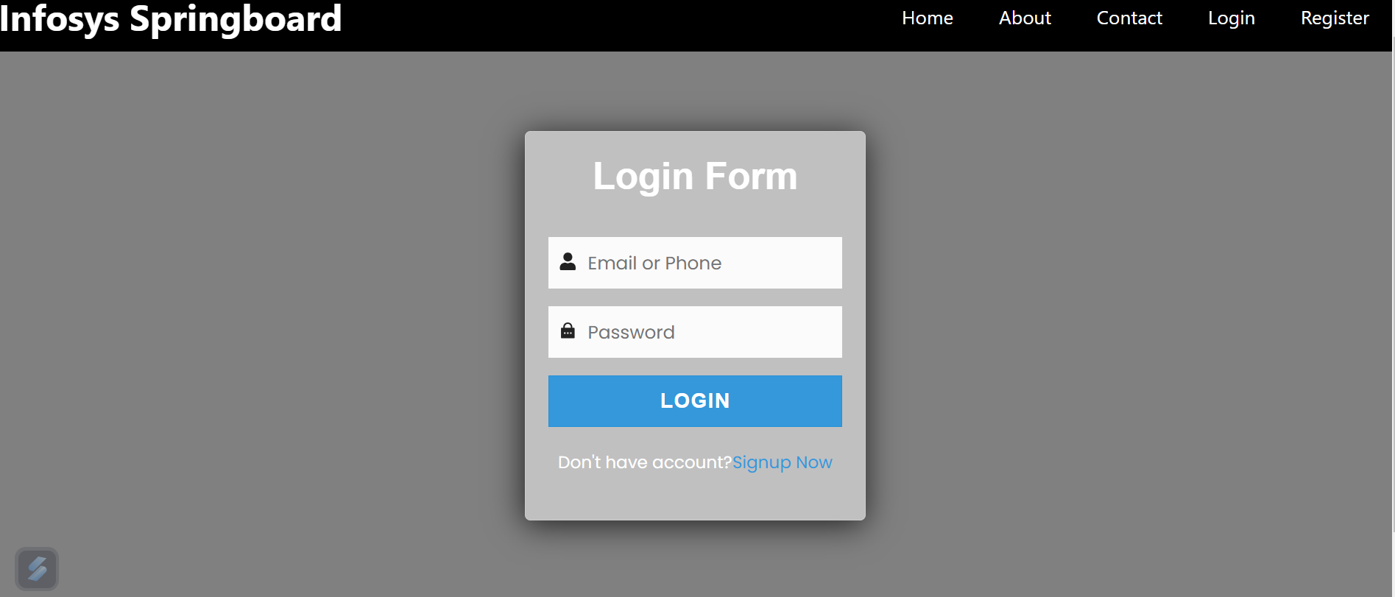
Output Screenshots
Login Page

Slide 9
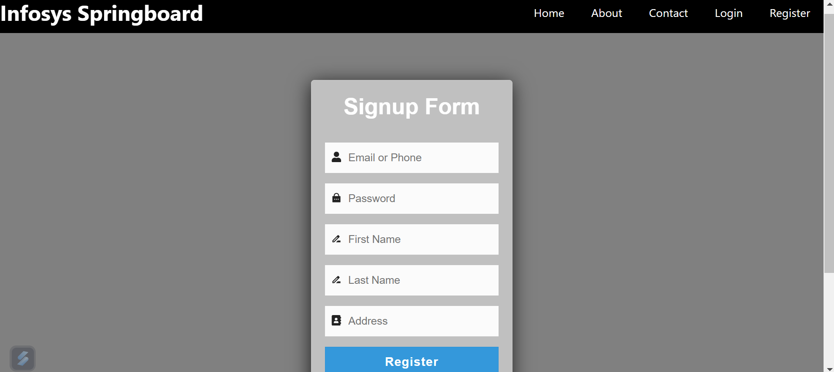
Output Screenshots
Signup Page

Slide 10
Module 2: Portfolio
User-Friendly Interface
Intuitive design for adding, editing, and managing portfolios
Streamlined workflows to enhance user experience
Comprehensive Calculations
Real-time portfolio value and performance tracking
Detailed insights into gains, losses, and investment growth
Robust Backend Integration
Seamless integration with live stock data APIs
Efficient handling of transactions and portfolio adjustments

Slide 11
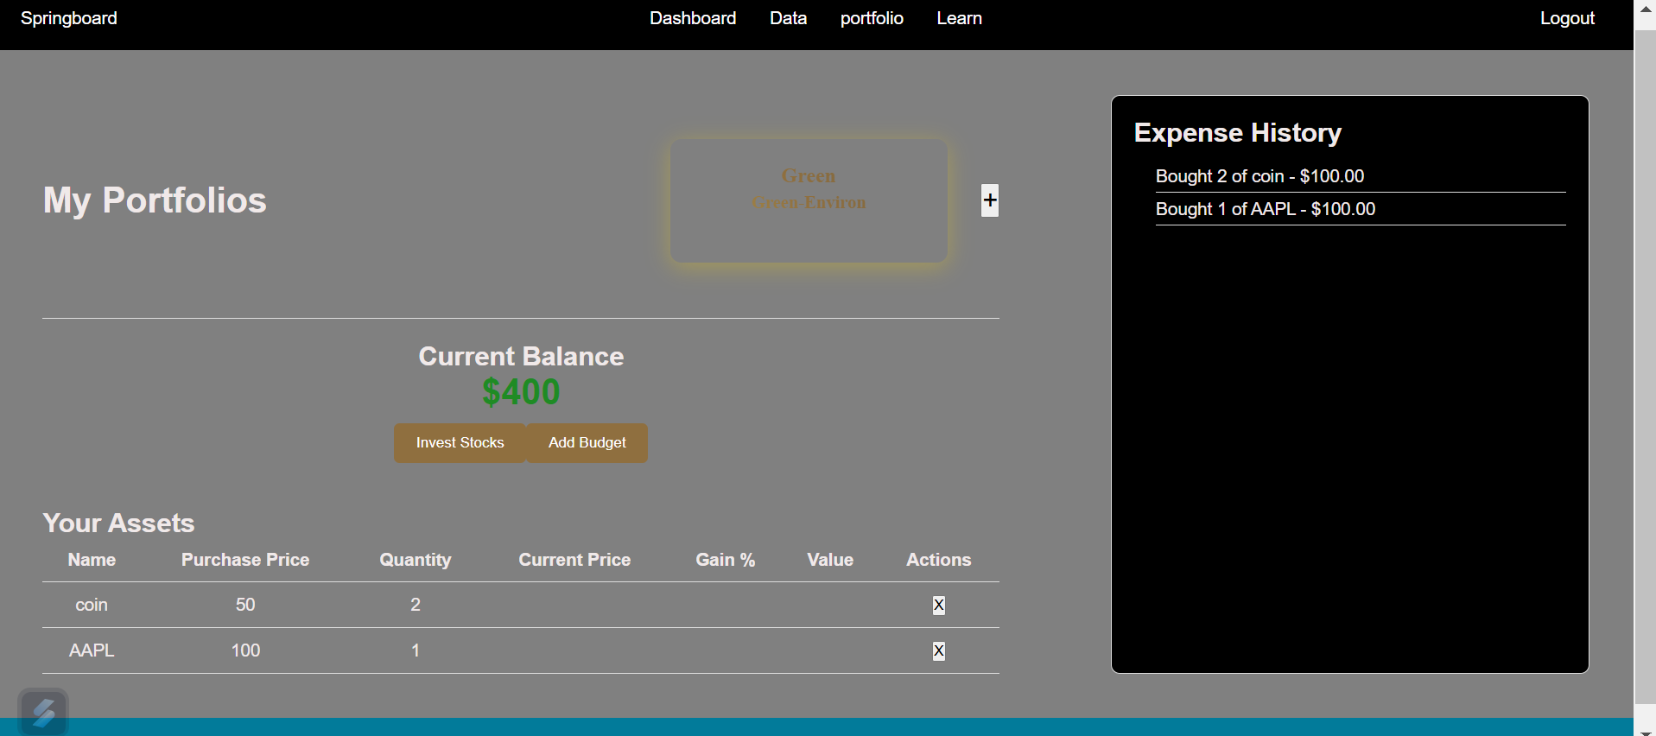
Output Screenshots
Portfolio Page

Slide 12
Module 3: Data and Visualization
Real-Time Data Interface
Seamlessly display live stock market data with an intuitive interface
API Integration
Fetch accurate and up-to-date stock prices and details through robust API integration
Interactive Visualizations
Utilize charts and graphs to vividly showcase market trends and insights

Slide 13
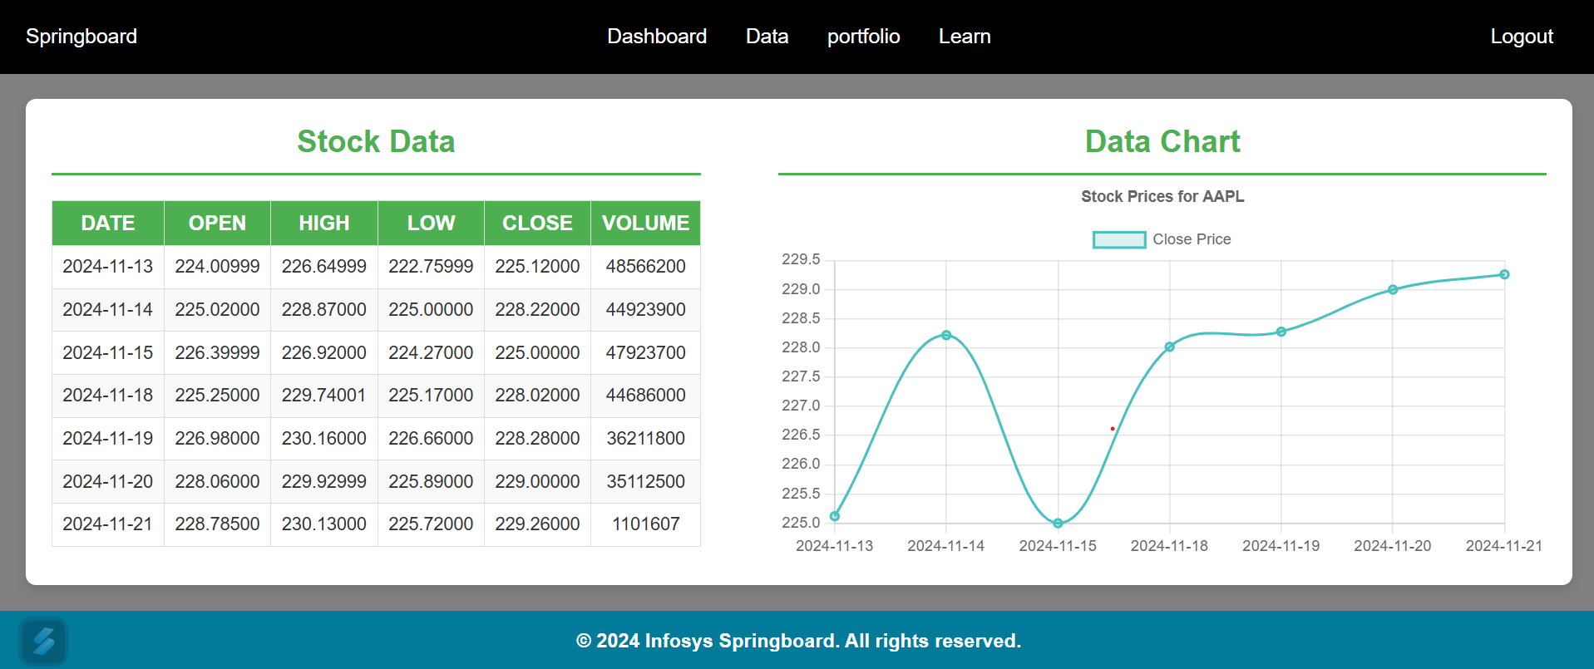
Output Screenshots
Data and Visualization Page

Slide 14
Module 4: Dashboard
Comprehensive Overview
User-friendly interface displaying total portfolio value and daily changes
Performance Insights
Highlight top-performing and underperforming stocks for informed decision-making
Market News Integration
Real-time news updates tailored to user holdings, enhancing market awareness

Slide 15
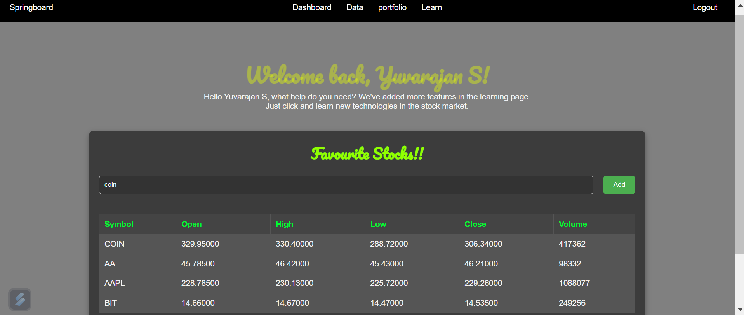
Output Screenshots
Dashboard page

Slide 16
Module 6: Learn Resources
Comprehensive Educational Content
Offer a variety of videos, and tutorials on stock market investing
User Engagement
Encourage continuous learning with engaging and informative resources

Slide 17
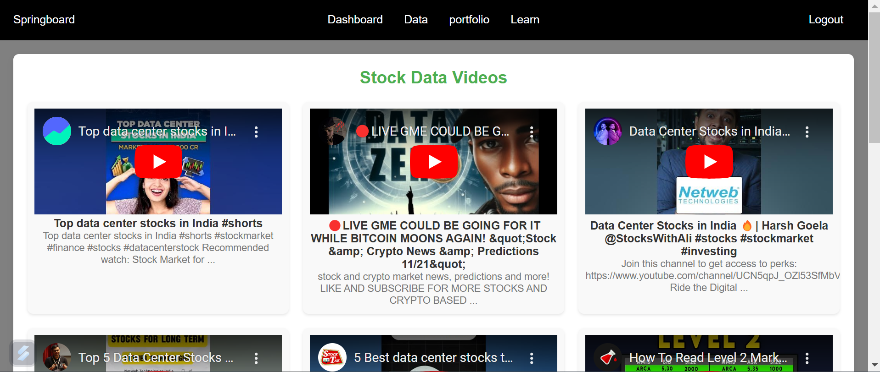
Output Screenshots
Learn page

Slide 18
Conclusion
Our Stock Market Investment Platform is a comprehensive solution designed to empower users with the tools and insights needed to make informed investment decisions. Throughout the development process, we have integrated various modules and features to create a robust, user-friendly, and efficient platform.
By integrating real-time data, comprehensive portfolio management, budget tracking, and educational resources, we aim to support users in achieving their financial goals. The platform’s emphasis on user experience and data security ensures a reliable and enjoyable investment journey.

