Slide 1

Quantum computing
nature isn't classical… and if you want to make a simulation of nature, you'd better make it quantum mechanical.
- Richard feynman

Slide 2


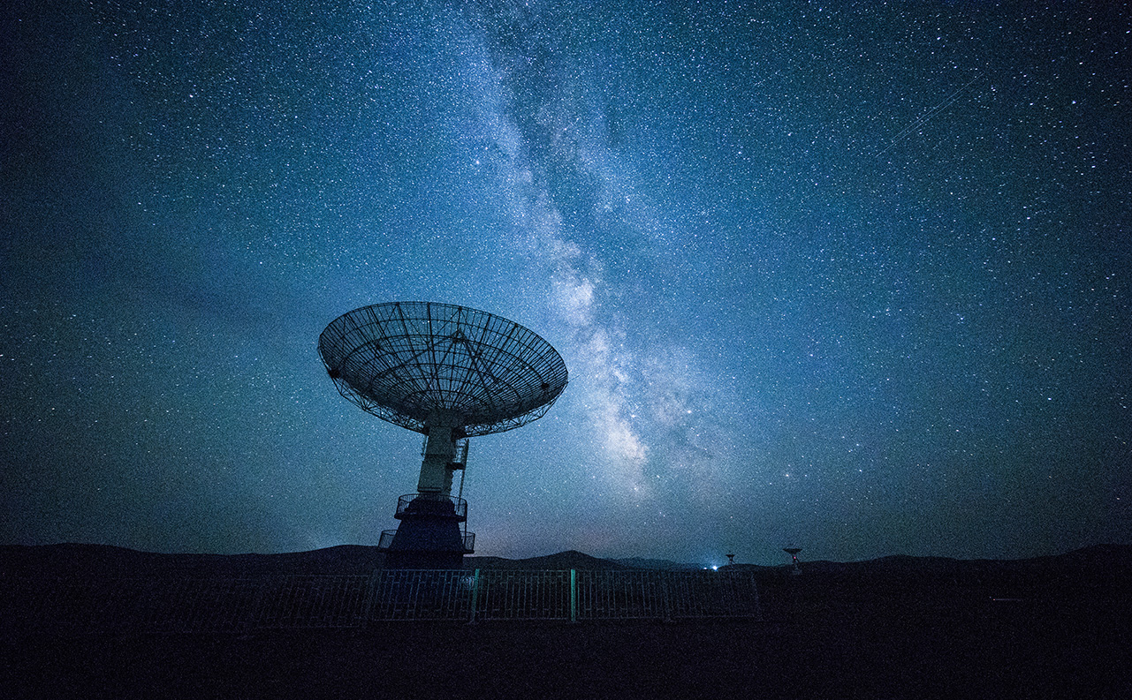
What is Quantum Computing?
Multidisciplinary field – physics, computer science, mathematics
Solve complex problems
Quantum Mechanics – Behaviour of Particles at Microscopic Level
Fundamental Unit – Qubit (similar to bit in traditional digital electronics)
Quantum States: |0> and |1> - vector spaces
Can be multiplied by constants, added together to get more valid quantum states

Slide 3
Why do we need quantum computers?
Complex problems with lots of variables interacting in complicated ways– difficult for classical supercomputers to deal with
Quantum computers – faster, more capable; create multidimensional computational spaces
These computational spaces can’t be created with classical computers, making them less useful
Real world runs on quantum physics, so why not make computers do calculations using quantum states of qubits?

Slide 4
Working of quantum computers
Superconductors
Quantum processors – near absolute zero temperature
Superposition and Entanglement
Quantum information held in a state of superposition
Entanglement – correlates behavior of two systems or two qubits
Interference
Waves of probabilities
Build at peaks, cancel out at interaction of peaks and troughs
Super-cooled super fluids
Low Temperatures → Superconductors
Superconducting qubits – controlled using photons
Amplified peak outcomes are solutions to a computation

Slide 5
Quantum CryptoGraphy
Decoherence: Quantum systems are delicate – smallest changes are detected, and so interception of messages is nearly impossible
Quantum Key Distribution: Entangled quantum states establish secure cryptographic keys
Quantum computing can break widely used public-key cryptography schemes
Modern fibre-optic cables – transmit over short distances

Slide 6
Addressing the hype
Differential engine – 1820s – Charles Babbage
Vacuum tubes – 1904 – lead to computers being built and their capabilities used appropriately
Modern Computers – 2000s – current classical computers and supercomputers
Quantum Computers replacing laptops? – science fiction currently
Google’s Sycamore – computation done in 200 seconds – 1000 times faster than traditional computers
Power scales exponentially with the addition of every qubit
Sycamore – 70 qubits
Minimum – 50 qubits
Commercial Standpoint – 1 million qubits
Neven’s Law – Double Exponential Rate

Slide 7

Thank You KabilesH selvakumar e - 2022506078 yuvaraj k - 2022506079 krishnaa s - 2022506104 abdul Rahman s m - 2022506311

