Slide 1
Rectifiers
Done by
Anushri T – 2022506075
Yuvaraj K – 2022506079
Anishvaran G – 2022506085
Sarveshvaran A – 2022506088
Karthikeyan B - 2022506093

Slide 2
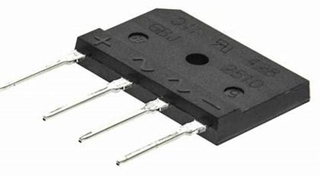
Rectification - Process
Rectifier - Device
AC
DC

Slide 3
Rectifiers
Uncontrolled
Half-Wave
Full-Wave
Controlled
Half-Wave
Full-Wave
Centre-Tap
Bridge
Centre-Tap
Bridge
Classification of Rectifiers

Slide 4
Uncontrolled Rectifier
Output voltage can’t be controlled, it is fixed depending on the AC input.
Diode – conducts as long as it is forward biased
Controlled Rectifier
Output Voltage can be varied and changed.
SCR – Silicon Controlled Rectifier; contains anode, cathode, AND control input called gate
Not in the operator’s control.
Starts forward conduction only when there is a pulse at the gate input.

Slide 5
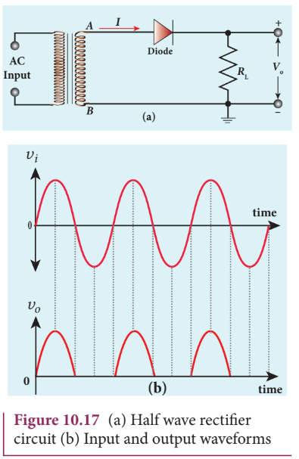
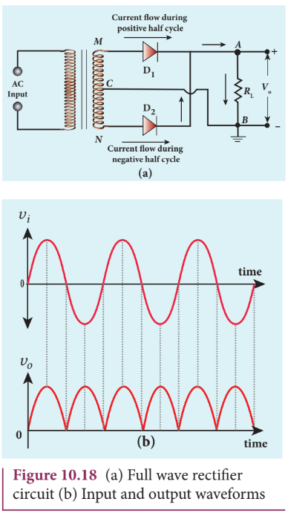
Half and Full Wave Rectifiers
Replace diode with SCR to get controlled output

Slide 6
Dual-Voltage Transformer
2 Inputs and 3 Output Terminals
Terminal connected to centre acts as reference ground
Centre Tap Rectifier

Slide 7
Uses 4 diodes to convert both halves of input AC to DC output
Positive Half-Cycle: D1 and D2 are forward biased
Negative Half-Cycle: D3 and D4 are forward biased
Bridge Rectifier

Slide 8
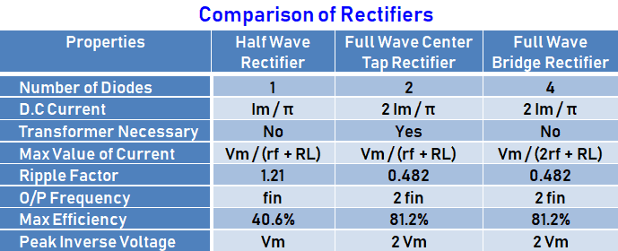

Slide 9
Applications of Rectifiers
Rectification – converting AC to DC
Electric Welding – to provide polarised voltage
Traction, rolling stock, and three phase traction motors for running trains
Half wave rectifiers are used in mosquito repellents, soldering iron, in AM radios as detectors and as signal peak detectors
Modulation, Demodulation, Voltage Multipliers

Slide 10
Thank You!

