Slide 1

TEXT EDITOR USING JAVA
YUVARAJ K
2022506079
NITHISH S
2022506099

Slide 2
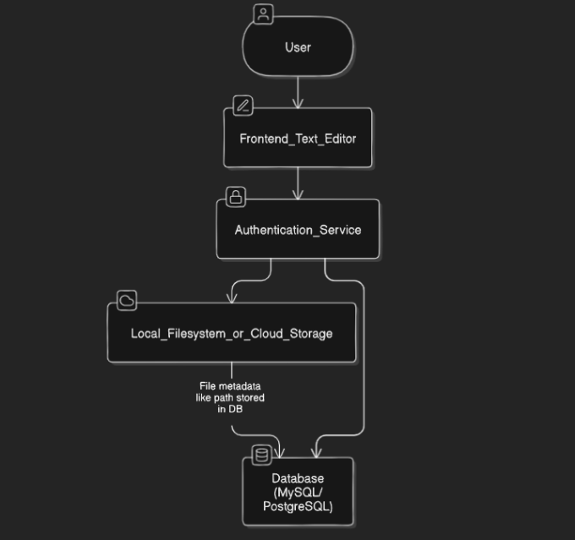
What we need to do
JavaFX and CSS
Access files using a login
Files are stored locally, simulating a cloud storage
JDBC - to store user details

Slide 3
Frontend
JavaFX
Design Ideas
Modern UI toolkit for Java applications.
Supports CSS for exhaustive styling control.
Seamlessly integrates with modern web technologies.
Text editor layout, colours, menu bars, file loading.
User registration, authentication windows and forms.
Options to open a new file, save an existing file, maybe a dark mode.

Slide 4
Backend
JDBC
Storage Ideas
Java Database Connectivity.
API to communicate with databases.
Database used - MySQL.
Simulating a cloud – store files locally.
Add metadata of storage location in database.
Also store user credentials in database.

Slide 5
Project TIMELINE
Brainstorm
Abstract
Frontend research
Backend Research
September
First Week of October
Second Week of October
Second Week of October
Frontend
Backend
Testing
Improvements
Third Week of October
Third Week of October
Fourth Week of October
First Week of November

