Slide 1
Blockchain Wallet
A Blockchain-Based Decentralised Banking Application

Slide 2
Need for Decentralised Banking
In our present banking system,
System users can modify bank details
System users can modify bank balance
Transactions can potentially be intercepted and affected
users have to wait for a long time to deposit and withdraw money

Slide 3
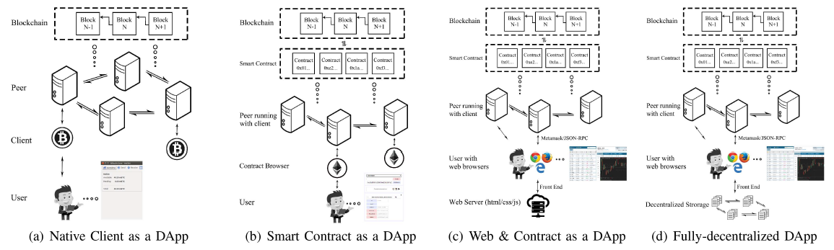
Decentralised Application Architectures

Slide 4
Scope
This report covers the following:
Study and implementation of blockchain technology in the banking domain.
Design of a decentralized architecture for banking operations using smart contracts.
Implementation of basic financial services: deposits, transfers, transaction history.
Use of Ethereum or similar platforms for smart contract development.
Evaluation of security, transaction costs, and user experience in the decentralized environment.
Comparative analysis between centralized and decentralized banking models.

Slide 5
Existing Solutions
Existing solutions for blockchain-based DApps include platforms like
Uniswap
Compound
OpenSea
which offer decentralized finance and NFT trading functionalities.

Slide 6
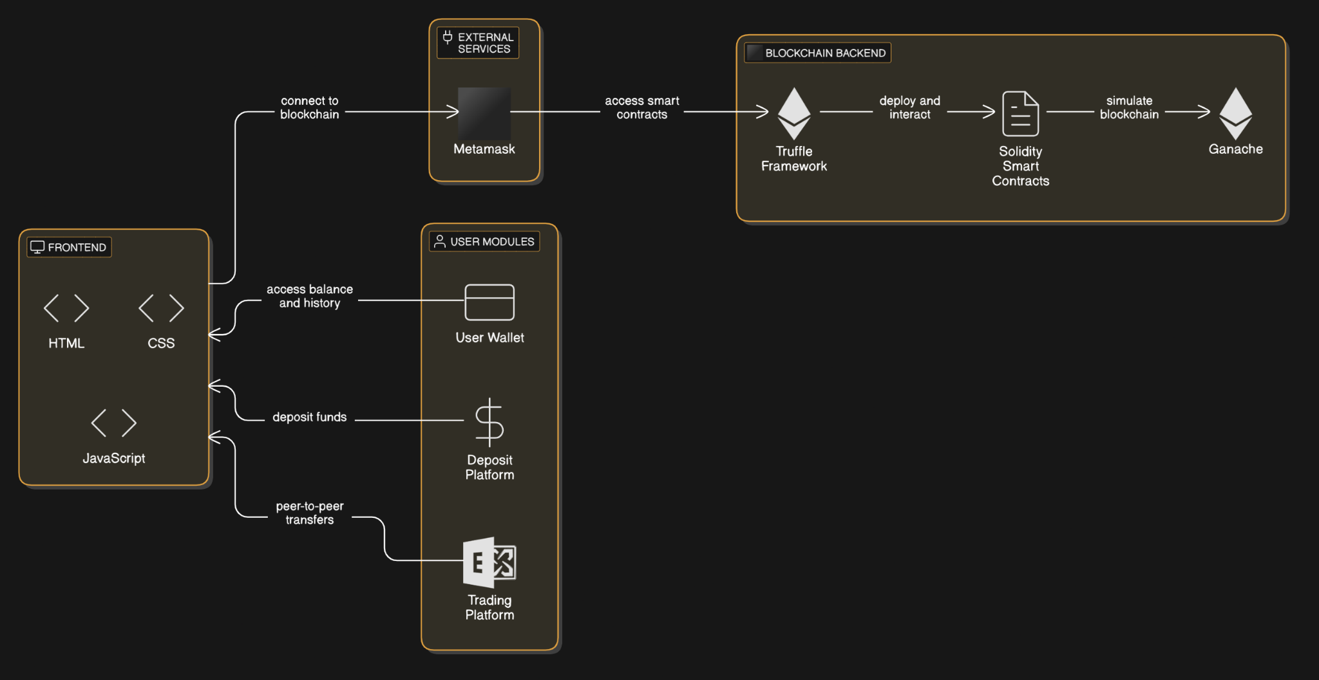
Proposed System

Slide 7
Technology Stack
Frontend | HTML
 | CSS
 | JS
 | jQuery
Backend | Solidity
Dependencies and Frameworks | NPM
 | Truffle
 | Ganache
 | Metamask
 | Mocha

Slide 8
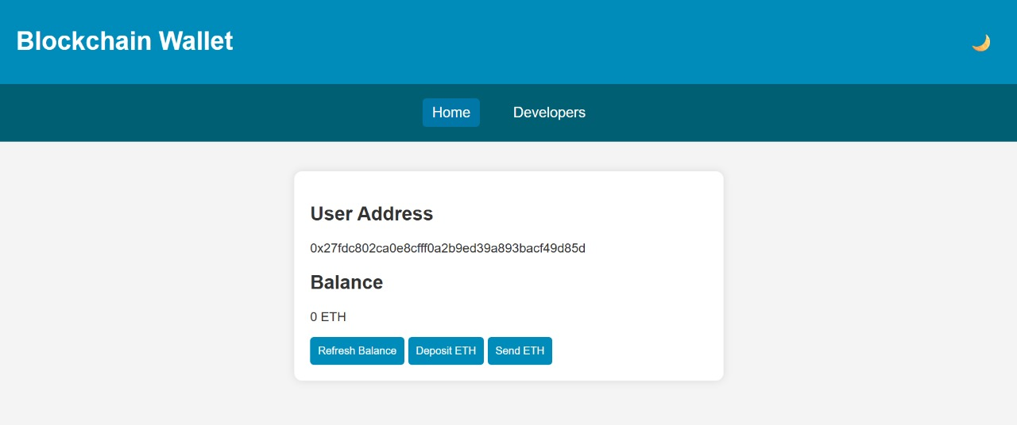
Implementation

Slide 9
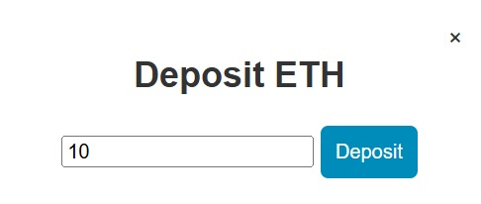
Implementation

Slide 10
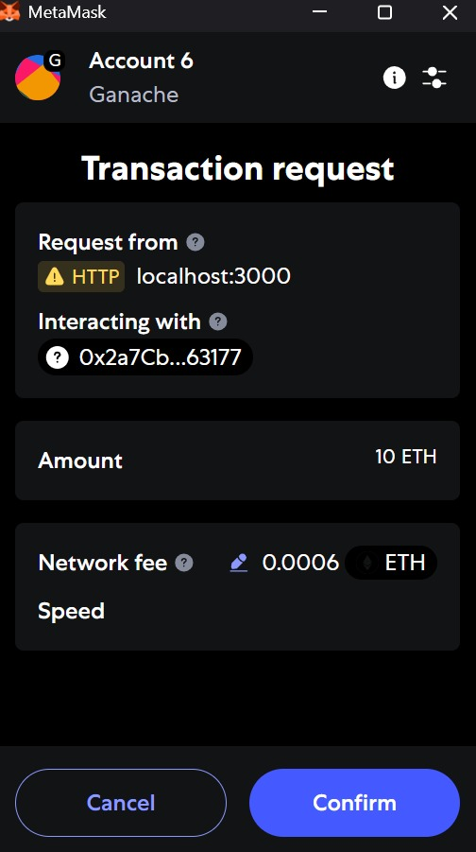
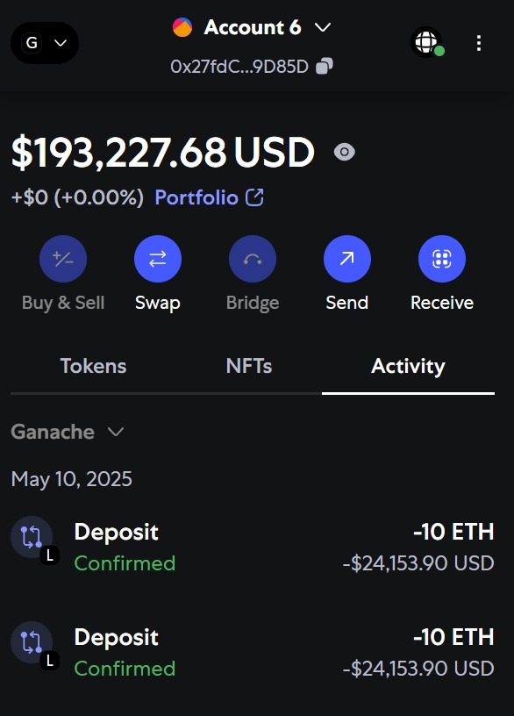

Implementation

Slide 11
Future Enhancements
Enhanced Authentication and Identity Management
Off-Chain Data Management
Modular Smart Contract Design
Frontend Modernization
Smart Contract Testing and Security
Multi-Chain and Interoperability Support

Slide 12
Conclusion
The proposed blockchain-based decentralized banking application represents a significant step toward redefining traditional financial systems by leveraging the transparency, security, and autonomy offered by blockchain technology. The current architecture provides a functional model that integrates key components such as smart contracts, wallet interfaces, and blockchain simulation environments. However, to transition from a proof-of-concept to a scalable, secure, and user-friendly financial platform, several enhancements are necessary.

Slide 13
Thank You
K Mohamed Jamal Basha
Yuvaraj K
Manobala P

